Slide 1
Fall 2020 New Student Arrival Seminar and Immigration Essentials
Center for International Services

Slide 2
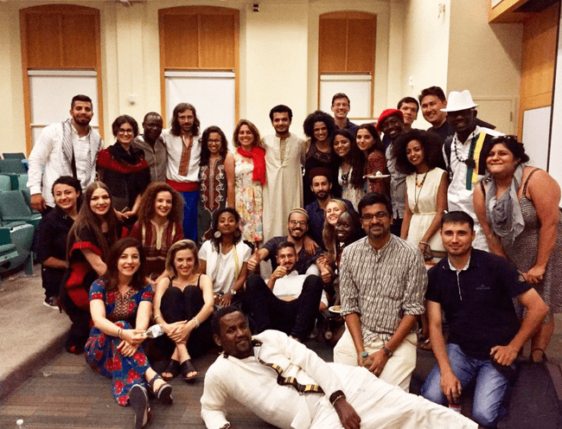
International Student Population at SU
2019-2020
Total Student Enrollment: 22,850
Total International Students: 4,302
Undergraduate Student Enrollment: 15,275
International Undergraduate Students: 2,139
Graduate Student Enrollment: 7,575
International Graduate Students: 2,163
On OPT: 735
On STEM OPT: 398
On CPT: 338
In 2018-2019: 533
Center for International Services

Slide 3
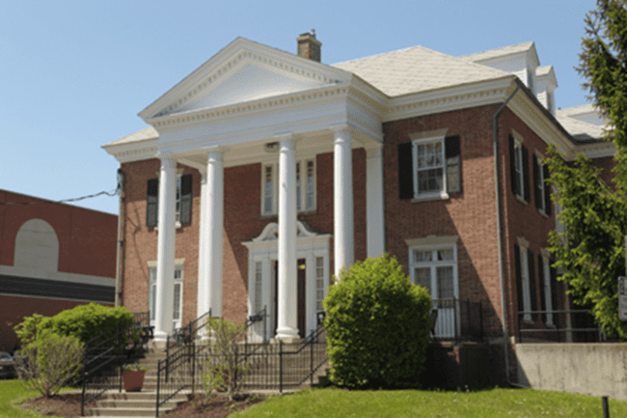
Center for International Services
310 Walnut Place
corner of Walnut and Waverley Avenues
across the street from Bird Library and Schine Student Center
Hours:
Monday-Friday
8:30 am - 5:00 pm
Summer: 8:00 am - 4:30 pm
Phone: 315-443-2457
Email: international@syr.edu
Website: international.syr.edu
Center for International Services

Slide 4
Center for International Services
Advisor on Call:
Monday-Friday, 11 am-3 pm
In person, By Phone, via Zoom, Teams, or Skype
Informational Seminars:
Curricular and Optional Practical Training
1st & 3rd Wednesday, 2nd Friday every month
In person and via Zoom
Newsletter
CPT
Center for International Services

Slide 5
SU ID Card
When, where and how to get your SU ID Card:
You must send a photo in jpg format (less than 2MB) to idcard@syr.edu & indicate SU ID Number in email
Pick up ID card at:
I.D. Trailer on the Quad
beginning Monday, August 17-28, 2020
10 am – 4 pm
After Friday, August 28, in Room 206 Steele Hall.
Student
123456789-0
Mickey
Mouse
What you can do with your SU ID Card:
campus building access
recreation facility access
library access
FOOD and Plus accounts.
$25 Replacement Fee!
Center for International Services

Slide 6
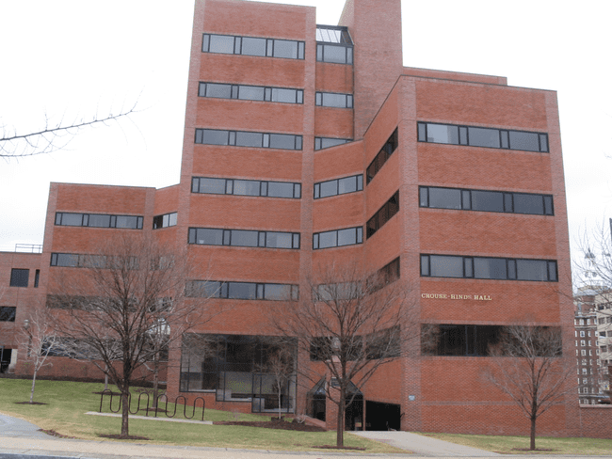
Campus Tours:
Virtual Tour: https://www.syracuse.edu/admissions/visit-tour/virtual-tour/
In person tour: will eventually resume
Office of Admissions in 100 Crouse Hinds Hall
Center for International Services

Slide 7
English Language Assessment Exam
https://syracuseuniversity.qualtrics.com/jfe/form/SV_3eIGwpVffvR2VKZ.- Deadline to register is August 15!
Who has to take the exam:
All Undergraduate Students for whom English is not their native language
All Graduate students whose TOEFL Score is below 90 or IELTs score is below a 6.5
Exceptions:
SU Abroad and other exchange students who are here for one or two semesters
Teaching Assistants
Graduate Students in the College of Engineering & Computer Science, Masters in Public Administration (MPA and EPMA), College of Law
When: August 19
Where: Online
If you have questions, please contact one of the ESOL Coordinators
Matthew Hammill mjhammil@syr.edu or Youmie Kim mjhammil@syr.edu.
Center for International Services

Slide 8
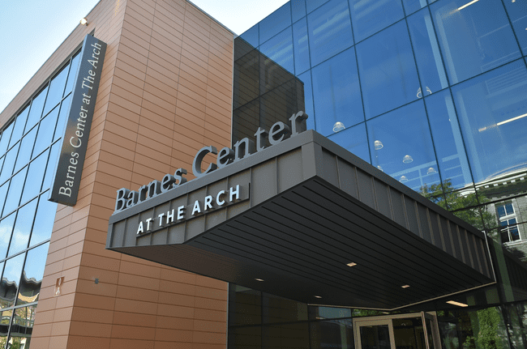
Health Services
Barnes Center at The Arch 150 Sims Drive, Syracuse, NY 13244
315.443.8000 - health@syr.edu
http://health.syr.edu/
Upload Health History and immunization records at the Barnes Center Patient Portal
Enroll in the Student Health Insurance Plan through MySlice, access your Aetna Insurance ID card, save or print out a copy
Center for International Services

Slide 9
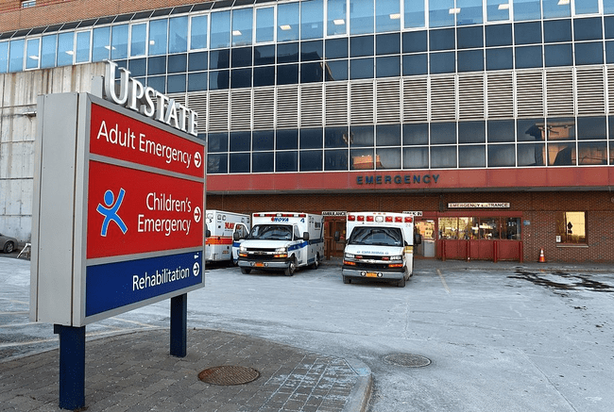
Emergency Health Services
Upstate Medical Center Emergency Room:
750 E Adams St, Syracuse, NY 13210
Crouse Hospital’s Emergency Services:
736 Irving Ave, Syracuse, New York 13210
Center for International Services

Slide 10
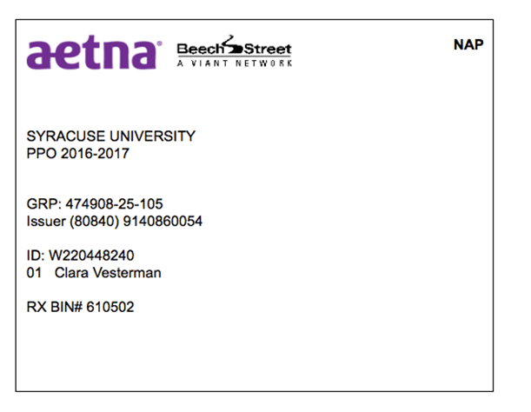
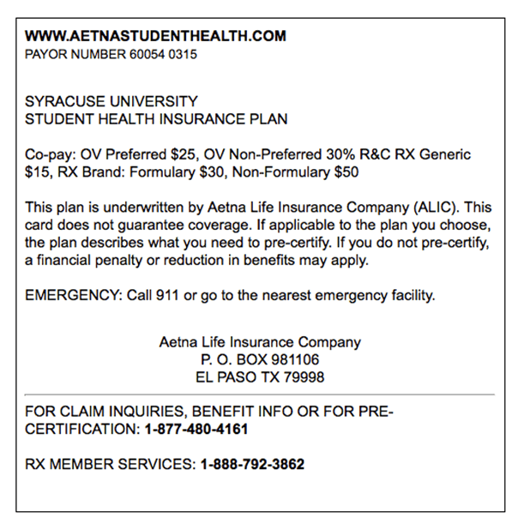
Health Insurance
http://healthinsurance.syr.edu/
https://www.aetnastudenthealth.com/
To Print Your Insurance Card:
Visit the Aetna website
Select Syracuse University in the school search box
Click ‘View your school’
Click ‘Print Your ID Card’ on the bottom menu
Enter in your SU student ID number and date of birth to view/print your card
Center for International Services

Slide 11
Health Insurance for Dependents
Aetna SHIP allows you to enroll dependents
See the Center for International Services website for a plan that allows enrollment of dependents only
Strongly discourage you from following the advice of friends and enrolling in New York State of Health plans-may be seen as a “public charge” issue and cause a problem for your immigration status
In your MySlice account; student must be enrolled first
https://www.isoa.org/voyager
Center for International Services

Slide 12
Bursar’s Office
119 Bowne Hall, Syracuse, NY 13244
315-443-2444 - bursar@syr.edu
http://bursar.syr.edu/
Account Information
Billing Information
Payment Plans
Electronic Funds Transfers
Share Access to your Account via MySlice
Center for International Services

Slide 13
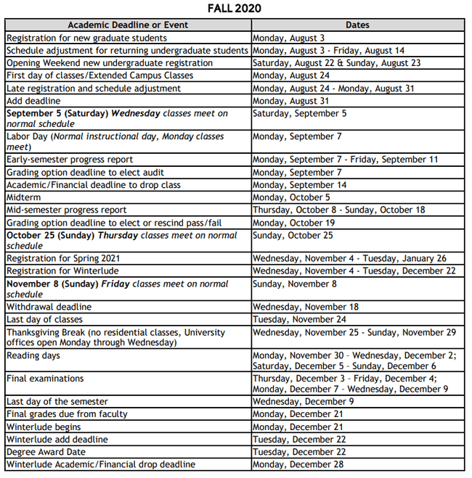
Academic Calendar
Center for International Services

Slide 14
Academic Calendar
Center for International Services

Slide 15
Off-Campus and Commuter Services
206 Goldstein Student Center, South Campus
315.443.5489 - offcampus@syr.edu
http://occs.syr.edu/
Resources:
Apartment Listings: https://housing.offcampus.syr.edu/
Landlord Tenant Relations: leases, responsibilities, requesting repairs, utilities
Neighborhoods
Short Term Housing:
http://graduateschool.syr.edu/gradhousing/
Center for International Services

Slide 16
Student Legal Services
Marshall Square Mall, 720 University Avenue-next to the U.S. Post Office
315.443.4532 – email@studentlegal.net
http://www.studentlegal.net/
Legal advice available to full-time undergraduate or graduate students paying the full-time activity fee
Free legal advice and, in certain situations, court representation: review of leases, interpretation of leases, traffic tickets
Out-of-pocket expenses such as court fines and fees and outside charges from other organizations needed in order to successfully represent you on your case
Center for International Services

Slide 17
Safety
Syracuse University Department of Public Safety
Emergency Number from a Cell Phone | #78 (#SU)
Emergency Number from campus landline | 711
Non-Emergency | 315-443-2224
City of Syracuse Police Department
Emergency Number | 911
Non-Emergency Number | 315-442-5111
Center for International Services

Slide 18
Banking
Name | Address | Phone
Near Main Campus
JP Morgan Chase | 649 S. Crouse Ave | 315-476-5870
Key Bank | 1004 E. Adams St | 315-476-2530
M&T Bank | 725 Irving Ave. | 315-422-2121
NBT Bank | 101 Marshall St. | 315-703-1300
Near South Campus
Key Bank | 215 Tecumseh Rd. | 315-446-8091
Bank of America | 401 Nottingham Rd. | 315-446-4205
You should take your passport and other immigration documents with you when you go to open your bank account, the bank representative will need you to show proof of your identity.
Center for International Services

Slide 19
Cell Phones
Verizon, T-Mobile, AT&T, and Sprint all have locations at Destiny Mall
You need to bring your passport, I-20, and SUID to open an account or purchase a new cellphone.
Every phone company offers different plans for Syracuse students, it is important to assess your needs and choose accordingly.
Syracuse University does not endorse any vendors. Be advised that discounts may change from time to time and must be confirmed with the vendor at the time of purchase
Center for International Services

Slide 20
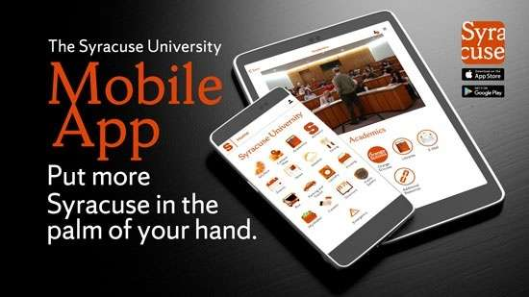
SU Mobile App!
Features:
MySlice Services
SU News
Campus Maps
Bus Times and Tracker
SU Events Calendar
SU Directory
SU Food Services Menu
LiveSafe, Blackboard, Adobe Connect, Tapingo, and SU Guides integration
Download at Google Play store and Apple App store.
Center for International Services

Slide 21
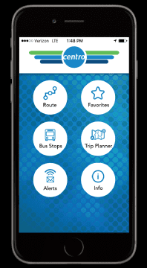
Centro Bus - GoCentroBus Mobile App
Destination | Route | Notes
South Campus | Centro #344
Manley/Skytop | Centro #44
East Campus | Birnie Bus #35 | Requires SUID to board
Westcott | Centro #530 | $2.00 if riding outside of the free fare zone
James Street | Birnie Bus #33 | Requires SUID to board
Nob Hill | Centro #240 | $2.00 fare
Connective Corridor | Centro #443
Destiny USA | Centro #40 | $2.00 fare
Tops Supermarket | Centro Drumlins #340
Target | Centro Camillus #36 | $2.00 fare
Center for International Services

Slide 22
Shopping
Grocery Stores:
Tops/Wegmans/Price Rite/Aldi’s/Price Chopper
Walmart/Target
Asia Food Market/Han’s Oriental Grocery/Samir’s Imported Foods
Household/Personal Items:
Walmart
Target
Dollar Stores (Dollar Tree, Family Dollar, Dollar General)
Bed, Bath and Beyond
Department Stores:
Macy’s in Destiny Mall
Outlet Stores in Waterloo & Destiny
Discount Stores:
Marshall’s
TJ Maxx
Burlington (Coat Factory)
Consignment/Thrift Stores:
3fifteen-Marshall Square Mall
Plato’s Closet/Clothes Mentor
Salvation Army
Rescue Mission Stores/Outlet-clothes by pound
Center for International Services

Slide 23
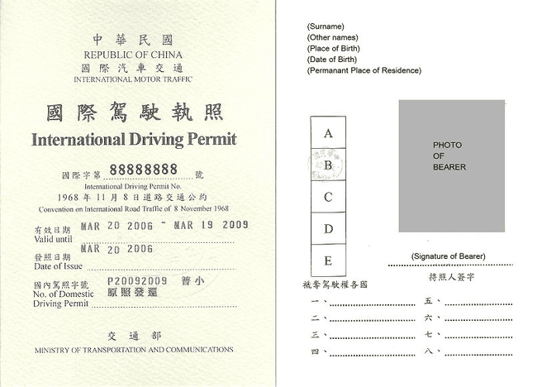
Driver’s Licenses
Valid Driver’s License in your Country/International Driving Permit
You may drive legally in New York if you have a valid foreign driver’s license from your country AND
a certified translation of your license or
a current International Driving Permit (issued for one year only)
International Driving Permit:
not a driver’s license
verifies that you hold a valid driver’s license in your home country.
Home Country driver’s license, not the International Driving Permit, allows you to drive in New York.
Contact the authorities in your home country to get an International Driving Permit.
Center for International Services

Slide 24
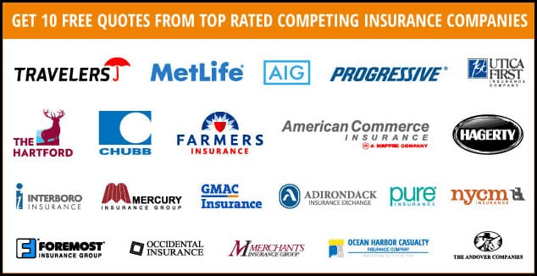
Driver’s Licenses
Valid Driver’s License in your Country/International Driving Permit
You do not need to apply for a New York driver’s license if:
your foreign driver’s license is valid and
you have no intention to reside permanently in New York State.
However, it is advisable to obtain a New York State license even if your foreign license is still valid:
help to avoid problems if you are stopped for a traffic violation or at some other time when you need to present a driver license.
if you intend to purchase a car because many car insurance companies will not insure your vehicle, or will insure you through a high risk pool at much higher rates.
Center for International Services

Slide 25
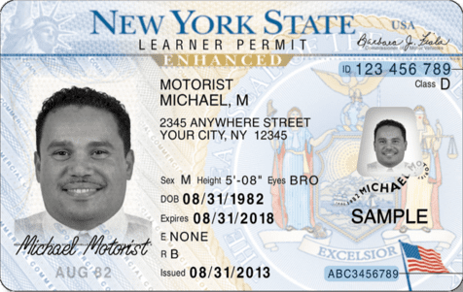
New York State Driver’s License
If you do not have a valid driver’s license
You must first apply for a New York State learner’s permit and practice your driving skills and then pass an actual driving test.
How to get a New York State Learner Permit:
Apply for a learner’s permit at the Department of Motor Vehicles (DMV)
requires SEVIS registration
Requires documentation that meets a point system
Pass the vision test
Pass the written test
You must consult www.dmv.org for specific requirements!
Center for International Services

Slide 26
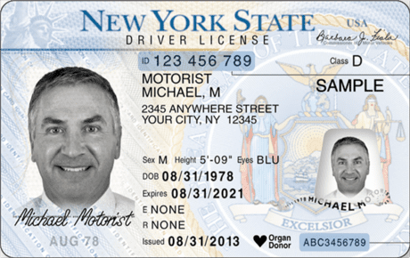
New York State Driver License
Obtaining a New York State Driver License:
Take a driver education course or a DMV-approved pre-licensing course.
Apply for a driver’s license at the DMV:
Requires SEVIS registration
Requires documentation that meets a point system
Make an appointment for a road test.
Pass your road test and receive your New York State driver license.
Make sure you don't show up to the road test alone.
You must consult www.dmv.org for specific requirements!
Center for International Services

Slide 27
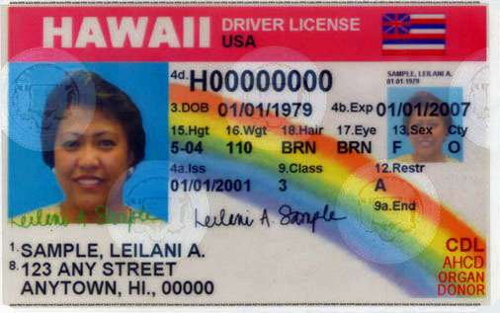
New York State Driver License
Transferring your driver’s license from another state or Canada to New York:
Apply for a driver’s license at the DMV:
Requires SEVIS registration
Requires documentation that meets a point system
Vision test
Surrender your current, out-of-state driver's license
You must consult www.dmv.org for specific requirements!
Center for International Services

Slide 28
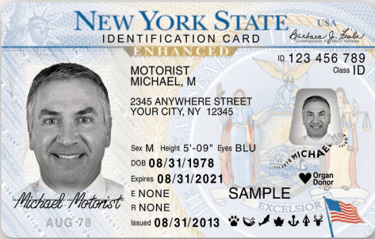
Non-Driver Photo Identification Card
If you do not drive, you may qualify for a Non-Driver Photo Identification Card from the Department of Motor Vehicles.
The DMV Non-Driver ID Card has the same personal identification information, photo, signature and special safeguards against alterations as a photo driver license.
You cannot hold a New York State driver license or learner permit while also holding a non-driver ID card.
Center for International Services

Slide 29
Immigration Essentials for Students
Fall 2020 Orientation
Center for International Services

Slide 30
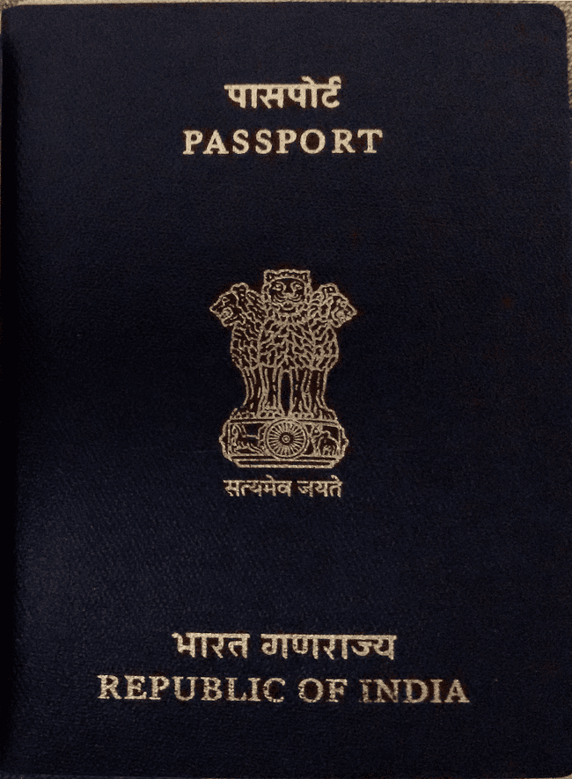
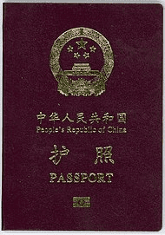
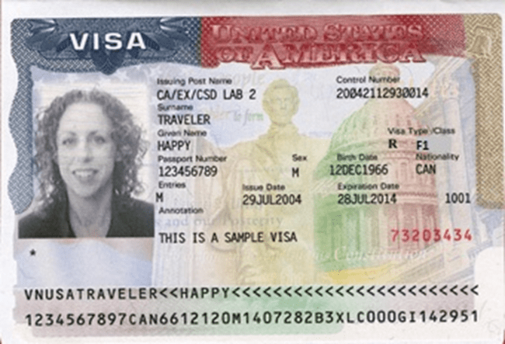
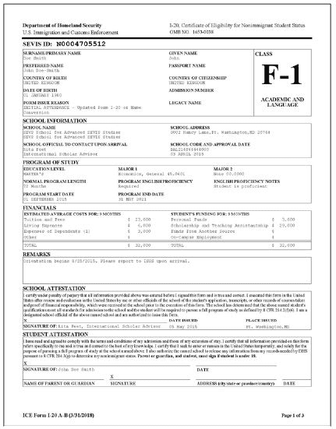
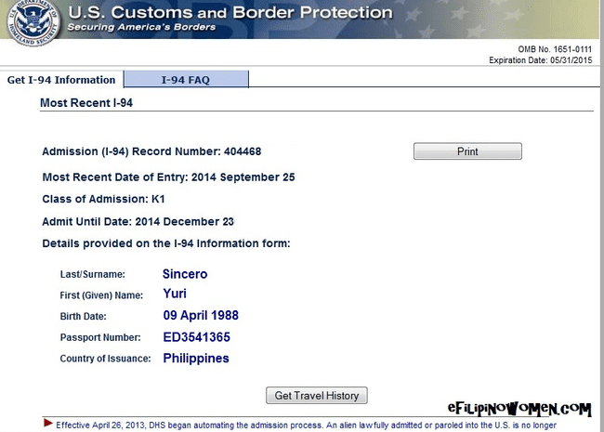
Tour of Documents
Center for International Services

Slide 31
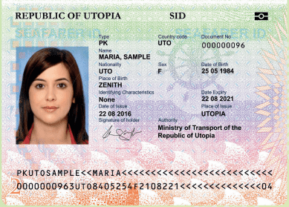
Passport
Know your passport expiration date
Your passport needs to be valid for at least 6 months into the future when entering the U.S.
Replace at your Consulate in New York City or Embassy in Washington, DC
Center for International Services

Slide 32
Visa
Know expiration date and Number of entries
Needs to be valid when entering the U.S.
Number of entries and length determined by diplomatic agreements
Can only be renewed at a U.S. Embassy or Consulate-all located outside the U.S.
Visa cannot be renewed inside the U.S.
Can expire while in the U.S.
Center for International Services

Slide 33
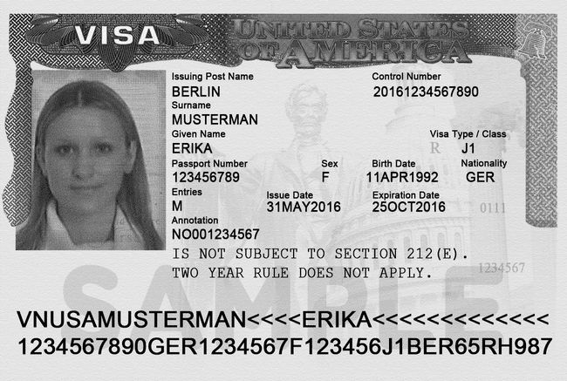
Two Year Home Residency Requirement
Some people in J status are subject to a Two Year Home Residency Requirement: the facts of your situation matter, not necessarily what it says on your visa
If you received government funding for your J program
If your country has your field of study on its Exchange Visitor Skills List
If your J program is for a Medical Residency Program
Center for International Services

Slide 34
Two Year Home Residency Requirement
If you are subject to the Two Year Home Residency Requirement:
cannot change status within the U.S.
are not eligible for an H, K or L visa
are not eligible for permanent residence in the U.S.
UNTIL you have been physically present in your home country for two years
Center for International Services

Slide 35
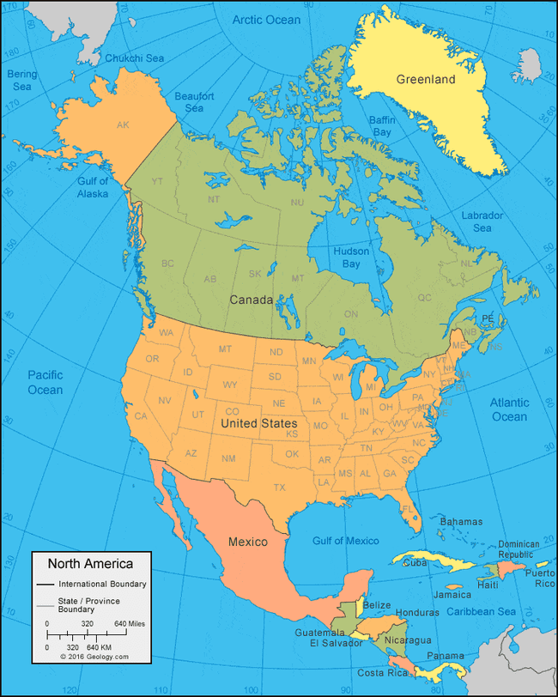
Travel
Visa needs to be valid to enter the U.S.
Exception:
Returning to the U.S. after a trip to Canada, Mexico, or the adjacent islands
Trip of less than 30 days
Trip solely to Canada, Mexico, or the adjacent islands
Cannot apply for U.S. Visa while there
Not a citizen of Iran, Syria, Sudan, or North Korea
Center for International Services

Slide 36
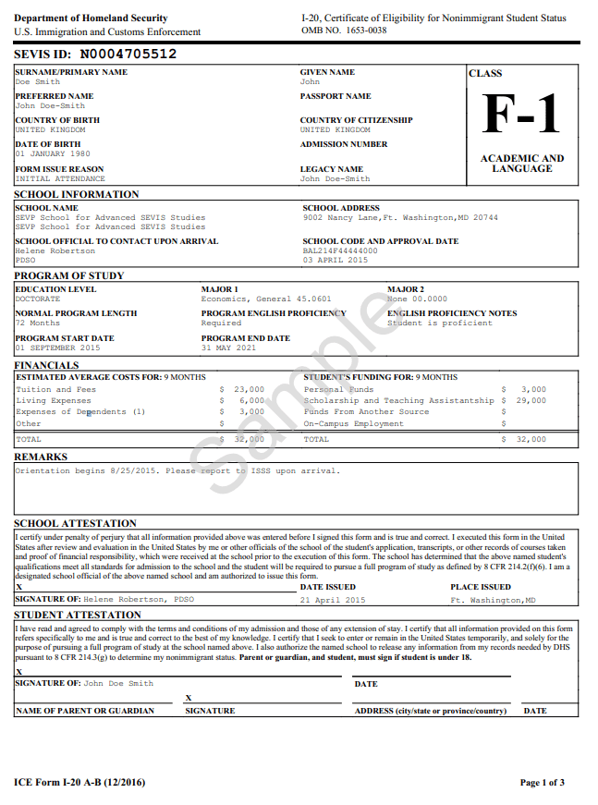
I-20
Immigration Selfie-tells your story
Issued by Syracuse University
Biographic Information about you
Degree Level
Program of Study
Program Start and End Date
Financial Information
Center for International Services

Slide 37
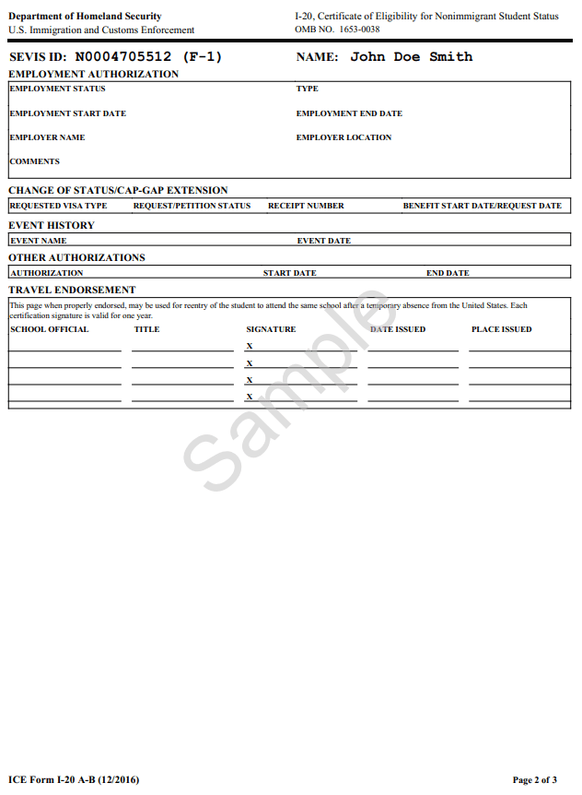
I-20 - Page 2
Employment Authorizations
Travel Endorsement
Travel Signatures-valid for one year/12 months
Ann Dievendorf International Student Advisor 10/10/2020 Syracuse,NY
Travel Signatures- Monday-Friday
October
9 am-4 pm Bird Library
Center for International Services

Slide 38
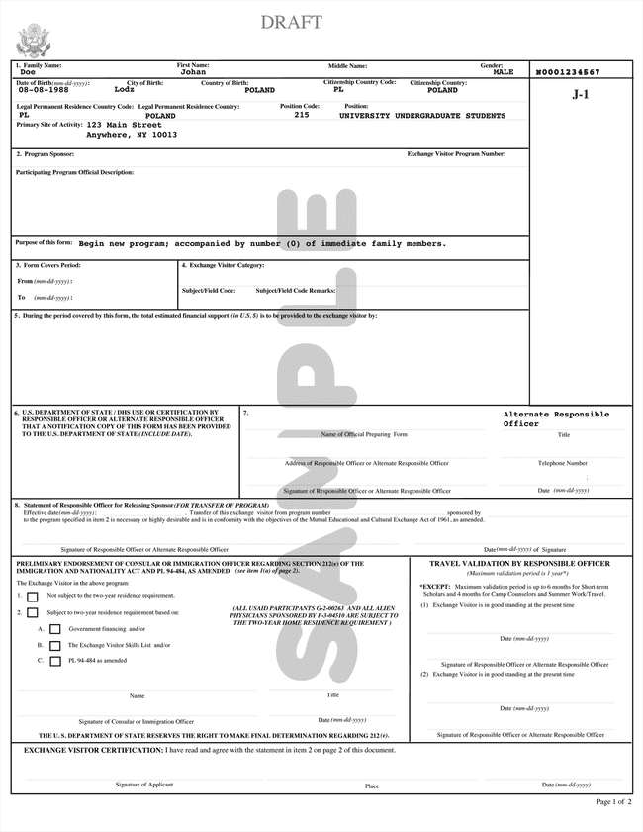
DS-2019
Immigration Selfie-tells your story
Issued by Syracuse University or J-1 Program Sponsor
Biographic Information about you
Degree Level
Program of Study
Program Start and End Date
Financial Information
Center for International Services

Slide 39
Travel Endorsement
Travel Signatures-valid for one year/12 months
Travel Signatures- Monday-Friday, October
9 am-4 pm Bird Library
10/10/2020
Center for International Services

Slide 40
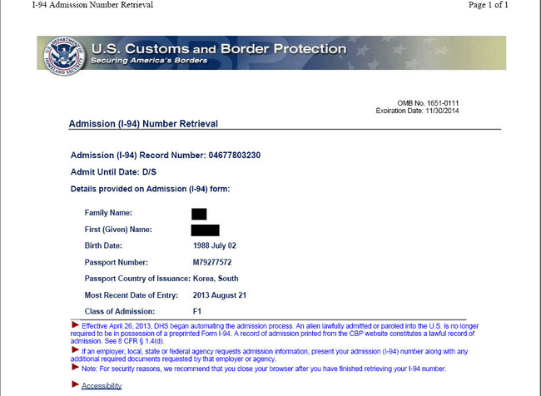
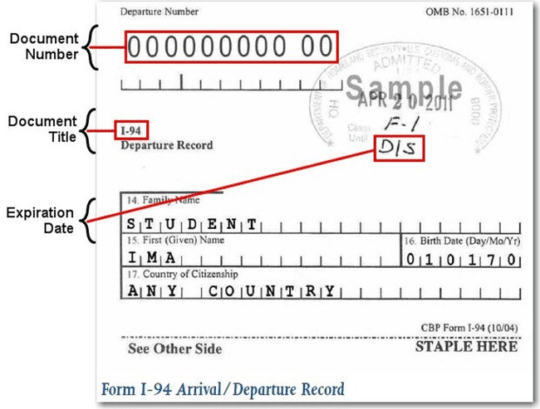
I-94 Arrival Record/Travel History
www.cbp.gov/I-94
Updated every time you travel out of the U.S. and enter
Check every time to be sure you were admitted to the US in F-1 status and for D/S
D/S = Duration of Status
Program End Date + 60 days to prepare to depart or change status
Center for International Services

Slide 41
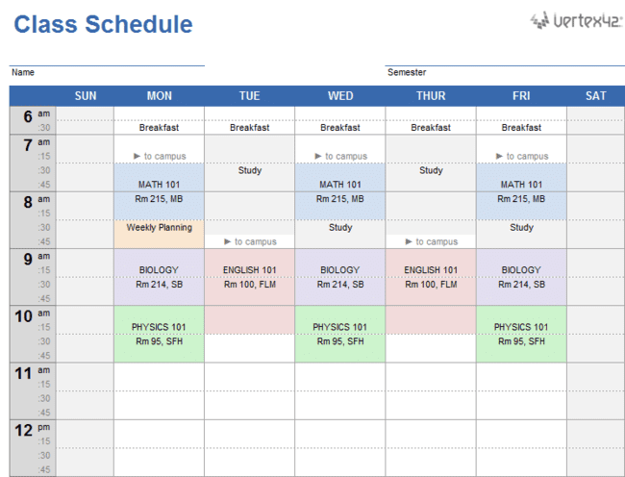
3 Do’s and a Don’t
DO - Keep your Documents valid
DO - Update your Information
DO - Register Full-time every semester
Don’t - Engage in unauthorized Employment
Center for International Services

Slide 42
D
Keep Your
ocuments valid!
I
Update Your
nformation!
F
Register
ull-time every semester!
E
Do not engage in unauthorized
mployment!
Center for International Services

Slide 43
Documents
Passport:
Keep your passport valid at all times
must be valid for 6 months into the future when entering the U.S. unless a citizen of the 6 month club
Visa:
Must be valid when entering the U.S.
Can expire while in the U.S.
I-94:
Check every time you enter the U.S.
F-1/J-1
D/S
I-20/DS-2019:
Program of Study
Program End Date
Travel Signature
Center for International Services

Slide 44
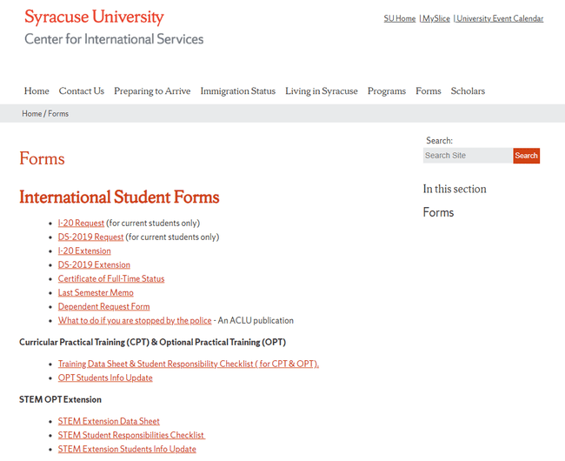
Program
Change Level of Study (Masters to Ph.D. or Ph.D. to Masters)
Program of Study (Computer Science to Computer Engineering)
I-20/DS-2019 Request on the Center for International Services Website
Center for International Services

Slide 45
Program End Date
If you need less time
changed when finish
If your need more time
I-20/DS-2019 Extension Request on the Center for International Services Website
Center for International Services

Slide 46
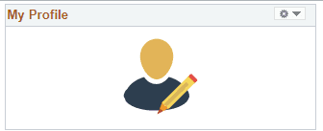
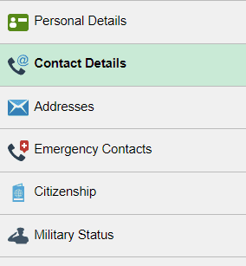
Information in MySlice
Name
Address
Current-here in Syracuse
Permanent-outside the U.S.
Phone Number
Emergency Contact Information
Center for International Services

Slide 47
Full-time Registration
Grad Students-9 credit hours each Fall and Spring semester
Usual Rule: Only one course can be taken online toward full-time registration (3 credits out of 9)
Fall 2020: New students (not enrolled in the U.S. in March 2020) have the one online course limit relaxed; but cannot be 100% online; Continuing students (were enrolled in the U.S. in March 2020) can be registered for all online classes
Summer registration not required by immigration regulations
Center for International Services

Slide 48
Full-time Registration
Exceptions:
This Fall 2020 semester: exempted from one online course rule
Final semester-can be registered for less than 9 credits if you need less than 9 credits to complete your degree-need Last Semester Memo
Teaching and Research Assistants
Certificate of Full-time Status
working on thesis or dissertation
studying for a qualifying exam
Internship
Center for International Services

Slide 49
Full-time Registration
Undergraduates-12 credit hours each Fall and Spring
Usual Rule: Only one course can be taken online toward full-time registration (3 credits out of 12)
Fall 2020: New students (not enrolled in the U.S. in March 2020) have the one online course limit relaxed; but cannot be 100% online; Continuing students (were enrolled in the U.S. in March 2020) can be registered for all online classes
Summer registration not required by immigration regulations
Center for International Services

Slide 50
Full-time Registration
Exceptions:
This Fall 2020 semester: exempted from the one online course limit
Final semester-can be registered for less than 12 credits if you need less than 12 credits to complete your degree-need Last Semester Memo
Center for International Services

Slide 51
Full-time Registration
Other Special Exceptions:
First Semester
Difficulty with English Language
Unfamiliarity with American teaching methods
Improper Course Placement
Must be documented by faculty member in writing
Medical Reasons
Must be documented by licensed medical doctor, doctor of osteopathy, or licensed clinical psychologist
Consult with an advisor from the Center for International Services first!
Center for International Services

Slide 52
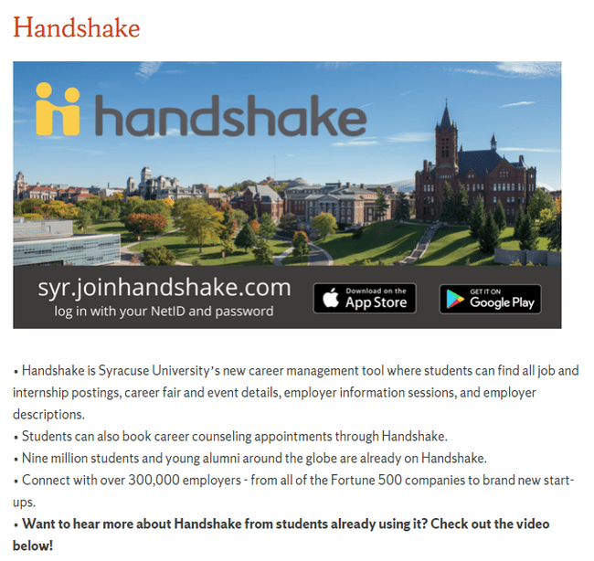
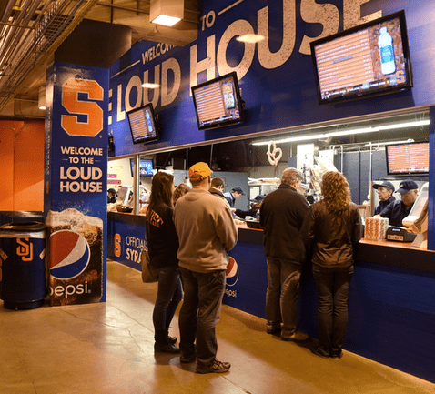
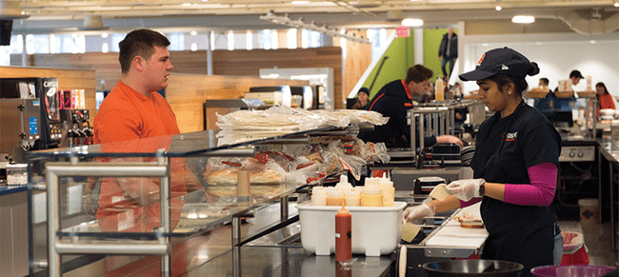
Employment
First Year in F-1 status limited to On campus employment
20 hours per week while school is in session; full-time during breaks
On Campus means on SU’s campus; paid by SU
Handshake
Center for International Services

Slide 53
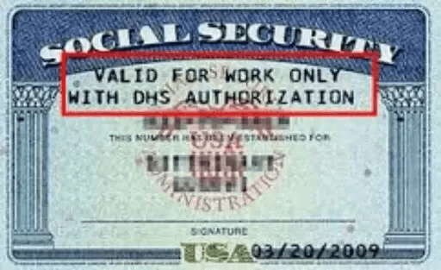
Social Security Numbers
Used for the purpose of tracking income to be taxed appropriately and eventually to earn retirement income
Only eligible if working/employed-not needed to begin working
Not needed to open a bank account, get a drivers license or obtain a credit card
Is not proof of identity – No photo on the card
Social Security Administration Offices are CLOSED-No Social Security Numbers are currently being assigned
Center for International Services

Slide 54
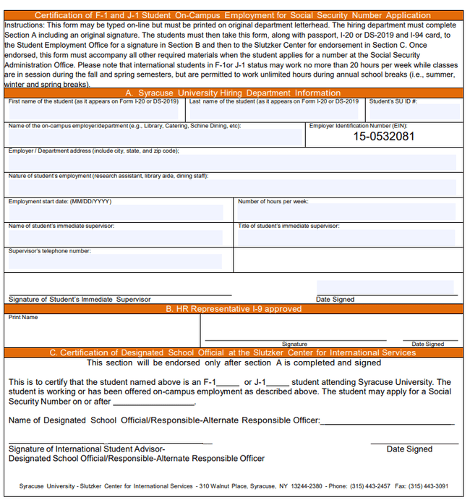
Employment
On Campus Employment
F-1 and J-1 students may work on campus up to 20 hours per work while school is in session, full-time during breaks
Handshake
Employer Verification Form-needed to apply for SSN
NO SSNs being given now-Payroll will contact you when you are able to apply for an SSN
Employing Department copies on to letterhead, completes section A & signs
Student Employment signs section B to indicate I-9 Employment Eligibility Verification Form completed
The Center for International Services signs section C to indicate registered in SEVIS
Center for International Services

Slide 55
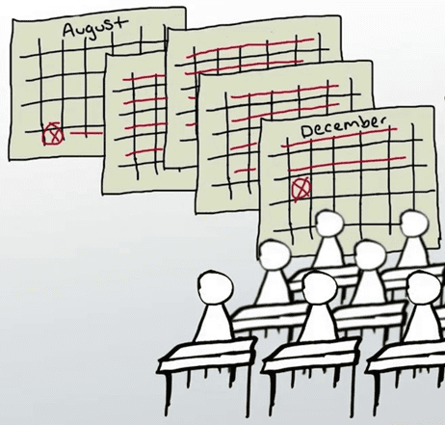
Employment
After two semesters (Fall and Spring, Spring and Fall)
Eligible for
F-1s
Curricular Practical Training
Optional Practical Training
Economic Necessity
J-1s
Academic Training
Economic Necessity
Curricular
Practical
Training
Optional
Practical
Training
Center for International Services

Slide 56
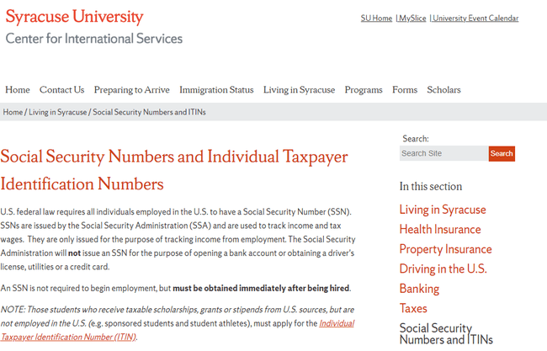
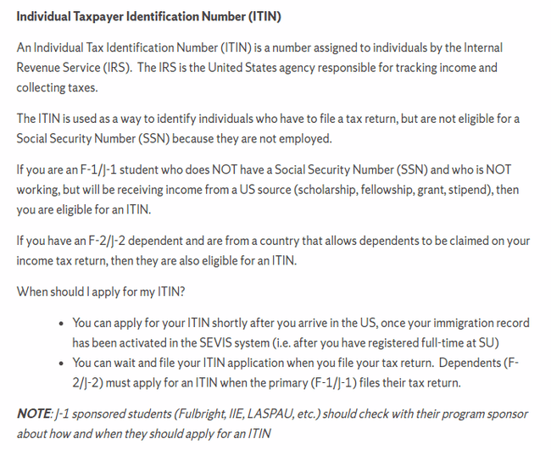
Individual Taxpayer Identification Numbers (ITINs)
Fellowship and Scholarship holders only
NOT if only receiving a reduction in your tuition
Information on the Center for International Services website website
Center for International Services

Slide 57
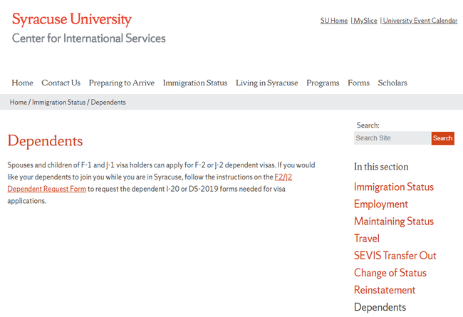
Dependents
Spouses and Children under 21 yrs. of age-not mother, father, sister, brother, grandma, etc.
Dependent Request Form on the Center for International Services website
Must submit financial support documentation & health insurance to bring dependents
Their legal status is linked to your status
F-2s cannot seek employment; J-2s can
F-2s cannot enroll in full-time course of study or degree program, except K-12; J-2s can enroll full-time
Center for International Services

Slide 58
Leaves of Absence
Medical:
Must submit written recommendation from a licensed physician, clinical psychologist or doctor of osteopathy
May remain in the U.S. while on an approved Medical Leave of Absence
Personal:
Must begin with academic department
F-1 status will be terminated
May not remain in the U.S. while on a Personal Leave of Absence
Center for International Services

Slide 59
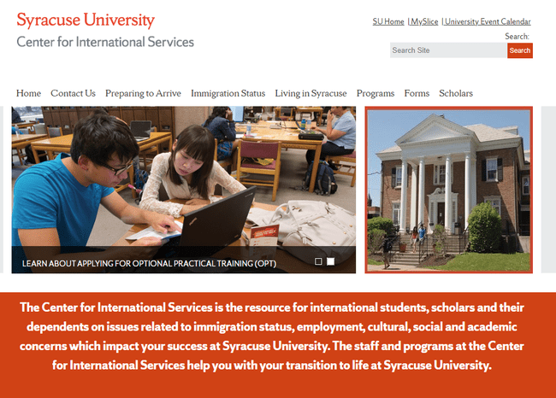
international.syr.edu
Center for International Services

Slide 60
Center for International Services

