Slide 1
Express
Entry

Slide 2
2020 Permanent Resident Targets

Slide 3
Step 1: Eligibility
Step 2:
The Pool
Step 3: Invitation to apply

Slide 4
Step 1: Eligibility Programs
Canadian Experience Class (CEC)
Federal Skilled Trades Program (FSTP)
Federal Skilled Worker Program (FSWP)

Slide 5
Federal Skilled Worker Program
1 year full-time paid work experience in skilled employment within last 10 years
Language Requirements

Slide 6
Step 1: Eligibility
Age
Education
Work Experience
Adaptability
Arranged Employment
Language Skills

Slide 7
Step 1: Online Application
Age
Education
Work Experience
Adaptability
Arranged Employment
Language Skills
Total
12
23
9
0
0
17
61
12
23
11
0
0
21
67
Category
Age
Education
Work Experience
Adaptability
Arraigned Employment
Language Skills
Total

Slide 8
Step 1: Eligibility
67
67 points or more on the online application enters you into the Express Entry pool

Slide 9
Comprehensive Ranking System
Total 1200 points
Core: 600 points
Additional: 600 points

Slide 10
CRS- Core Factors
Factor | Points Possible
Age | 110
Education Level | 150
Language Proficiency | 160
Canadian Work Experience | 80
Skill Transferability | 100

Slide 11
CRS-Additional Factors
Factor | Points Possible
Sibling is Canadian Citizen or PR | 15
Second language skills | 30
Post-secondary education in Canada | 30
Arranged employment | 200
Provincial Nominee | 600

Slide 12
Recent Rounds of Invitations
Date | Minimum CRS Score | Invites issued
February 5 | 472 | 3,500
January 22 | 471 | 3,400
January 8 | 473 | 3,400
December 19 | 469 | 3,200
December 11 | 472 | 3,200
November 27 | 471 | 3,600

Slide 13
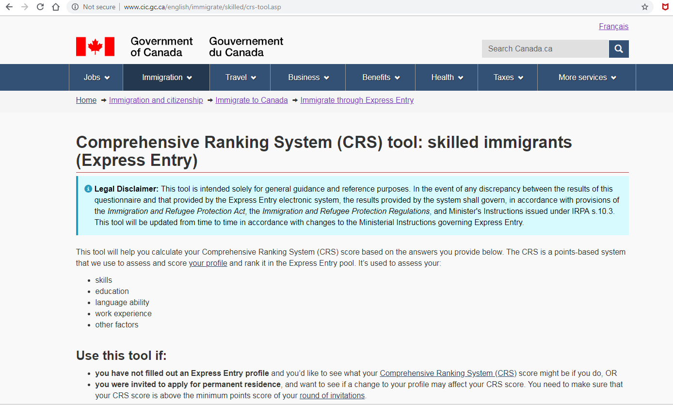

Slide 14
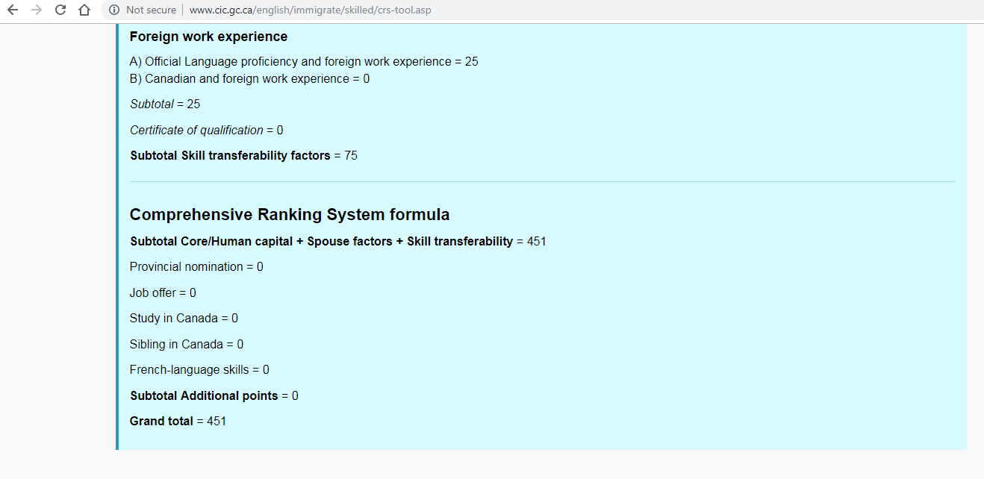

Slide 15
Step 1: Eligibility
Step 2:
The Pool
Step 3: Invitation to apply

Slide 16
Step 3: Invitation to Apply
60 days to submit application
Education Equivalency
Police certificates
Medical Exam
Funds
Language Test Results

Slide 17
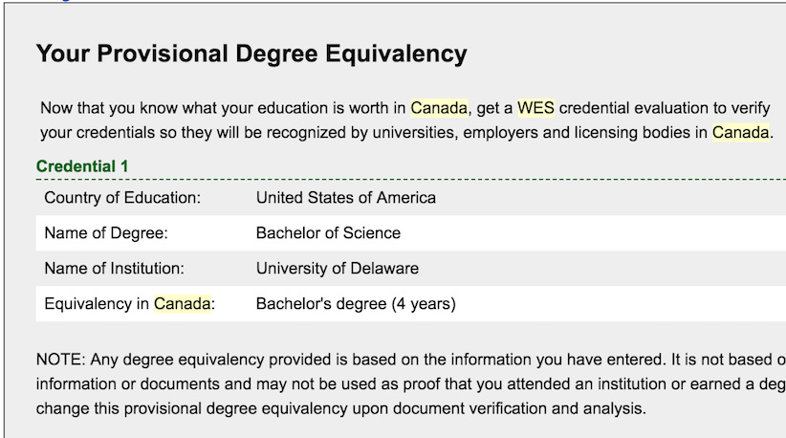
Step 3:Education Equivalency

Slide 18
Step 3: Police Certificates

Slide 19
Step 3: Medical Exam & Funds

Slide 20
Step 3:Language Test Results

Slide 21
Step 3: Invitation to Apply
60 days to submit application
Education Equivalency
Police certificates
Medical Exam
Funds
Language Test Results

Slide 22
Canadian Experience Class
Work Permit
Transfer to Canada
Sponsorship by Canadian employer
International Experience Canada

Slide 23
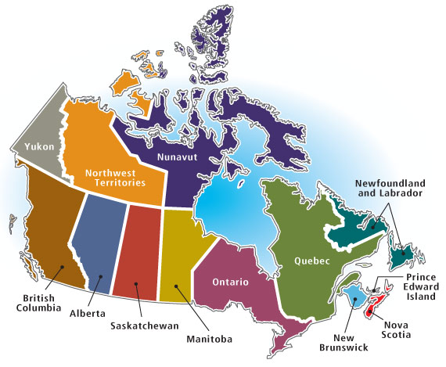
Provincial Nominee Programs

Slide 24
Permanent Residency
Universal health care
Strong,stable economy
Multicultural,
diversity
Top places for doing business

Slide 25
Thank you!

