Slide 1
Fall 2024 Grad Immigration Essentials Part 1
Center for International Services

Slide 2
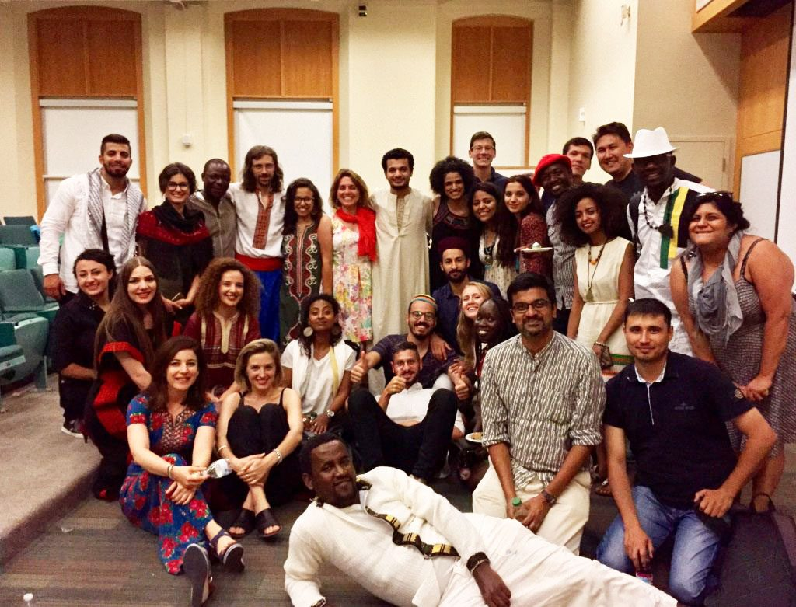
International Student Population at SU
2023-2024
Total Student Enrollment: 22,948
Total International Students: 4,163
Undergraduate Student Enrollment: 15,739
International Undergraduate Students: 1,784
Graduate & Law Student Enrollment: 7,209
International Graduate Students: 2,379
In 2023/2024
CPT Applications Processed: 609/239-less
OPT Applications Processed: 728/788-more
STEM OPT Applications Processed: 195/221-more
Center for International Services

Slide 3
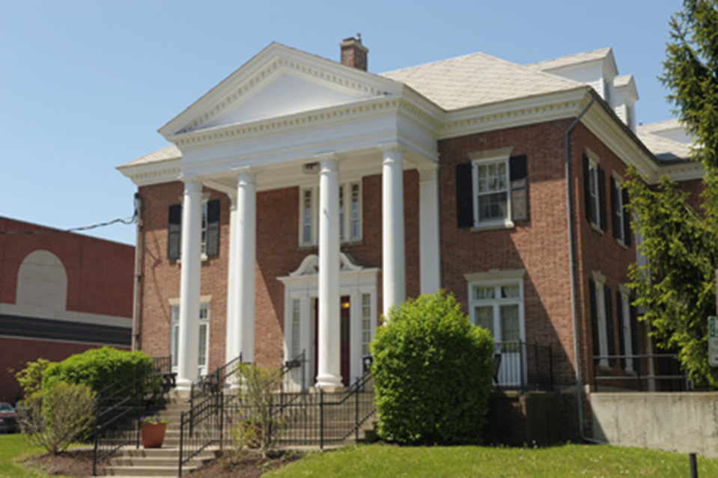
Center for International Services
310 Walnut Place
corner of Walnut Place and Waverly Avenue
across the street from Bird Library and Schine Student Center
Hours:
Monday-Friday
8:30 am - 5:00 pm
Summer: 8:00 am - 4:30 pm
Phone: 315-443-2457
Email: international@syr.edu
Website: https://experience.syracuse.edu/international
Center for International Services

Slide 4
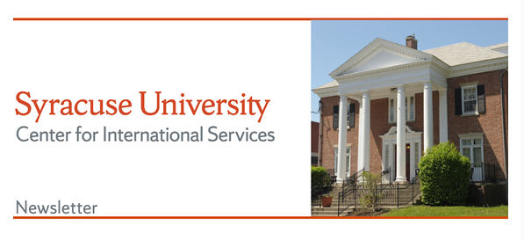
Center for International Services Continued
Advisor on Call:
Monday-Friday, 11 am-3 pm
In person, By Phone, via Zoom, Teams, or Skype
Informational Seminars:
Curricular and Optional Practical Training
1st & 3rd Wednesday, 2nd Friday every month
Newsletter –every other week
CPT
Center for International Services

Slide 5
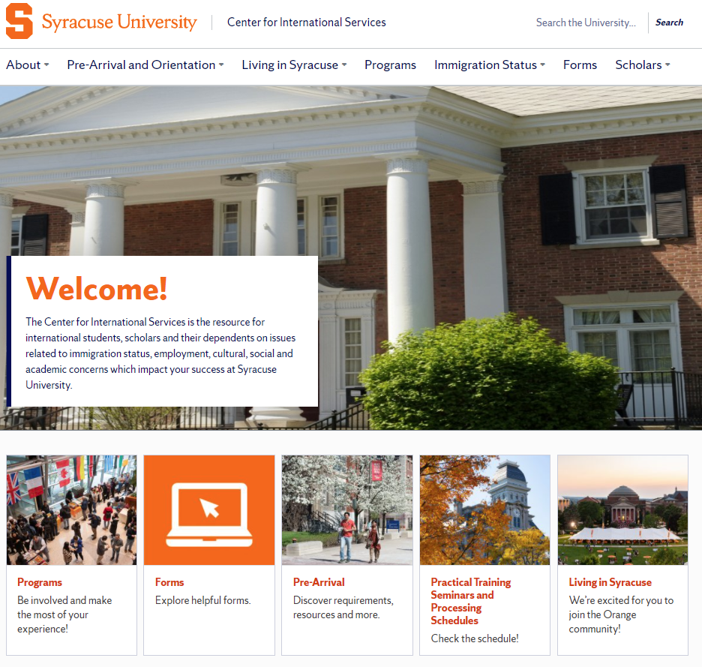
https://experience.syracuse.edu/international/
Center for International Services

Slide 6
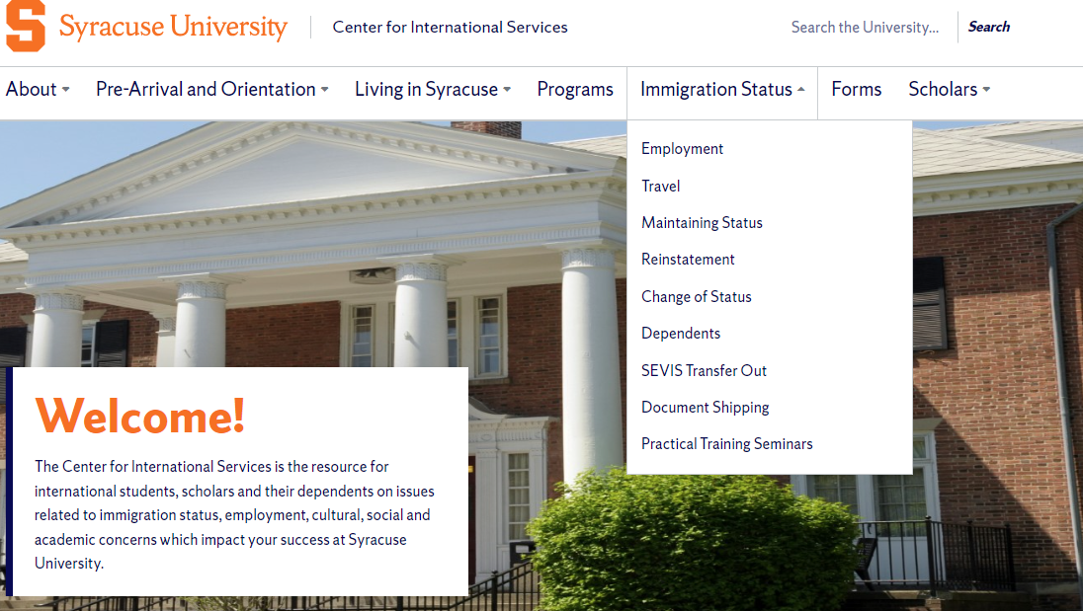
https://experience.syracuse.edu/international/
Center for International Services

Slide 7
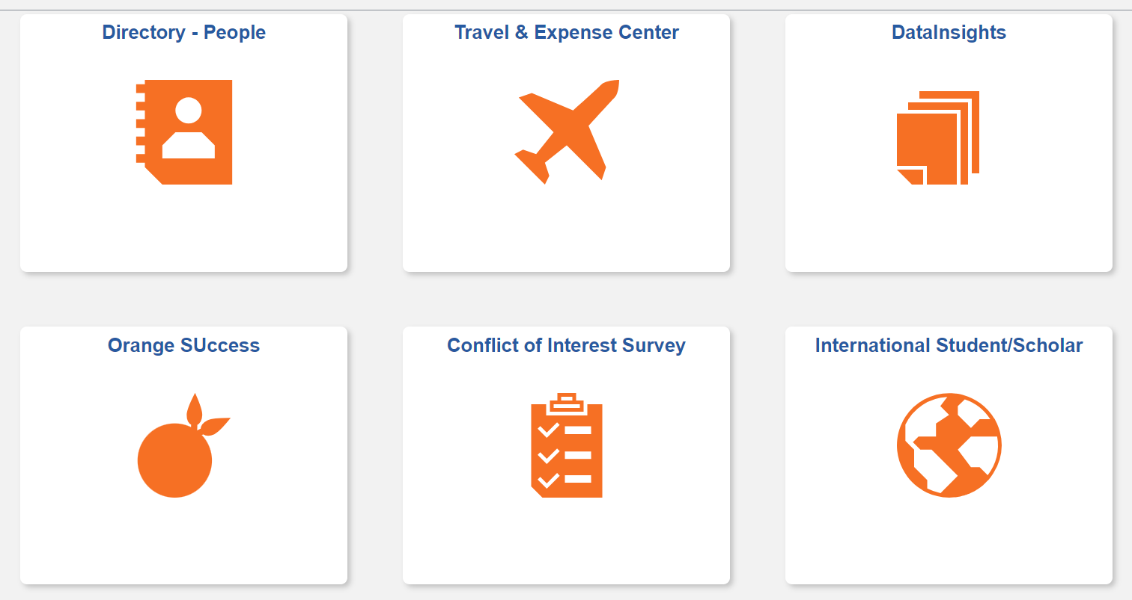
Requests will be done in MySlice
Center for International Services

Slide 8
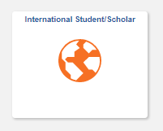
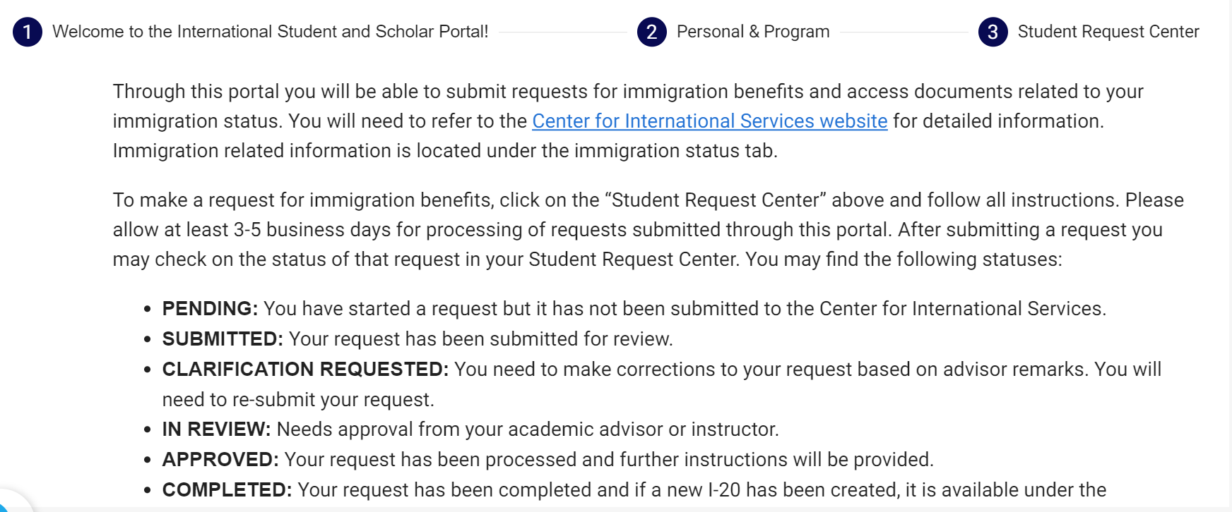
Through My Slice
Use the My Slice ISSS tile for most requests
Center for International Services

Slide 9
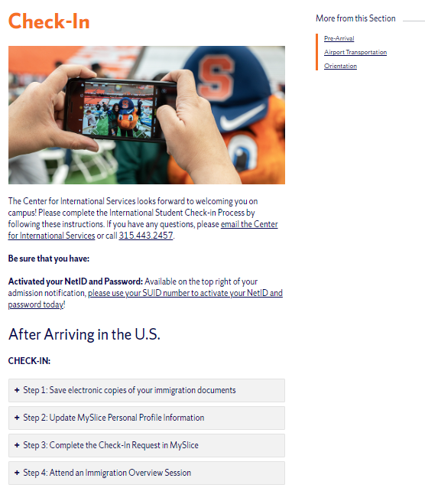
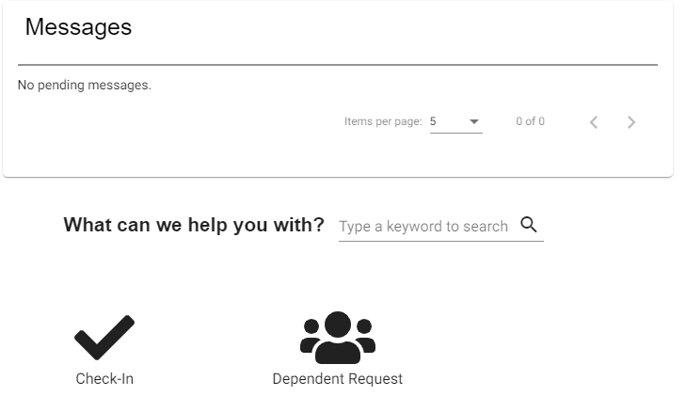
Center for International Services Check-In
Center for International Services

Slide 10
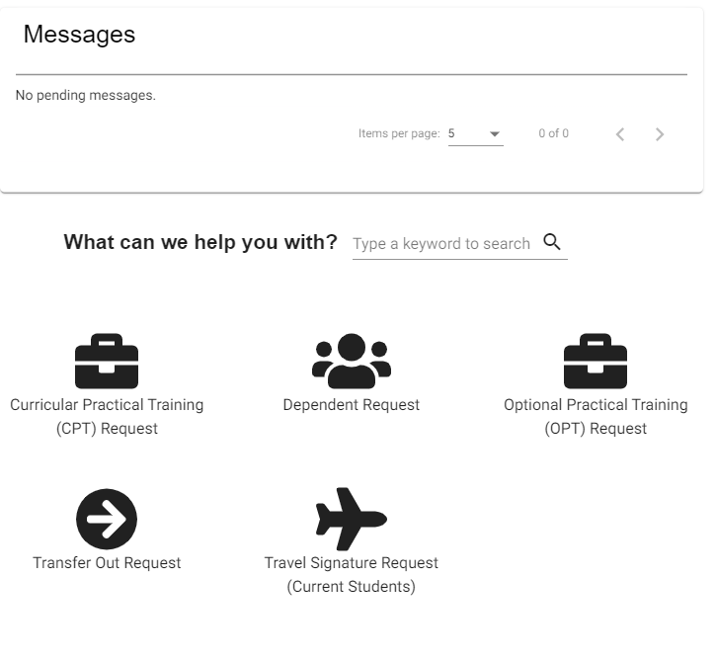
Student Request Center
Center for International Services

Slide 11
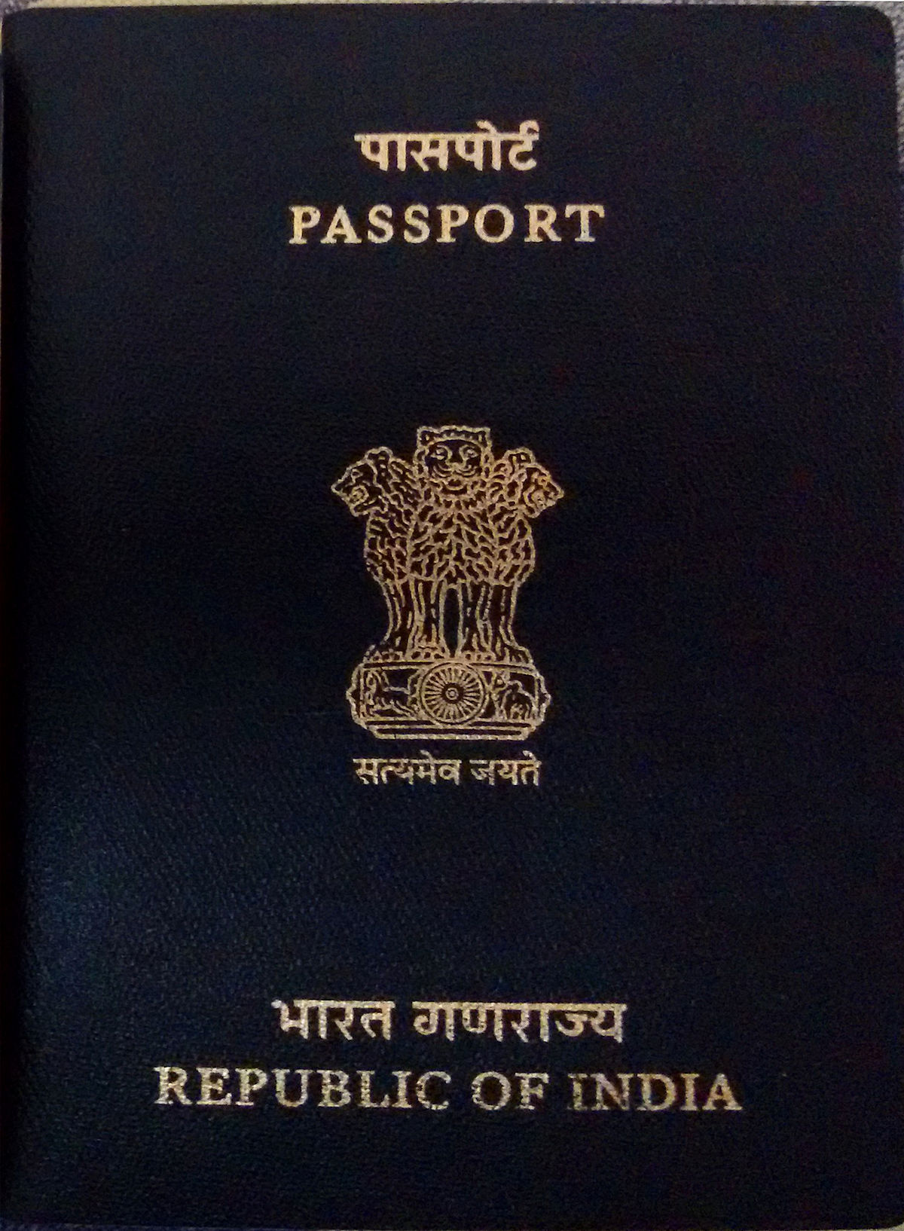
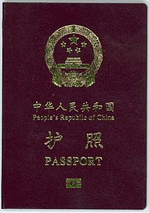
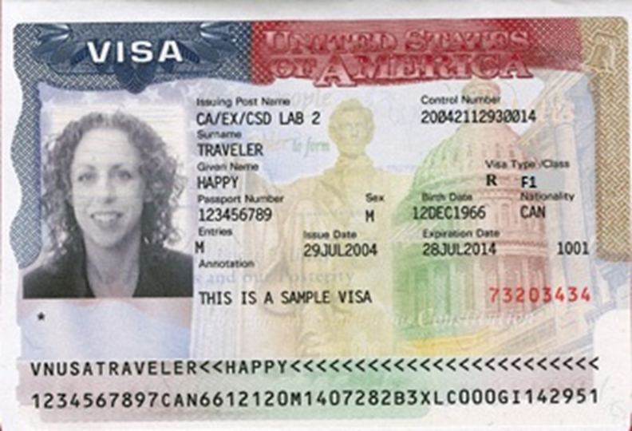
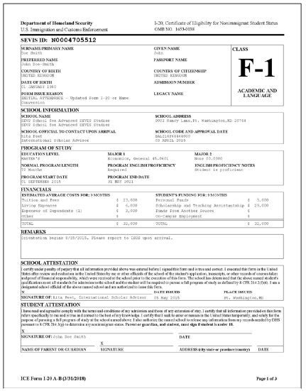
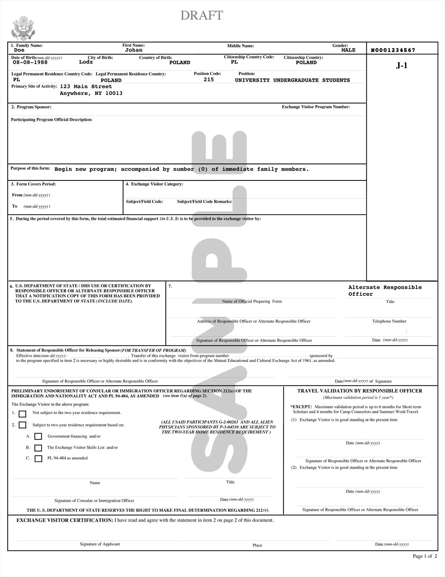
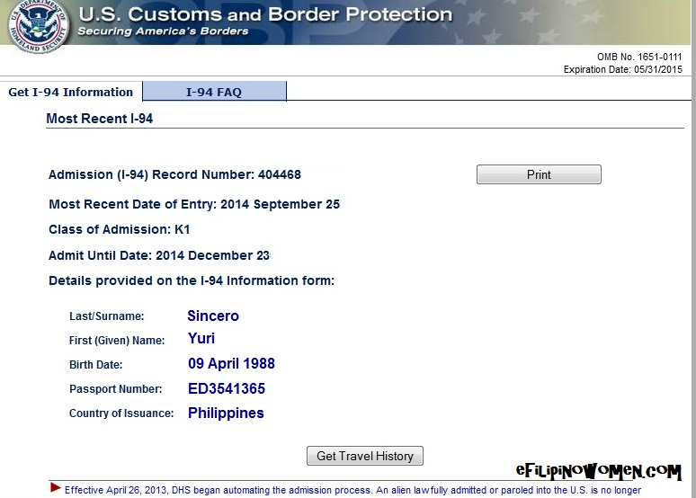
Tour of Documents
Center for International Services

Slide 12
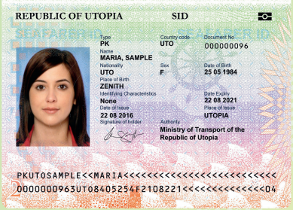
Passport
Know your passport expiration date
Your passport needs to be valid for at least 6 months into the future when entering the U.S.
Replace at your Consulate in New York City or Embassy in Washington, DC
Center for International Services

Slide 13
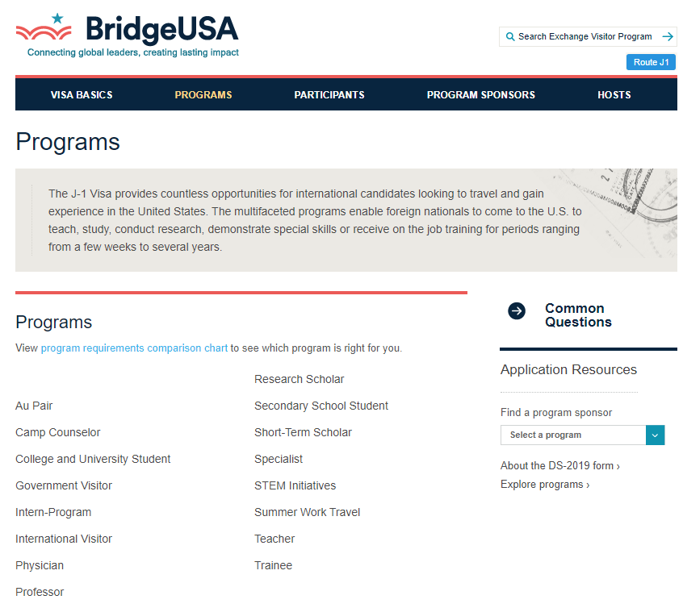
Are you an F or are you a J?
F = the default visa for students
J = an Exchange Visitor
many categories, not just student
have to qualify by participating in an exchange, be selected, receive government funding
Center for International Services

Slide 14
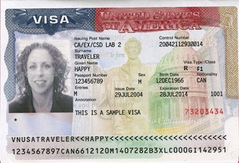
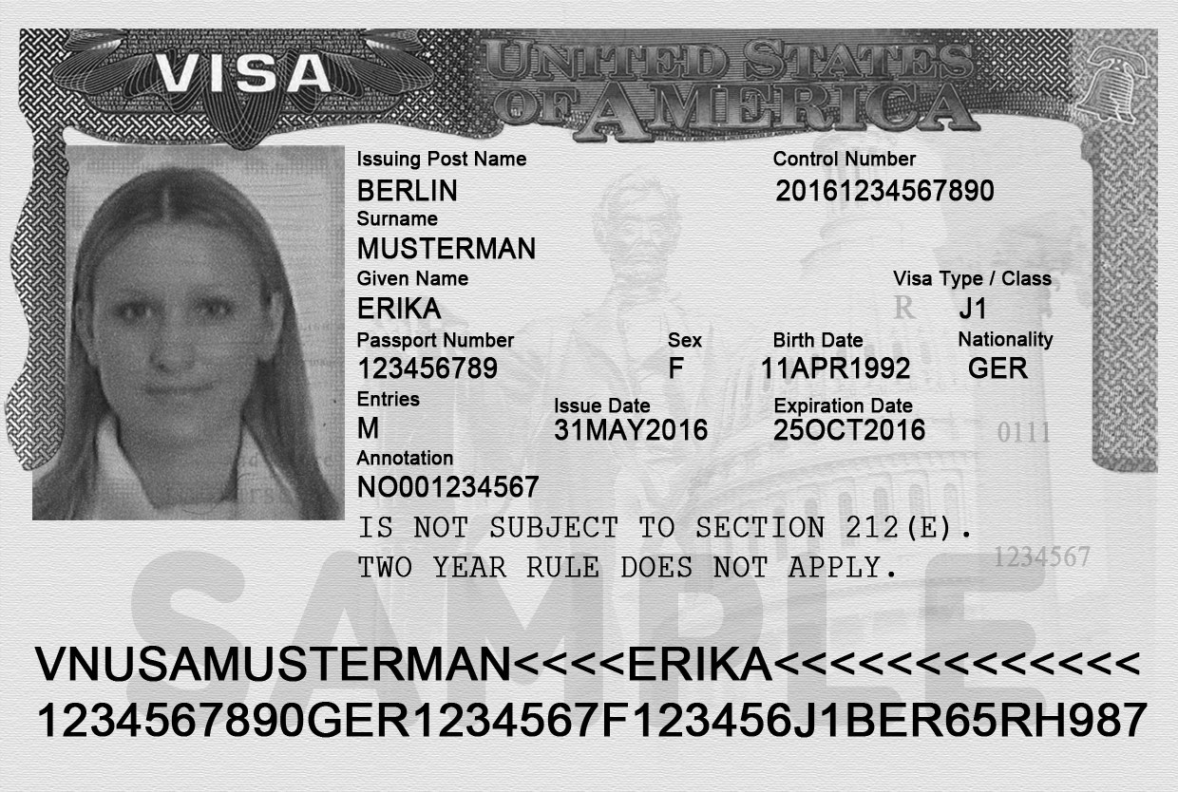
Visa
Know expiration date and Number of entries
Needs to be valid when entering the U.S.
Number of entries and length determined by diplomatic agreements
Usually annotated with SEVIS Number
Usually annotated with school Name
Can only be renewed at a U.S. Embassy or Consulate-all located outside the U.S.
Visa cannot be renewed inside the U.S.
Can expire while in the U.S.
Center for International Services

Slide 15
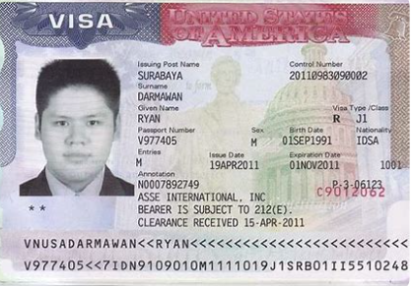
Two Year Home Residency Requirement
Some people in J status are subject to a Two Year Home Residency Requirement: the facts of your situation matter, not necessarily what it says on your visa
If you received government funding for your J program
If your country has your field of study on its Exchange Visitor Skills List
If your J program is for a Medical Residency Program
Center for International Services

Slide 16
Two Year Home Residency Requirement
If you are subject to the Two Year Home Residency Requirement:
cannot change status within the U.S.
are not eligible for an H, K or L visa
are not eligible for permanent residence in the U.S.
UNTIL you have been physically present in your home country for two years
Center for International Services

Slide 17
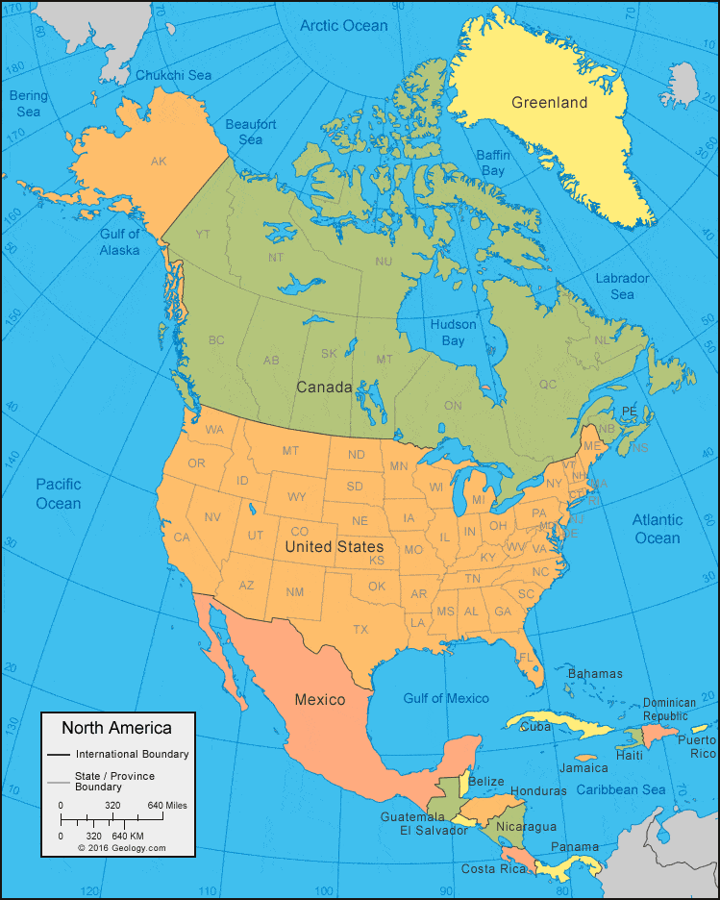
Travel
Need a valid passport
F-1/J-1 Visa needs to be valid to enter the U.S.
Exception:
Returning to the U.S. after a trip to Canada, Mexico, or the adjacent islands
Trip of less than 30 days
Trip solely to Canada, Mexico, or the adjacent islands
Cannot apply for U.S. Visa while there
Not a citizen of Iran, Syria, Sudan, or North Korea
But need to determine if you need a vis to travel to those countries
Center for International Services

Slide 18
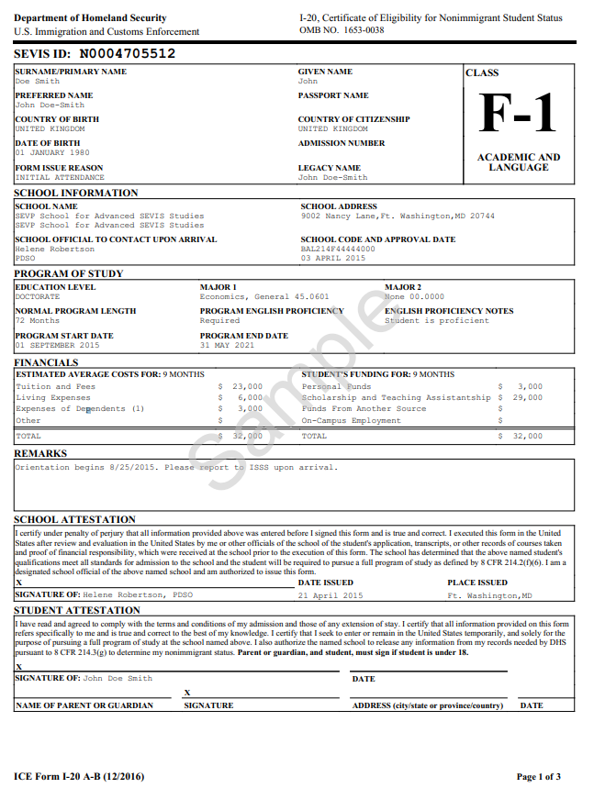
I-20
Issued by Syracuse University
Biographic Information about you
Degree Level
Program of Study
Program Start and End Date
Financial Information
Center for International Services

Slide 19
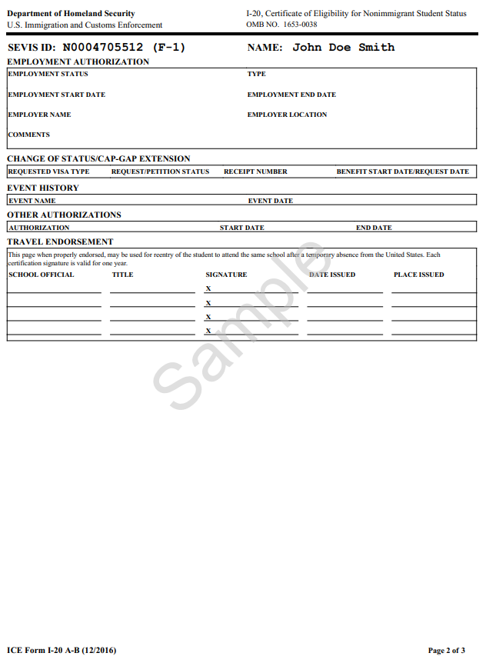
I-20 - Page 2
Employment Authorizations-should be blank, only used for off-campus employment authorization
Travel Endorsement-needed to re-enter the U.S.
Travel Signatures-valid for one year/12 months
Advisor on Call, Monday – Friday, 11 am – 3 pm
Through MySlice ISSS Portal
Express Travel Signatures
Ann Dievendorf International Student Advisor 07/30/2021 Syracuse,NY
Express Travel Signatures
September 30-October 4
9 am-4 pm 310 Walnut Place
Center for International Services

Slide 20
DS-2019
Issued by Syracuse University or J-1 Program Sponsor (Fulbright, IIE, LASPAU, Amideast, etc.)
Biographic Information about you
Degree Level
Program of Study
Program Start and End Date
Financial Information
Center for International Services

Slide 21
Travel Endorsement
Travel Signatures-needed to re-enter the U.S.
valid for one year/12 months
J students sponsored by other than Syracuse University must obtain travel signatures from their J Sponsor-IIE, LASPAU, Amideast, etc.
Express Travel Signatures September 30-October 4
9 am-4 pm 310 Walnut Place
07/30/2021
Center for International Services

Slide 22
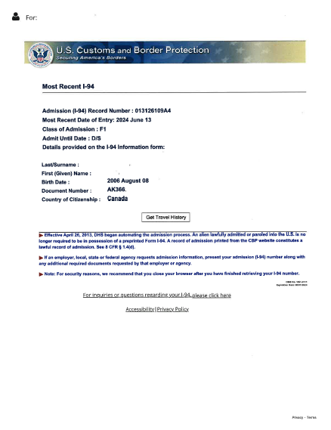
I-94 Arrival Record/Travel History
www.cbp.gov/I-94
Updated every time you travel out of the U.S. and enter
Check every time to be sure you were admitted to the US in F-1/J-1 status and for D/S
D/S = Duration of Status
F-1 = Program End Date + 60 day grace period
J-1 = Program End Date + 30 day grace period
Center for International Services

