Slide 1
Fall 2024
Grad Immigration Essentials
Part 2
Center for International Services

Slide 2

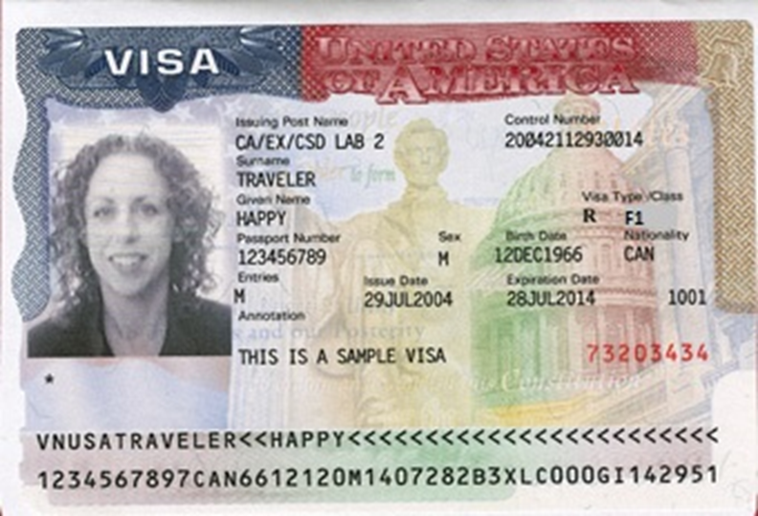
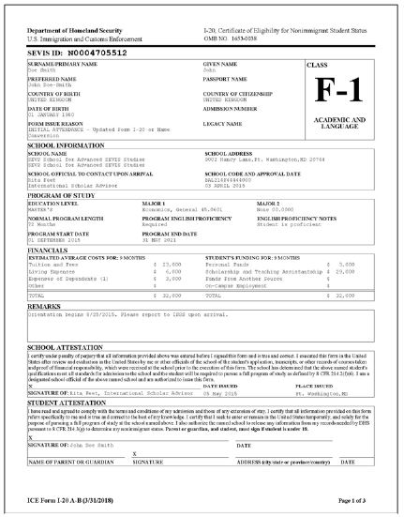
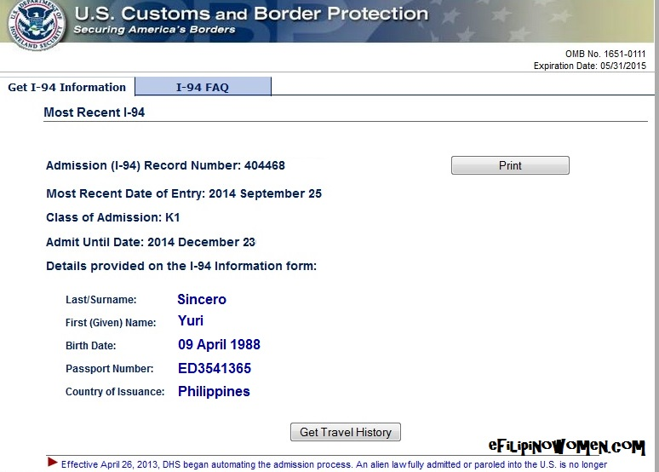
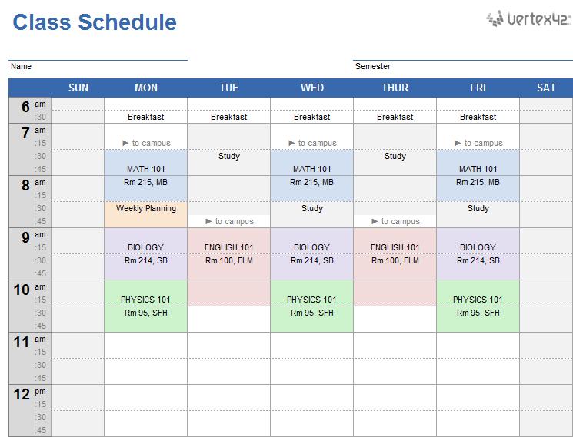


3 Do’s and a Don’t
DO - Keep your Documents valid
DO - Update your Information
DO - Register Full-time every semester
Don’t - Engage in unauthorized Employment
Center for International Services

Slide 3
D
Keep Your
ocuments valid!
I
Update Your
nformation!
F
Register
ull-time every semester!
E
Do not engage in unauthorized
mployment!
Center for International Services

Slide 4

Documents
Passport:
  Keep your passport valid at all times
  must be valid for 6 months into the future when entering the U.S. unless a citizen of the 6 month club
Visa:
  Must be valid when entering the U.S.
  Can expire while in the U.S.
I-94:
  Check every time you enter the U.S.
  F-1/J-1
  D/S
I-20/DS-2019:
  Travel Signature
  Program of Study
  Program End Date
Center for International Services

Slide 5
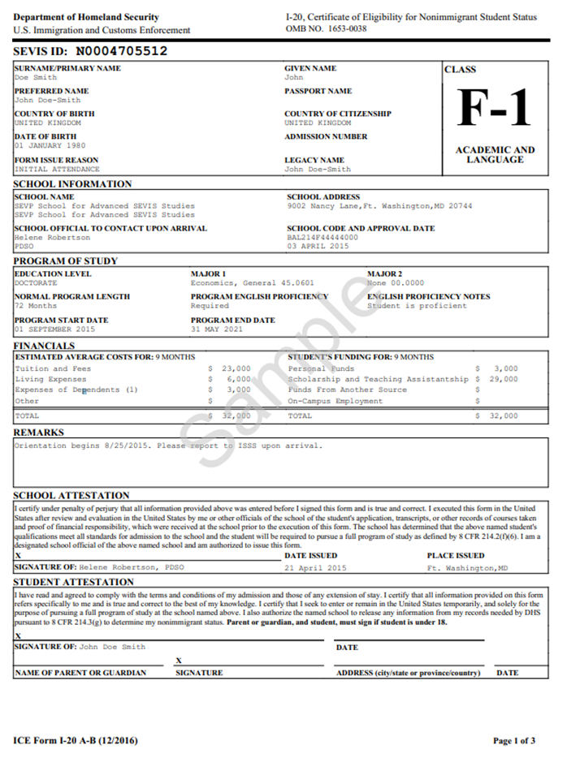
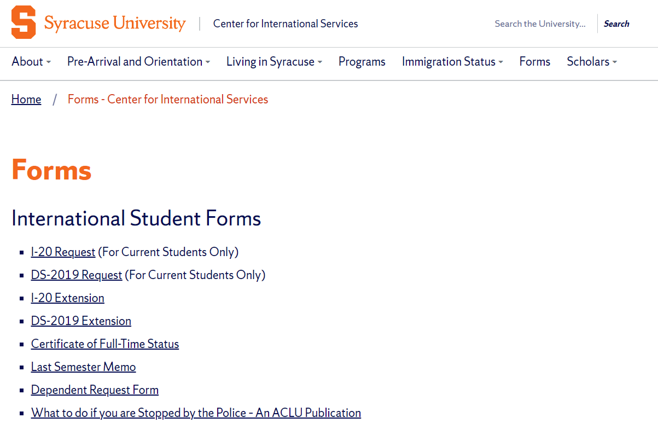
Program
Change Level of Study (Bachelor’s to Masters; Language Instruction to Bachelor’s)
Program of Study (Computer Science to Computer Engineering)
I-20/DS-2019 Request on the Center for International Services Website
Center for International Services

Slide 6

Program End Date
If you need less time
  changed when finish
If your need more time
  I-20/DS-2019 Extension Request on the Center for International Services Website
Center for International Services

Slide 7
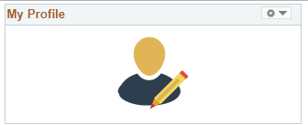
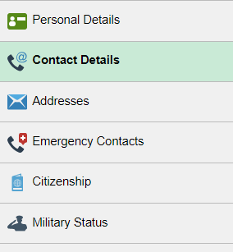
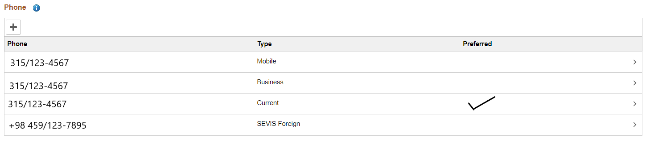
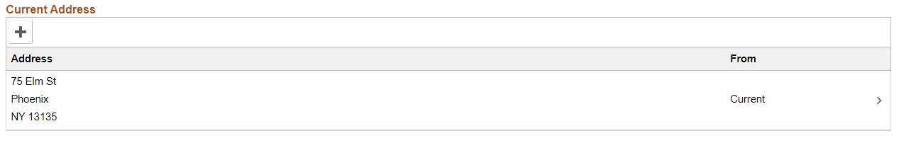
Information in MySlice
Name
Address
  Current-here in Syracuse
  Permanent-outside the U.S.
Phone Number
Emergency Contact Information
Center for International Services

Slide 8




Full-time Registration
  9 credit hours every Fall and every Spring semester
  Summer registration not required by immigration regulations but may be required by your program
  Only one course can be taken online toward full-time registration (3 credits out of 9)
Center for International Services

Slide 9
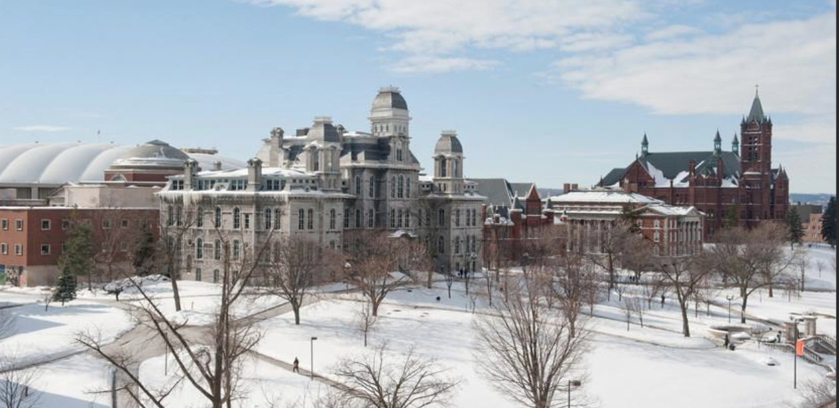
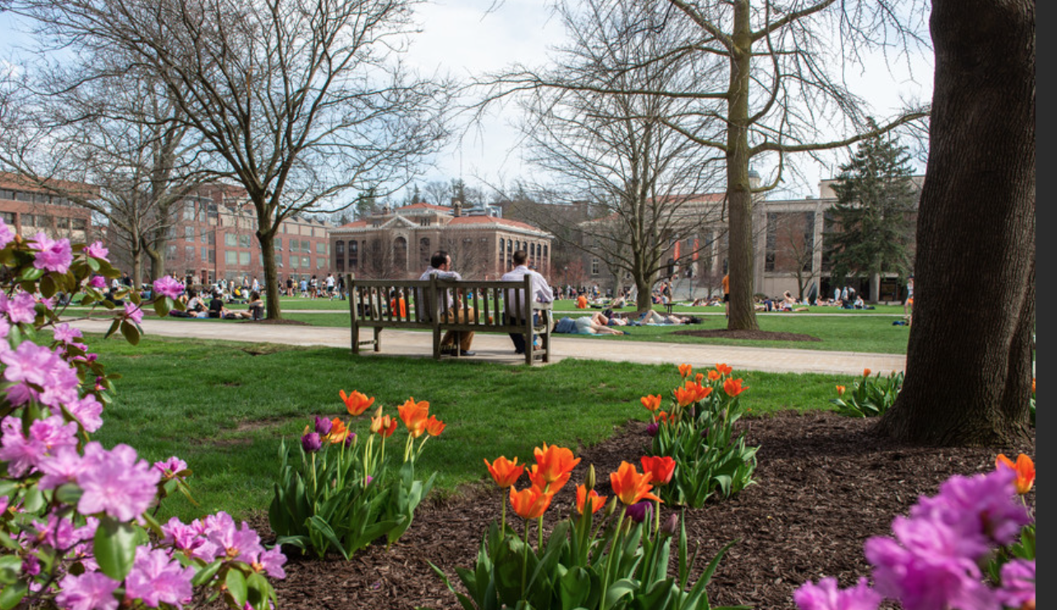
Summer Registration
  Summer registration can be:
    full-time
    part-time
    in person
    online unless last period of registration
  Winterlude and Maymester
    short-term online academic terms
    cannot be counted toward full-time requirements for Spring or Fall registration
    cannot extend your stay
Center for International Services

Slide 10

Full-time Registration
Exceptions:
First Semester
  Difficulty with English Language
  Unfamiliarity with American teaching methods
  Improper Course Placement
Must be documented by faculty member in writing
Medical Reasons
  Must be documented by licensed medical doctor, doctor of osteopathy, or licensed clinical psychologist
  Consult with an advisor from the Center for International Services first!
Center for International Services

Slide 11

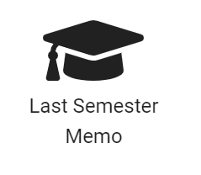
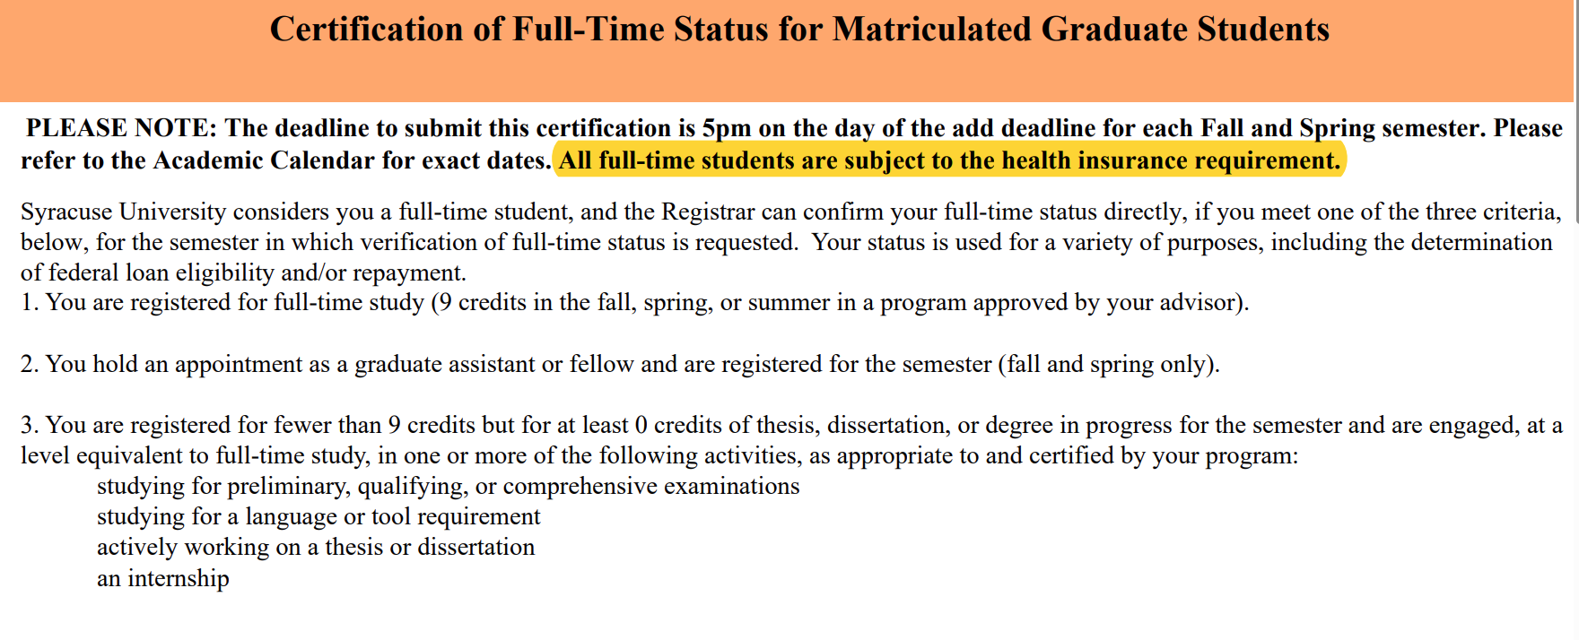
Full-time Registration
Exception:
  Final semester-can be registered for less than 9 credits if you need less than 9 credits to complete your degree
    need Last Semester Memo
  TAs/RAs/GAs/Fellows-registered for something automatically considered full-time
  Graduate School’s Certificate of Full-time Status
    Studying for a qualifying Exam
    Studying for a language or tool requirement
    Writing thesis or dissertation
    Full-time Internship
Center for International Services

Slide 12

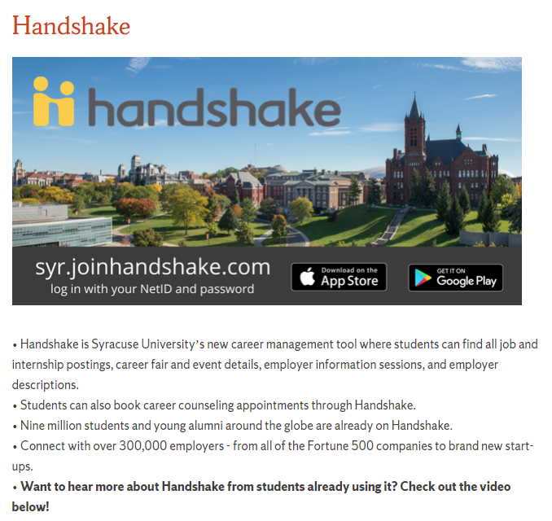
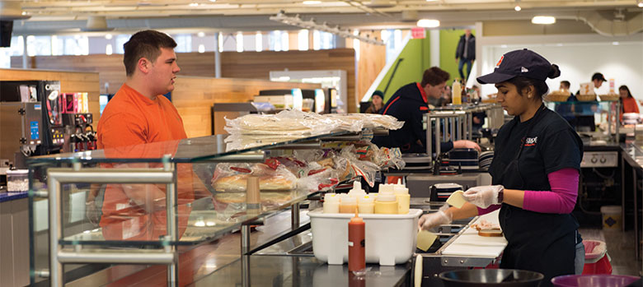
Employment
First Year in F-1 status limited to On campus employment
20 hours per week while school is in session; full-time during breaks but not more than 40 hours per week
  Summer 2024: May 8 – Aug. 25, 2024
  Fall Break 2024: Oct. 14-Oct. 15, 2024
  Thanksgiving Break 2024: Nov. 24-December 1, 2024
  Winter Break 2024-2025: Dec. 18, 2024 – Jan. 12, 2025
  Spring Break 2025: March 9-16, 2025
  Summer 2025: May 7 – approximately Aug. 24, 2025 (to be determined)
On Campus means on SU’s campus; paid by SU
Handshake
Center for International Services

Slide 13
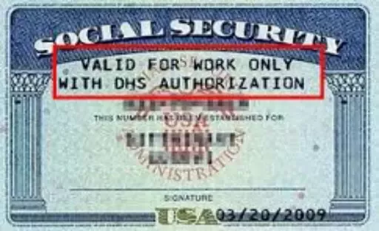
Social Security Numbers
Used for the purpose of tracking income to be taxed appropriately and eventually to earn retirement income
Only eligible if working/employed-not needed to begin working
Not needed to open a bank account, get a drivers license or obtain a credit card
Is not proof of identity – No photo on the card, no date of birth
If you are hired on campus, there is a process in place involving
  Payroll
  Student Employment Services/’Cuse Works
  Center for International Service
  A few weeks after you receive your first paycheck, we
  will email you with instructions to apply for an SSN
  when we have what we need to give you to apply for an
  SSN
Center for International Services

Slide 14
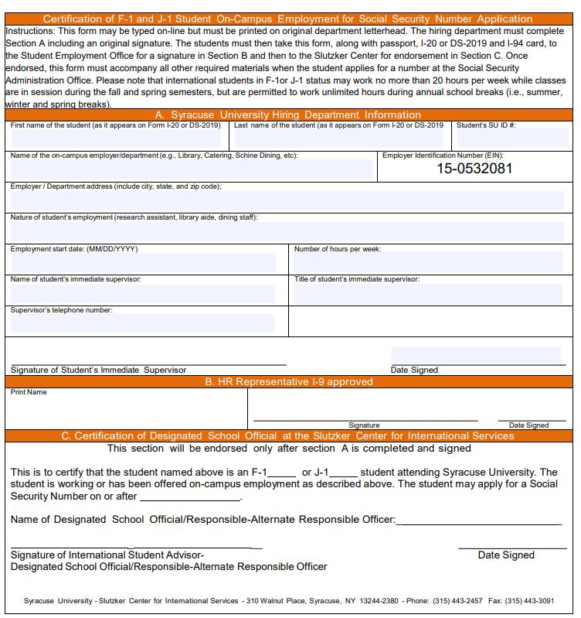
Employment On Campus
On Campus Employment
F-1 students may work on campus up to 20 hours per work while school is in session, full-time during breaks
Handshake
Employer Verification Form (EVF)-needed to apply for SSN
The Center for International Services will contact you when we receive an EVF from Student Employment and you are able to apply for an SSN
Center for International Services

Slide 15
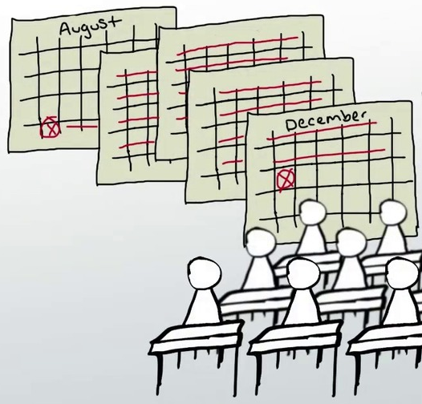
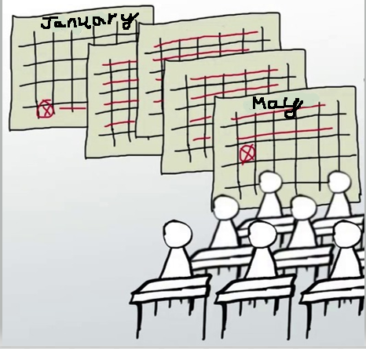
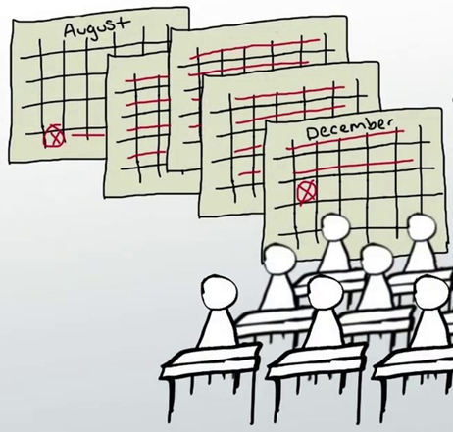


Employment Continued
After two semesters (Fall and Spring, Spring and Fall)
Eligible for
  Curricular Practical Training
  Optional Practical Training
  Economic Necessity
Curricular
Practical
Training
Optional
Practical
Training
Center for International Services

Slide 16
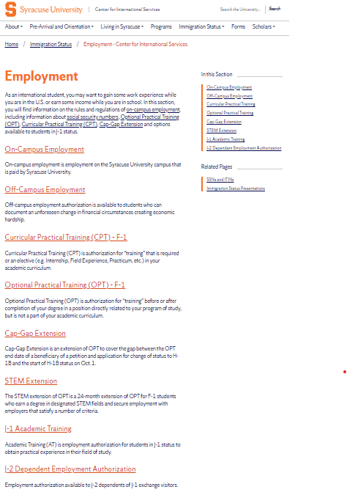
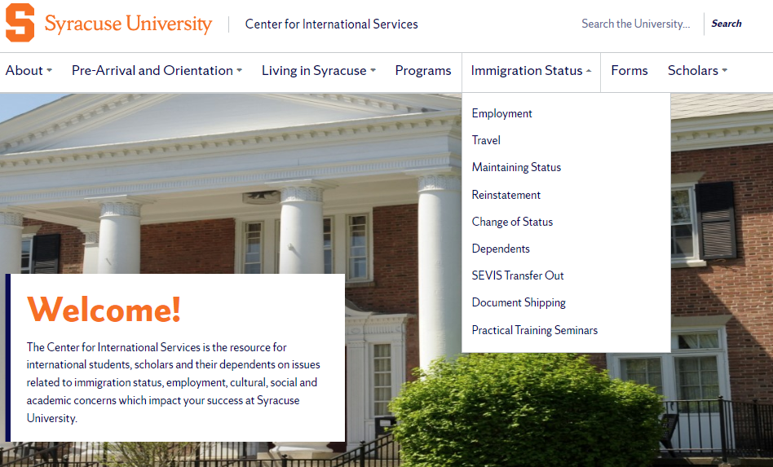
Employment Continued
After two semesters (Fall and Spring, Spring and Fall)
Eligible for
  F-1s
    Curricular Practical Training
    Optional Practical Training
    Economic Necessity
Center for International Services

Slide 17
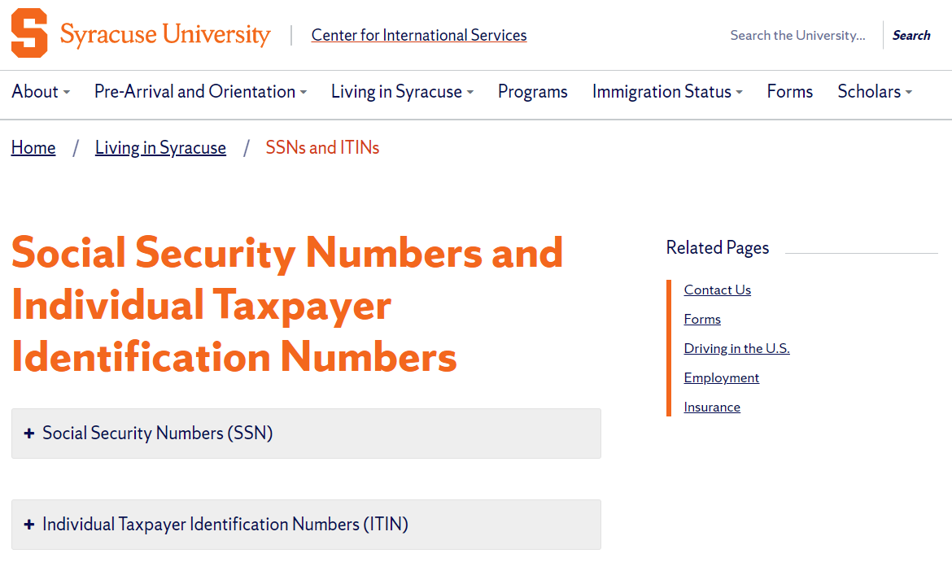
Individual Taxpayer Identification Numbers (ITINs)
Fellowship and Scholarship holders only
NOT if only receiving a reduction in your tuition that may be called a scholarship on your I-20
Information on the Center for International Services website website
Center for International Services

Slide 18
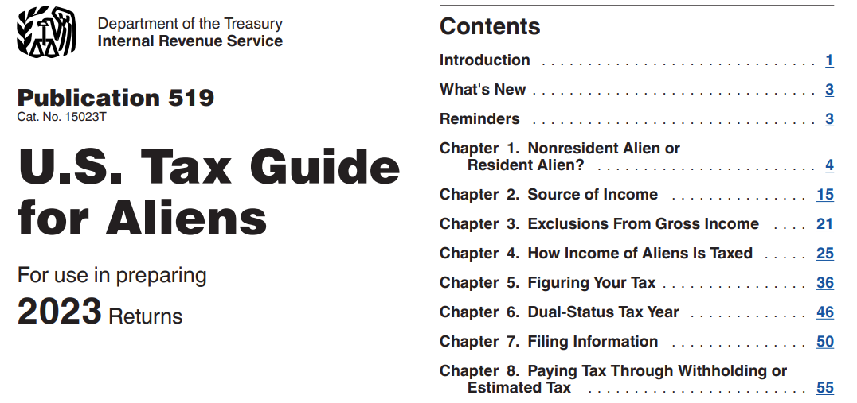
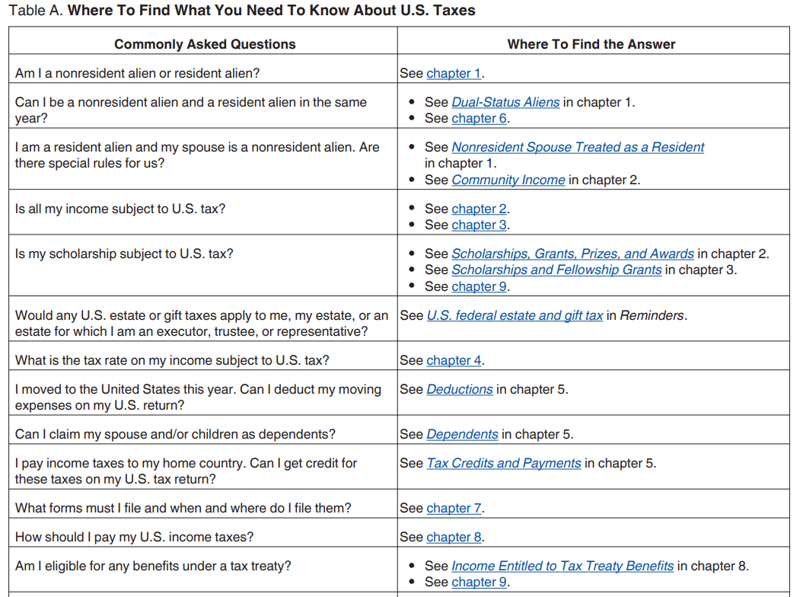
A Few Words about Taxes
In U.S., taxes are a very private, confidential matter
Individuals are responsible for their own taxes
Syracuse University, the Center for International Services, Payroll, your department are not responsible and cannot take responsibility for advising you on tax matters
That said, some basic, very general information may be helpful
Center for International Services

Slide 19


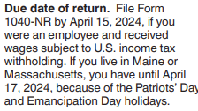
Tax System
Government Office involved is the Internal Revenue Service = IRS
Tax year = January 1-December 31
Filing deadline is April 15 or so of the following year
For income you received in 2024, you will have to file a tax return between the end of January 2025 and April 15, 2025
Center for International Services

Slide 20
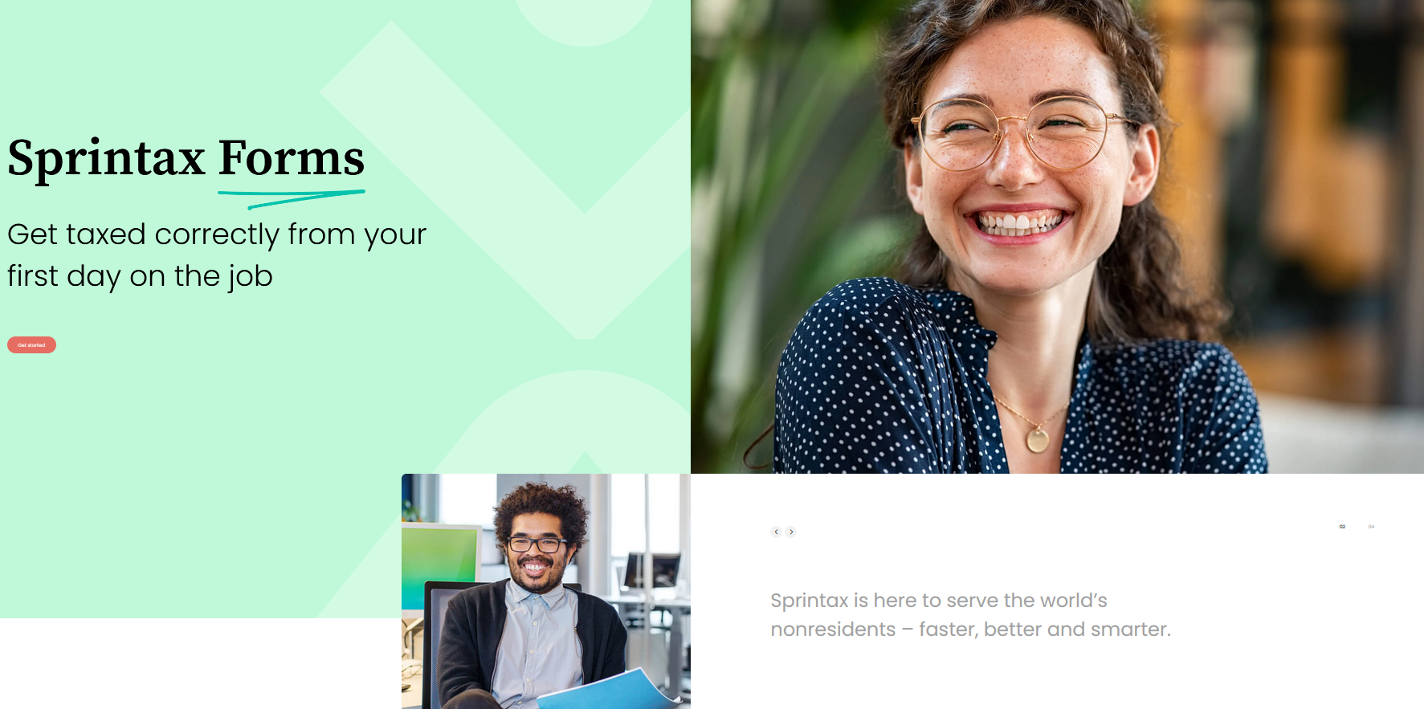
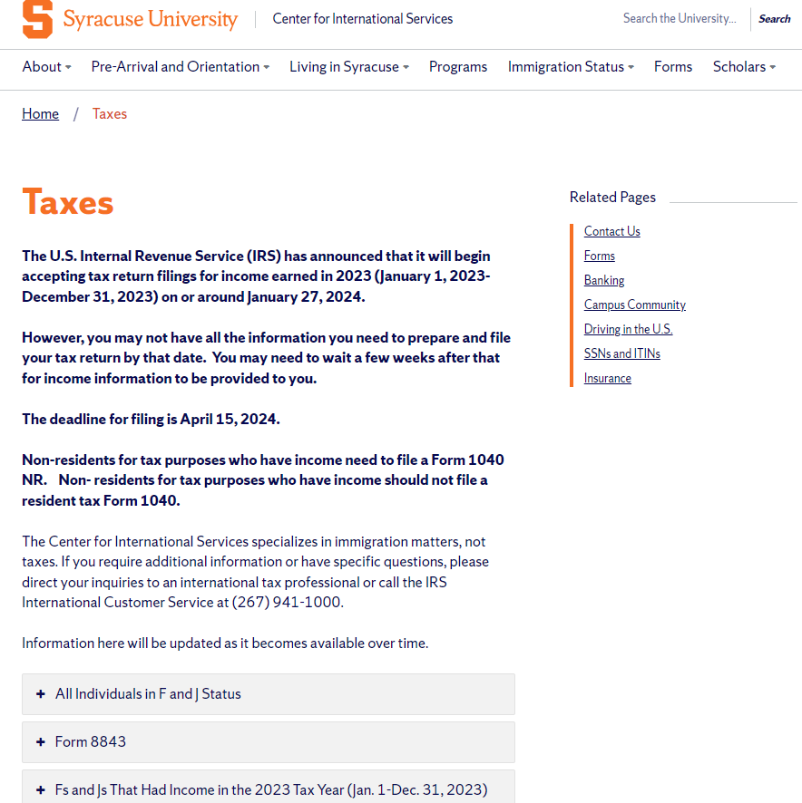
Tax Returns
Center for International Services purchases licenses to a software program for you to use to help prepare your tax returns = SPRINTAX
We will send an email in February 2025 with instructions about using SPRINTAX to file your tax return for income earned in 2024
We will provide a code to use to file your federal return for free
Some students will also have to file a New York state tax return (and other states)-cannot use SPRINTAX for free. Cost varies by state; some states provide free filing services
Center for International Services

Slide 21
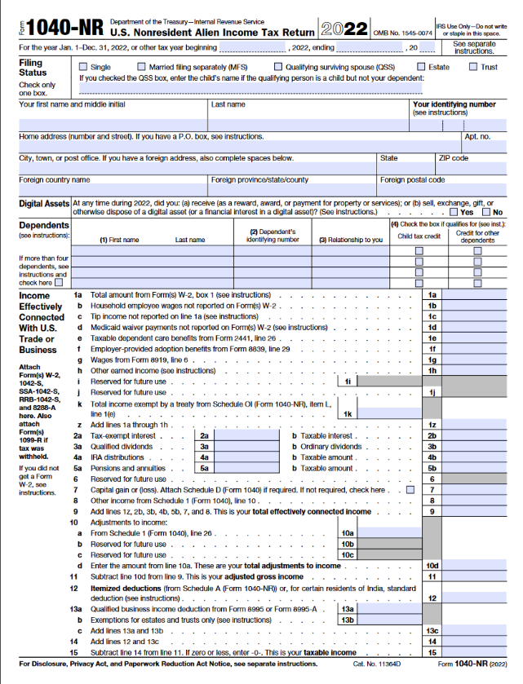
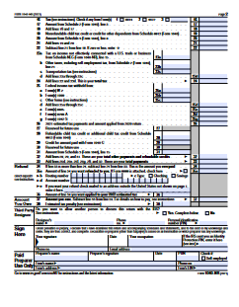
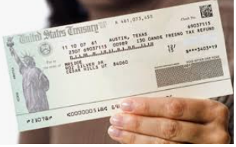

Tax System
“Tax Return” – bad name
Leads students to think if they file a tax return they will receive a refund of all the taxes they paid
“Tax Return” (1040NR) is a form used to reconcile your tax account with the government
If you paid too much, you will receive a refund of the over amount
If you paid too little, you will owe money in taxes
Center for International Services

Slide 22
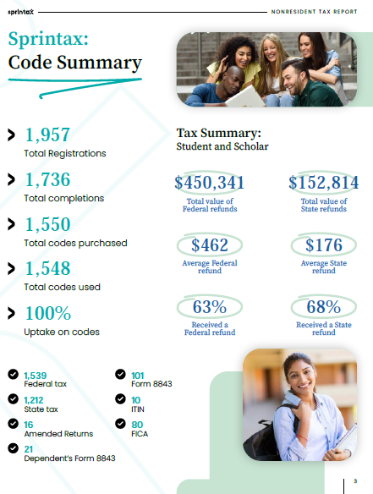
Tax System
Why would someone have paid more or less than what they owe in taxes?
System is based on estimated withholding of taxes by employers
Employers estimate what you will owe in taxes based on information you provide them and pay it over to the government throughout the year-called withholding
Foreign National Information System (FNIS)-system Syracuse University uses to collect information from you for tax purposes
Center for International Services

Slide 23


Dependents
Spouses and Children under 21 yrs. of age-not mother, father, sister, brother, grandma, etc.
Dependent Request Form on Center for International Services Website
Must submit financial support documentation & health insurance to bring dependents
Their legal status is linked to your status
F-2s cannot seek employment
F-2s cannot enroll in full-time course of study or degree program, except K-12
Center for International Services

Slide 24
Leaves of Absence
Medical:
Must submit written recommendation from a licensed physician, clinical psychologist or doctor of osteopathy
May remain in the U.S. while on an approved Medical Leave of Absence
Personal:
Must begin with academic department
F-1 status will be terminated
May not remain in the U.S. while on a Personal Leave of Absence
Center for International Services

Slide 25
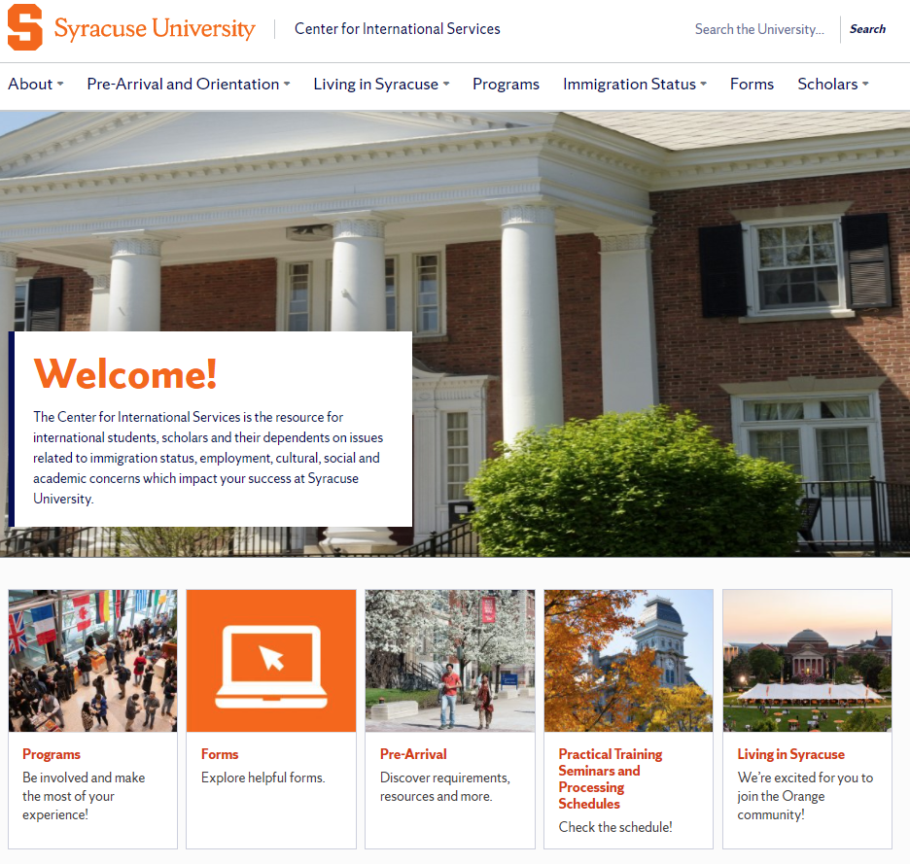
https://experience.syracuse.edu/international/
Center for International Services

Slide 26

Top Ten Tips for Using Our Office
10. Use our Advisor on Call hours, Monday through Friday, 11 am -3 pm: someone is always available during those times; outside those times you risk having no one available to see you.
9. Use our general office email: international@syr.edu; it is monitored several times a day, Monday through Friday, and messages are distributed to advisors throughout the day, Monday through Friday. Remember our office is closed over the weekends so an email you send on Friday at 9 pm will likely not be read until sometime on Monday. If you have a real emergency, you can always contact the Department of Public Safety (DPS) and they know how to contact the Director.
8. It is best practice to either email OR call OR come in; you do not need to do all three.
7. It is best practice to email one advisor about a topic, not all the advisors with the same message; it is best practice to email international@syr.edu OR an individual advisor. Best practice is likely to get you the fastest response!
6. Try looking under the immigration tab on our website for an answer to your question first…there is a lot of information there!
Center for International Services

Slide 27
Top Ten Tips for Using Our Office
5. Include your SU ID Number in all emails to the office.
4. It is a good practice to bring your immigration documents with you to the office if you are coming to ask an immigration question.
3. Immigration advice relates to an individual and specific circumstances. Advice that was given to a friend may not be applicable to you.
2. You should seek advice before you act or fail to act on immigration matters. It is easier to help you before you have a situation than after you have a problem.
1. If you receive an email from international@syr.edu , READ IT! We try to send only really important information from that email address. It is something you need to know. And sometimes, something you need to take action on. Do not miss a deadline because you did not read your email.
Center for International Services

