Slide 1
F-1 Optional Practical Training Seminar
Center for International Services

Slide 2
Optional Practical Training (OPT)
OPT is authorization for “training” before or after completion of your degree in a position directly related to your program of study.
Center for International Services

Slide 3
How long can OPT Training be authorized for?
All F-1 students are eligible for one year of authorization at each degree level
12 months at the Bachelor’s level +
12 months at the Master’s level +
12 months at the Ph.D. level
Some F-1 students may be eligible for additional OPT (STEM extension) if they meet all the requirements
Center for International Services

Slide 4
What Makes OPT Optional?
You are not required to do it, you do not have to apply for OPT
You have some choice about when you can apply for it
It is not something required for your degree or a course you can register for in your curriculum; you would use Curricular Practical Training (CPT) for that
Center for International Services

Slide 5
Must the Training Be Related to my Major?
The training must be in your major field of study as indicated on your I-20
All majors/programs of study should be listed on your I-20
It cannot be in a minor
It cannot be in a previous major/degree not included on your current I-20
Bachelor’s degree in Computer Science, now doing a Master’s degree in History-OPT would have to be in History
Center for International Services

Slide 6
Do I Need a Job Offer to Apply for OPT?
An offer for the training is not necessary to apply for OPT
You do not need to wait for a job offer to apply for OPT
Center for International Services

Slide 7
Who Authorizes OPT?
The Center for International Services recommends the OPT by issuing a new I-20
not like CPT that we authorize
OPT is approved and authorized by USCIS (US Citizenship & Immigration Services)
Center for International Services

Slide 8
Who is Eligible for OPT?
OPT is a benefit of F-1 status
You must currently be in lawful F-1 status-you must be physically present in the U.S.; you cannot apply for OPT from outside the U.S.
J-1 students are not eligible for OPT but are eligible for Academic Training
J-2s, H-4s, L-2s, etc. are not eligible for OPT but may have other employment authorization
Center for International Services

Slide 9
Who is Eligible for OPT?
You must have been a full-time student for at least one academic year (Fall and Spring or Spring and Fall)
no time spent in an English language program counts toward this one year full-time requirement
time as a full-time student in another immigration status (H-4, L-2, J-2, etc.) does count toward the one year full-time requirement
OR
Center for International Services

Slide 10
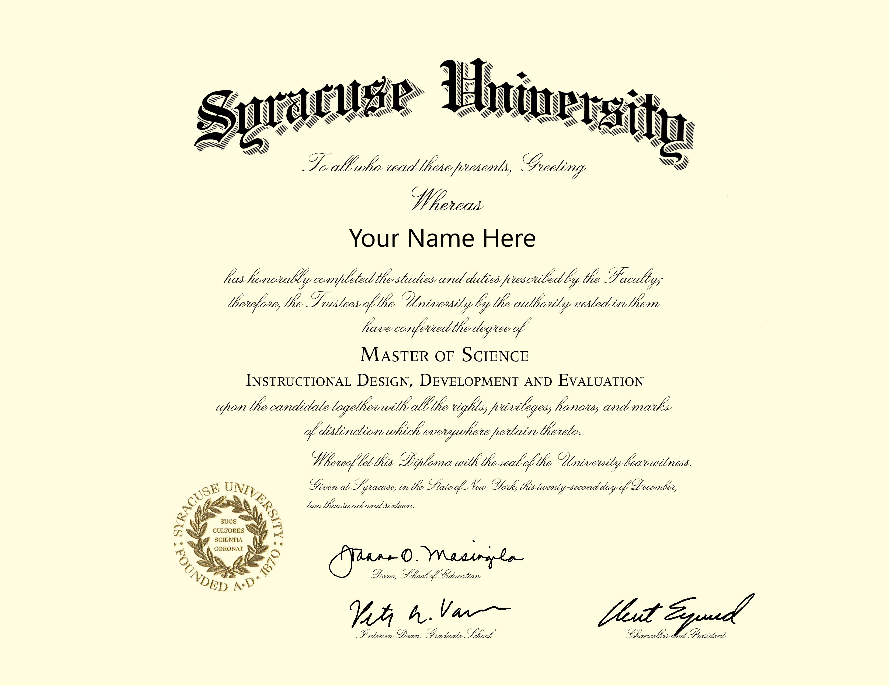
What Would Make Me Ineligible for OPT?
You cannot have utilized an equivalent of 12 months of OPT at the same degree level or for a higher degree
Can do a Bachelor’s degree and get 12 months of OPT then do a Masters degree and get 12 months of OPT and do a Ph.D. degree and get 12 months of OPT
Cannot do two Masters degrees and get two 12 month periods of OPT
You cannot have done 365 days of full-time Curricular Practical Training (CPT) at the same degree level
+ 12 Months of OPT
+ 12 Months of OPT
+ 12 Months of OPT
+ 12 Months of OPT
+ 12 Months of OPT
Center for International Services

Slide 11
Does Approval for CPT Affect How Much OPT I am Eligible for ?
CPT is never deducted from OPT; you can use CPT and OPT
But if you use 12 months of full-time CPT, then you will not be eligible for any OPT
You can use as much part-time CPT and “up to 364 days” of full-time CPT and still be eligible for OPT
USCIS is closely examining extended periods of full-time CPT authorization
$25 Replacement Fee!
Center for International Services

Slide 12
When Can I Use OPT?
Pre-Completion of program (before program end date on your I-20)
During annual/summer vacation- Part-time or Full-time
While school is in session- Part-time
After you have completed all course work and are working on your thesis or dissertation- Part-time or Full-time
Most students use CPT for these experiences because opportunities for Internships, Practicum, Field Experience are plentiful at SU
Post-completion of program (start date of OPT is after the program end date on your I-20)-when most students use OPT
Center for International Services

Slide 13
How Much OPT am I eligible for?
Maximum authorization = 12 months
If you use any pre-completion OPT (prior to completion of your program) :
Full-time authorization is subtracted from the twelve months
three months of full-time summer OPT would leave you with 9 months of OPT
Part time authorization is subtracted from the 12 months at ½ the rate
four months of part-time authorization would leave you with 10 months of OPT
$25 Replacement Fee!
Center for International Services

Slide 14
When Can/Should I Apply for OPT?
If Applying for Pre-Completion OPT
If applying during your 1st year of study
You can apply no more than 90 days before completing your first academic year
because you are not eligible for OPT until you have been a full-time student for two semesters
If applying after your 1st year of study
You can apply no more than 90 days prior to the work authorization start date you request
Center for International Services

Slide 15
When Can/Should I Apply for OPT?
If applying for Post-completion OPT: there is a 5 month window for application
No more than 90 days/3 months prior to your program end date and up to 60 days/2 months after your program end date
Your application must be received by USCIS no later than 60 days/2 months after your program end date
Program End Date
Must be received by USCIS no later than 60 days after program end date
No more than 90 Days before your program end date
5 Month Window To apply for OPT
Center for International Services

Slide 16
How much does it cost to apply for OPT?
Effective April 1, 2024
USCIS Filing fee for OPT increased to $470
Friends who applied last year paid less
$$
$$
$$$
Center for International Services

Slide 17
How long does it take for USCIS to approve OPT?
USCIS reports that 80% of OPT applications are processed within 45 days
Again, the earlier you apply, the quicker your processing time
May graduates who apply in February experience faster processing times (weeks) than those that wait until April/May to apply (months)
December graduates who apply in September experience faster processing times (weeks) than those that wait until December to apply (months)
Including a job offer letter does NOT make your application get processed any faster
Center for International Services

Slide 18
Optional Practical Training (OPT) Why apply early?
Center for International Services

Slide 19
Can my OPT application be expedited?
An application will only be expedited if you can document specific criteria set by the USCIS:
Severe financial loss to company or person
Emergency situation
Humanitarian reasons
Nonprofit organization whose request is in furtherance of the cultural and social interests of the United States
Department of Defense or national interest situation
USCIS error
Compelling interest of USCIS
It is extremely difficult to get an application expedited
Center for International Services

Slide 20
Premium Processing
Guarantees 30 days processing time
not an approval
a guarantee they will look at your application within 30 days
our experience is 3-5 days
No expedite of the production of your EAD card nor mailing of it to you
Usually takes an additional 7-10 days for EAD card to be produced
Usually takes an additional 7-10 days for EAD card to be mailed to you
Center for International Services

Slide 21
How much does Premium Processing cost?
Premium Processing Fee = $1685
Filing Fee for Form I-765 = $470
Total = $2155
You can:
file Request for Premium Processing when you file your Form I-765 Application for Employment Authorization OR
you can request it after filing, while Form I-765 is pending
We advise you apply early enough to avoid having to use premium processing in order to begin a job in a timely fashion!
$
Center for International Services

Slide 22
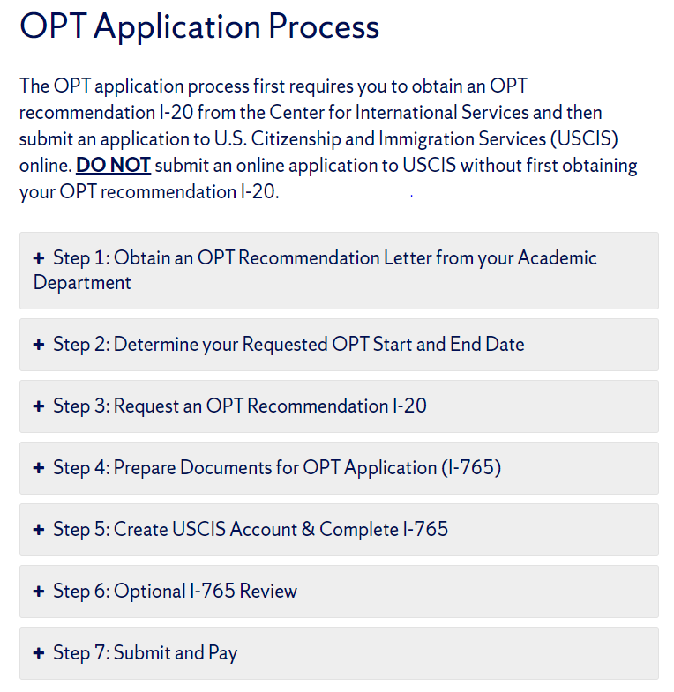
OPT Application Process Overview
To get here from our website > Immigration Status > Employment > Optional Practical Training (OPT) – F-1 > OPT Application Process
Center for International Services

Slide 23
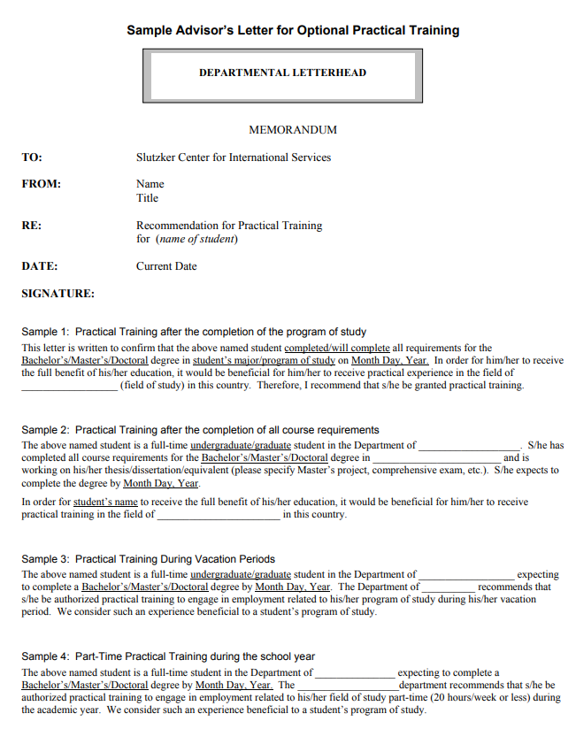
STEP 1: Obtain an OPT Recommendation Letter from your Academic Department
Obtain a Recommendation Letter from your department printed on departmental letterhead
You will need to Upload this letter to your request for an OPT Recommendation I-20
Do NOT ask your department to send it to the Center for International Services
Center for International Services

Slide 24
STEP 2: Determine your Requested OPT Start and End Date
Pre-Completion OPT
may begin any day after you complete two semesters as a full-time student and end any day within 12 months of your requested start date
Center for International Services

Slide 25
STEP 2: Determine your Requested OPT Start and End Date
Post completion OPT
There is a 60 day “window” for your OPT start date
OPT may begin any day after your program end date up to no later than 60 days after your program end date
If you have a job and know when you will start and that start date is within 60 days after you complete your program, choose that start date
Program End Date
Requested OPT Start Date
12 Months OPT Authorization
OPT Start Date – 60 Day Window
Center for International Services

Slide 26
STEP 2: Determine your Requested OPT Start and End Date
If you do not have a job offer, you still have to choose a start date
You may have to make an educated guess
If you have not yet applied for jobs or have not even written your resume yet, you may want to choose the last possible date to begin OPT
If you have begun your job search, you may want to choose a start date in between
Program End Date
Requested OPT Start Date
Requested OPT Start Date
12 Months OPT Authorization
12 Months OPT Authorization
OPT Start Date – 60 Day Window
Center for International Services

Slide 27
STEP 2: Determine your Requested OPT Start and End Date
Post-Completion OPT end date must be no later than 14 months after your program end date regardless of the OPT employment start date
If you apply early, your OPT will likely begin on the start date you request
If USCIS has not approved your application by your requested start date, it will begin on the date USCIS approves it
If on the date USCIS approves your OPT they can still approve 12 months of OPT, you will be approved for 12 months.
If not, you will be approved until no later than 14 months after your program end date
You may actually be approved for less than 12 months of OPT
Center for International Services

Slide 28
STEP 2: Determine your Requested OPT Start and End Date
USCIS Approves Application and adjusts start date
14 months After
Program End Date
USCIS Receives Application
Program End Date
USCIS 90 Days Processing
Actual Work Authorization – 9 months of OPT
Requested Authorization – 12 months of OPT
OPT Start Date – 60 Day Window
Center for International Services

Slide 29
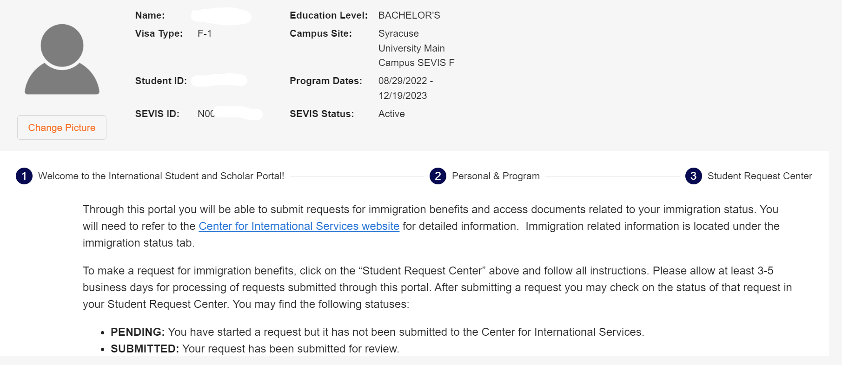
STEP 3: Request an OPT Recommendation I-20
Log in to the International Student and Scholar (ISSS) Portal through MySlice.
Go to the Student Request Center.
Center for International Services

Slide 30
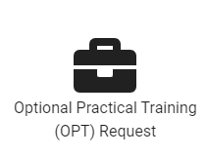
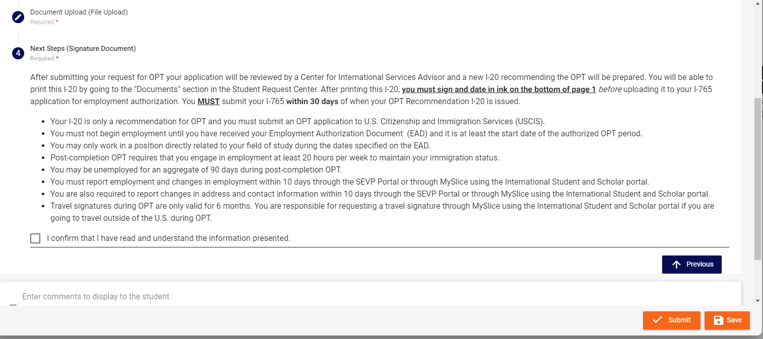
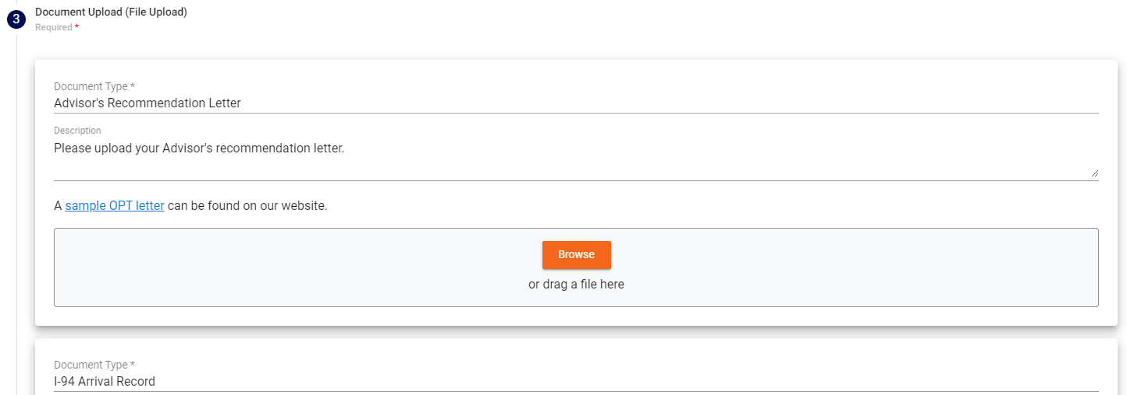
STEP 3: Request an OPT Recommendation I-20
3. Find the Optional Practical Training (OPT) Request.
4. Complete the Questionnaire.
5. Upload the Required Documents:
Advisor’s Letter
Most recent I-94 and Travel History
Read the Next Steps and Confirm.
Submit Request.
Center for International Services

Slide 31
STEP 4: Prepare Documents for OPT Application (I-765)
While you are waiting for your OPT I-20 you should prepare digital files of the following for your I-765:
A passport style photograph. 2 X 2 inches, white or light background, no glasses.
Your most recent I-94.
Your passport biodata page (with photo and expiration date) and most recent F-1 visa.
Any previous Employment Authorization Document (EAD) from USCIS if you have had employment authorization in the past (e.g., OPT for previous degree).
Any I-20s authorizing CPT and/or OPT
You will also need your OPT Recommendation I-20 from ISSS Portal once it is available
Center for International Services

Slide 32
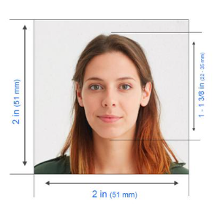
STEP 4: Prepare Documents for OPT Application (I-765)
Obtain a 2” x 2” inch photo of yourself (no eye glasses allowed)
The photo must be from within the last 30 days, do NOT use passport or visa photos that you might have if they were not taken within the last 30 days
Center for International Services

Slide 33
STEP 4: Prepare Documents for OPT Application (I-765)
Downloading your OPT Recommendation I-20 from the ISSS Portal:
You will receive an email when your OPT Recommendation I-20 is available in your ISSS Portal
Steps to retrieve your I-20:
Go to the ISSS Portal
Navigate to the Student Request Center
Find the documents section
Download, print and sign your I-20
Center for International Services

Slide 34
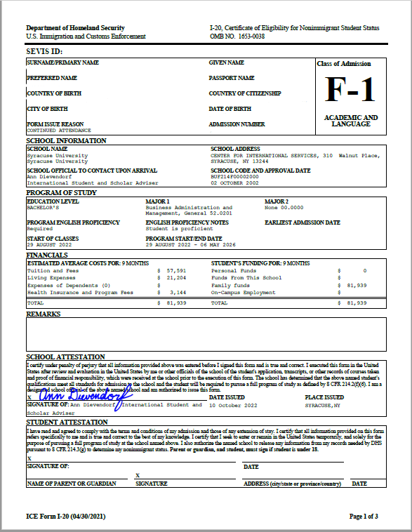
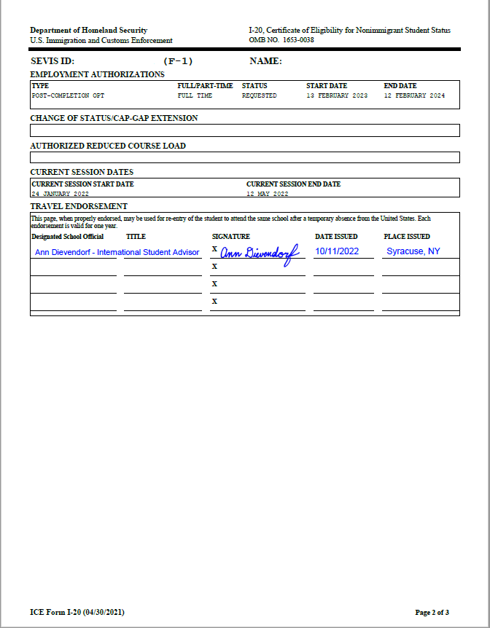
STEP 4: Prepare Documents for OPT Application (I-765)
You should print your I-20 from your ISSS Portal, sign and date it in ink, and then scan it.
You will upload this I-20 to your I-765 application.
Center for International Services

Slide 35
STEP 5: Creating your USCIS Account & Completing the I-765
Go to: https://myaccount.uscis.gov
Create an account (or log in to an existing account once you have established an account)
After you have created your account the first time, you will log in each time after with your email and password; the system will send you a pin that you will enter
You will do this each time you log in
Center for International Services

Slide 36
STEP 5: Completing the I-765
Once you have logged in, click on:
“File a form online” to begin your application process.
Center for International Services

Slide 37
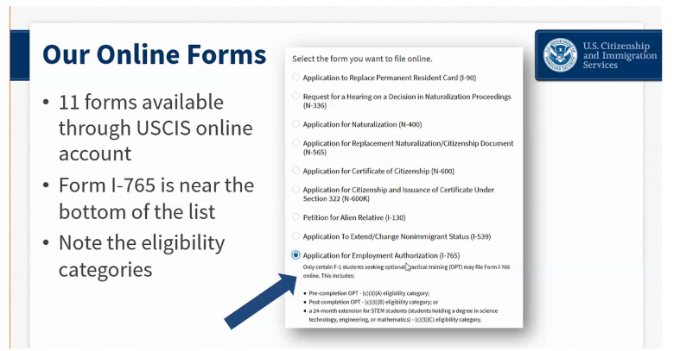
STEP 5: Completing the I-765
Select “I-765 Application for Employment Authorization” from the drop down list.
Center for International Services

Slide 38
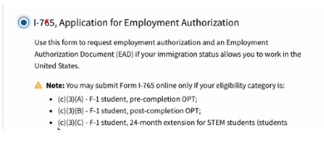
STEP 5: Completing the I-765
OPT applicants may file the I-765 Form online because you meet the eligibility category:
(c)(3)(B)
You do not apply under category
(c)(3)(c)
at this time because you are not applying for the STEM extension at this time.
Center for International Services

Slide 39
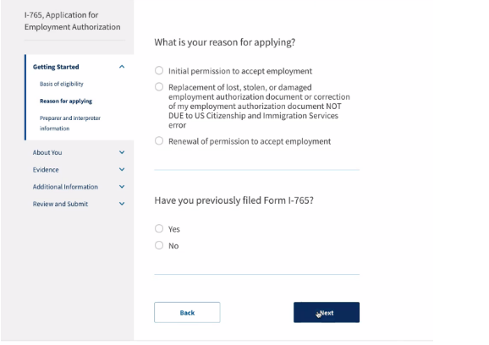
STEP 5: Completing the I-765
You should select “Initial permission to accept employment.”
If you have ever filed form I-765 before (even if it was denied), you should answer yes. You will give details about the previous application later in the form.
Center for International Services

Slide 40
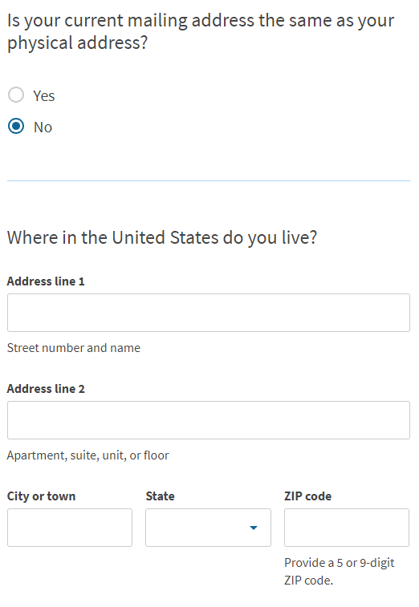
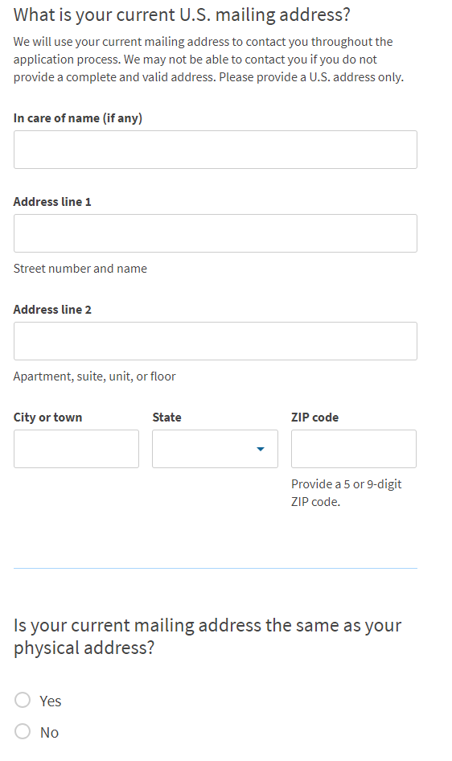
STEP 5: Completing the I-765
Mailing Address – the address your EAD card will be mailed to
If you will be moving - can be a friend or family member
Put friend or family member’s name in the “In Care of” box
If this is not your address, you will be asked to enter your physical address
Physical Address – the address you live at on the day you file your application
Center for International Services

Slide 41
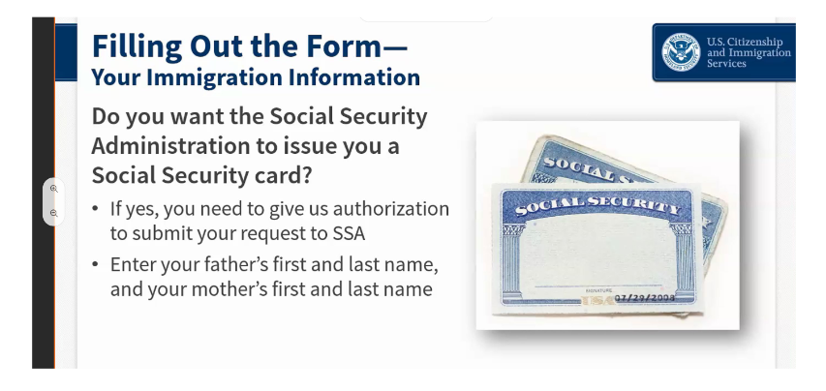
STEP 5: Completing the I-765
If you do not already have a social security number (SSN), you can apply for it at the same time as you apply for your EAD card.
Do NOT apply again if you already have an SSN.
If you have lost your card, you apply for a replacement card through a local SSA office.
Center for International Services

Slide 42
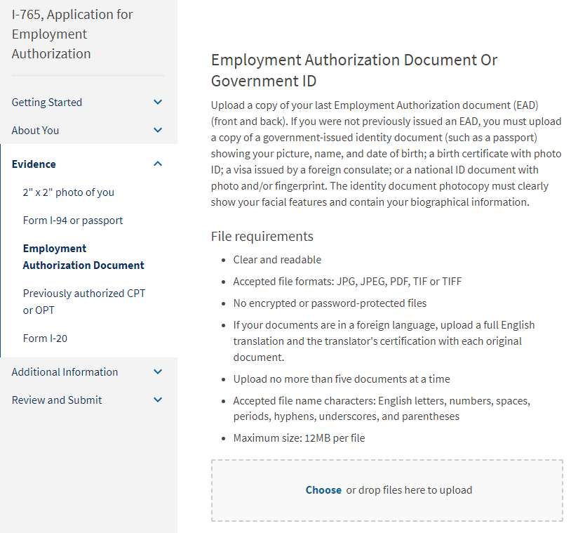
STEP 5: Completing the I-765
Upload the Required Documents:
2 x 2 Photo
Form I-94-USCIS does not require the Travel History
Employment Authorization Document or Government ID
Upload Passport and visa here
Previously Authorized CPT or OPT
Only upload I-20s that include CPT or OPT
Form I-20
Only upload signed OPT Recommendation I-20
Center for International Services

Slide 43
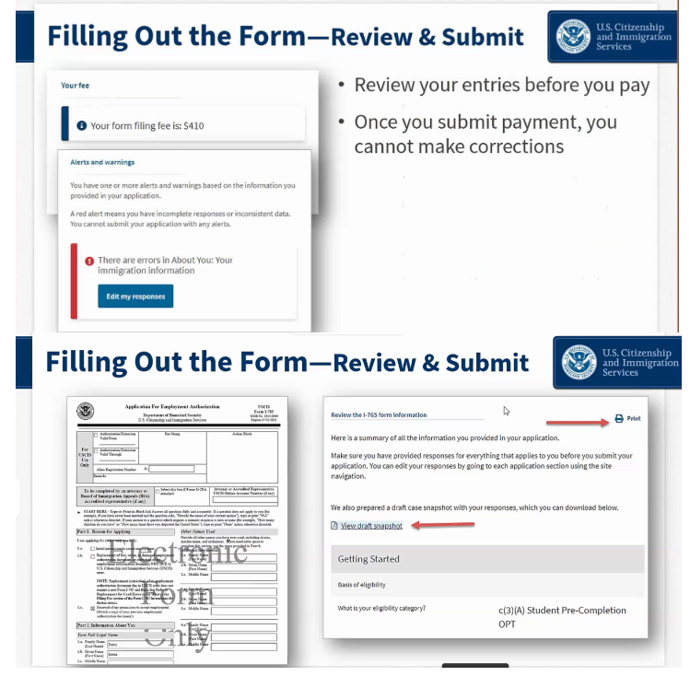
STEP 5: Completing the I-765
Before moving to payment, the application will check for errors and notify you if you need to edit your response.
It will NOT check your answers for accuracy – you must make sure that the data you provided in your application is correct. An “error” simply means you may have missed something on the application or formatted something incorrectly.
If an error is highlighted in red, it must be corrected before you can submit your application.
A “yellow” error calls your attention to something that may need correction. Review it to make sure your information is correct.
Most likely it is that you need to upload CPT I-20s but if you have none, you have nothing to upload
Center for International Services

Slide 44
STEP 6: Optional I-765 Review If you would like your I-765 reviewed by a CIS Advisor – DO NOT SUBMIT YOUR APPLICATION TO USCIS
SAVE a draft of your I-765
We will review your application for completeness, you need to review spelling, document numbers, etc.
Come to the Center for International Services during Advisor on Call hours for your application to be reviewed:
Monday – Friday from 11:00 am – 3:00 pm.
Center for International Services

Slide 45
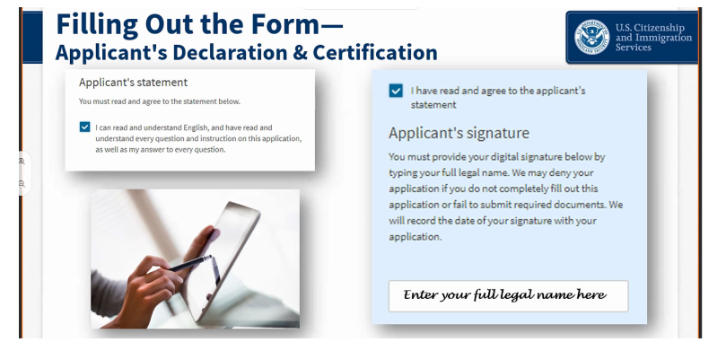
STEP 7: Submit and Pay
After review, log back in to your USCIS account and your saved I-765 application.
Complete a final review of your application.
Sign and submit the application.
You will be redirected to pay the application fee. It can be paid by credit or debit card.
Center for International Services

Slide 46
Changing Requested Dates of OPT
If you have not submitted your application to USCIS, you are not cancelling or withdrawing your application-you are changing your requested dates
the Center for International Services can cancel the OPT recommendation in your SEVIS record and reprocess an OPT Request
Submit a new request for OPT with the new requested dates in MySlice>ISSS Portal
Your application will go back in the queue and be processed in the order it was received-allow additional 3-5 days processing
If you really don’t know what OPT start date you want, you should wait to request your I-20 recommending OPT
Center for International Services

Slide 47
Cancelling or Withdrawing an OPT Application
In what circumstances might I think about cancelling or withdrawing my application?
You learn that you will not be graduating
You decide to continue for another degree
You decide to leave the U.S.
If any of these situations occur, please see an Advisor at the Center for International Services
Center for International Services

Slide 48
Cancelling or Withdrawing an OPT Application
If you have submitted your application to USCIS
it may or may not be possible to cancel or withdraw your application or changes your requested dates of OPT
you will not receive a refund of your filing fee
If USCIS has approved your OPT application
you cannot withdraw your application
you may use your OPT to work up to 20 hours per week while completing your degree
Center for International Services

Slide 49
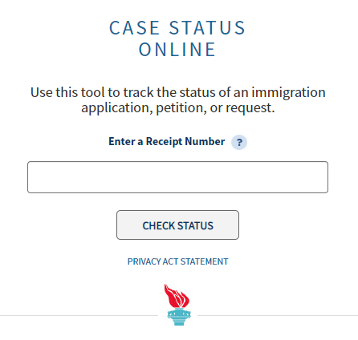
Checking the Status of your Pending Application
Once you receive your USCIS receipt number either electronically or by Form I-797 paper receipt notice:
Access the USCIS Case Status Search Page https://egov.uscis.gov/casestatus/landing.do
Enter your “IOE Application Receipt Number” (ex: IOE2390012345)
It will inform you if:
your application has been received
USCIS has requested further information for your application
Your application has been approved
Your EAD card has been mailed
Center for International Services

Slide 50
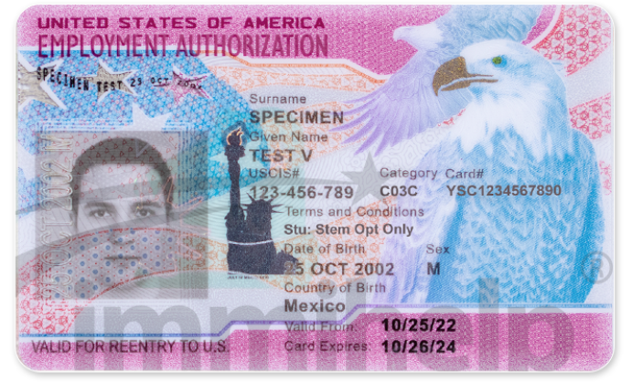
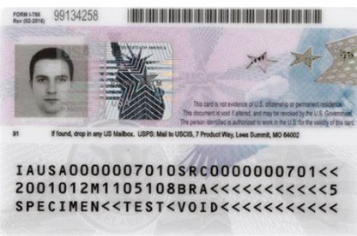
Employment Authorization Document (EAD)
USCIS work authorization is issued in the form of an Employment Authorization Document (EAD).
Center for International Services

Slide 51
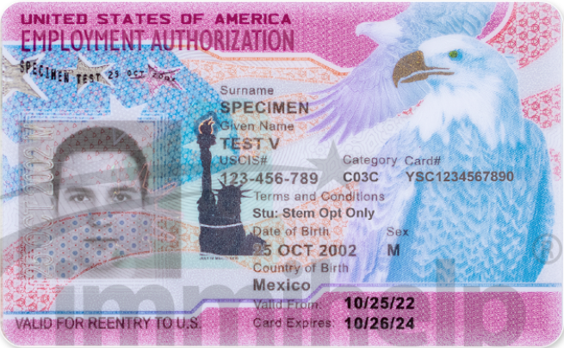
When Can I begin working?
In order to begin “working”:
You must have received your EAD card; AND
It must be the day of or after the EAD start date
Center for International Services

Slide 52
Do I have to be Employed during OPT?
“Employment” is required to maintain F-1 status while on OPT
You cannot accumulate more than 90 days (aggregate) of “unemployment” during initial OPT authorization period but you can accrue up to 90 days of unemployment.
Days of unemployment exist; unusual for a
student to not have days of unemploy-
ment unless they have a job with a fixed
start date before they apply for OPT;
could look suspicious to immigration for
a student to have 0 days of unemployment-life is not like that
Center for International Services

Slide 53
What is considered “Employment”?
To avoid accruing days of “unemployment” you must work at least 20 hours per week in your field.
It can be:
Paid employment
Unpaid employment: as a volunteer or unpaid intern as long as this practice does not violate labor laws (except STEM Extension)
Employment through an agency or consulting firm
Work for hire: individual performs services on a contractual basis instead of an employment basis-payment usually reported for tax purposes on a Form 1099
For multiple employers at the same time
For short-term multiple employers at different times
As a Self-employed business owner
Center for International Services

Slide 54
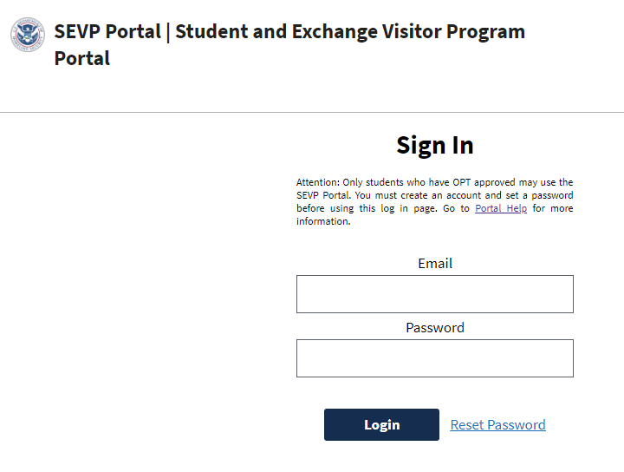
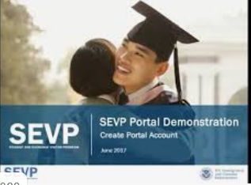
How Do I Report Employment While on OPT?
After your OPT start date is reached, you will receive an email from the Student Exchange Visitor Program (SEVP) instructing you to create an SEVP Portal Account.
You will use the SEVP Portal account to report any changes within 10 days of such changes to
Your Employer Information
name
address
starting date
ending date
Center for International Services

Slide 55
Other Reporting Requirements While on OPT?
You will also use the SEVP Portal to report changes to your:
U.S. address
Foreign Address
Telephone Number
Center for International Services

Slide 56
What if I Lose MY EAD Card?
If you have not begun working yet or will change employers, you will need to apply to USCIS for a Replacement EAD
Another I-765
Another photo
Copies of documents
Another Filing Fee
If you will continue to work for the same employer, you may not need to apply for a Replacement EAD
Center for International Services

Slide 57
Can I Travel Outside the U.S. While on OPT?
If Authorized for Pre-Completion OPT
Requirements are the same as travel while in F-1 status
Passport, valid F-1 visa, I-20 signed for Travel on Page 2 within last 12 months
If Authorized for Post-Completion OPT
Passport
Valid F-1 visa
I-20 signed for Travel on Page 2 within last 6 months
EAD card
Documentation of employment-letter of recent date, recent pay stub
Center for International Services

Slide 58
Can I Travel Outside the U.S. While my OPT is Pending?
Yes, if you are still enrolled as a full-time student
May graduates apply for OPT in February and travel during Spring break
December graduates apply for OPT in September and travel during Thanksgiving break
If you have already completed your program of study: Travel is not recommended.
No basis for readmission to the U.S.
No longer a student
OPT not yet approved
Regulatory language: Students approved for OPT may be readmitted to the U.S. to resume employment
Center for International Services

Slide 59
I-9s, Social Security and Taxes
I-9: All employees in the U.S. must complete an I-9 Employment Eligibility Verification Form with their employers within 3 days of starting employment.
E-verify: Some employers participate in an electronic verification of identity and employment eligibility; this is not yet required by law
Social Security: Employment in the U.S. requires a Social Security Number (SSN). If you do not have an SSN, you may apply for a SSN at the same time that you apply for OPT or once you receive your EAD
Taxes: See IRS Publication 519, US Tax Guide for Aliens.
Social Security and Medicare Taxes: Typically, non-resident F-1 students with authorized OPT are exempt from Social Security (F.I.C.A) and Medicare taxes as long as you continue to declare non-resident status for tax purposes.
Income Taxes: Federal, state, and local taxes will be withheld from your paycheck by employers unless you qualify for a tax treaty exemption. (More information also available at the IRS website)
Center for International Services

Slide 60
H-1B Status
The next usual employment status for F-1 students is H-1B status
H-1B status
temporary (maximum time period is 6 years) worker
in a specialty occupation (position requires the minimum of a Bachelor’s degree in a specific field)
Annual limit (cap) on the number of H-1Bs that can be approved:
65,000 for those with at least a Bachelor’s degree
an additional 20,000 for those with a U.S. Masters or higher degree
H-1Bs become available on October 1 of every year
Center for International Services

Slide 61
H-1B Status
The number of applications for H-1B status has exceeded the number of H-1Bs available every year for the last several years
Employers file an electronic registration to compete for an H number for a set time period beginning in March
Many people whose employers will register for an H will not get chosen in this “lottery” system-will not be eligible to file an H-1B petition
If not enough applications received, then more “lottery winners” are notified they can file. This year, many H-1B approvals were withdrawn because of layoffs/economic conditions and more H numbers became available during the year
Center for International Services

Slide 62
OPT Cap Gap and H-1Bs
If your registration is chosen and your employer files an H-1B petition for you, you may be eligible for a Cap Gap extension of your OPT
If your OPT expires before your H-1B can take effect on October 1, your OPT will be automatically extended to cover the gap in employment authorization between the end date of your OPT and the start of the H-1B on October 1
Center for International Services

Slide 63
Cap Gap and H-1Bs
H-1B petition must request a Change of Status
Cap Gap extension of OPT is not available to those whose:
H-1B is filed as Consular Notification-will apply for an H-1B visa abroad
OPT is valid until/past the date the H-1B change of status can take effect on October 1
H-1Bs are filed by exempt employers-universities and related research institutions
Extension of F-1 status and OPT work authorization are automatically terminated upon rejection, denial, or revocation of H-1B petition.
Center for International Services

Slide 64
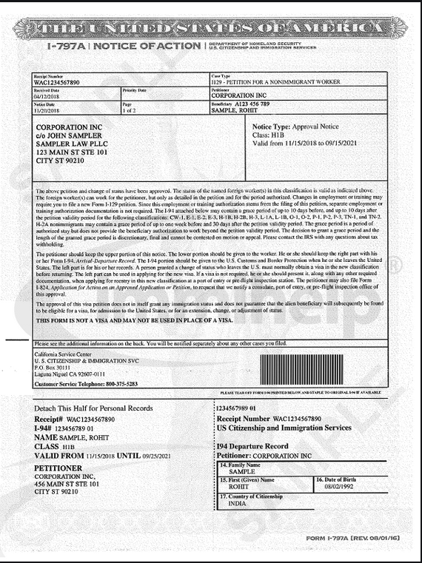
Cap Gap and H-1Bs
If you or your employer have not received
a receipt notice for an H-1B from USCIS,
then your SEVIS record is not likely to
have the cap gap applied to it and we
will not be able to produce an I-20 with
the cap gap.
Center for International Services

Slide 65
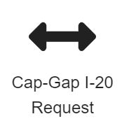
How D0 I Request a Cap Gap I-20?
After your employer has received the I-797 H1B receipt notice or approval notice
Log in to the International Student and Scholar (ISSS) Portal.
Go to the Student Request Center on the right side of the page.
Go to the Cap-Gap I-20 Request icon.
Complete the Questionnaire.
Upload your H-1B Application Receipt or Approval Notice.
Submit the Request.
Within 3-5 business days you should receive an email that your Cap-Gap I-20 has been processed and is available in the ISSS Portal.
Center for International Services

Slide 66
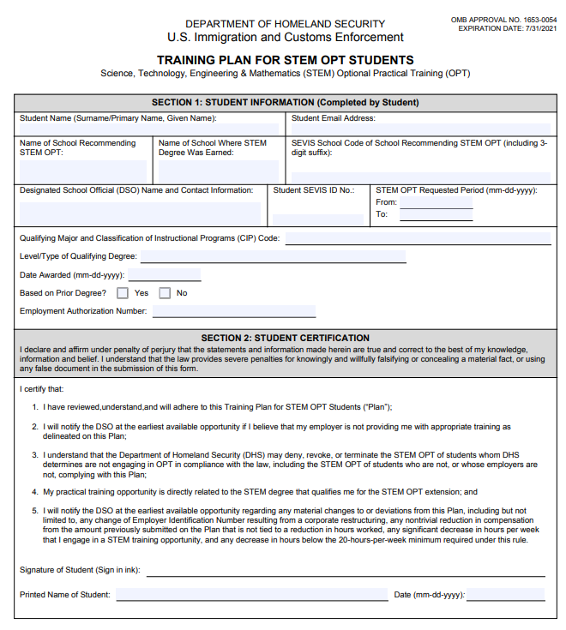
STEM Extension of OPT
Some F-1 students may be eligible to apply for an additional 24 months of STEM OPT.
The F-1 student must:
Have earned a degree in a STEM field
Be currently authorized for OPT
Work for an employer that:
participates in E-verify
is willing to complete a Form I-983: Training Plan that requires the employer to identify:
goals and objectives for work-based learning
oversight and supervision that will be provided to the student during the training
assessment and evaluation that will be undertaken
And the STEM Extension requires the employer to agree to increased reporting requirements and government site visits.
Center for International Services

Slide 67
STEM Extension of OPT
Submit a timely STEM extension application
USCIS must receive the STEM application prior to EAD expiration but no more than 90 days before OPT end date
Have maintained valid F-1 status
reported all changes of personal and employment info
have not accumulated more than 90 days of unemployment during OPT
Center for International Services

Slide 68
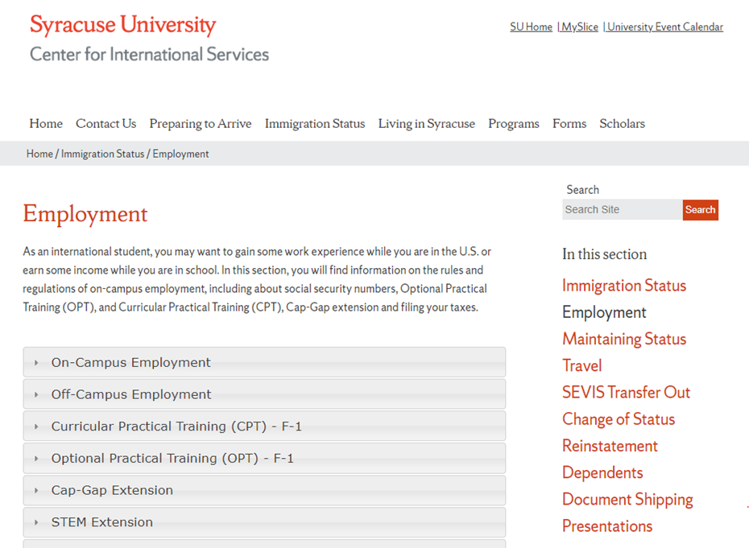
Application Process for STEM Extension of OPT
Similar to OPT
Request Recommendation from the Center for International Services on a new I-20 through the ISSS Portal in MySlice
Must submit copies of diploma, I-94, I-983 and EAD card
I-20 returned to you for you to submit with your application to USCIS
Approval by USCIS in the form of an EAD
Will need to look at the Center for International Services website to get up to date instructions
Center for International Services

Slide 69
STEM Extension of OPT
Cannot accrue a total of 150 days of unemployment over the 36 month OPT period
Reporting Requirements:
Must report the following within 10 days of the change:
legal name, residential or mailing address, email address, employer name, employer address
Must report above info to the Center for International Services every 6 months even if there is no change
Automatic extension of status and work authorization up to 180 days while a timely filed STEM extension OPT application is pending
Can still benefit from the cap-gap provision
Center for International Services

Slide 70
Immigration Status After F-1 Status
Tuesday, April 2, 2024
3:00 pm
Room 104, Peter Graham Room
Bird Library
Andrea Godfread Brown, Berardi Immigration Services
Watch for Fall 2024 dates in the CIS Newsletter!
Center for International Services

