Slide 1
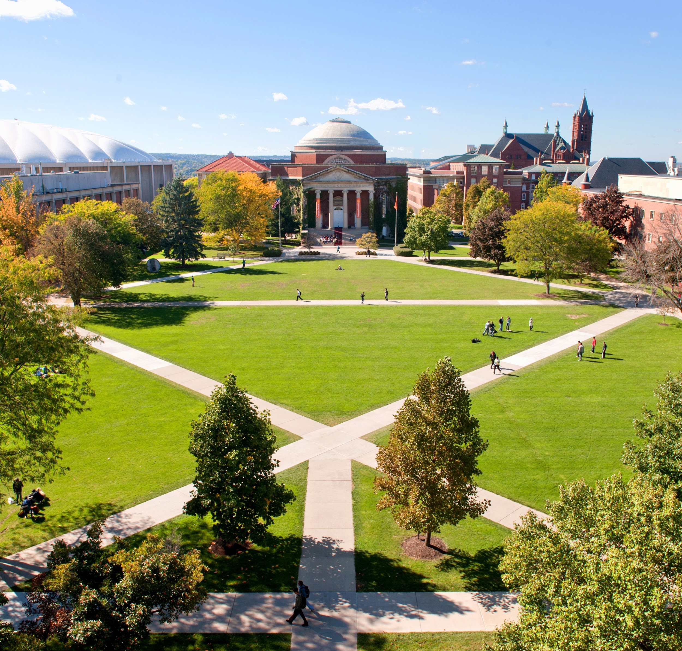
Syracuse Welcome!
Center for International Services

Slide 2
Resources & Tips for International Students
Center for International Services

Slide 3
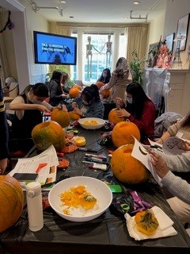
Services We Provide
Helping you prepare for arrival
Support in adjusting to Syracuse
Immigration paperwork and processing
Employment (CPT and OPT)
Maintaining requirements/status
Travel Signatures
Programs and Community Connections

Slide 4
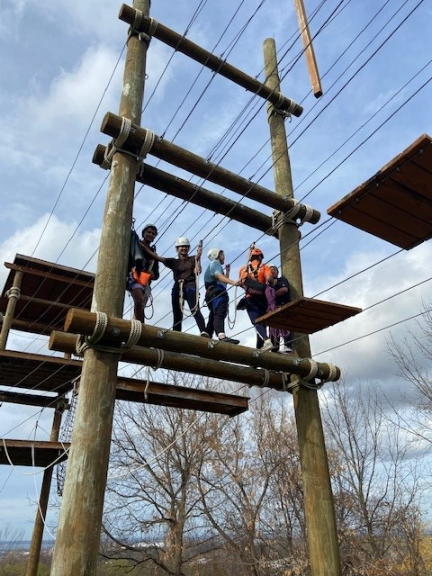
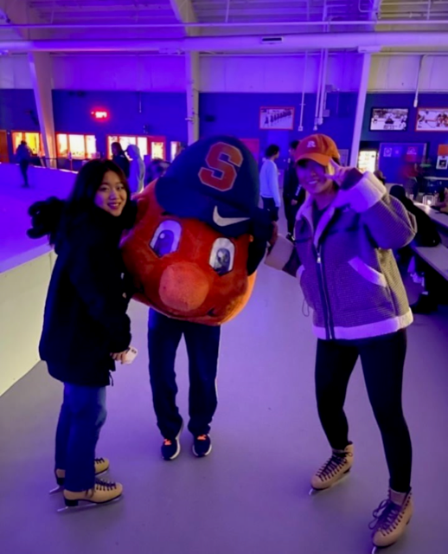
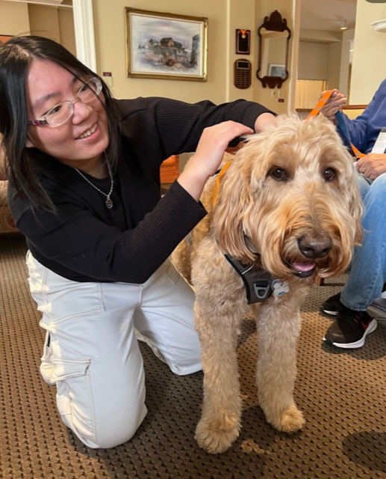
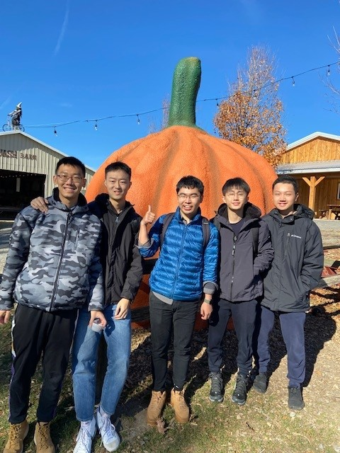
Signature Programs
Mix it Up
English Conversation Group
Intro to Upstate
Connections
International Thanksgiving
International Festival
International Festival Video
College 101

Slide 5
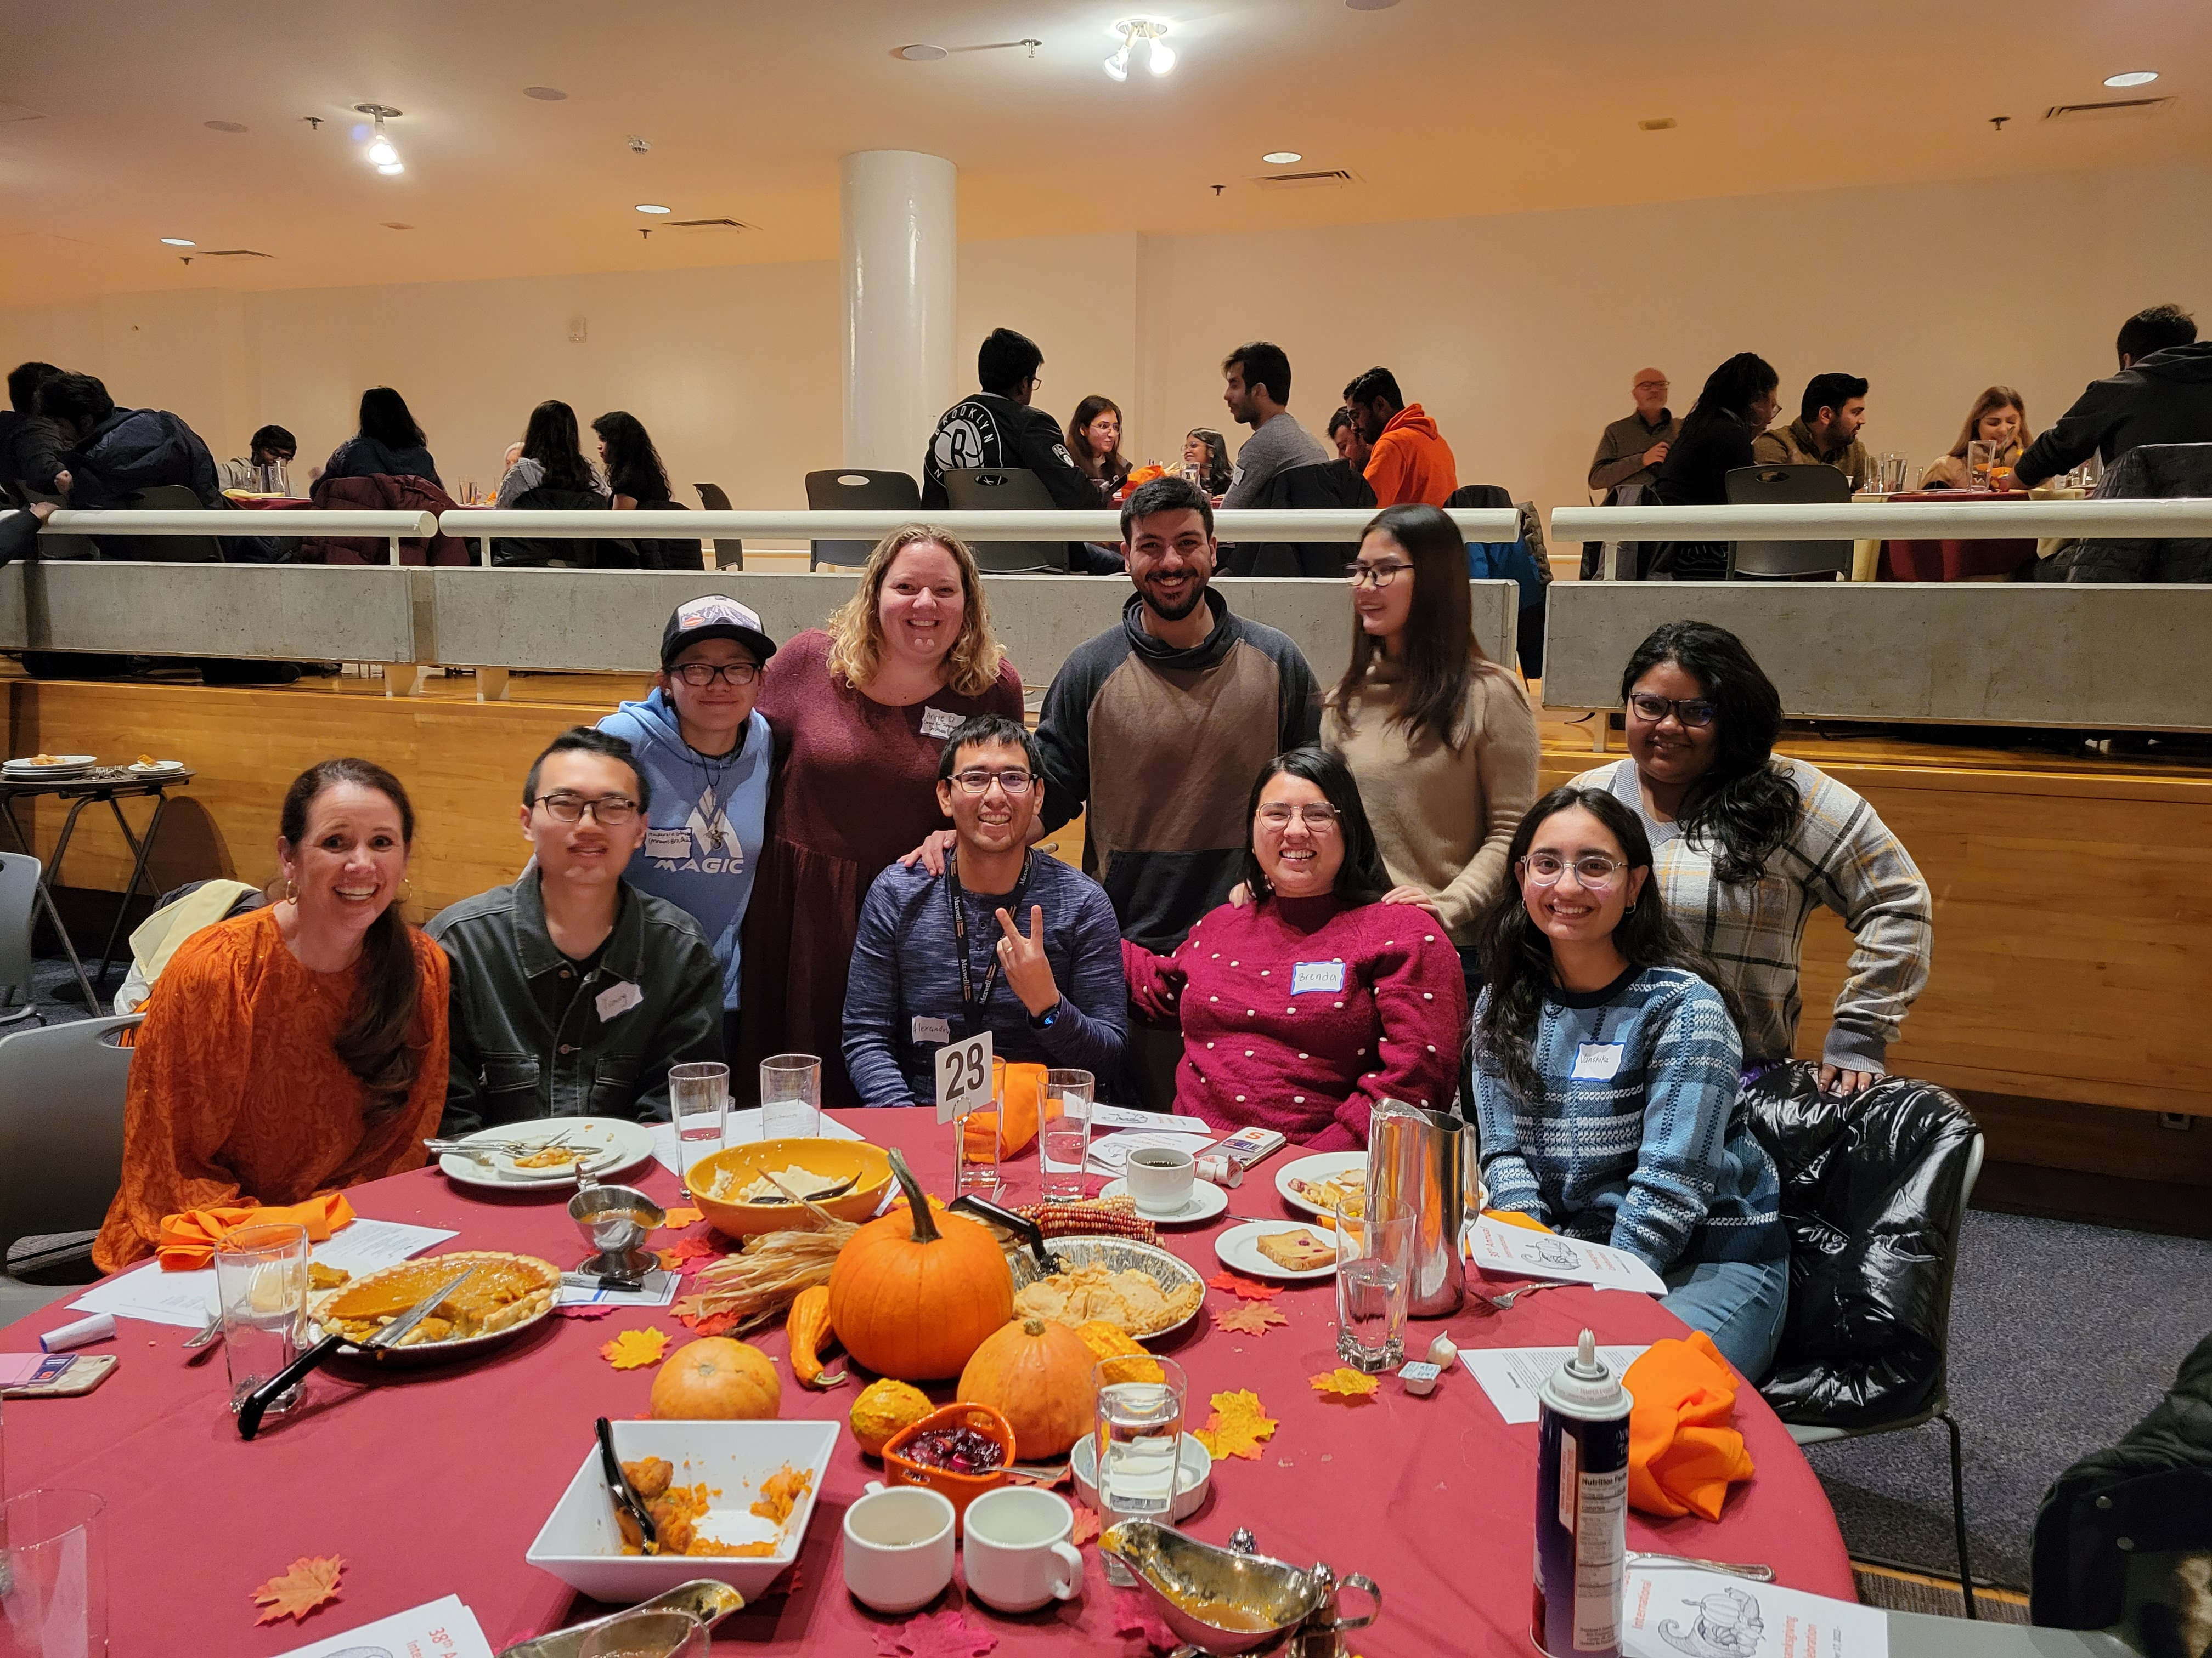
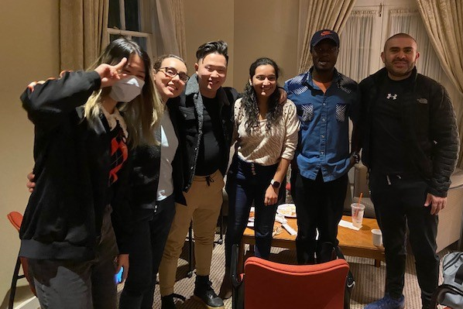
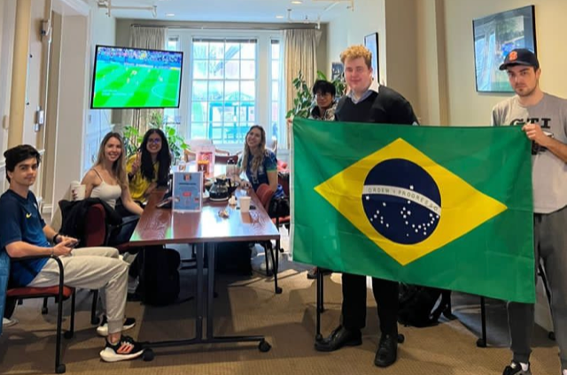
Programming Information
Website:
Center for International Services-Programs
Social Media:
Facebook @internationalsyracuse
Instagram @internationalcentersu
WeChat @syracuse_university
Center for International Services:
310 Walnut Place

Slide 6
Syracuse Welcome International Orientation
Orientation: Details will be shared on CIS website
Programs highlights:
1) 1/11 1- 5 pm, shopping trip to Walmart.
2) 1/12 guided campus tour, small groups, CIS Open house with Pizza and snacks.
3) 1/13 10:00 am, New Student Convocation and
brunch

Slide 7
General Information & Resources

Slide 8
Technology Resources
MySlice
Student Home:
Degree Works
Blackboard
Student Patient Portal
Wellness Portal
Handshake
SU Zoom Account
SU Email (netid@syr.edu)
Google Account (netid@g.syr.edu)
Microsoft Office 365
SU Events calendar
Notes:
Blackboard - professors may use in class for syllabus, readings, course content
Degree Works - helps students monitor progress toward degree completion

Slide 9
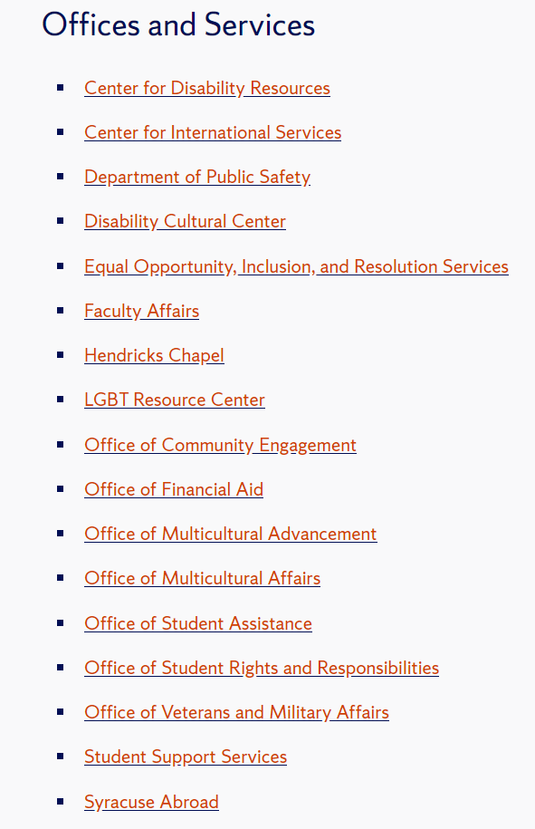

Slide 10
Some Main Services and Resources
Barnes Center at the Arch (ese.syr.edu/bewell)
Information Technology Services (ITS) (help@syr.edu)
Career Services
Graduate School
Bursar Office (bursar@syr.edu)
Housing, and ID Card Services
Parking and Transit Services
Library (library.syr.edu)
Bookstore (bookweb.syr.edu/)

Slide 11
Cell phones
Center for International Services

Slide 12
Why do you need a US phone number?
- Easy to communicate through text and call.
- Link to your email account, Amazon, Uber, MySlice, WhatsApp, etc.
- A lower rate compared to the international carrier rate.
- Driver’s license, bank account, etc.
It will be very inconvenient not to have one.

Slide 13
Which carrier should I select?
National: big 4
Other carriers
Mint Mobile
US Mobile
Google Fi
Metro
Cricket*
CTExcel*
att.com/prepaid/
t-mobile.com/
verizon.com/plans/
www.sprint.com/
AT&T
T-Mobile
Verizon
Sprint

Slide 14
What plans can I select?
 | Prepaid | Contract | Pay-as-you-go
Pros | Control what you spend each month Cancel anytime by stop paying No Credit check | Obtain a huge discount on cell phones Offer family plans (usually 4 people) which are the cheapest if you use a lot of data each month Usually offer international services | Very cheap upfront cost Can stop any time
Cons | Usually data cost is expensive | Credit check required 2-year commitment for most carriers. Inflexible to pause or cancel while not using More expensive and hidden fees | Usually for phones can only texts and calls (no internets)

Slide 15
Is there any chance I can save money?
Family Plan (T-Mobile Simply Prepaid 4 lines for $100, and many other choices)
Cell Phone Plan + Apartment Internet Plan
Consider data usage (You may stay at home or on campus where have Wi-Fi all around)
Study your latest bill to determine if you're being billed for any unnecessary features
Be smart to downgrade some features

Slide 16
Banks
Center for International Services

Slide 17
Why you need a US bank account?
- Send money to friends when you need to split the bill
- Deposit / withdraw money easily
- Set up daily payment (rent, utility payment, etc.)

Slide 18
How to open a bank account? Which account should I open?
- Call the bank and make an appointment (call or in person)
- Bring all the documents with you (passport, F1 visa, I-20, etc.)
- Choose the account(s) to open
- Set up bank mobile app/online platform and activate your account

Slide 19
Account Type
Checking account
Saving account
A bank account you can write checks from, or access several other ways, which tends to make it your go-to, daily transaction bank account.
(The money you can withdraw from the debit card)
Where you stash funds that you aren't ready to use yet, often with the goal of accumulating more. (If you lost your debit card, the money in the saving account will be safe.
You can transfer money to checking account. But there will be some extra fee or restrictions for the saving account)

Slide 20
Which bank is better (for SU students)?
- Chase: large bank, location near main campus, better service.
- M&T Bank
- Bank of America: large bank, located near South Campus (or downtown), better deal for open a credit card.
- KeyBank
- NBT Bank
(Not so famous than the above mentioned)

Slide 21
Social Security Number (SSN)
- You can get an SSN once you have an on-campus job.
- You need an SSN to open most credit cards.
- An SSN is important everywhere. (Apply for government relief, rent an apartment, credit cards, DL, Direct Deposit etc.)
Instructions on how to apply for SSN

Slide 22
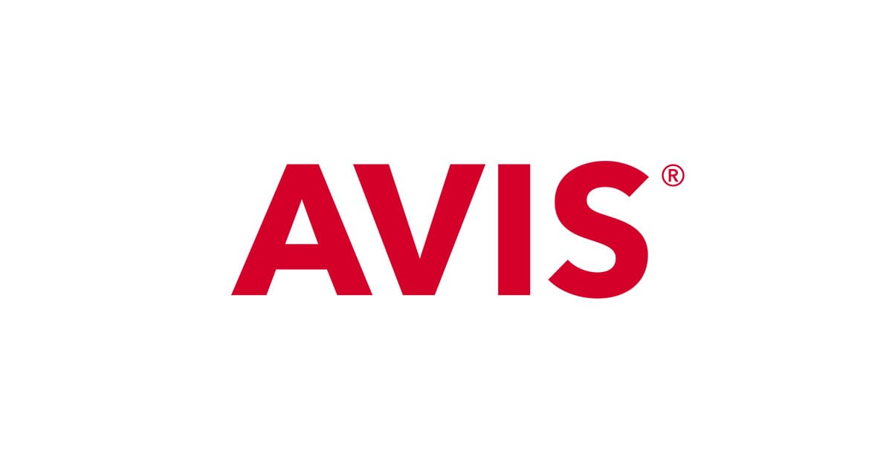
Why credit card is important? How to save money from credit card?
Build Credit Record for future
Credit card provides better protection against fraudulent.
Credit cards may have more deals which you need to explore by yourself.
Needed to book rental cars:

Slide 23
Explore Syracuse!
Center for International Services

Slide 24
Where to eat
Dosa Grill (Indian)
Syracuse Halal Gyro (Halal)
Margaritas Mexican Cantina
New Century (Vietnamese)
Gangnam Style Korean Kitchen (Korean)
Chuan Taste (Chinese)
Bleu Monkey (Japanese)
Secret Garden (Korean and Japanese)
Royal Indian Grill (Indian)
Dinosaur Bar-B-Que (American BBQ)
Texas de Brazil (Brazilian Steakhouse)
The Cheesecake Factory (American)
The Fish Friar (American Seafood)

Slide 25
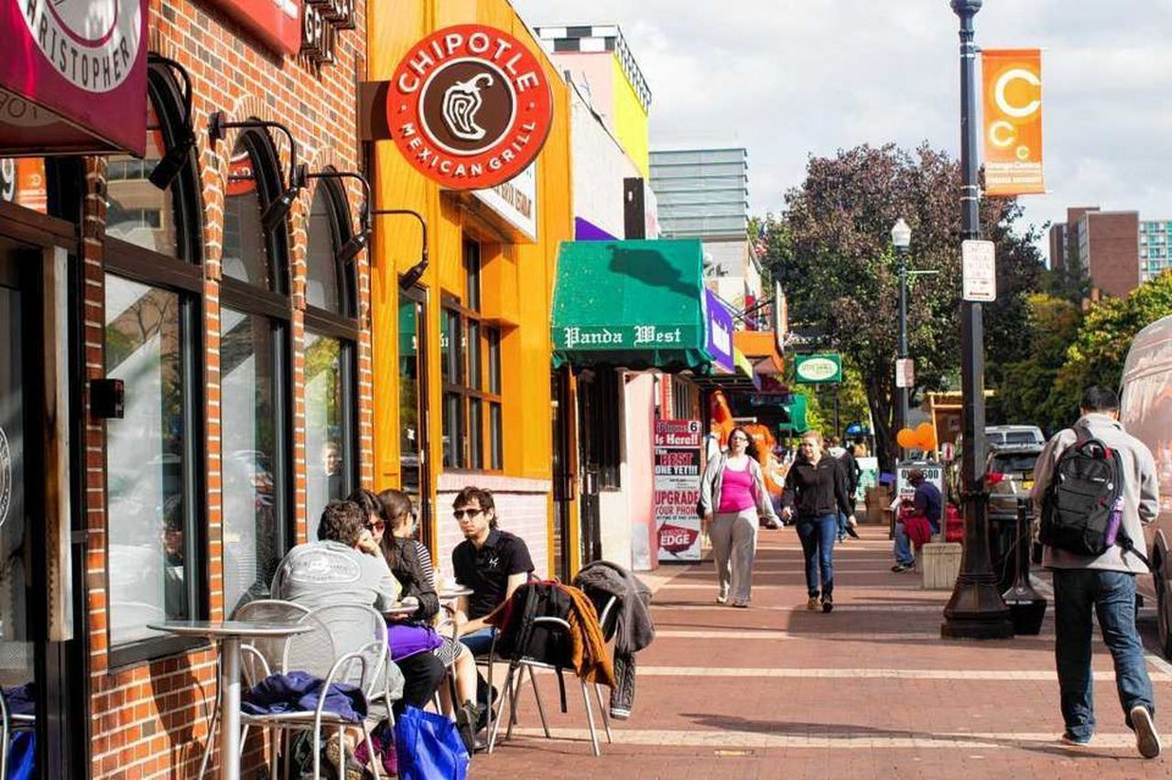
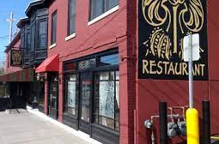
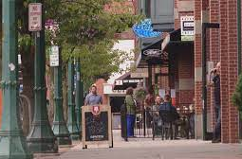
Where to eat
Marshall St
Near Campus
Downtown area
Bleu Monkey
Varsity Pizza
Five Guys
Chipotle
Popeye’s
Lulu Hotpot
XO Taco
Strong heart café (vegan)
Phoebe’s Restaurant & Coffee Lounge
Pastabilities
Dinosaur BBQ
Funk’n Waffles
Apizza Regionale

Slide 26
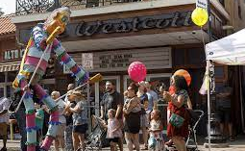
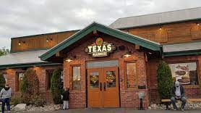
Where to eat
Westcott St
Destiny Mall
Erie Boulevard
Gangnam Style
Rise N Shine Diner
Syracuse Halal Gyro
Alto Cinco
Texas de Brazil
Cheesecake Factory
PF Changs
Texas Roadhouse
Storming crab
Thai Thai
Red Chili
Use application like Grubhub and Uber Eats for delivery service.

Slide 27
Where to go shopping
Destiny USA: 6th Largest Shopping Mall in the US
Regional market
India Bazaar
Costco/Walmart/Target/Wegmans/ PriceRite: Daily Shopping for food, drinks. – Provides grocery delivery
Trader Joe’s
Asian Food Market
Han's Oriental Grocery (Korean food)

Slide 28
Where to travel
In Syracuse
Around Syracuse
Green Lakes State Park
Clark Reservation State Park
Rosamond Gifford Zoo
Everson Museum of Art
Onondaga Lake Park
Oswego
Fair Haven
Cazenovia
Sodus Point
Finger Lakes
Skaneateles
Ithaca
Chittenango Falls
Watkins Glen State Park
https://www.iloveny.com/
(great resource)

Slide 29
Where to travel
Green Lakes State Park
Skaneateles

Slide 30
Hotel Near Campus (For your friends & family in the future)
Sheraton Syracuse University Hotel & Conference Center
Hotel Skyler Syracuse, Tapestry Collection by Hilton
Crowne Plaza Syracuse
Marriott Syracuse Downtown
Courtyard by Marriott Syracuse Downtown at Armory Square
Residence Inn by Marriott Syracuse Downtown at Armory Square
Quality Inn & Suites Downtown
Embassy Suites by Hilton Syracuse Destiny USA
Holiday Inn Express & Suites Dewitt

Slide 31
Transportation in Syracuse
Uber/Lyft can be great (but not always the cheapest way)
Centro Bus for free in restricted area (https://www.syracuse.edu/about/campus-shuttle/)
Regional Transportation Center for Buses (Greyhound) and Trains (Amtrak)
Syracuse Hancock International Airport (SYR)
Veo rides

Slide 32
Prepping for Winter

Slide 33
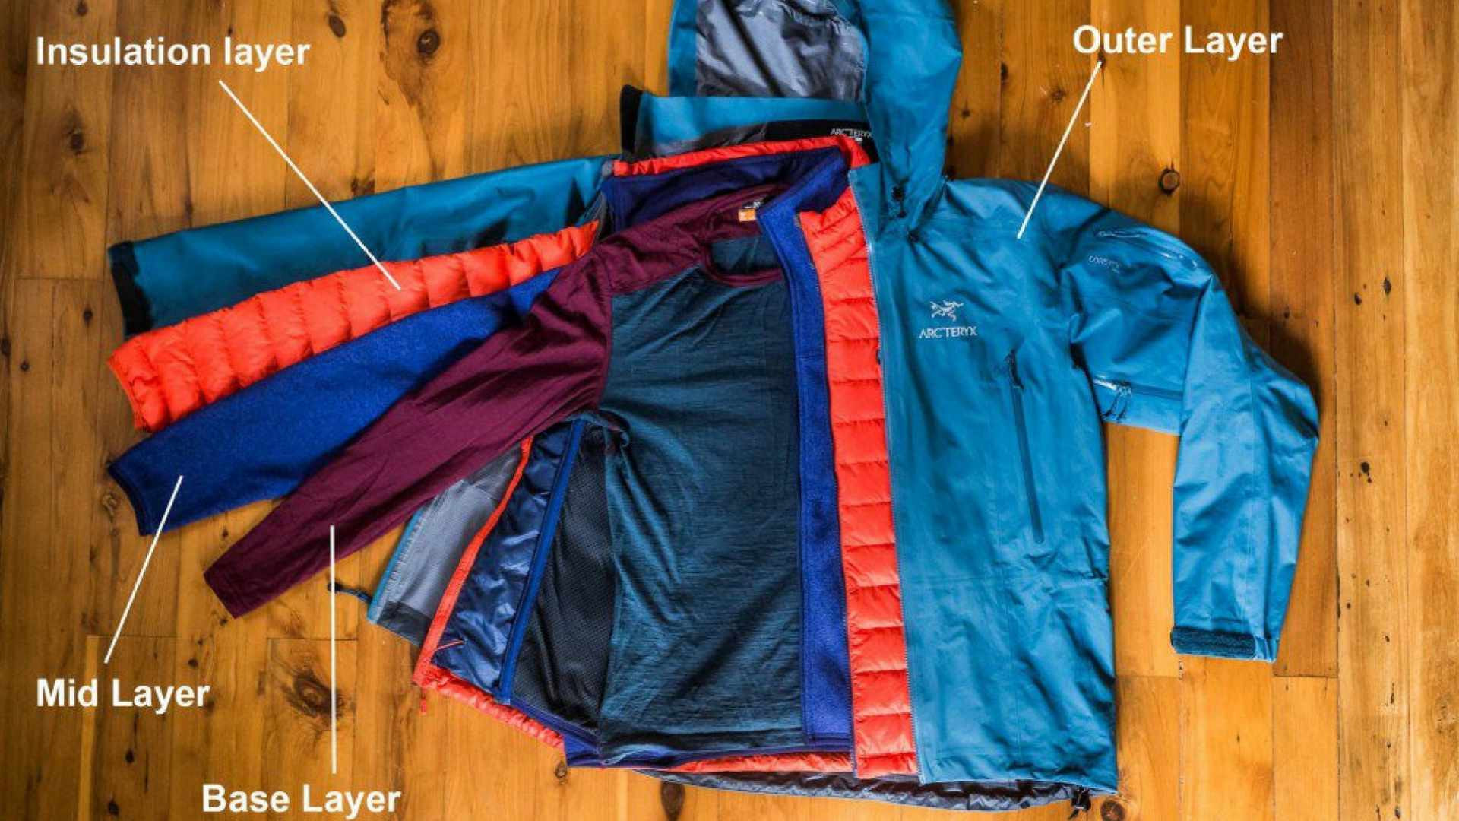
Layer Layer Layer!
Boots with thermal insulation, waterproof and deep threads
Winter socks
Winter coats/Jackets
Thermals as inners
Gloves – good quality and waterproof
Accessories as required – earmuffs, scarves, beanies, shades
Notes:
Shades required during the day due to high glare on the snow

Slide 34
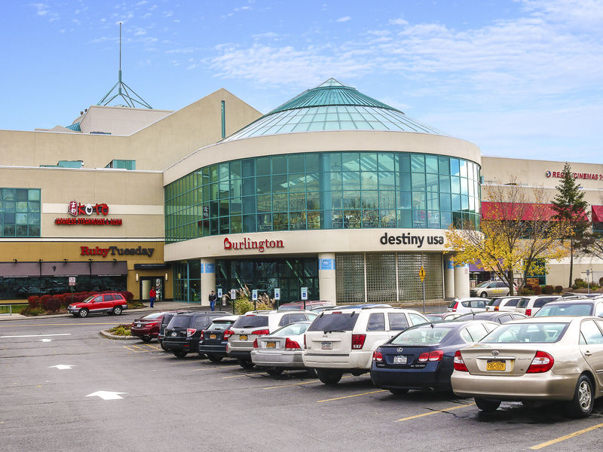
Shopping Trips
Student Association often organizes free shopping trip on weekend to Target, Wegmans and Walmart. Details can be found here when they update it.
Recommended stores for winter wear:
Macy’s
TJ Maxx
Burlington
DSG
Nordstorm Rack

Slide 35
Graduate Student Resources
Graduate School

Slide 36
Writing Center / Graduate Editing Center
Writing Center (grad students and undergrads)
One-on-one consultations, either in person or online (synchronous or asynchronous)
Can help with interpreting assignments, developing ideas, structure and organization, conventions of academic writing
Graduate Editing Center (grads only)
free editing and proofreading services
submit papers in advance; turnaround time varies
if work is for a course, must inform instructor
Make appointments online: https://syr.mywconline.com

Slide 37
Subject Librarians
Library staff can help you ...
Understand how graduate-level research in your field is conducted
Identify and use the library resources most relevant to your topic or project
Offer helpful Research Guides for your discipline
Saves you so much time getting started with your research
Find your Subject Librarian: https://library.syr.edu/staff/subjects/php

Slide 38
Graduate Student Organization (GSO)
https://gradorg.syr.edu
Advocates for grad student needs and interests at the University
Provides travel grants for grad students
Sponsors Recognized Student Organizations covering a wide range of grad student interests
Helps fund Student Legal Services, so free legal advice is available to you
Offers regular social events (e.g., Fall Picnic) and supports the Inn Complete (grad student hangout on South Campus)

Slide 39
Graduate School Professional and Career Development
One-on-one career and job-search advising by appointment (https://syr.joinhandshake.com/login)
Future Professoriate Program (FPP) for aspiring faculty
TA Program helps grad students develop as teachers
one-on-one English Conversation Partner service
Support for dissertation writers (summer dissertation fellowships, Dissertation Boot Camp, and more)
Career and professional development programming throughout the year

