Slide 1
Spring 2024 Immigration Essentials Part 1
Center for International Services

Slide 2
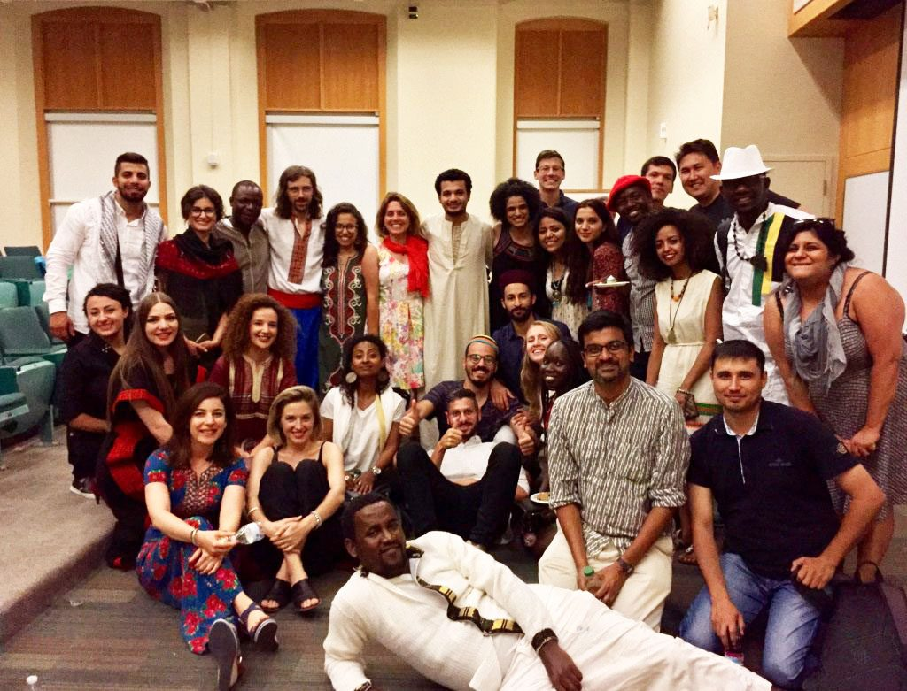
International Student Population at SU
Fall 2023
Total Student Enrollment: 22,948
Total International Students: 4,163
Undergraduate Student Enrollment: 15,739
International Undergraduate Students: 1,784
Graduate & Law Student Enrollment: 7,209
International Graduate & Law Students: 2,379
CPT Applications Processed: 553
2023
OPT Applications Processed: 714
STEM OPT Applications Processed: 188
Center for International Services

Slide 3
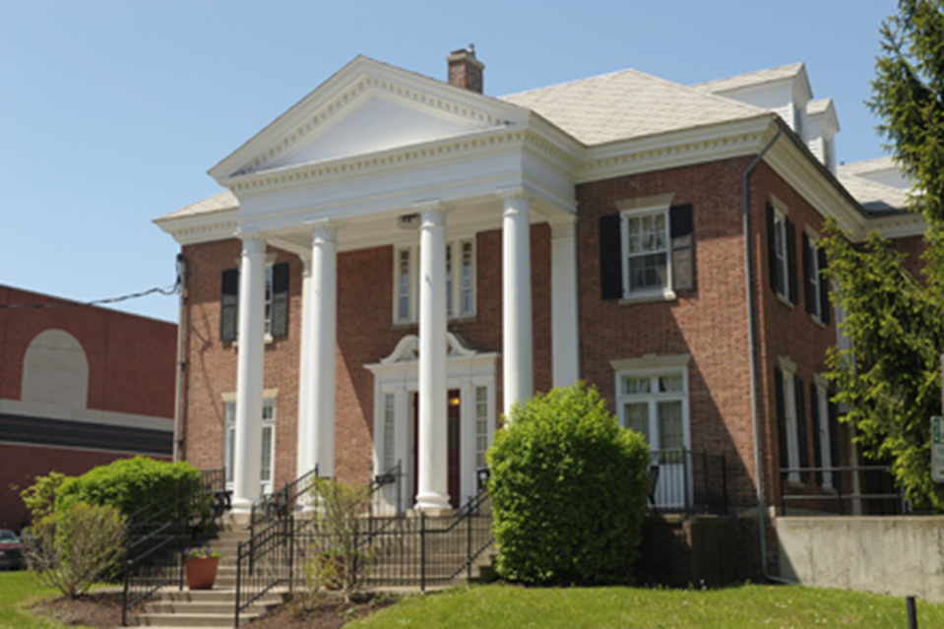
Center for International Services
310 Walnut Place
corner of Walnut Place and Waverly Avenue
across the street from Bird Library and Schine Student Center
Hours:
Monday-Friday
8:30 am - 5:00 pm
Summer: 8:00 am - 4:30 pm
Phone: 315-443-2457
Email: international@syr.edu
Website: https://experience.syracuse.edu/international
Center for International Services

Slide 4
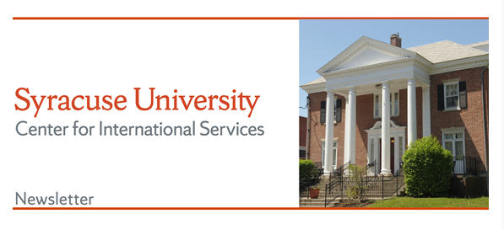
Center for International Services Continued
Advisor on Call:
Monday-Friday, 11 am-3 pm
In person, By Phone, via Zoom, Teams, or Skype
Informational Seminars:
Curricular and Optional Practical Training
1st & 3rd Wednesday, 2nd Friday every month
Newsletter –every other week
CPT
Center for International Services

Slide 5
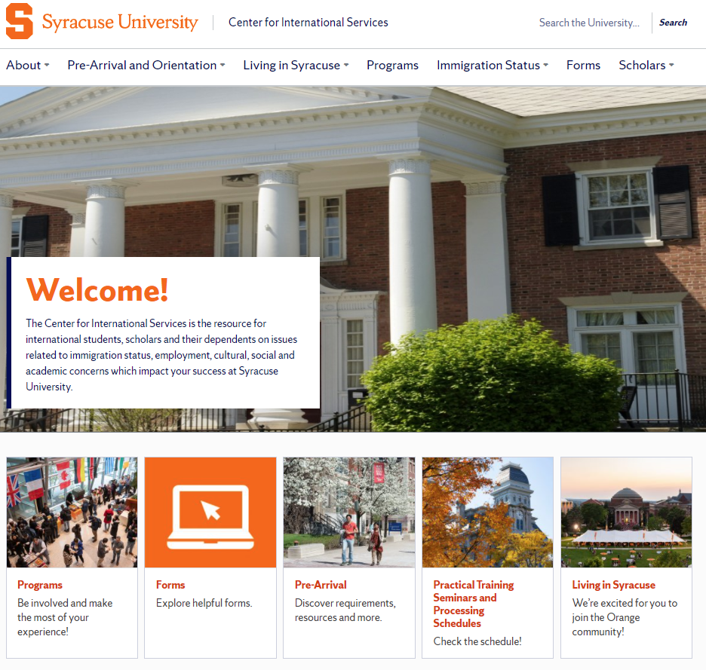
https://experience.syracuse.edu/international/
Center for International Services

Slide 6
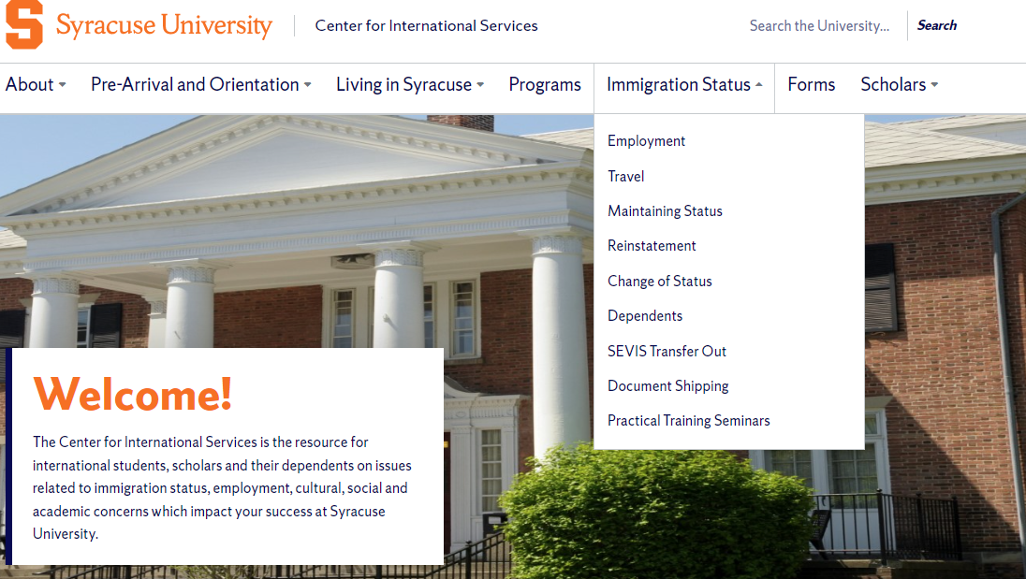
https://experience.syracuse.edu/international/
Center for International Services

Slide 7
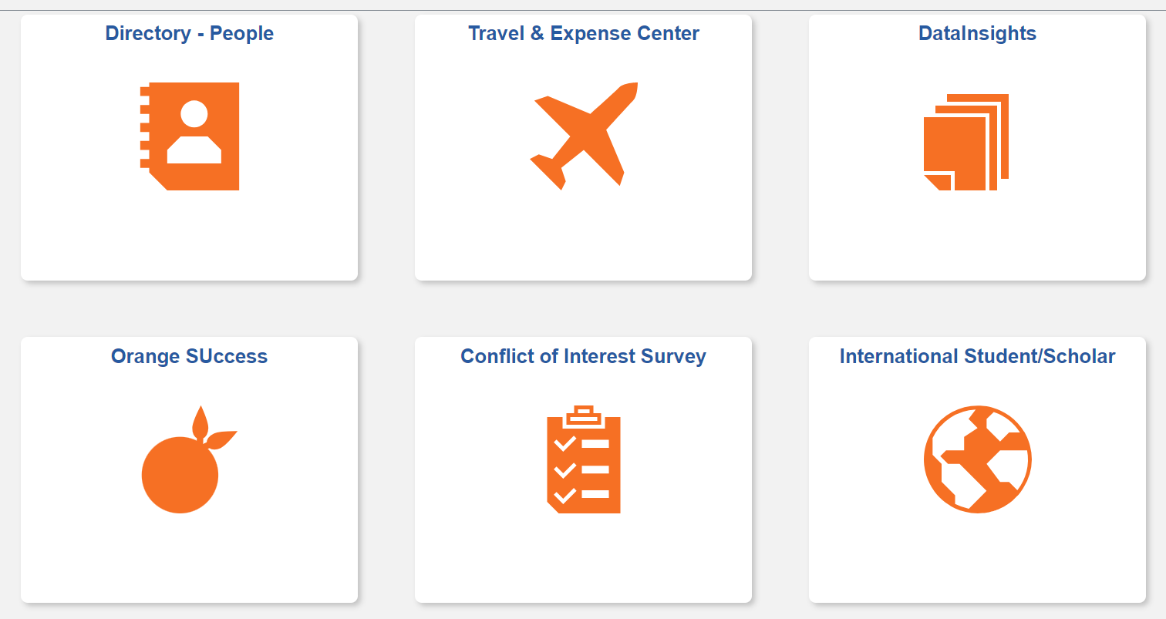
Requests will be done in MySlice
Center for International Services

Slide 8
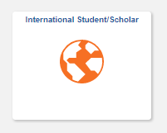
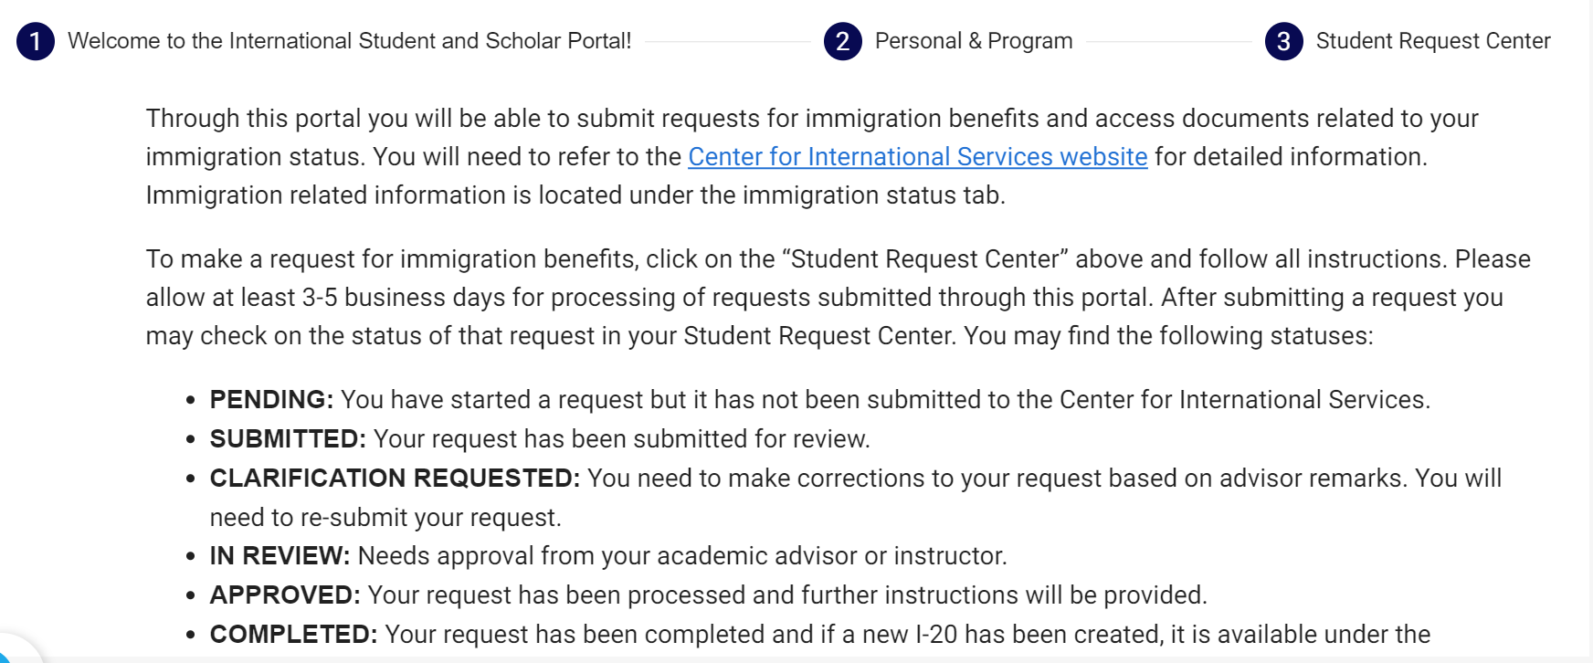
Through My Slice
Use the My Slice ISSS tile for most requests
Center for International Services

Slide 9
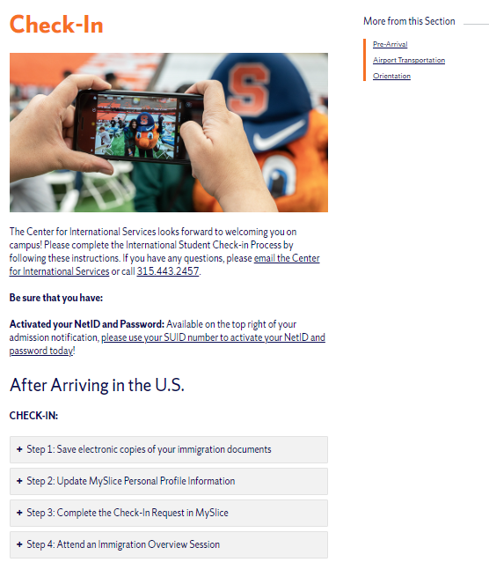
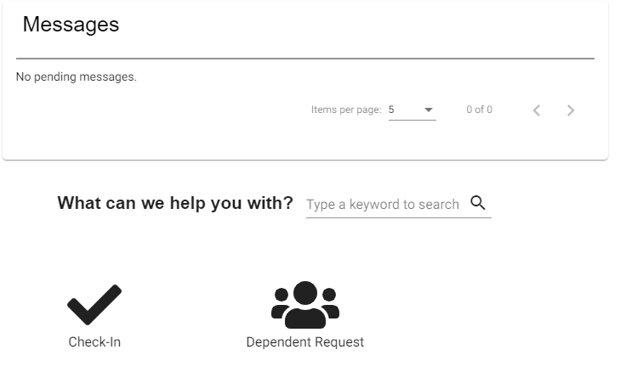
Center for International Services Check-In
Center for International Services

Slide 10
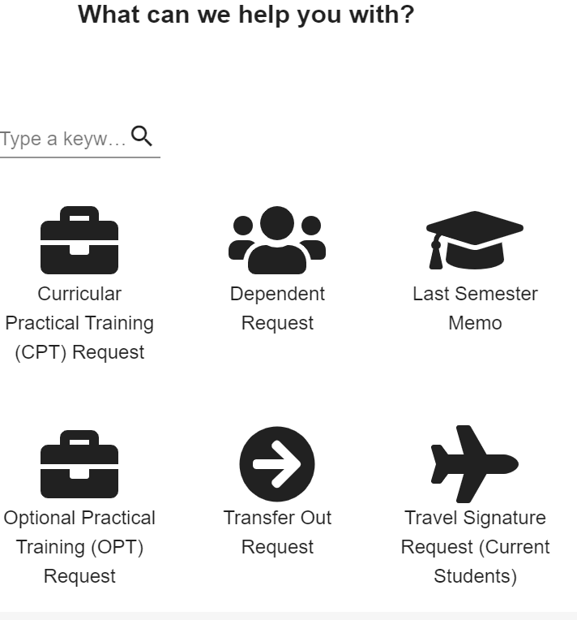
Student Request Center
Center for International Services

Slide 11
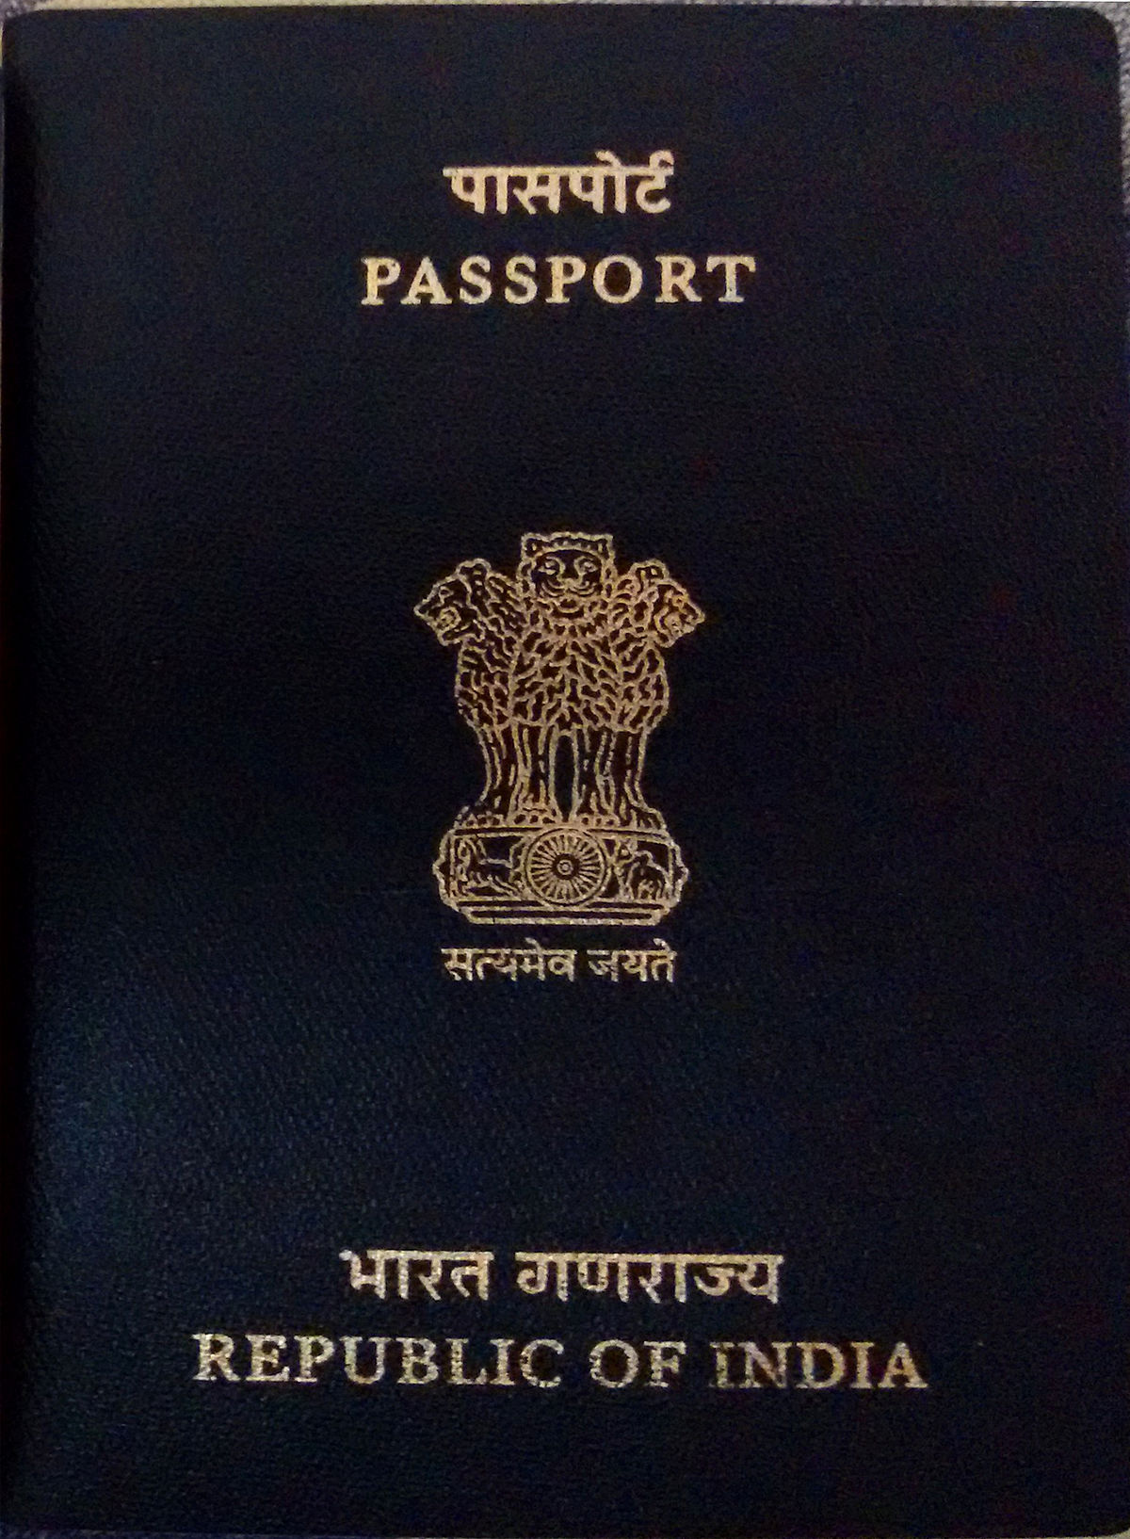
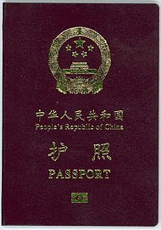
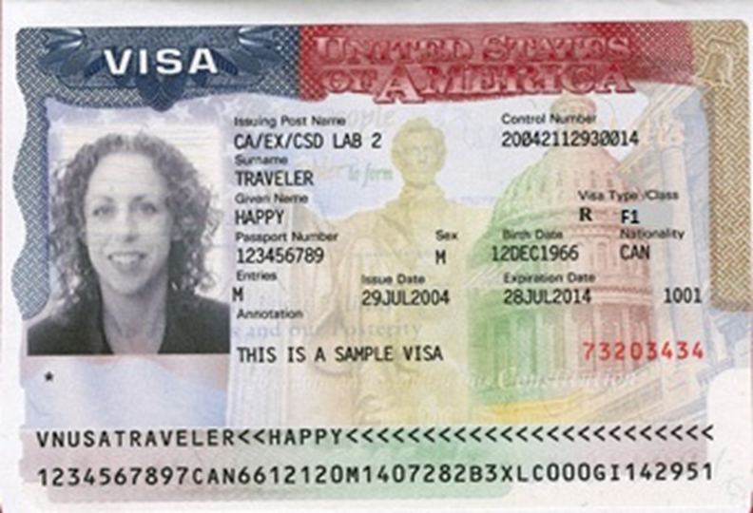
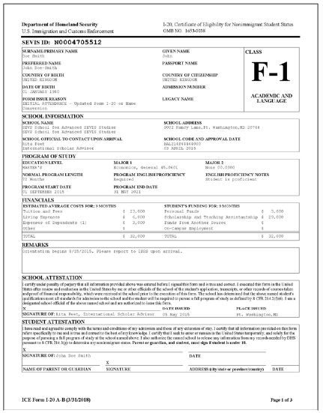
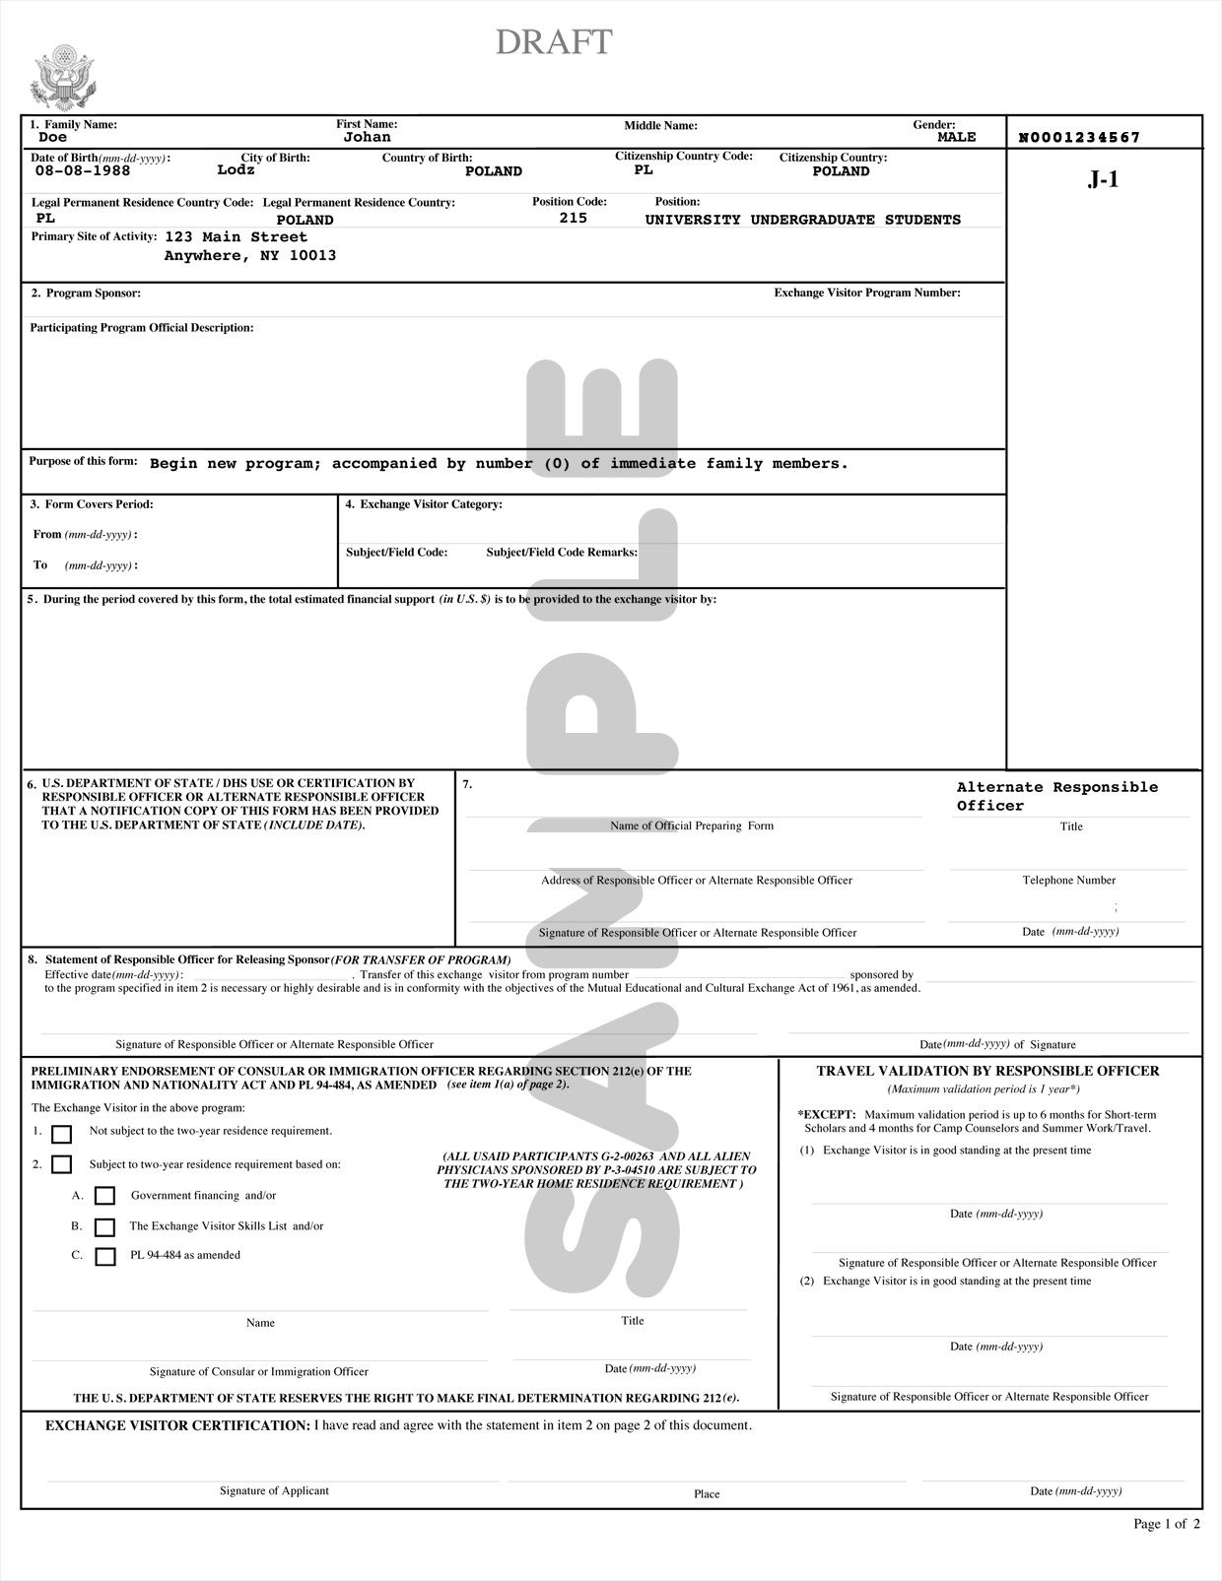
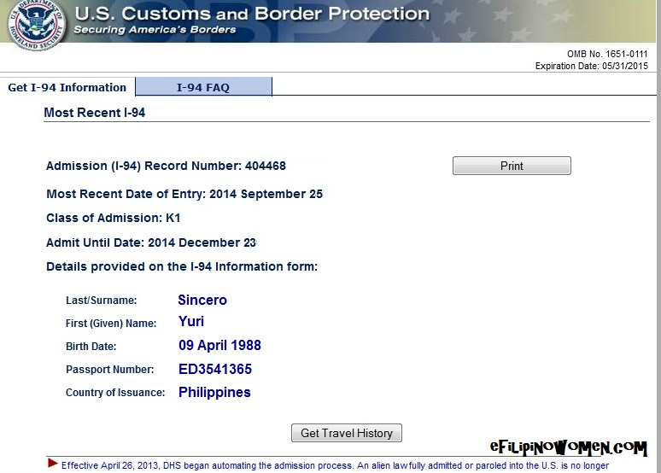
Tour of Documents
Center for International Services

Slide 12
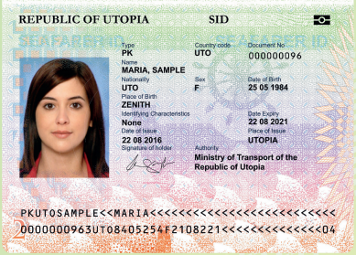
Passport
Know your passport expiration date
Your passport needs to be valid for at least 6 months into the future when entering the U.S.
Replace at your Consulate in New York City or Embassy in Washington, DC
Center for International Services

Slide 13
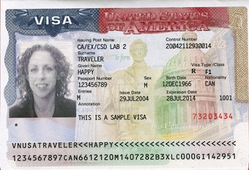
Visa
Know expiration date and Number of entries
Needs to be valid when entering the U.S.
Number of entries and length determined by diplomatic agreements
Usually annotated with SEVIS Number
Usually annotated with school Name
Can only be renewed at a U.S. Embassy or Consulate-all located outside the U.S.
Visa cannot be renewed inside the U.S.
Can expire while in the U.S.
Center for International Services

Slide 14
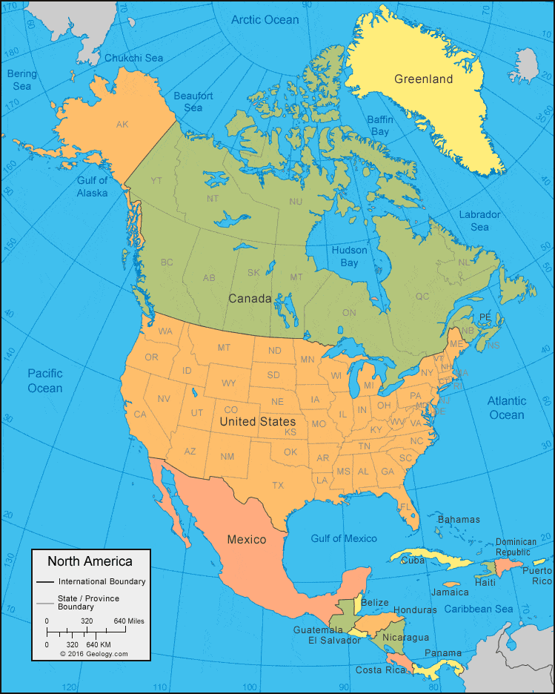
Travel
Visa needs to be valid to enter the U.S.
Exception:
Returning to the U.S. after a trip to Canada, Mexico, or the adjacent islands
Trip of less than 30 days
Trip solely to Canada, Mexico, or the adjacent islands
Cannot apply for U.S. Visa while there
Not a citizen of Iran, Syria, Sudan, or North Korea
But need to determine if you need a visa to travel to other countries
Center for International Services

Slide 15
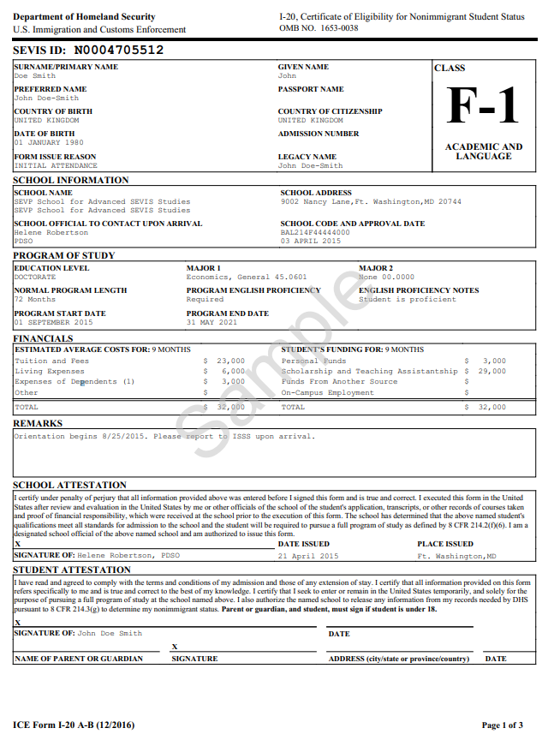
I-20
Immigration Selfie-tells your story
Issued by Syracuse University
Biographic Information about you
Degree Level
Program of Study
Program Start and End Date
Financial Information
Center for International Services

Slide 16
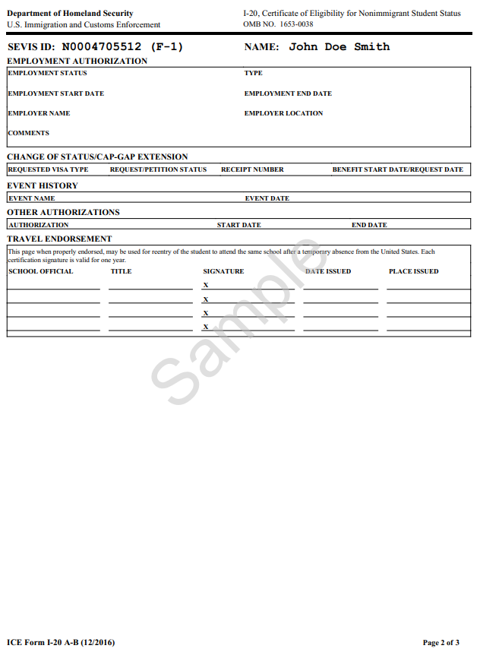
I-20 - Page 2
Employment Authorizations
Travel Endorsement
Travel Signatures-valid for one year/12 months
Advisor on Call, Monday – Friday, 11 am – 3 pm
Through MySlice ISSS Portal
Express Travel Signatures Spring Break-March 10-17
Ann Dievendorf International Student Advisor 07/30/2021 Syracuse,NY
Travel Signatures Thursday & Friday
February 15 & 16
9am-4 pm 310 Walnut Place
Center for International Services

Slide 17
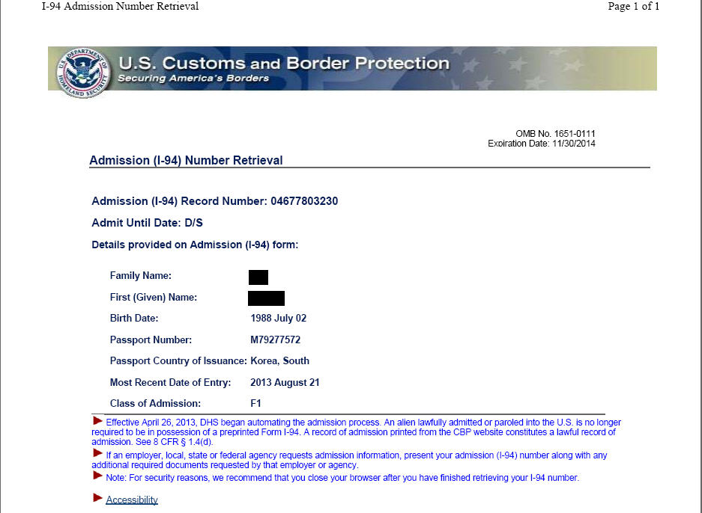
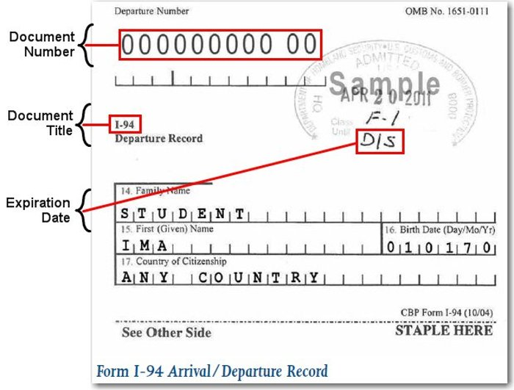
I-94 Arrival Record/Travel History
www.cbp.gov/I-94
Updated every time you travel out of the U.S. and enter
Check every time to be sure you were admitted to the US in F-1 status and for D/S
D/S = Duration of Status
Program End Date + 60 days
to prepare to depart or change status
Center for International Services

