Slide 1
Fall 2023
Immigration Essentials
Part 1
Center for International Services

Slide 2
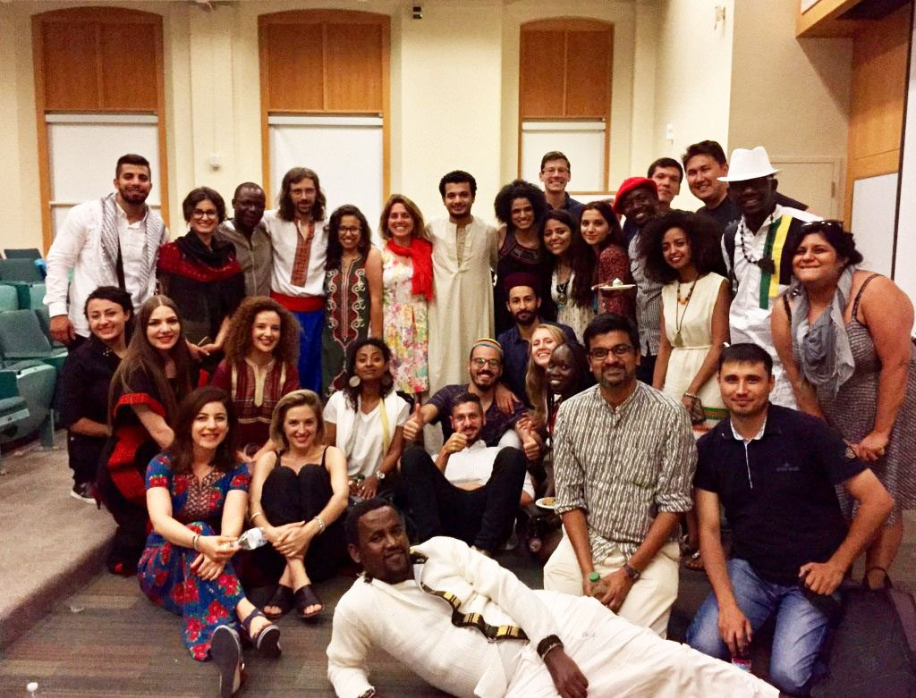
International Student Population at SU
2022-2023
Total Student Enrollment: 22,698
Total International Students: 4,251
Undergraduate Student Enrollment: 15,421
International Undergraduate Students: 1,997
Graduate Student Enrollment: 7,277
International Graduate Students: 2,254
CPT Applications Processed: 265
OPT Applications Processed: 529
STEM OPT Applications Processed: 432
Center for International Services

Slide 3
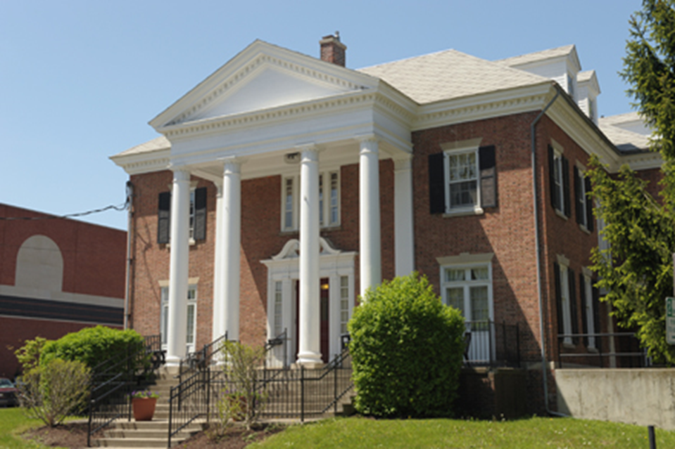
Center for International Services
310 Walnut Place
corner of Walnut Place and Waverly Avenue
across the street from Bird Library and Schine Student Center
Hours:
Monday-Friday
8:30 am - 5:00 pm
Summer: 8:00 am - 4:30 pm
Phone: 315-443-2457
Email: international@syr.edu
Website: https://experience.syracuse.edu/international
Center for International Services

Slide 4


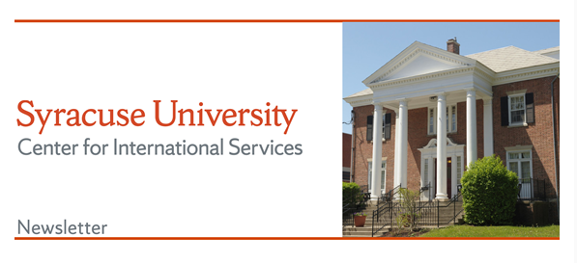
Center for International Services Continued
Advisor on Call:
Monday-Friday, 11 am-3 pm
In person, By Phone, via Zoom, Teams, or Skype
Informational Seminars:
Curricular and Optional Practical Training
1st & 3rd Wednesday, 2nd Friday every month
Newsletter –every other week
CPT
Center for International Services

Slide 5
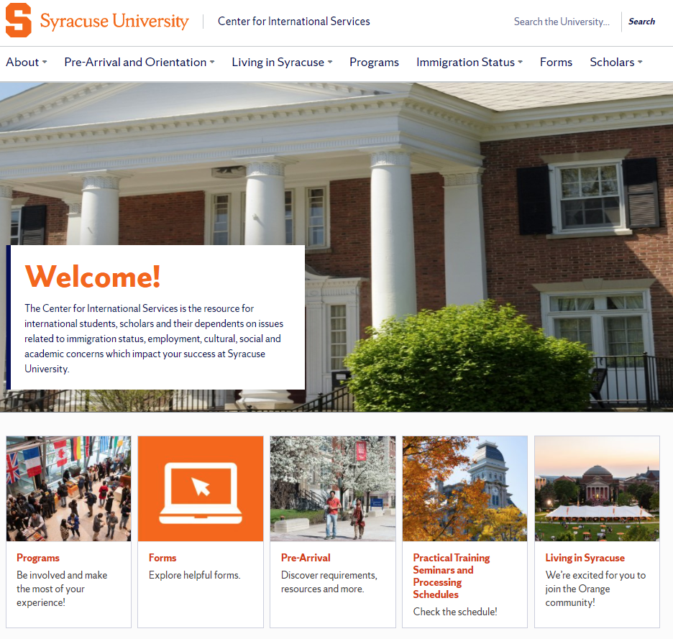
https://experience.syracuse.edu/international/
Center for International Services

Slide 6
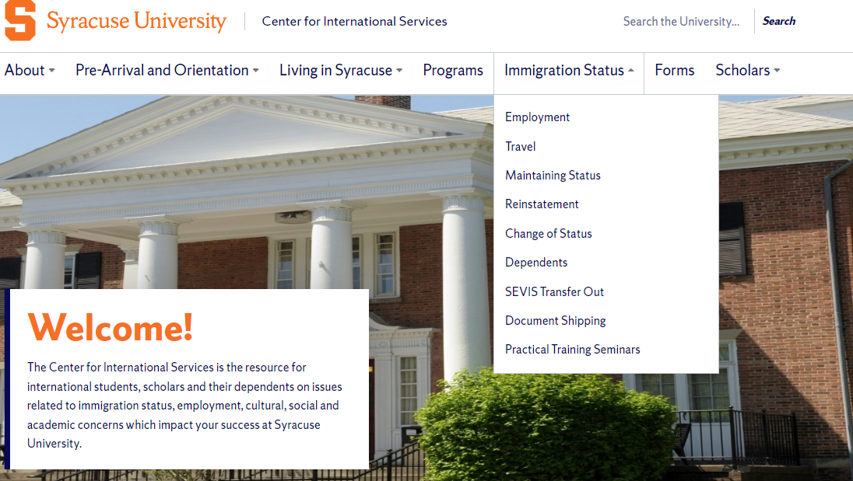
https://experience.syracuse.edu/international/
Center for International Services

Slide 7
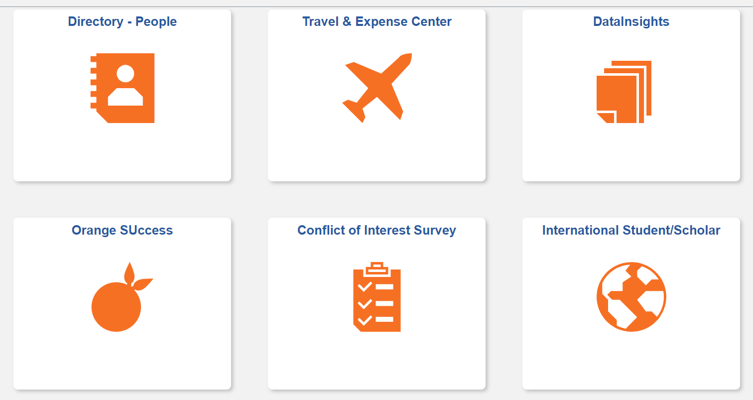
Requests will be done in MySlice
Center for International Services

Slide 8
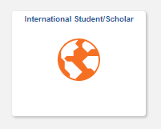
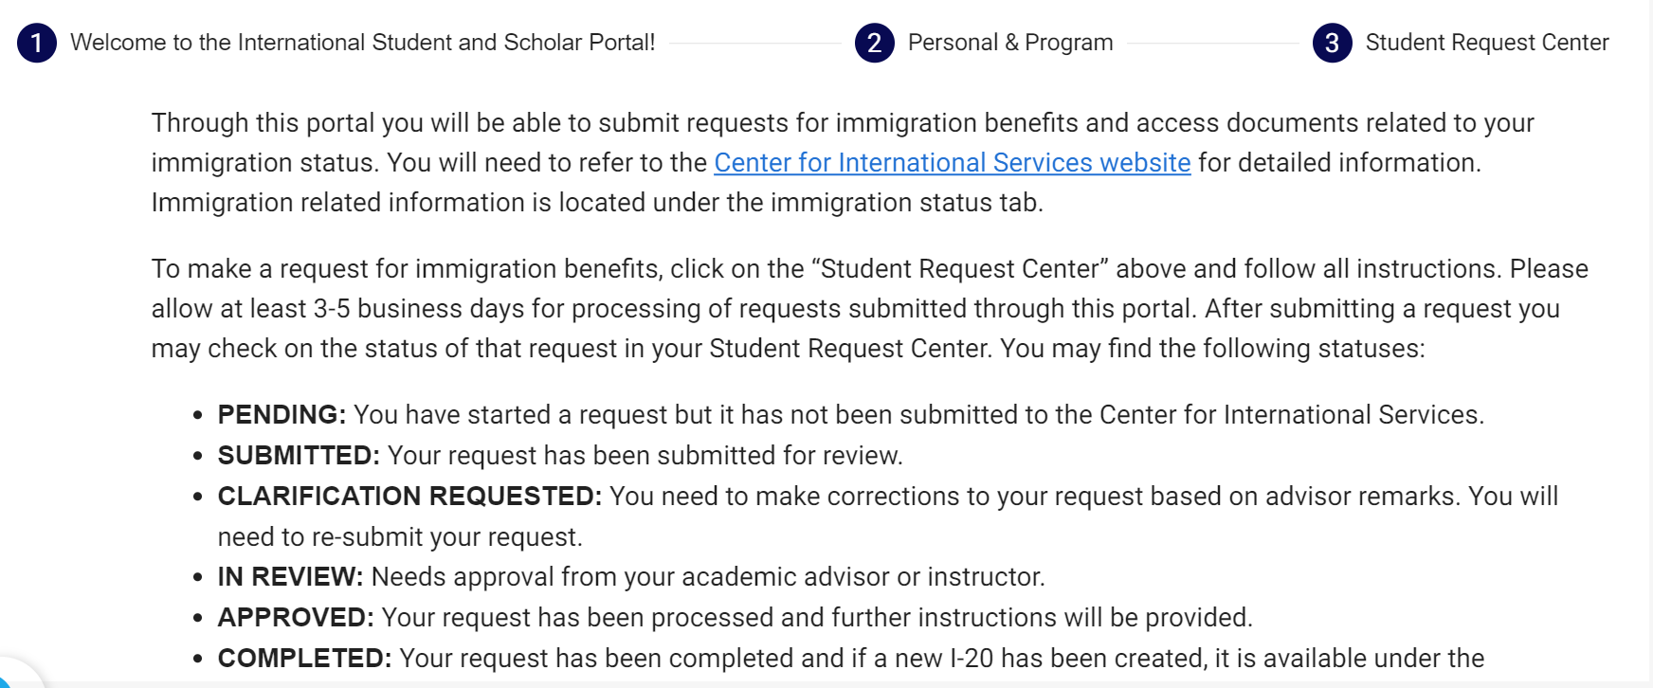
Through My Slice
Use the My Slice ISSS tile for most requests
Center for International Services

Slide 9
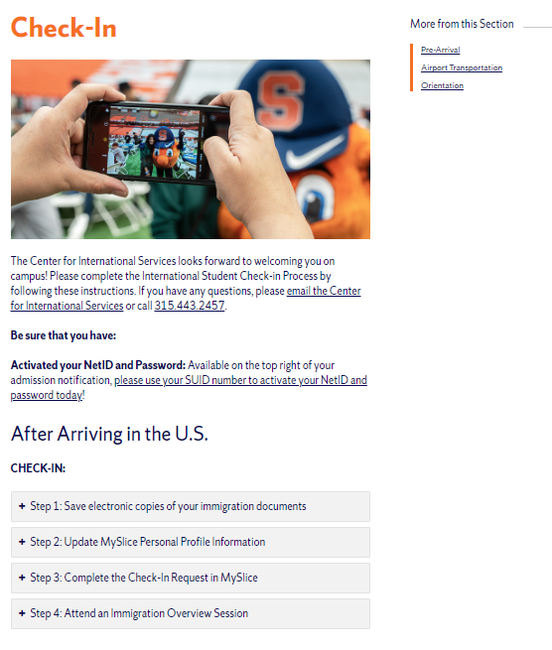
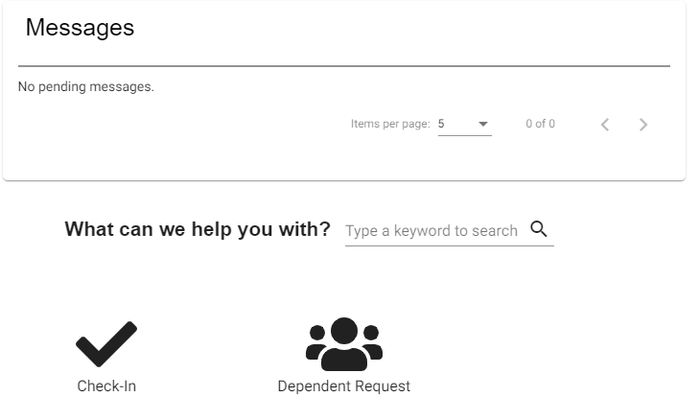
Center for International Services Check-In
Center for International Services

Slide 10
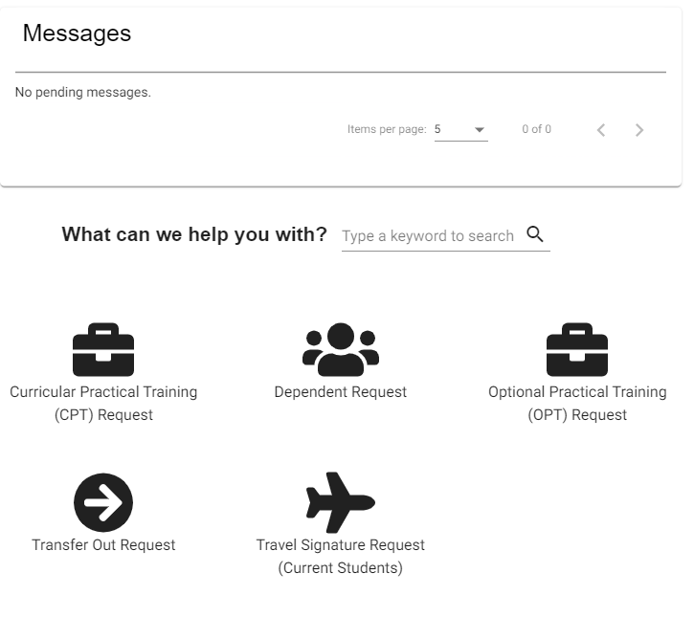
Student Request Center
Center for International Services

Slide 11
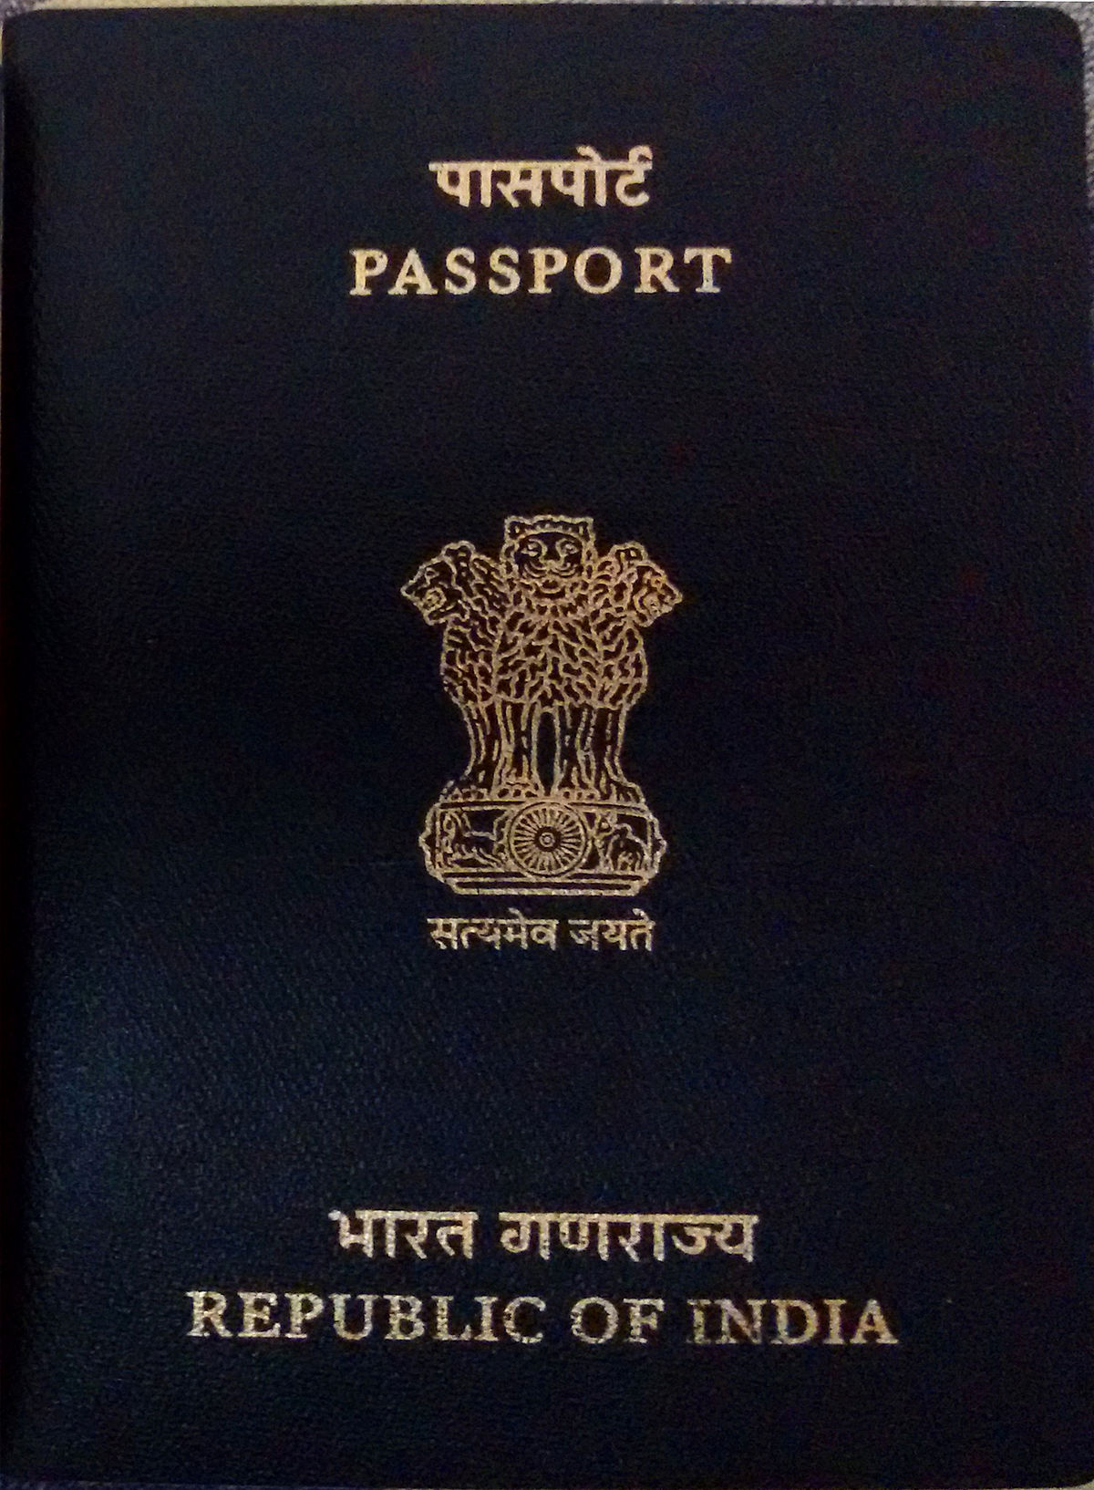
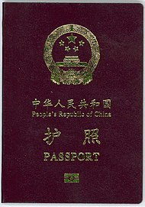
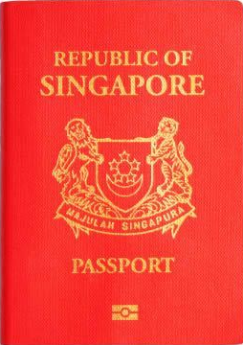
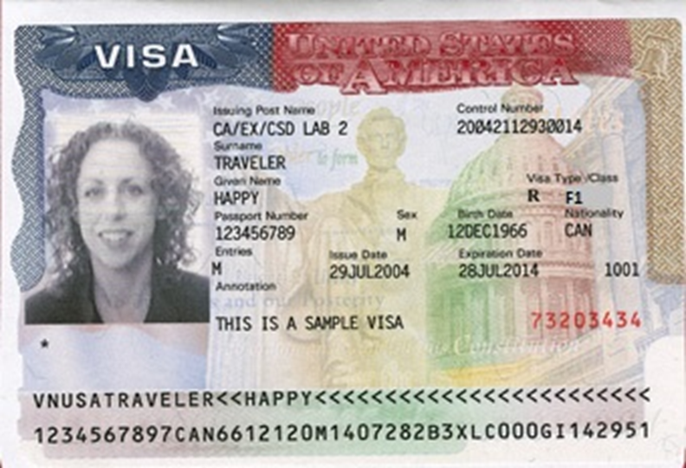
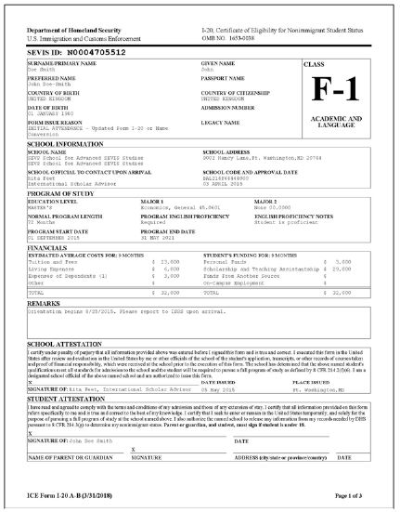
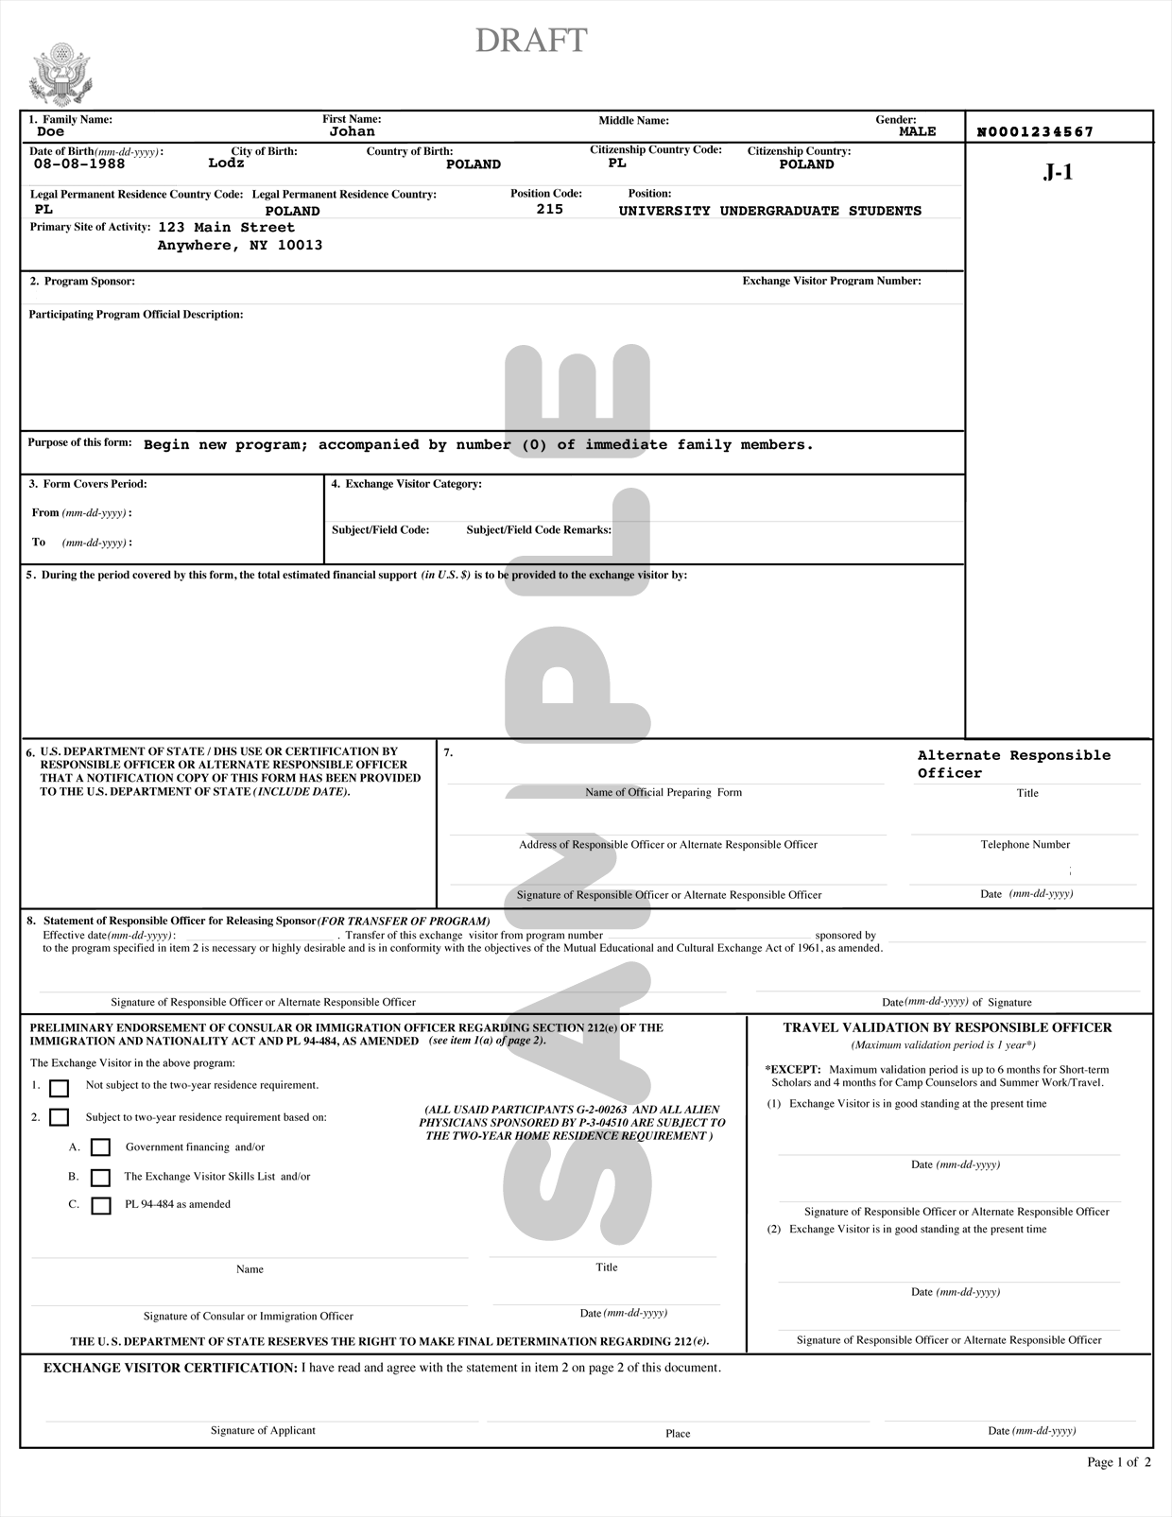
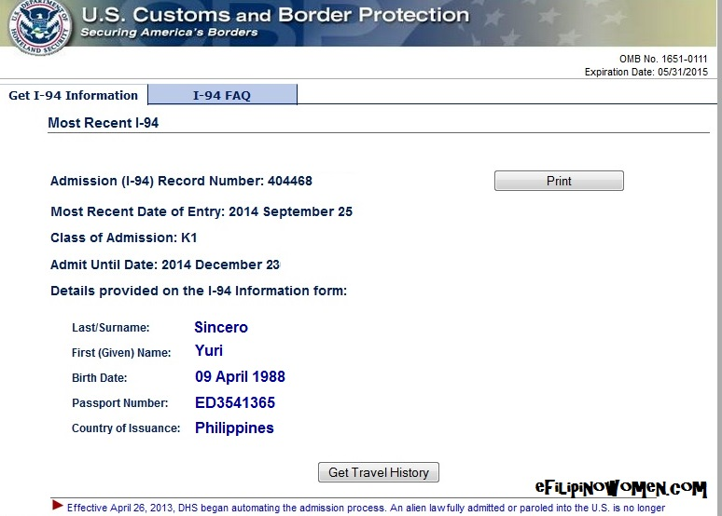
Tour of Documents
Center for International Services

Slide 12
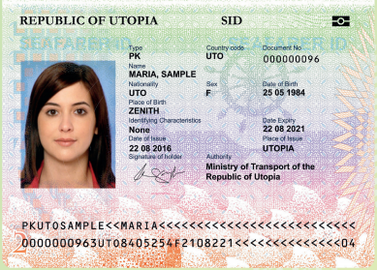
Passport
Know your passport expiration date
Your passport needs to be valid for at least 6 months into the future when entering the U.S.
Replace at your Consulate in New York City or Embassy in Washington, DC
Center for International Services

Slide 13
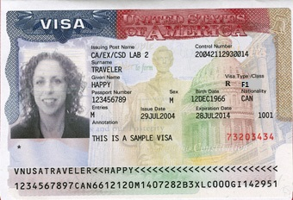
Visa
Know expiration date and Number of entries
Needs to be valid when entering the U.S.
Number of entries and length determined by diplomatic agreements
Usually annotated with SEVIS Number
Usually annotated with school Name
Can only be renewed at a U.S. Embassy or Consulate-all located outside the U.S.
Visa cannot be renewed inside the U.S.
Can expire while in the U.S.
Center for International Services

Slide 14
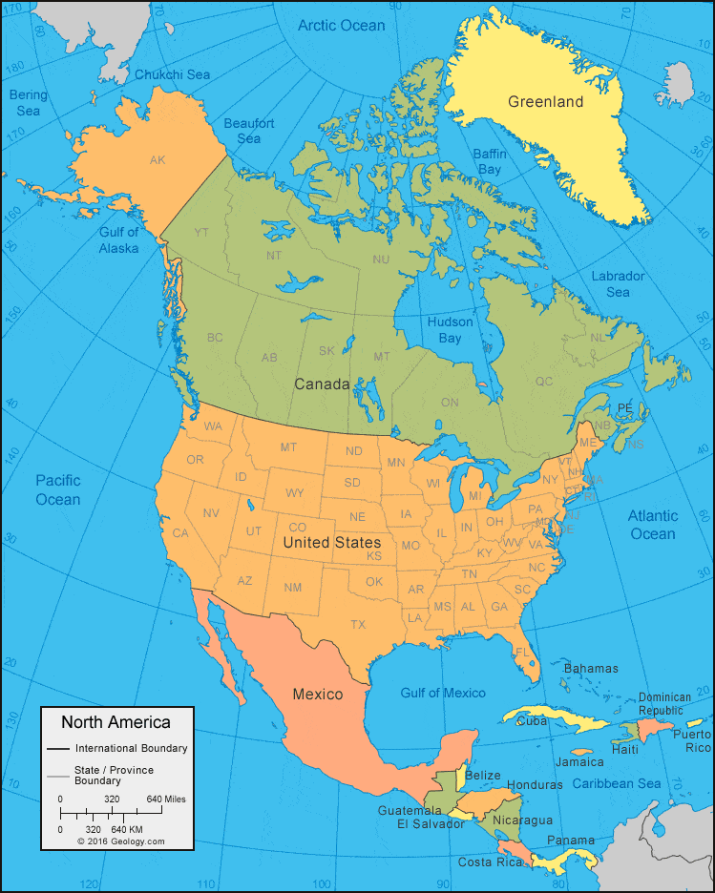
Travel
Visa needs to be valid to enter the U.S.
Exception:
  Returning to the U.S. after a trip to Canada, Mexico, or the adjacent islands
    Trip of less than 30 days
    Trip solely to Canada, Mexico, or the adjacent islands
    Cannot apply for U.S. Visa while there
    Not a citizen of Iran, Syria, Sudan, or North Korea
    But need to determine if you need a visa to travel to other countries
Center for International Services

Slide 15
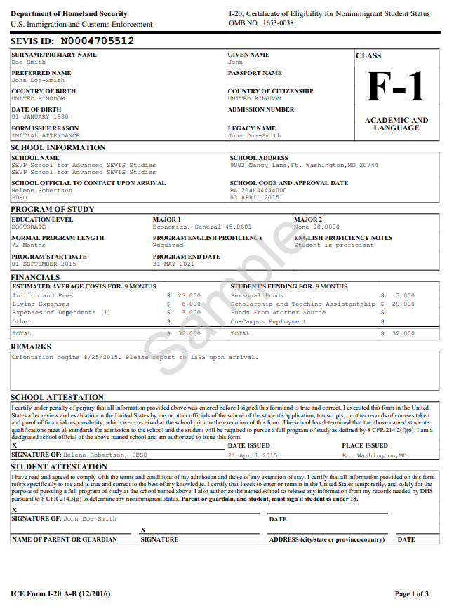

I-20
Immigration Selfie-tells your story
Issued by Syracuse University
Biographic Information about you
Degree Level
Program of Study
Program Start and End Date
Financial Information
Center for International Services

Slide 16
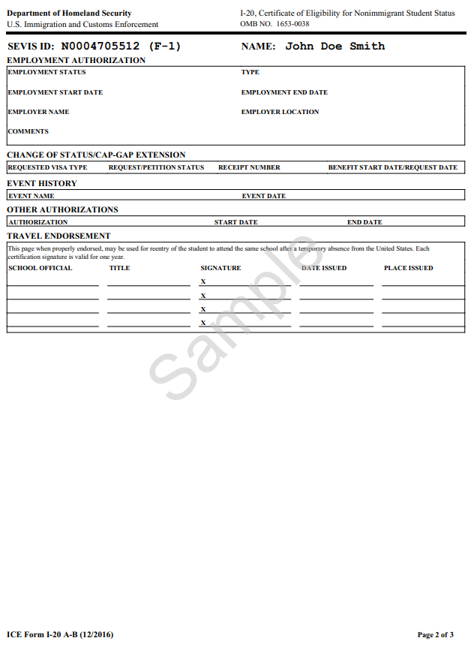
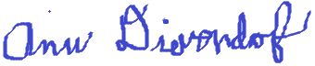
I-20 - Page 2
Employment Authorizations
Travel Endorsement
  Travel Signatures-valid for one year/12 months
  Advisor on Call, Monday – Friday, 11 am – 3 pm
  Through MySlice ISSS Portal
  Express Travel Signatures
Ann Dievendorf International Student Advisor 07/30/2021 Syracuse,NY
Travel Signatures
Monday-Friday
October 9-13
9am-4 pm
310 Walnut Place
Center for International Services

Slide 17
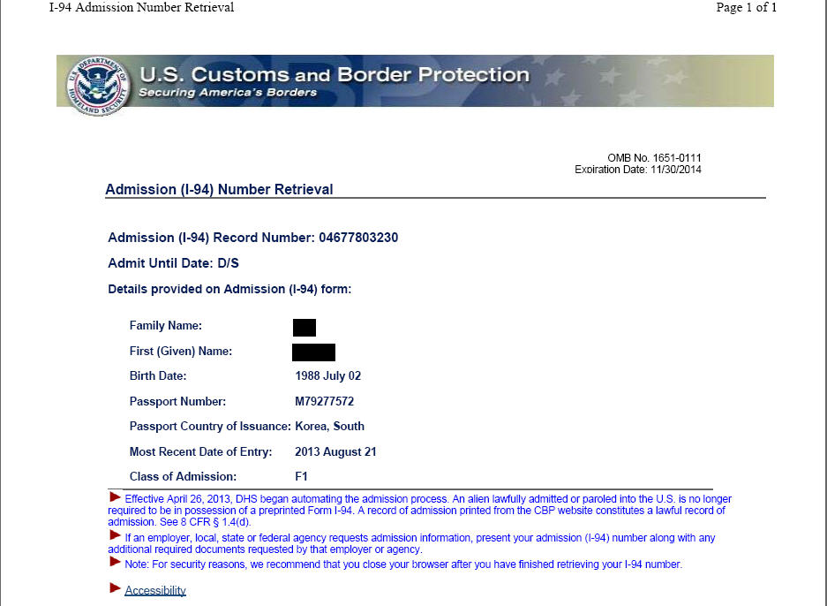
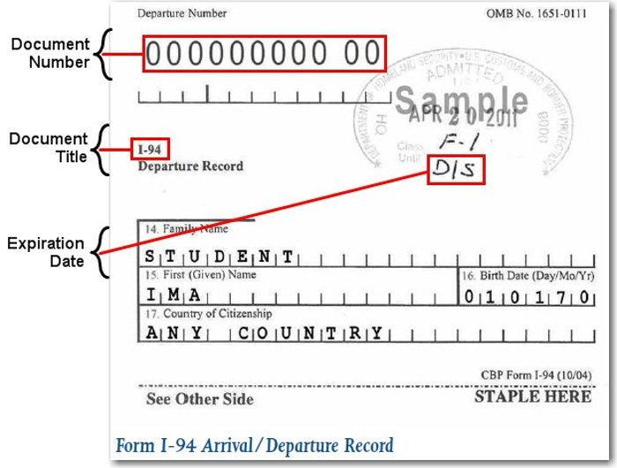

I-94 Arrival Record/Travel History
www.cbp.gov/I-94
Updated every time you travel out of the U.S. and enter
Check every time to be sure you were admitted to the US in F-1 status and for D/S
D/S = Duration of Status
  Program End Date + 60 days
  to prepare to depart or change status
Center for International Services

