Slide 1
Immigration 101:
Options After The F-1
Andrea Godfread-Brown, Esq.
Senior Counsel
Immigration Practice Group
April 14, 2023

Slide 2

U.S. Immigration Basic Concepts
Non-Immigrant Visa
Lawful Permanent Resident/Immigrant Visa (Green Card)
Citizenship (Naturalization)

Slide 3

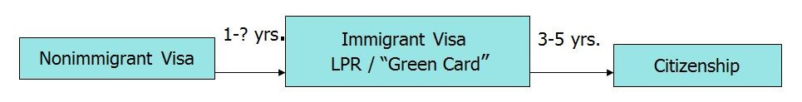
Overview of U.S. Immigration Process
B-1/2 Visitor for Business/Pleasure
E-1/2 Treaty Trader/Investor
E-3 Specialty worker – Austr.
F -1 Student - OPT
H-1B Specialty worker
H-2 Temporary Worker
H-3 Trainee
J-1 Exchange Visitor
L-1 Intracompany Transferee
O-1 Alien of Extraordinary Ability
R-1/2 Religious Worker
TN Trade NAFTA
FAMILY-BASED CATEGORIES
IR Immediate relatives
FB-1 Unmarried sons/daughters of USCs
FB-2 Spouses/children of LPR
FB-3 Married sons/daughters of USCs
FB-4 Brothers/sisters of USC
EMPLOYMENT-BASED CATEGORIES
EB-1 Outstanding researchers
Aliens of extraordinary ability
Multinational managers
EB-2 Advanced degrees/NIW
EB-3 Professionals
2 yrs. experience
Other workers
EB-4 Special immigrants/religious
EB-5 Investors
3 yrs. if by marriage to U.S. citizen
5 yrs. for everyone else
3

Slide 4

The H-1B Visa: Professionals
REQUIREMENTS | APPLICATION STEPS | TIMETABLE | DURATION
1. Job must require BA/BS degree or equiv. as minimum entry-level requirement 2. Applicant must have degree equivalent to U.S. BA/BS, or equiv. experience 3. Employer must pay at least prevailing wage for the position in geographic area NO TEST OF U.S. LABOR MARKET REQUIRED; NO ADVERTISING; NO RECRUITMENT | Determine prevailing wage for position 2. Post Labor Condition Application (LCA) at employer’s work place File LCA with U.S. Dept. of Labor; wait 7 days for certification 4. File visa petition with USCIS 5. Change of status with petition if in US US consular processing overseas if out of status or overseas Canadians can apply at U.S. border | 3-6 months - Variable! Premium processing: decision in 15 days H-1B portability: May work as soon as filed if already holding H-1B visa WATCH OUT FOR GAPS IN STATUS | Granted for 3 years Renewable for 3 years Extend beyond 6 years if GC or PERM pending one year before H maxes out.
 |  |  | COSTS
 |  |  | $460* USCIS filing fee $500 Antifraud fee $750 (25 or fewer EEs) or $1,500 ACWIA fee (> 25 EEs) - Credentials evaluation ($75-500) - Premium processing ($2,500)

Slide 5

H-1B Basics
“Specialty Occupation” – job must require BA/BS or equivalent in a specific field for entry-level requirement
  And employee must have a degree related to the specialty occupation
Employer-employee relationship
  W-2 employee
  Employer-specific – no moonlighting, but can have concurrent H-1Bs
  Off-site employment permitted if petitioner retains control over work, salary, etc.
Granted for up to 3 years at a time; maximum of 6 years in H-1B status
Employer must pay all costs/fees associated with H-1B petition process – by law, employees/beneficiaries are prohibited from paying these costs, even if they want to

Slide 6
H-1B Visas – The Numerical Cap
For Non-Exempt/Private Employers
H-1B Visas Currently Capped at 65,000 per year
  Cap exemptions for colleges, universities and some non-profit/government research institutions
  Fiscal Year (FY) begins in October
Advanced Degree Allocation
  Additional 20,000 visas reserved for graduates of Masters or higher degree programs from U.S. colleges

Slide 7
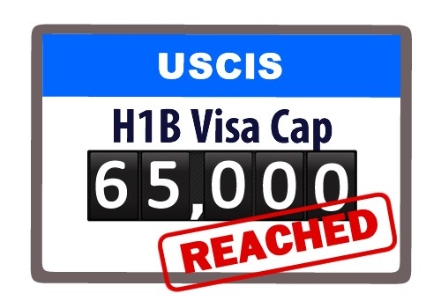
The H-1B Cap
Insufficient H-1B Visas In Every Year Since 2004
  Some years: hit the cap AFTER the start of the FY
  Other years: hit the cap between filing & start of the FY
  2008, 2009, 2014, 2015, 2016, 2017: hit the cap on April 1
  2014: 124,000 cases filed for 85,000 visas (68% chance)
  2015: 174,000 cased filed for 85,000 visas (48% chance)
  2016: 233,000+ cases for 85,000 (36% chance)
  2017: 199,000 cases for 85,000 visas (43% chance)
  2018: 190,098 cases for 85,000 visas (95,885 AD – 21% chance; 94,213 Bachelor’s 38%)
  2022: 308,613 registrations; 87,500 selected

Slide 8
H-1B Employer Registration
USCIS has implemented an Employer Registration process from which to conduct the “lottery” or selection for H-1B processing
March 1 – March 20 Employers can register (via their attorney representative) into the online account. Selections will be randomly made by end of March
As of April 1 if selected in the on-line lottery, the Employer can then file the full H-1B petition on behalf of their H-1B employee
90 day window to file the H-1B petition

Slide 9

H-1Bs Cap Subject vs. Cap Exempt
Numerical cap
  H-1B limited to 65,000 visas per year plus 20,000 extra for those who possess Master’s degrees from U.S. institutions
  NO numerical cap for:
    Employees of institutions of higher education as defined by Higher Education Act of 1965
    Organizations related to/affiliated with institutions of higher education
Fee Exemption
  H-1B government fees normally
    $1,500 Workforce Training Fee ($750- for entities under 25 employees)
    $500 Anti-Fraud fee
    $460 I-129 Form fee
  Fee exemption for institutions of higher education
    No $1500 Workforce Training Fee
    $500 Anti-Fraud fee still required
    $460 I-129 Form fee still required

Slide 10

Alternatives to the H-1B
TN (Trade NAFTA) for Canadians and Mexicans in specified professions (including faculty members)
Special Free Trade Hs for Chileans and Singaporeans
E-3s for Australian professionals
O-1s (Aliens of Extraordinary Ability)
F-1 students (CPT and OPT)
H-2Bs for temporary need (usually unskilled workers)
J-1s for exchange visitors
H-3s, Ps, Qs, etc.

Slide 11

J-1 Cultural Exchange Visas
INTENDED AS A ‘CULTURAL EXCHANGE’ OPPORTUNITY
  Administration through U.S. Dept. of State
  Employer must be authorized by DOS to sponsor J-1 visas themselves
(universities, hotel chains, medical centers) OR
  Employer must work through approved sponsoring agencies for defined
categories: J-1 Trainees, Summer Work Study, etc.
  Approved sponsors listed on DOS website (http://j1visa.state.gov)
MANY CATEGORIES OF J-1 VISAS:
  Professor / Research Scholar (5 years)
  Specialist (12 months)
  Short-Term Scholar (6 months)
  Trainee (18 months) / Intern (12 months)
  Au pair (2 years) / Camp counselors (4 months)
  Teachers – primary & secondary (3 years)

Slide 12

J-1 Visas: Exchange Visitors
REQUIREMENTS | APPLICATION STEPS | TIMETABLE | DURATION
1. Must be sponsored by organization with approved J-1 program 2. Must fall within sponsor’s defined program: e.g., research scholars, trainees, professors, specialists, etc. 3. Some participants are subject to mandatory two- year home residency requirement. Waiver of requirement can be difficult or impossible. | 1. Approved J-1 sponsor organization issues DS- 2019 to applicant 2. Issuance of J visa - If in U.S., change status via USCIS - If overseas, apply for J-1 entry visa stamp at U.S. consulate overseas 3. Applicant may start work when has I-94 with J-1stamp in hand | 30 days for DS-2019 2 weeks - 3 mos. for consular processing OR At least12 months for change of status | Depends on category: 1 month to six years Research scholars: 3 years Trainees: 18 months Specialists: 1 year
 |  |  | COSTS
 |  |  | DS-2019: depends on umbrella organization, if used Visa application fees at consulate or $370 for change of status

Slide 13
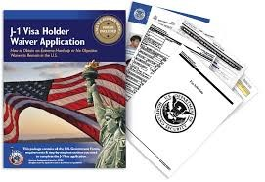
J-1 Risk: Home Residency Requirement
TWO-YEAR HOME RESIDENCY REQUIREMENT
  Some participants in full-time programs must to home country before change to H or L visa, or ‘green card’.
  Two-year home residency requirement applies if:
    Either U.S. or home government paid for the sojourn in the US OR
    Country has filed Skills List with DOS designating study areas which are needed in country – no matter who paid for the study.
    Participant has engaged in Graduate Medical Education in US
    “Home country” = country of citizenship or last residence at time of J grant
WAIVER OF HOME RESIDENCY REQUIREMENT BY DOS POSSIBLE
  4 statutory grounds for waiver application; decision is ALWAYS discretionary
  Some situations where waivers are almost NEVER granted: Fulbright, AID
  Medical graduates: special alternatives, service in medically-underserved areas

Slide 14

TN Visas : Trade NAFTA
(United States-Mexico-Canada Agreement [USMCA]: new trade deal replacing NAFTA; not expected to have any impact on NAFTA’s immigration/visa provisions)
REQUIREMENTS | APPLICATION STEPS | TIMETABLE | DURATION
Canadian or Mexican citizen: Job on list of TN professions, e.g.: Teacher (high school & univ.) Mgmt. consultants Science/engineering Systems analysts Medical professionals Must have req’d education or training: usually BA/BS and/or license. Exceptions include: Mgmt. consultants Scientific technicians Systems analysts (2 yr. degree min.) | Canadians: Apply at U.S. border or airport port of entry: processed on the spot No visa petition or USCIS preprocessing required Mexicans: Apply at U.S. consulate in Mexico; fast processing | Canadians: Almost immediate Avoid processing at high-traffic or holiday weekends Mexicans: 2-3 weeks: Must make appt. at consulate | May be granted up to 3 years Renewable without set limitation
 |  |  | COSTS
 |  |  | Border fees: $56+$6 per I-94

Slide 15

O-1A Visas
Individuals with Extraordinary Ability or Achievement
Science, Education, Business or Athletics
National or International Acclaim
  Letters of support
  Publication
  High salary
  Media, citations, press
  Judge work
  Awards, critical acclaim
  Selective professional memberships
Available to J-1 holders who are subject to home residence requirement

Slide 16

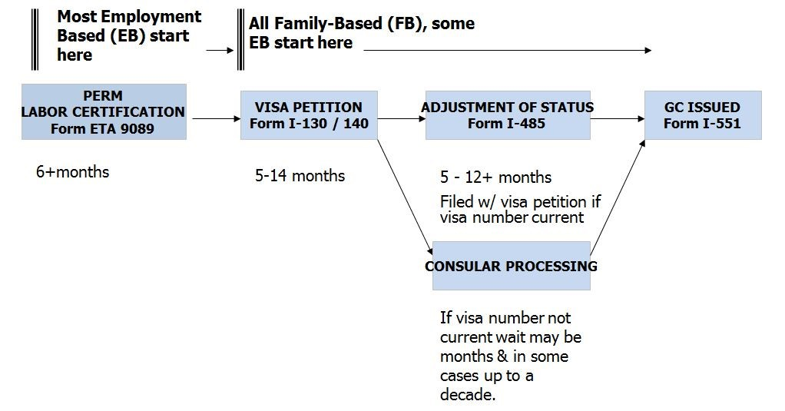
Overview: Green Card Process

Slide 17
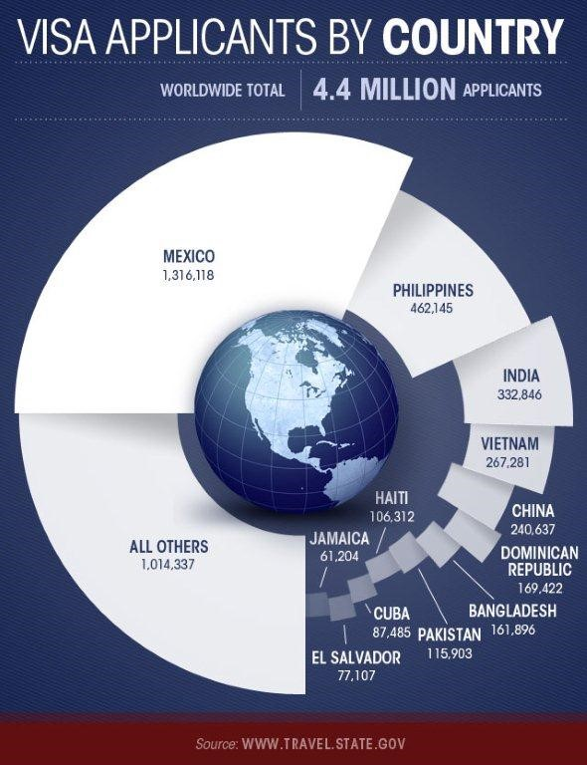
Quotas and Priority Dates
LIMITS ON NUMBER OF GREEN CARDS PER YEAR
Each type of green card (preference category) have numerical limits: numbers vary by year and by usage
Approximately 140,000 EB-based GCs in all categories
Approximately 226,000 FB-based GCs in all categories
Each country is also limited to a ceiling number of visas, regardless of demand
When either preference group or country quotas are met, waiting lists build
PRIORITY DATE DETERMINES PLACE ON WAITING LIST
When waiting lists build, cases are processed in priority date order
Priority date established at the first official filing date of the paperwork (USCIS, DOL)
GLOBAL VS. COUNTRY WAITING LISTS
Country which hits country ceiling taken out of the worldwide visa pool and given its own separate pool of visas (approximately 7% of total available)
Ensures even distribution of visas across all GC categories.
Leads to longer waits in many categories.
The Visa Bulletin (www.travel.state.gov): priority dates for each month.

Slide 18
Visa Bulletin: Employment
VISA BULLETIN November 2022 www.travel.state.gov
Annual employment-based immigration: 140,000
Employment-based immigrant visa cases with priority dates before the stated dates are eligible for final action:
Employment Categories | World-wide | China | El Salvador Guatemala. Honduras | India | Mexico | Philippines
EB-1 | C | C | C | C | C | C
EB-2 | C | 08JUN19 | C | 01APR12 | C | C
EB-3 -BA | C | 15JUN18 | C | 01APR12 | C | C
EB-3 - other | 01JUN20 | 01DEC12 | 01JUN2020 | 01APR12 | 01JUN20 | 01JUN20
EB-4 | C | C | 15MAR18 | C | 15SEP20 | C
Relig. Workers | C | C | 15MAR18 | C | 15SEP20 | C
EB-5 | C | 22MAR15 | C | 08NOV19 | C | C

Slide 19

Why are waiting lists a problem?
Core Issue: Cannot file adjustment of status until priority date is current
Labor certification and I-140 can be filed without regard to priority date
Cannot file adjustment of status or consular process an immigrant visa unless a priority date is current.
Deprives applicants of AOS-related benefits
Obtaining EADs and Advance Parole earlier in process
Eliminating the need for H-1B visa renewals; visa stamp processing, etc.
Minor children can “age out”, i.e., turn 21 & fall off parents’ applications

Slide 20
PERM Labor Certification
MOST COMMON EMPLOYMENT-BASED GREEN CARD PROCESS:
Application by employer to USDOL to certify individual and position after
statutorily mandated recruitment campaign
Nearly all positions qualify
Process requires significant employer involvement, including payment of legal fees and all associated costs

Slide 21

PERM Labor Certification (cont.)
PROCEDURES/ADVERTISING:
Define job and skills on DOL forms in compliance with DOL requirements
Obtain DOL prevailing wage determination
Advertise two Sundays in paper of general circulation
Professional positions: 3 additional recruitment steps (job fairs, web ads, etc.)
Interview and evaluate applicants; prepare recruitment report
Submit ETA 9089 to DOL with recruitment results
DOL reviews and approves or audits
Possible audits in 30% of cases
Requirements simplified for university faculty under “Special Handling”
Only 1 national journal advertisement required
“Most qualified” standard as opposed to minimally qualified

Slide 22
Other Employment Based Green Card Options
Extraordinary Ability Alien (EB-1A)
Outstanding Researcher (EB-1B)
Multinational Manager (EB-1C)
National Interest Wavier (EB-2)
*All of the above are exempt from the labor certification requirement

Slide 23

EB-1B Outstanding Researcher or Professor
Intended to accommodate prospective immigrants who are recognized nationally or internationally for their outstanding achievement in their field. An employer must submit this petition on behalf of a prospective permanent resident.
USCIS regulations provide that applicant must demonstrate international recognition for outstanding achievements in a particular academic field, as well as at least 3 years’ experience in teaching or research in that academic area.
Applicant must be entering the United States in order to pursue tenure or tenure track teaching or comparable research position at a university or other institution of higher education.

Slide 24

EB-1B Evidence Requirements
Documentary Evidence must include at least 2 of the following:
Evidence of receipt of major prizes or awards for outstanding achievement
Evidence of membership in associations that require their members to demonstrate outstanding achievement
Evidence of published material in professional publications written by others about the alien's work in the academic field
Evidence of participation, either on a panel or individually, as a judge of the work of others in the same or allied academic field
Evidence of original scientific or scholarly research contributions in the field
Evidence of authorship of scholarly books or articles (in scholarly journals with international circulation) in the field

Slide 25
Useful Resources
Immigration and Customs Enforcement (www.ice.gov)
NAFSA: Association of International Educators (www.nafsa.org)
U.S. Citizenship and Immigration Services (www.uscis.gov)
Immigration Attorney

Slide 26

Contact Information
  Andrea Godread-Brown
  Lu (Kevin) Wang
  Harris Beach PLLC
  syrimmigration@harrisbeach.com
  315-423-7100

