Slide 1
F-1 Curricular Practical Training Seminar
Center for International Services

Slide 2
Curricular Practical Training (CPT)
A training experience (Internship, Practicum, Field Experience, etc.) that occurs off campus that is either:
required of all candidates for a degree-must be stated in the program description
  no registration required
integral to your degree program
  must register for a course (e.g., Internship, Practicum, Experience Credit, etc.) for at least 1 credit hour
dissertation research
  doctoral student who must engage in off-campus work to complete research necessary for a dissertation
  must register for GRD 998 and/or a department-specific dissertation credit and file a Certificate of Full Time Status
Center for International Services

Slide 3
Curricular Practical Training (CPT)
CPT is permission to be off campus for the training/course:
  at a specific location
  from a specific date to another specific date
  for 20 hours per week or less (part-time) or more than 20 hours per week (full-time)
The training experience must be arranged before you apply for CPT
Center for International Services

Slide 4
Curricular Practical Training (CPT)
  Must be directly related to your major field of study indicated on your I-20
    Cannot be in a minor field of study
    Cannot be in a previous field of study if different than your current major field of study
  Only available prior to degree completion-for an Internship after you complete your degree you must apply for Optional Practical Training (OPT)
  Must be authorized by the Center for International Services on a new I-20
  May be paid or unpaid
Center for International Services

Slide 5
Who is Eligible for CPT?
CPT is a benefit of F-1 status
  You must currently be in lawful F-1 status
  J-1 students are not eligible for CPT but are eligible for Academic Training
  J-2s, H-4s, L-2s, etc. are not eligible for CPT but may have other employment authorization
Center for International Services

Slide 6


Who is Eligible for CPT?
You must have been a full-time student for at least one academic year (Fall and Spring or Spring and Fall)
Exception: if you are in a graduate program requires the internship in the first year of study
no time spent in an English language program counts toward this one year full-time requirement
time as a full-time student in another immigration status (H-4, L-2, J-2, etc.) does count toward the one year full-time requirement
OR
Center for International Services

Slide 7
How Much CPT am I Eligible For?
There is no regulatory limit to how much CPT you are eligible for
It is based on your curriculum
You may participate in as much CPT as your degree program will allow and your department will recommend
If your curriculum allows you to do multiple internships, you may be authorized for CPT multiple times
  Must submit a new CPT request for each semester including summer session(s).
  365 days of full time CPT makes you ineligible for OPT
Center for International Services

Slide 8
What is Part-time CPT vs. Full-time CPT?
Part-Time: 20 hours or less per week
  If your Internship is up to 20 hours per week, you will be authorized for part- time CPT
Full-Time: More than 20 hours per week
  If your internship is more than 20 hours per week, you will be authorized for full-time CPT
Center for International Services

Slide 9
Does CPT Affect My Eligibility for OPT?
CPT is never deducted from OPT; you can use CPT and OPT
HOWEVER, if you are authorized for one year of full-time CPT, you will not be eligible for any OPT
You can use as much part-time CPT and “up to 364 days” of full-time CPT and still be eligible for OPT
  USCIS is closely examining extended periods of full-time CPT authorization
Center for International Services

Slide 10
Do I need to be registered at the time I do my Internship?
CPT is for an Internship/Practicum/Field Experience that is part of your curriculum
  you are registered for a Fall Internship or a Spring Internship or a Summer Internship
CPT is authorized by semester
  For example: If you are requesting CPT in the Fall semester, you must be registered for a Fall Internship/Practicum/Field Experience
Center for International Services

Slide 11
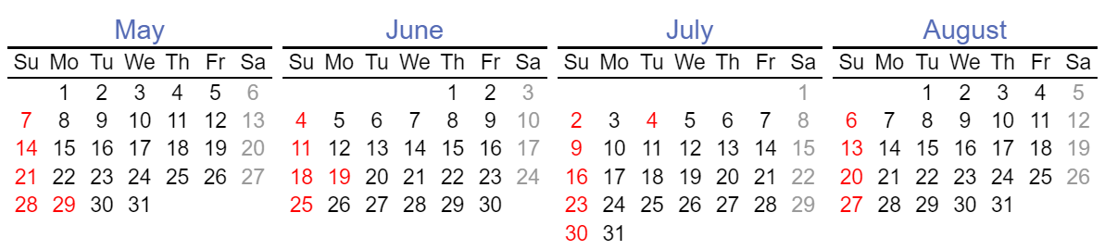
Must My Internship Begin on the Beginning Date of the semester and End on the end date of the semester?
Participation in CPT may begin after the last day of the previous semester of registration
CPT must end before the first day of the following semester of registration
For example: Summer CPT cannot begin until after the Spring semester ends and must end before the Fall semester starts
You must be registered in the semester that your CPT is approved for
Center for International Services

Slide 12
Full-time Enrollment During CPT
If applying for CPT in Fall or Spring semester, you must maintain your full-time enrollment
Undergraduate Students:
  Must be registered for 12 credit hours unless
  If it is your last semester and fewer than 12 credits are required to graduate
    Must file a Last Semester Memo with the Center for International Services
Graduate Students:
  Must be registered for 9 credit hours OR
  File a Certificate of Full-Time Status with the Registrar’s Office (copy to Center for International Services); or
  If it is your last semester and fewer than 9 credits are required to graduate
    Must file a Last Semester Memo with the Center for International Services
Center for International Services

Slide 13
I-20 Extensions
Because the internship must be integral to the program of study for CPT purposes:
  The duration of an I-20 should provide sufficient time to complete the academic degree for which it was issued
  You must plan your program of study to include time for your internship without requiring an extension of your program
  Participation in CPT should not delay your program completion
  An I-20 will not be extended to continue working on CPT unless the Internship/Practicum/Field Experience is required for the degree
Center for International Services

Slide 14
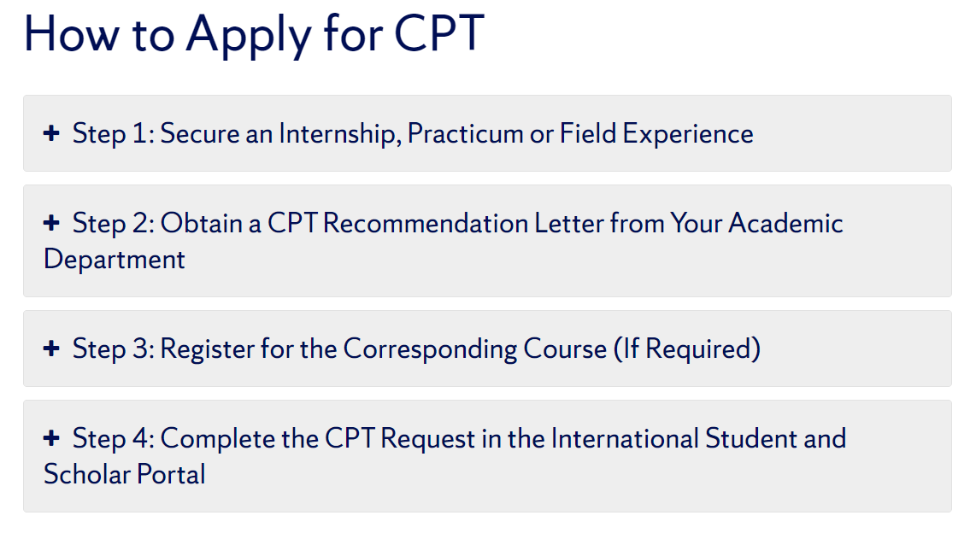
CPT Application Process Overview
To get here from our website > Immigration Status > Employment > Curricular Practical Training (CPT) – F-1 > How to Apply for CPT
Center for International Services

Slide 15
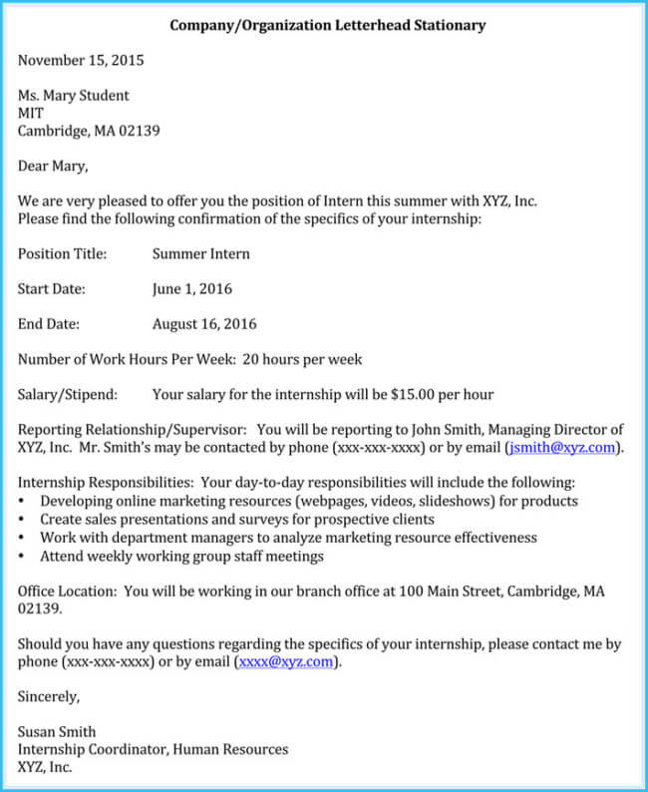
STEP 1: Secure an Internship/Practicum/Field Experience
Secure an internship/practicum/field experience and save a copy of your internship off/placement letter. You will submit this letter with your application
The letter should include:
    Location
    beginning date and ending date
    number of hours
Center for International Services

Slide 16
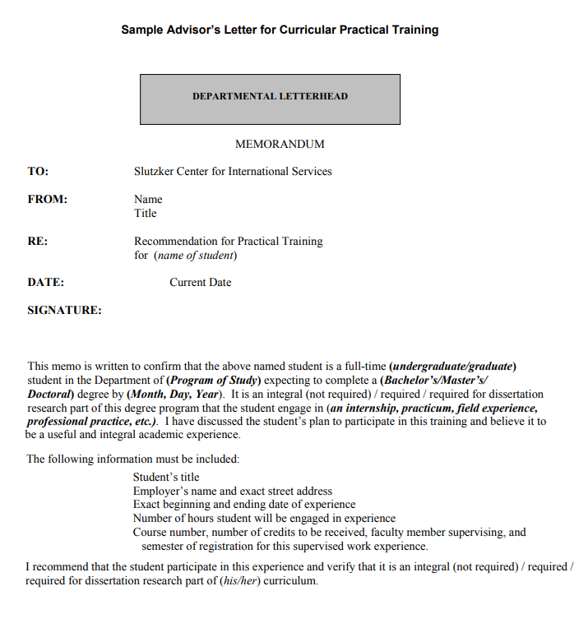
STEP 2: Obtain a CPT Recommendation Letter from your Academic Department
Obtain a Recommendation Letter from your department printed on departmental letterhead
You will need to Upload this letter to your request for CPT Authorization
Do NOT ask your department to send it to the Center for International Services
Center for International Services

Slide 17
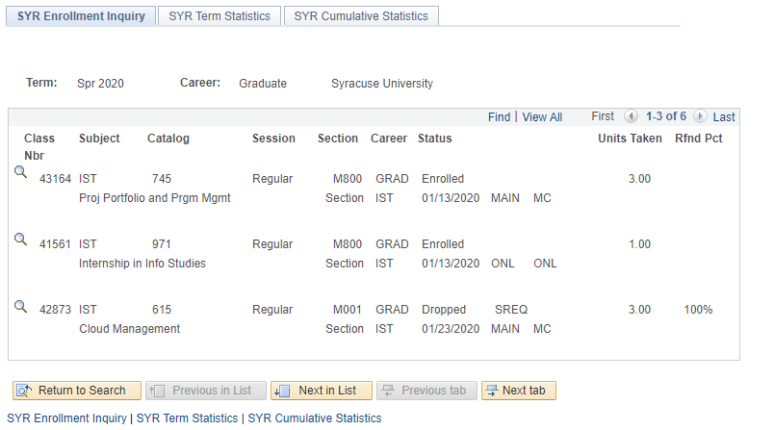
STEP 3: Register for the Corresponding Course (If Required)
If you are applying for CPT that is integral to your degree or required for dissertation research register for the corresponding course as indicated in your department recommendation letter.
CPT applications will not be processed if you are not yet registered for the corresponding course.
Take a screenshot of your MySlice record showing you are registered for the corresponding course. You will upload this screenshot to your request for CPT authorization.
Center for International Services

Slide 18

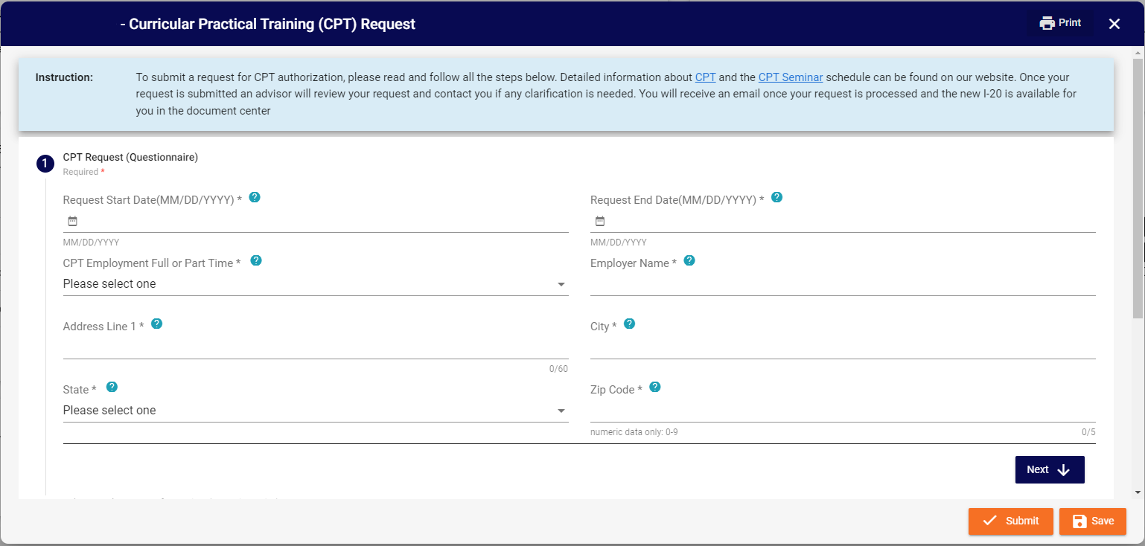
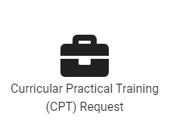
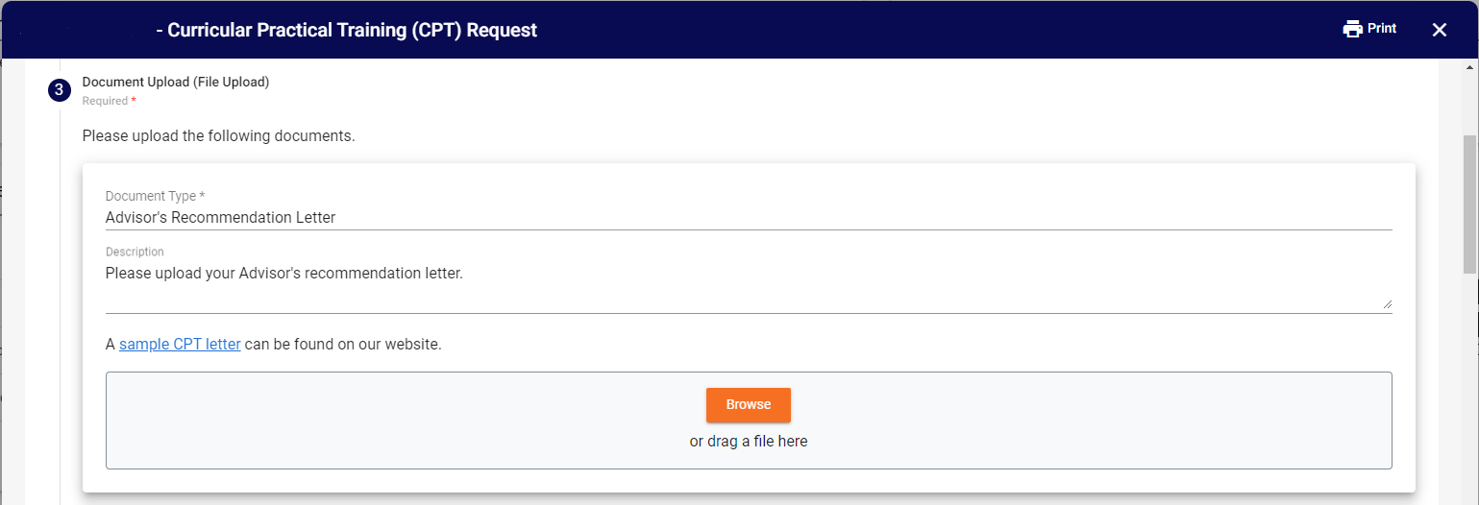
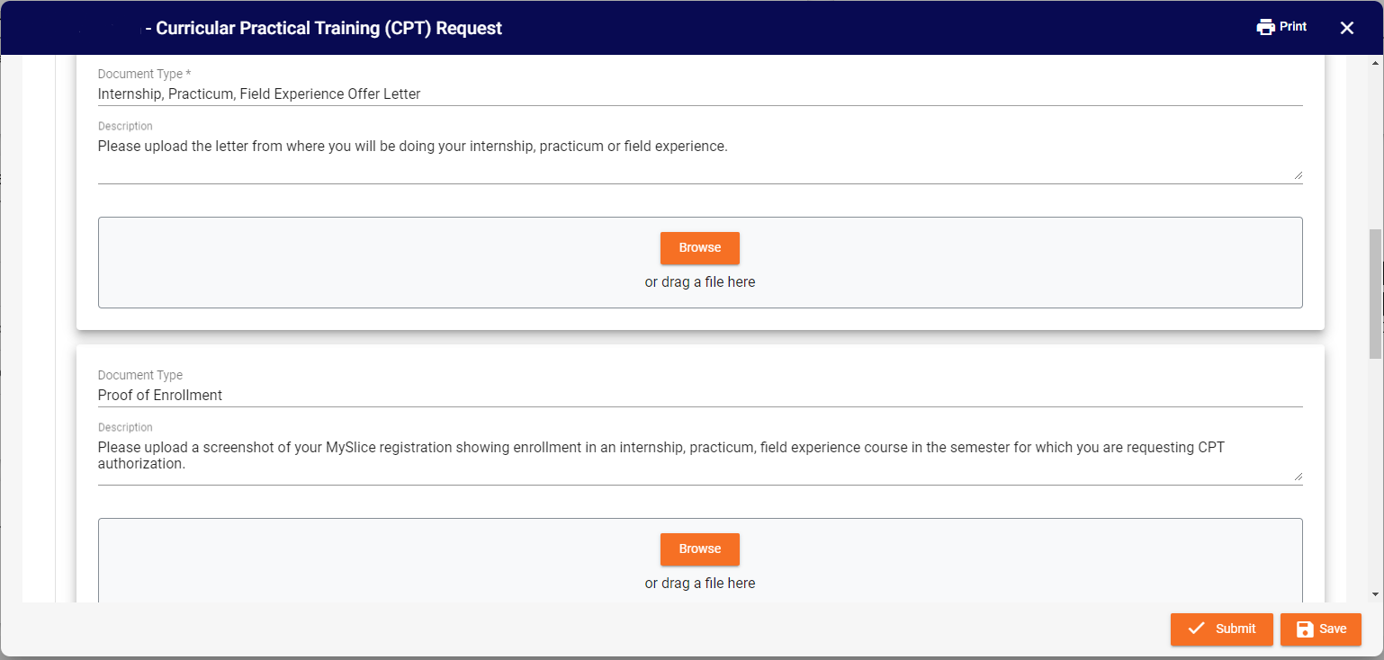
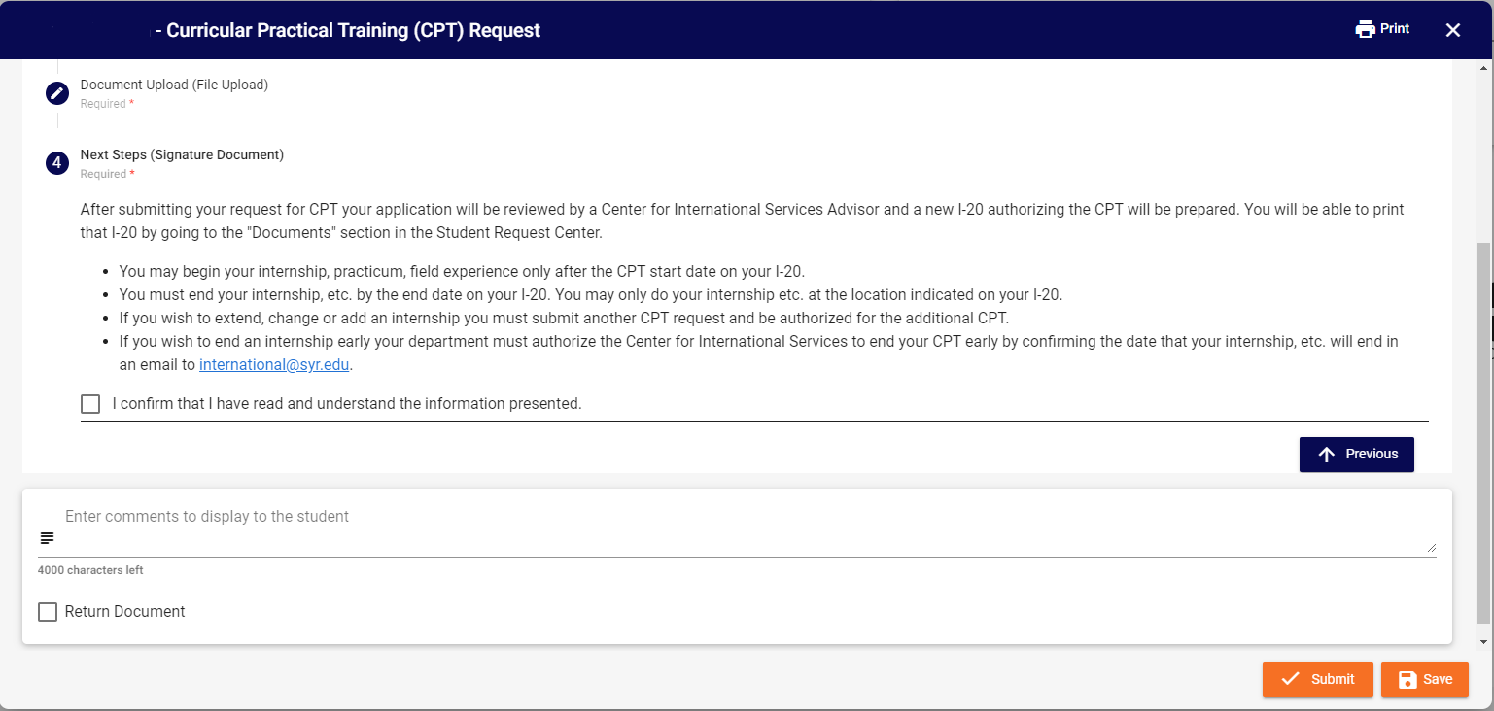
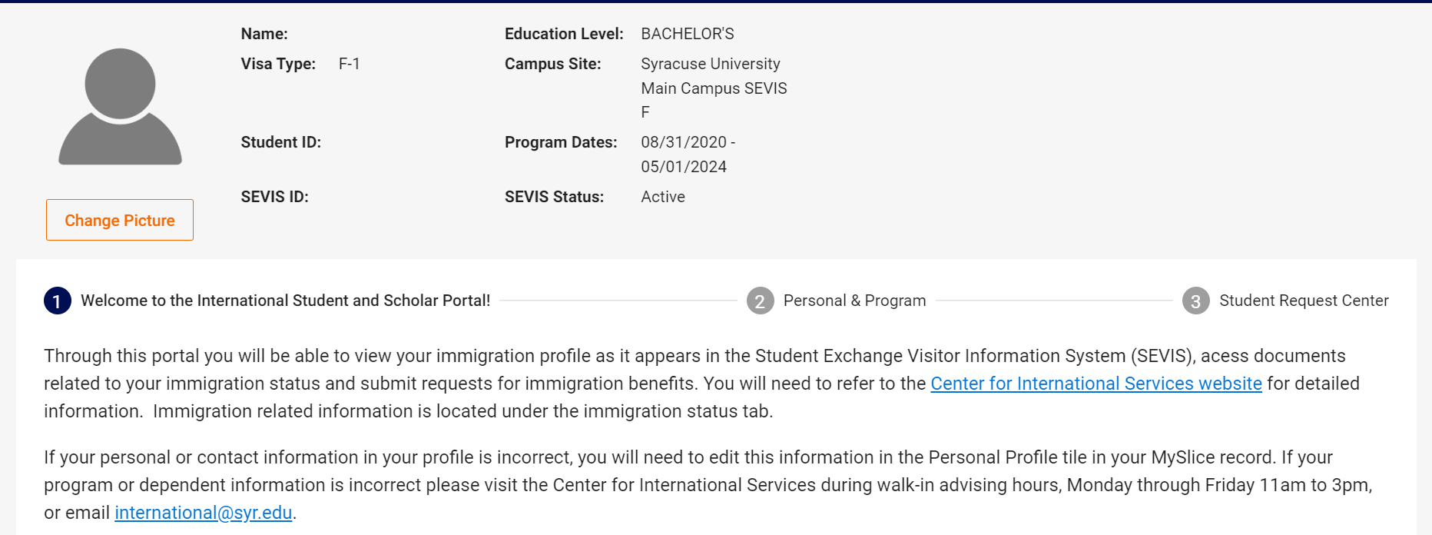
STEP 4: Complete the Curricular Practical Training Request in the ISSS Portal
Log in to the International Student and Scholar (ISSS) Portal through MySlice.
Go to the Student Request Center.
Find the Curricular Practical Training (CPT) Request.
Complete the Questionnaire.
Upload the Required Documents:
  Advisor’s Recommendation Letter
  Internship, Practicum, Field Experience Offer Letter
  Proof of Enrollment
  Most recent I-94
Read the Next Steps and Confirm.
Submit Request.
Center for International Services

Slide 19
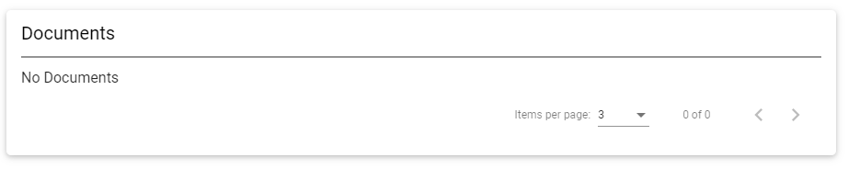
Downloading your CPT I-20 from the ISSS Portal:
Within 3-5 business days you should receive an email that your CPT I-20 has been processed and is available in the ISSS Portal.
Steps to retrieve your I-20:
  Go to the ISS Portal
  Navigate to the Student Request Center
  Find the documents section
  Download, print and sign your I-20
Center for International Services

Slide 20
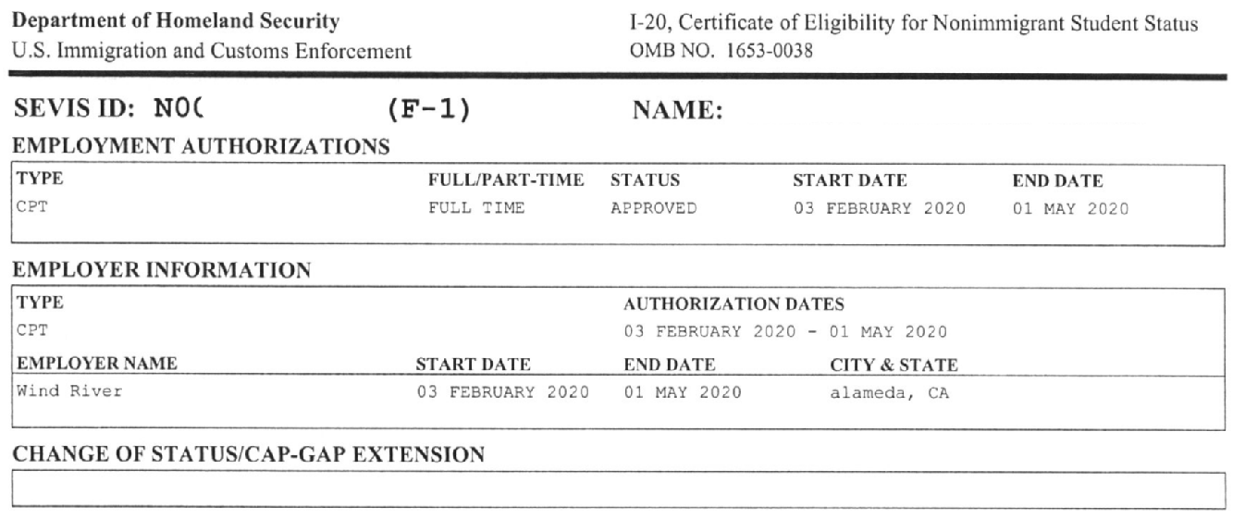
CPT Authorization
Your CPT Authorization will be on Pg. 2 of your I-20. Make sure to review the information to ensure it is correct.
Center for International Services

Slide 21
When Can I begin working?
In order to begin “working”: You must have CPT approval and it must be the day of or after the CPT authorization start date
Center for International Services

Slide 22
Can I end my CPT early or change internships on CPT?
Yes, if any of these situations occur, please contact the Center for International Services
You will need to obtain documentation from your department:
that your internship has ended
that you have been recommended for a different internship
Center for International Services

Slide 23
I-9s, Social Security and Taxes
I-9: All employees in the U.S. must complete an I-9 Employment Eligibility Verification Form with their employers within 3 days of starting employment.
E-verify: Some employers participate in an electronic verification of identity and employment eligibility; this is not yet required by law
Social Security: Employment in the U.S. requires a Social Security Number (SSN). If you do not have an SSN, you may apply for a SSN once your CPT has been authorized and the start date is within 30 days
Taxes:
  Social Security and Medicare Taxes: Typically, non-resident F-1 students with authorized CPT are exempt from Social Security (F.I.C.A) and Medicare taxes as long as you continue to declare non-resident status for tax purposes.
  Income Taxes: Federal, state, and local taxes will be withheld from your paycheck by employers unless you qualify for a tax treaty exemption. (More information also available at the IRS website)
Center for International Services

Slide 24
Can I Travel Outside the U.S. While on CPT?
You remain in F-1 status while Authorized for CPT
Requirements for travel are the same
  Valid Passport
  Valid F-1 visa
  I-20 signed for Travel on Page 2 within the last 12 months
Center for International Services

