Slide 1
Living in Syracuse
2022 International Students Orientation

Slide 2
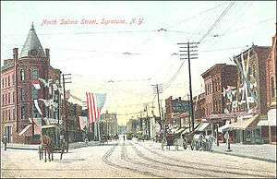
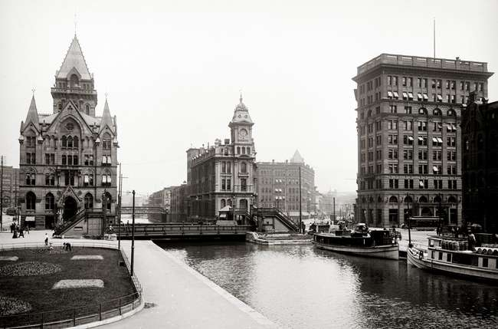
History of Syracuse
Representatives from Syracuse University
Haudenosaunee, “People of the Longhouse” or the Onondaga Nation, of the powerful Iroquois Confederacy, lived and continue to live in what we now call New York State
1600s - French Jesuits established a mission on the shore of Onondaga lake
1820 - the area we now call Syracuse was established as a town called “Bogardus Corners,” the name was eventually changed to Syracuse after Siracuse, Italy which is also on a salt lake
1825 - Erie Canal built and continued to run until the mid-1920s connecting the Great Lakes to the Atlantic Ocean
Syracuse is called the “Salt City” because its major industry was originally salt making from Onondaga Lake

Slide 3
Current statistics
Population: 149,310 – 5th most populous city in New York State
(larger: NYC, Buffalo, Rochester, Yonkers)
Demographics:
White: 53.44%
Black or African American: 29.39%
Two or more races: 6.95%
Asian: 6.95%
Other race: 2.34%
Native American: 0.92%
Native Hawaiian or Pacific Islander: 0.02%
Largest ancestries: Irish (15.9%), Italian (14.1%), German (12.2%), English (7.6%), and Polish (5.0%)

Slide 4
Upstate University health system 9,525
Syracuse University 4,621
St. Joseph's Hospital Health Center 3,745
Wegmans 3,713
Crouse Hospital 2,700
Loretto 2,476
Lockheed Martin 2,250
Time Warner Cable 1,800
National Grid 2,000
Raymour & Flanigan 1,400
Top
employers
Notes:
https://calendar.syracuse.edu/events/?_ga=2.110248645.1743761191.1660952429-579974476.1656011808

Slide 5
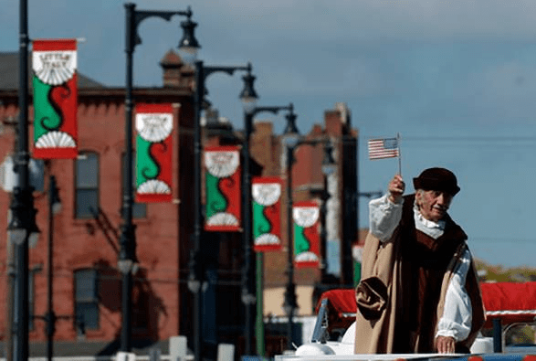
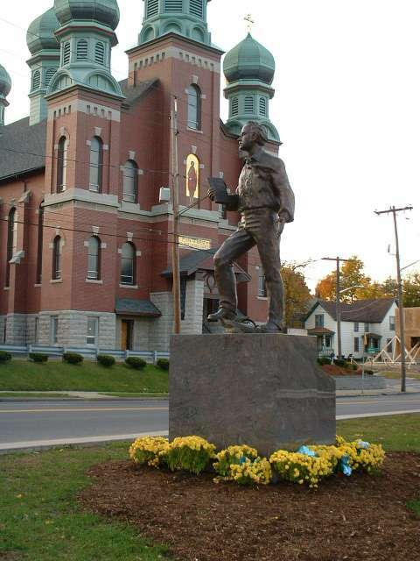
Historically diverse neighborhoods
Traditionally. . .
Irish, Polish and Ukrainian immigrants settled on the Westside
Jewish Americans settled on the Eastside
German and Italian immigrants settled on the Northside
African-Americans settled on the Southside

Slide 6
Neighborhoods
University Hill: Marshall Street, along with its terminus South Crouse Avenue, is lined with stores, bars, and restaurants catering primarily to students on “the hill” and the thousands of people who work in the area (at the University and the hospitals).
Westcott: located east of University Hill is known as a liberal bohemian quarter. Westcott Street’s main business district, between Beech and Dell streets, includes restaurants, bars, a theater, a consignment shop, a bicycle shop and more.
.

Slide 7
Neighborhoods
Eastwood: known as "the village within the city," this former village still has a lively local retail corridor featuring a movie theater, used bookstores, and cafes along James Street.
Northside: The traditional “Little Italy” has several blocks of bakeries, restaurants, pizzerias, shops, and services. Now a hub for refugee resettlement, the formerly Italian area includes many Southeast Asian restaurants and grocery stores as well as African markets and a Halal butcher. Destiny USA and the CNY Regional Farmers’ Market bound the area’s northwest end.
Eastwood: known as "the village within the city," this former village still has a lively local retail corridor featuring a movie theater, used bookstores, and cafes along James Street.
Downtown: Armory Square, the main retail and dining area of downtown, features many local restaurants, bars, pubs, clubs and retail stores. Downtown is also home to the Museum of Science and Technology (MoST) and the historic Landmark Theatre which hosts concerts, comedians, Broadway tours, and other events.

Slide 8
SU Timeline
1870: Methodist Episcopal church charters SU
1873: Hall of Languages, first building dedicated
1890: Orange becomes SU’s official color
1920: SU severs ties with Methodist church, becomes “nonsectarian”
1924: Maxwell School of Citizenship and Public Affairs founded
1931: SU adopts ‘Saltine Warrior’ mascot, abandoned in 1978 because it was offensive to Native American students

Slide 9
SU Timeline
1960: Undefeated football team’s only National Championship season,
beats Texas in ‘Cotton Bowl’
1961: Running Back, Ernie Davis, becomes only ‘Orangeman,’
first African American to receive Heisman Trophy.
He dies of Leukemia 2 years later, his legend endures in #44.
1980: $27 mil.Carrier Dome opens
1983: Lacrosse team wins first of 5 National Championships
1988: Terrorist bombing of Pan AM 103 kills 35 SU Abroad students over Lockerbie, Scotland
1995: For the first time, SU does not hold classes in recognition of Eid Ul-Fitr
2004: Nancy Cantor, the first female, named the 11th Chancellor, President
2014: Kent Syverud named 12th Chancellor, President

Slide 10
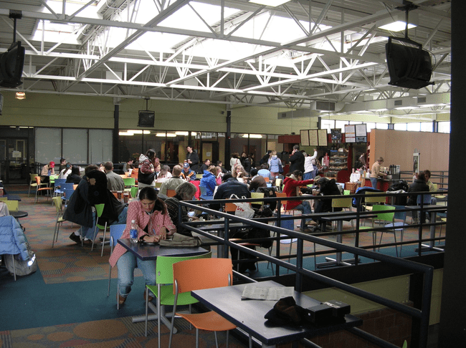
Practical Matters
Post-office: Marshall Square Mall
Teall Avenue
Libraries: on-campus: Bird, Carnegie
Public library
Dry cleaning: Bookstore has dry cleaning services
Barbers/hairstylists
Western Union: sending $

Slide 11
Buying Food
Grocery Stores
Area chains (there may be many of the same store in the area): Wegmans, Tops, Price Rite, Aldi’s, Price Chopper, Walmart
Wholesale Membership Clubs (for buying in large quantities): BJ’s
Farmers’ Market
CNY Regional Market, 2100 Park Street, Syracuse
Saturdays 7 am-2 pm year round; Thursdays 7 am-2 pm May-November
Sundays: flea market, 7 am -2 pm May-November
Westcott Community Center, 826 Euclid Ave., Wednesdays June – October
Downtown, Clinton Square, Tuesdays, June – October
Syracuse Real Food Co-op: member owned cooperative, source of local, organic goods
618 Kensington Road, in the Westcott neighborhood

Slide 12
Specialty Grocery Stores
Han’s Oriental Grocery: 2731 Erie Blvd E, (315) 446-7801
Far East & Asian Groceries, 924 Townsend St, (315) 476-9630
Laos Market, 317 Butternut St, (315) 474-2149
Samir’s, 811 E Genesee, (315) 422-1850
Jerusalem Super Market, 1927 Teall Ave, (315) 295-0456
Pyramid Halal Meats, 1700 Lodi St, (315) 314-7296
African & Caribbean Central Market, 703 N. Salina St, (315) 473-1588
Asia Food Market, 1449 Erie Blvd East, (315) 478-9888
India Bazaar, 4471 E Genesee, (315) 449-4400

Slide 13
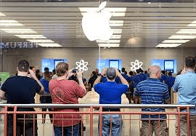
Electronics
Best Buy – 3401 Erie Blvd E, Dewitt, NY
Ra-Lin Discount – 625 Burnet Ave, Syracuse
Apple Store – Destiny USA

Slide 14
Amazon
UberEATS
DoorDash
Grubhub
Ticketmaster
Online shopping

Slide 15
Household/Personal Items
Walmart: 6438 Basile Rowe, East Syracuse
Target: Camillus, Fayetteville
K mart: 3469 Erie Blvd E, DeWitt, NY
Bed Bath and Beyond: 3409 Erie Blvd E, DeWitt
Dollar Stores: Dollar Tree (everything is a dollar), Family Dollar, Dollar General

Slide 16
Department stores
Clothes, shoes, coats, boots, appliances
In malls (many stores under one roof)/plazas (many stores under a covered walkway)
Macy’s, Destiny USA;
Discount department stores-name brands at cheaper prices
Marshall’s: 3405 Erie Blvd E, Syracuse
TJ Maxx: Destiny USA, Fayetteville

Slide 17
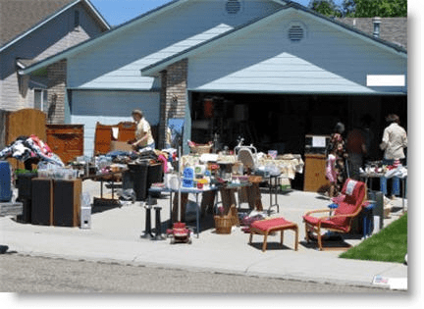
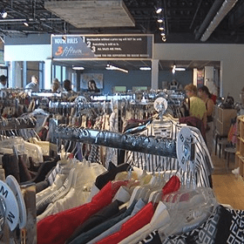
Consignment shops/Thrift stores
People sell their used clothes and the store keeps a percentage of the sale price
Clothes Mentor: Erie Blvd E, Syracuse
Cluttered Closet: S Beech St (the Westcott neighborhood)
Salvation Army: Erie Blvd E
Rescue Mission Stores
3fifteen in Marshall Square Mall
Yard/Garage sales
Be careful about buying used furniture-upholstered furniture, mattresses, and rugs can transport “bed bugs” (insects)

Slide 18
On campus Recreation services Gym: The Barnes Center at the Arch Goldstein Fitness Center Ice skating: Tennity Ice Pavilion Outdoor Education Skytop Recreation Area Pools: Webster, Sibley
Recreation

Slide 19
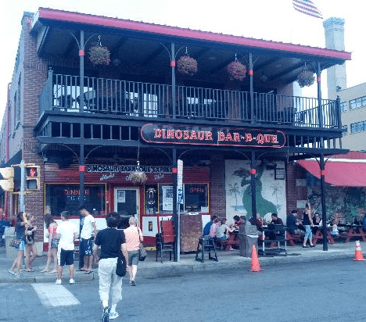
Restaurants/night life
Close to campus
Inn complete
Marshall Street
Westcott Street
Armory Square
Tipperary Hill
Erie Blvd.
LGBT Bars:
Rain and Trexx
Local Restaurants:
Dinosaur BBQ
Pastabilities
Funk n’ Waffles
LoFo
Flame
Mom’s Diner
International Cuisine
Firudo
New Century
Boom Boom Mex Mex
Alto Cinco
Euro Bazar Restaurant
Blue Monkey
Orange Asian Café
Old Chengdu Café
Ethioeritrea Restaurant

Slide 20
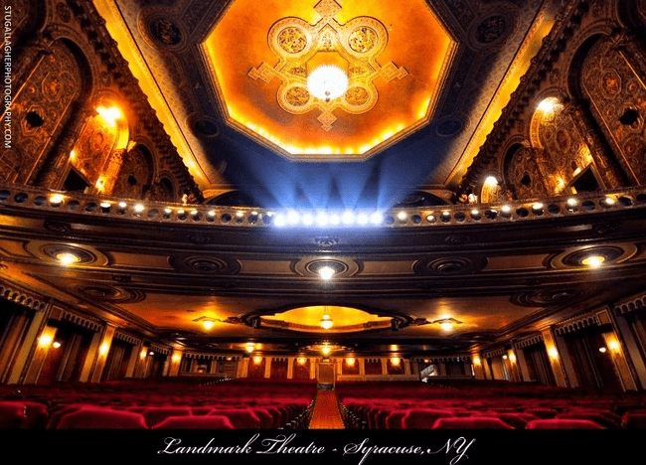
On campus
Movies: Destiny USA, Palace Theater, Hollywood Theatre - Mattydale (cheap movies), Manlius Art Cinema (independent films), Movie Tavern
Theatre: Landmark Theatre, Syracuse Stage, Red House
Music Concerts: Westcott Theater
The OnCenter
Movies & Theatre

Slide 21
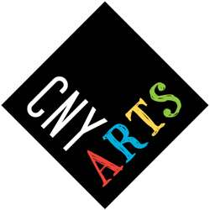
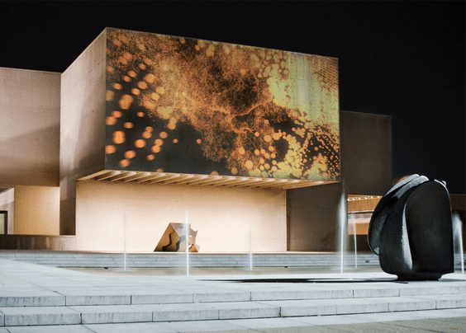
Everson Museum of Art
Museum of Science & Technology(MoST)
Erie Canal Museum
Salt Museum
Onondaga Historical Society
ArtRage Gallery
Museums

Slide 22
Sports
On campus: purchase tickets to games for. . .
basketball, football, lacrosse
Free tickets: soccer, volleyball
Semi-professional teams
Baseball: Syracuse Mets
Hockey: Syracuse Crunch

Slide 23
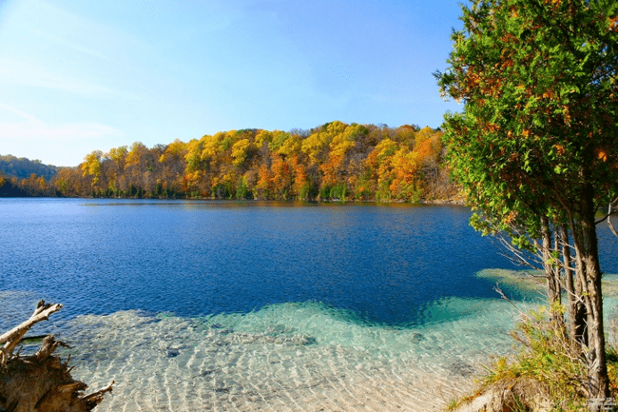
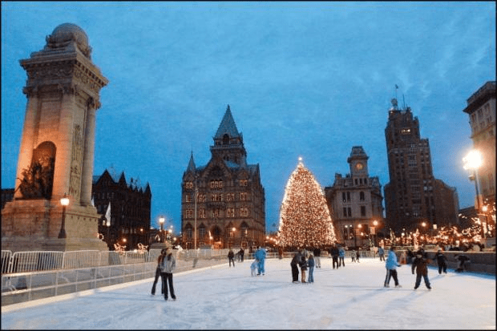
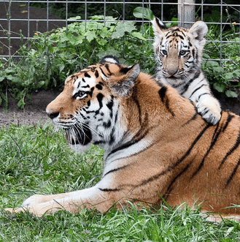
Outdoors
Rosamond Gifford Zoo
Green Lakes
Beaver Lake
Berry Park (Westcott)
Clark Reservation
Onondaga Lake Park
Golfing
Skiing
Ice Skating
Indoors
Wonderworks
Bowling
Indoor Go Karts

Slide 24
Nearby
Skaneateles: shopping, lake
Seneca Falls
Women’s Rights National Historic Park
Canastota
International Boxing Hall of Fame
Auburn
Harriet Tubman House
Cooperstown
Baseball Hall of Fame
Cazenovia
Stone Quarry Hill Art Park
Ithaca: gorges, Cayuga Lake, hiking, concerts/events
Finger Lakes Wine Trail
The Adirondack Mountains
Buffalo/Niagara Falls (2.5-3 hour drive)

