Slide 1
Spring 2022 Immigration Essentials- Part 2
Center for International Services

Slide 2
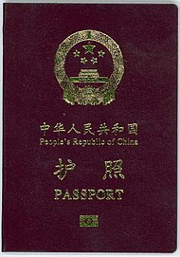
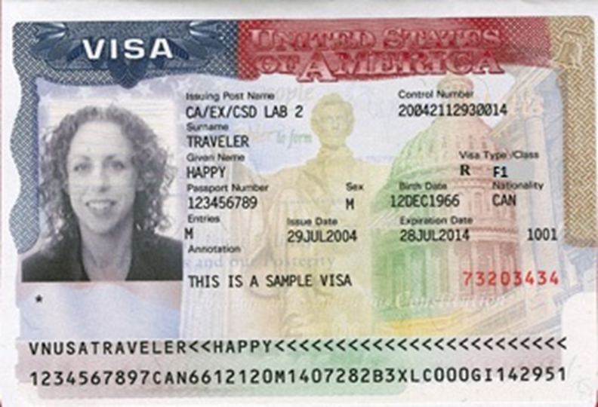
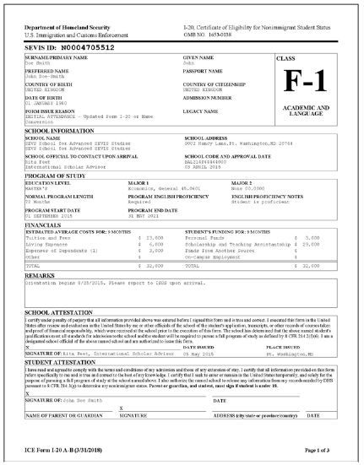
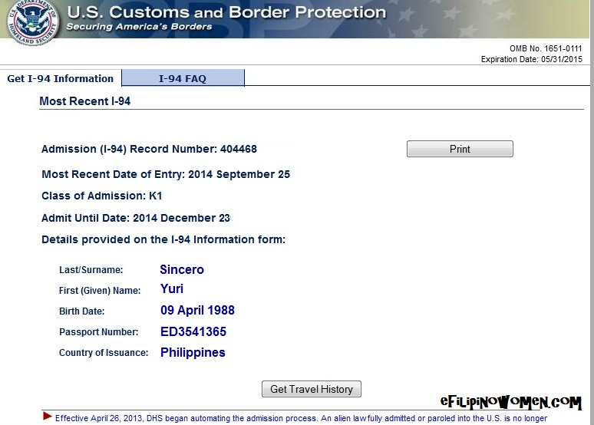
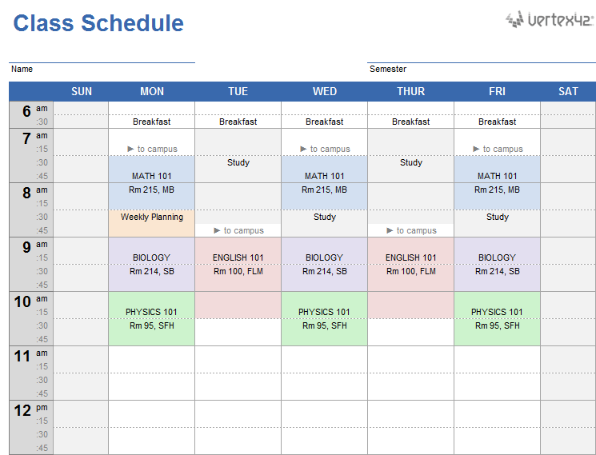
3 Do’s and a Don’t
DO - Keep your Documents valid
DO - Update your Information
DO - Register Full-time every semester
Don’t - Engage in unauthorized Employment
Center for International Services

Slide 3
D
Keep Your
ocuments valid!
I
Update Your
nformation!
F
Register
ull-time every semester!
E
Do not engage in unauthorized
mployment!
Center for International Services

Slide 4
Documents
Passport:
Keep your passport valid at all times
must be valid for 6 months into the future when entering the U.S. unless a citizen of the 6 month club
Visa:
Must be valid when entering the U.S.
Can expire while in the U.S.
I-94:
Check every time you enter the U.S.
F-1/J-1
D/S
I-20/DS-2019:
Program of Study
Program End Date
Travel Signature
Center for International Services

Slide 5
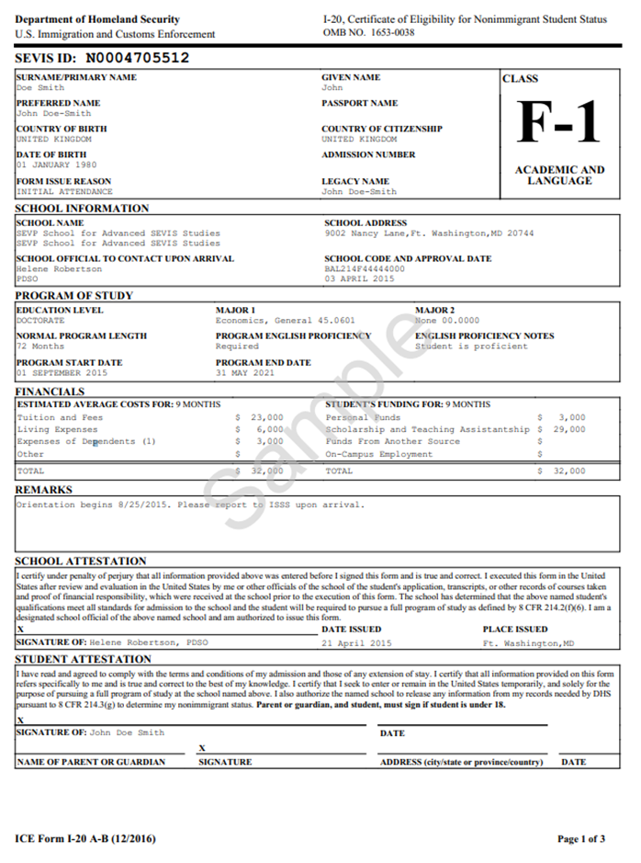
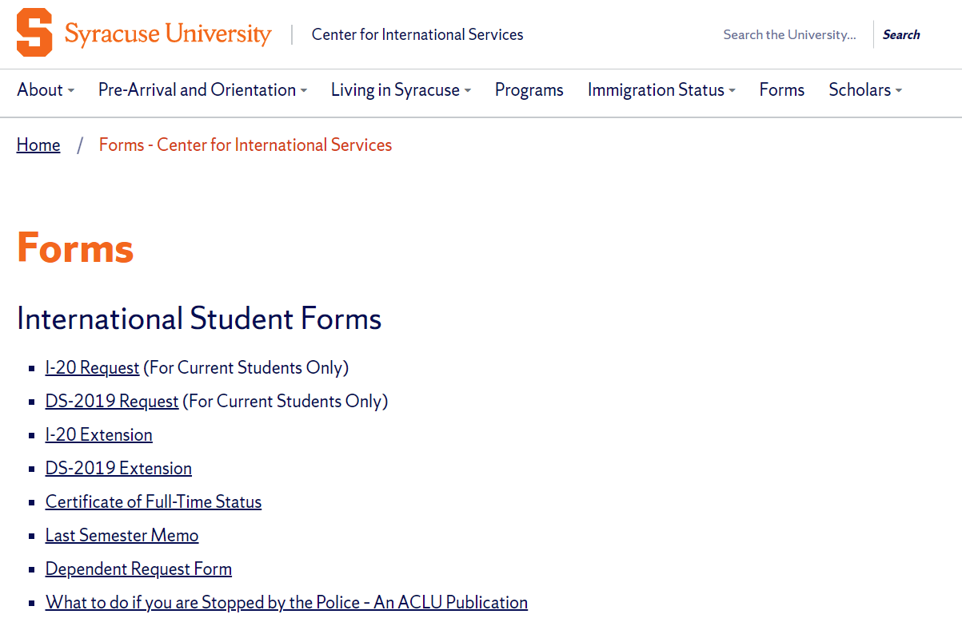
Program
Change Level of Study (Masters to Ph.D. or Ph.D. to Masters)
Program of Study (Computer Science to Computer Engineering)
I-20/DS-2019 Request on the Center for International Services Website
Center for International Services

Slide 6
Program End Date
If you need less time
changed when finish
If your need more time
I-20/DS-2019 Extension Request on the Center for International Services Website
Center for International Services

Slide 7
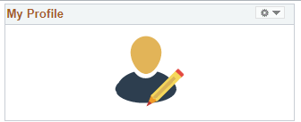
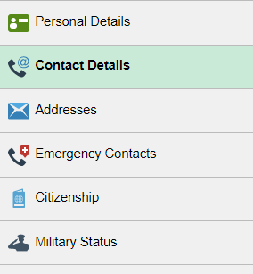
Information in MySlice
Name
Address
Current-here in Syracuse
Permanent-outside the U.S.
Phone Number
Emergency Contact Information
Center for International Services

Slide 8
Full-time Registration
Grad Students-
9 credit hours every Fall and Spring semester
Summer registration not required by immigration regulations but may be required by your program
Only one course can be taken online toward full-time registration (3 credits out of 9)
Center for International Services

Slide 9
Full-time Registration
Exceptions:
Final semester-can be registered for less than 9 credits if you need less than 9 credits to complete your degree-need Last Semester Memo
Teaching and Research Assistants-must be registered for something + have TA or RA
Certificate of Full-time Status
working on thesis or dissertation
studying for a qualifying exam
Internship
Center for International Services

Slide 10
Full-time Registration
Other Special Exceptions:
First Semester
Difficulty with English Language
Unfamiliarity with American teaching methods
Improper Course Placement
Must be documented by faculty member in writing
Medical Reasons
Must be documented by licensed medical doctor, doctor of osteopathy, or licensed clinical psychologist
Consult with an advisor from the Center for International Services first!
Center for International Services

Slide 11
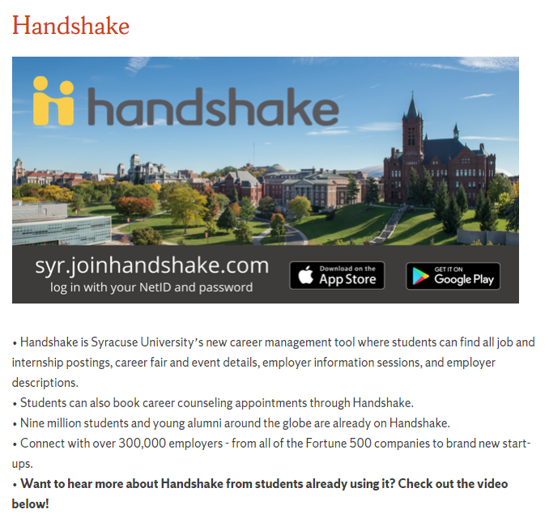
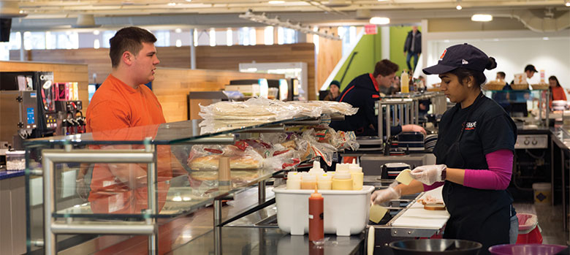
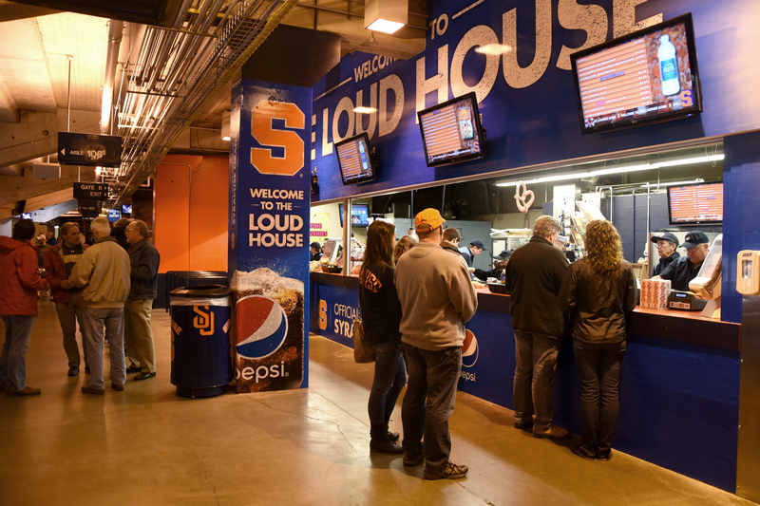
Employment
First Year (two semesters) in F-1 status limited to On campus employment
20 hours per week while school is in session; full-time during breaks
Spring Break 2022: March 12, 2022 to March 20, 2022
Summer 2022: May 6, 2022 to August 28, 2022
Thanksgiving Break 2022: November 20, 2022 to November 27, 2022
Winter Break 2022-2023: December 18, 2022 to January 16, 2023
Means On Campus and paid by SU; F-1 students are not eligible for jobs that are listed as requiring “Work Study”
Center for International Services

Slide 12
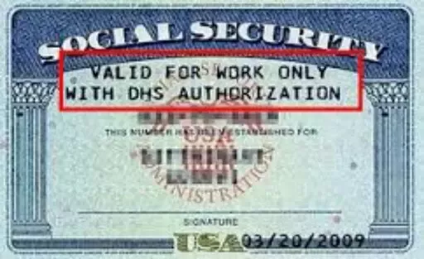
Social Security Numbers
Used for the purpose of tracking income to be taxed appropriately and eventually to earn retirement income
Only eligible if working/employed-not needed to begin working
Not needed to open a bank account, get a drivers license or obtain a credit card
Is not proof of identity – No photo on the card
Social Security Administration Offices are CLOSED-Social Security Number applications have to be done by mail through the Center for International Services
If you are hired on campus, Payroll will let the Center know and we will contact you with instructions
Center for International Services

Slide 13
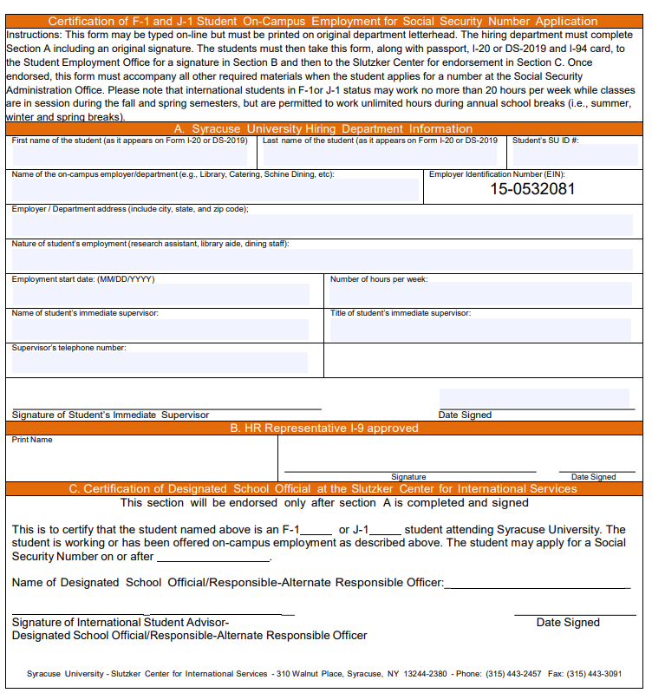
Social Security Number Based on On Campus Employment
Employer Verification Form (EVF)-needed to apply for SSN
The Center for International Services will contact you when we receive an EVF from Student Employment and you are able to apply for an SSN
Will likely be after you receive your first paycheck
Center for International Services

Slide 14
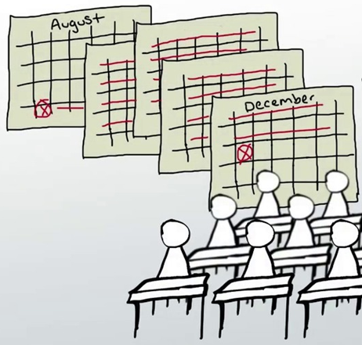
Employment Continued
After two semesters (Fall and Spring, Spring and Fall)
Eligible for
F-1s
Curricular Practical Training
Optional Practical Training
Economic Necessity
J-1s
Academic Training
Economic Necessity
Curricular
Practical
Training
Optional
Practical
Training
Center for International Services

Slide 15
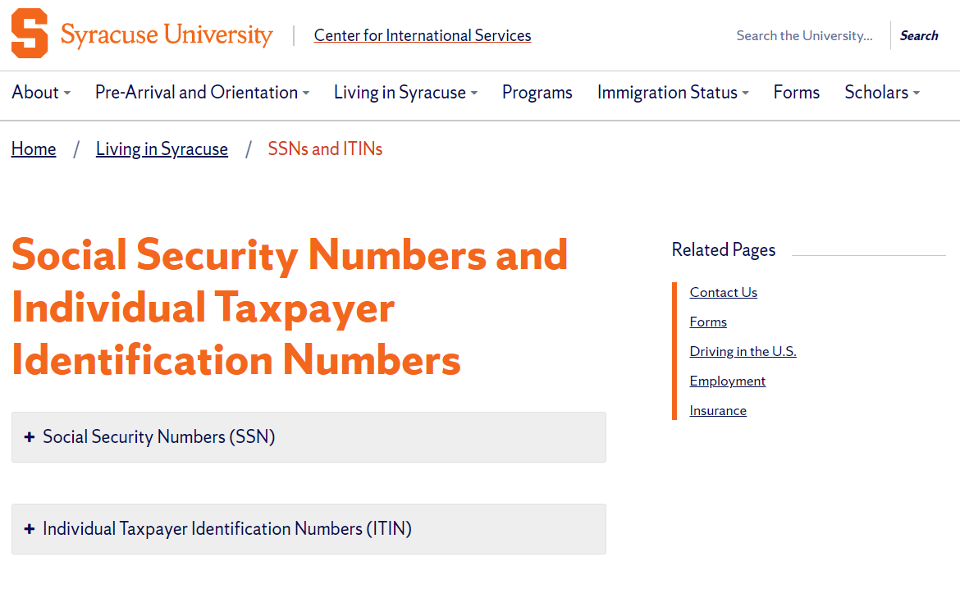
Individual Taxpayer Identification Numbers (ITINs)
Fellowship and Scholarship holders only
NOT if only receiving a reduction in your tuition that may be called a scholarship on your I-20
Information on the Center for International Services website website
Center for International Services

Slide 16
Dependents
Spouses and Children under 21 yrs. of age-not mother, father, sister, brother, grandma, etc.
Dependent Request Form on Center for International Services Website
Must submit financial support documentation & health insurance to bring dependents
Their legal status is linked to your status
F-2s cannot seek employment
F-2s cannot enroll in full-time course of study or degree program, except K-12
Center for International Services

Slide 17
Leaves of Absence
Medical:
Must submit written recommendation from a licensed physician, clinical psychologist or doctor of osteopathy
May remain in the U.S. while on an approved Medical Leave of Absence
Personal:
Must begin with academic department
F-1/J-1 status will be terminated
May not remain in the U.S. while on a Personal Leave of Absence
Center for International Services

Slide 18
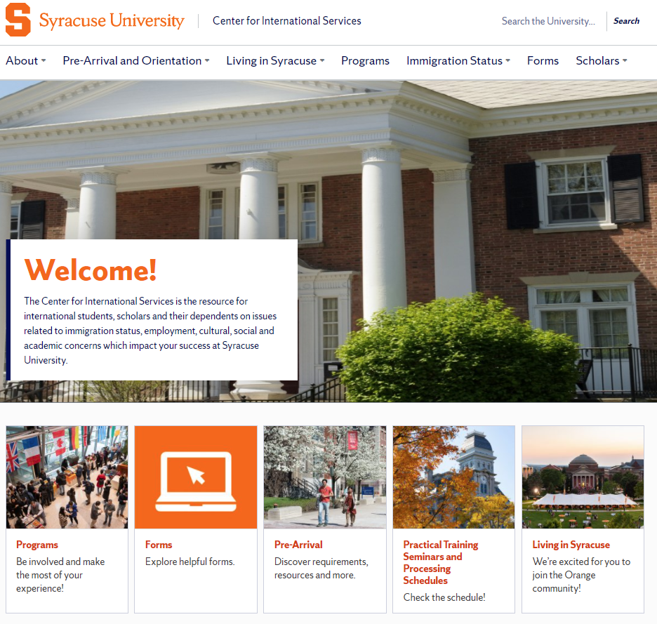
international.syr.edu
Center for International Services

Slide 19
Top Ten Tips for Using Our Office
10. Use our Advisor on Call hours, Monday through Friday, 11 am -3 pm: someone is always available during those times; outside those times you risk having no one available to see you.
9. Use our general office email: international@syr.edu; it is monitored several times a day, Monday through Friday, and messages are distributed to advisors throughout the day, Monday through Friday. Remember our office is closed over the weekends so an email you send on Friday at 9 pm will likely not be read until sometime on Monday. If you have a real emergency, you can always contact DPS and they know how to contact the Director.
8. It is best practice to either email OR call OR come in; you do not need to do all three.
7. It is best practice to email one advisor about a topic, not all the advisors with the same message; it is best practice to email international@syr.edu OR an individual advisor. Best practice is likely to get you the fastest response!
6. Try looking under the immigration tab on our website for an answer to your question first…there is a lot of information there!
Center for International Services

Slide 20
Top Ten Tips for Using Our Office
5. Include your SU ID Number in all emails to the office.
4. It is a good practice to bring your immigration documents with you to the office if you are coming to ask an immigration question.
3. Immigration advice relates to an individual and specific circumstances. Advise that was given to a friend may not be applicable to you.
2. You should seek advice before you act or fail to act on immigration matters. It is easier to help you before you have a situation than after you have a problem.
1. If you receive an email from international@syr.edu , READ IT! We try to send only really important information from that email address. It is something you need to know. And sometimes something you need to take action on. Do not miss a deadline because you did not read your email.
Center for International Services

Slide 21
Quiz Time!
https://create.kahoot.it/share/grad-immigration-session/3acf2fd1-3e2f-48fe-a1c1-484e802889a8

Slide 22
Quiz Questions
How many months is a travel signature valid for?
How many hours per week can a student work on campus when school is in session?
How many credit hours does a grad student have to register for each semester to be considered enrolled full-time?
Does your visa have to be valid while in the U.S.? Passport?
How many days is the grace period after you complete your studies? F-1? J-1?
Can you renew a visa from within the U.S.?

