Slide 1
Scam Alert
Department of Public Safety

Slide 2
What is a scam?
Obtaining money/personal information by using deception
Fake personalities
Fake photos
Fake template letters
Forged documents
Non-existent phone numbers
Non-existent address

Slide 3
Types of Scams
Phishing email scams
The Out of the Country Inheritance scam
Greeting card scams
Bank loan or credit card scam
Lottery scam
Hitman scam
Romance scams
Fake antivirus software
Facebook impersonation scam (hijacked profile scam)

Slide 4
Types of Scams
Make money fast scams (Economic scams)
Travel scams
Bitcoin scams
Fake news scam
Fake shopping websites
Loyalty points phishing scam
Job offer scams
SMS Scamming(Smashing)

Slide 5
Email Scams

Slide 6
Email Scams
Receive an email
Individual needs to launder money
Offers to make you rich
Requires upfront fees
Sometimes, more than money is lost
Often perpetrated from other countries

Slide 7
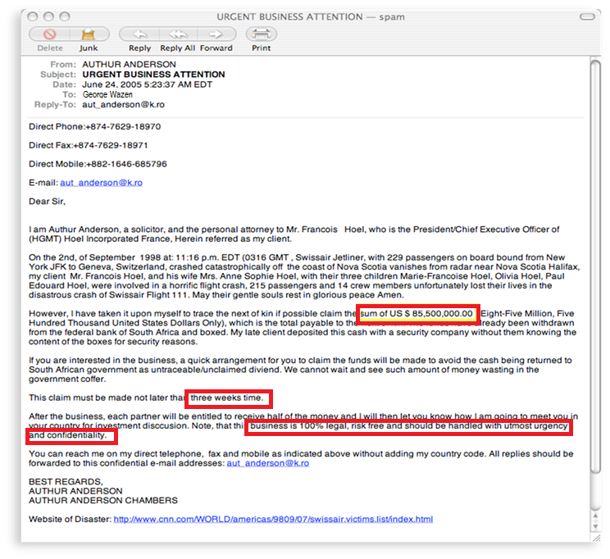
Email Scams

Slide 8
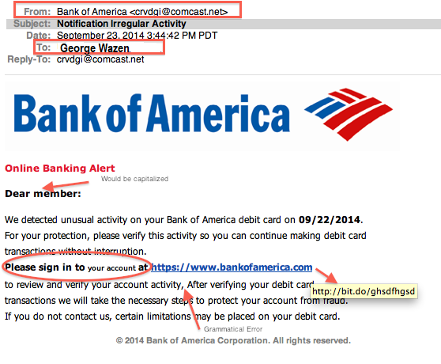
Email Scams

Slide 9
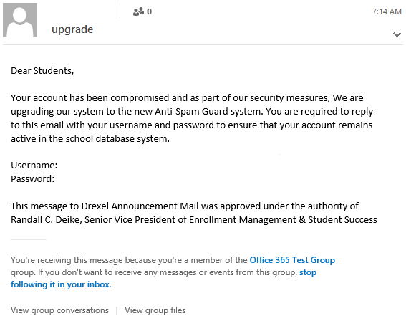
Email Scams

Slide 10
Postal Mail / Check Fraud

Slide 11
Postal Mail / Check Fraud
Victim is selling something online
Anxious buyer needs item immediately
Buyer must ship item after receiving check
Check is forged
But item is already sent

Slide 12
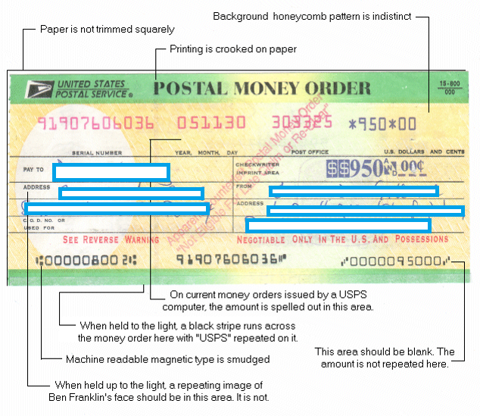
Postal Mail / Check Fraud

Slide 13
Telephone Scams

Slide 14
Telephone Scam
Travel Packages. “Free” or “low cost” vacations can end up cost­ing a bundle in hidden costs. Some of these vacations never take place, even after you’ve paid.
Credit and loans. Advance fee loans, payday loans, credit card protection, and offers to lower your credit card interest rates are very popular schemes, especially during a down economy.
Sham or exaggerated business and investment opportunities. Promoters of these have made millions of dollars. Scammers rely on the fact that business and investing can be complicated and that most people don’t research the investment.
Charitable causes. Urgent requests for recent disaster relief efforts are especially common on the phone.
High-stakes foreign lotteries. These pitches are against the law, which prohibits the cross-border sale or purchase of lottery tickets by phone or mail. What’s more, you may never see a ticket.
Extended car warranties. Scammers find out what kind of car you drive, and when you bought it so they can urge you to buy overpriced — or worthless — plans.
“Free” trial offers. Some companies use free trials to sign you up for products — sometimes lots of products — which can cost you lots of money because they bill you every month until you cancel.

Slide 15
Telephone Scams
Don’t Say Yes Scam
https://youtu.be/VH6Oj8jhu40
We will Cancel your Student Visa Scam
https://youtu.be/qnXRZj9I9yA

Slide 16
Internal Revenue Service Imposters

Slide 17
Internal Revenue Service Imposters
The I.R.S. will not:
Call to demand immediate payment, nor call about taxes owed without first having mailed you a bill.
Demand that you pay taxes without giving you the opportunity to question or appeal the amount they say you owe.
Require you to use a specific payment method for your taxes, such as a prepaid debit card.
Ask for credit or debit card numbers over the phone.
Threaten to bring in local police or other law-enforcement groups to have you arrested for not paying.

Slide 18
Measures You Can Take To Avoid Fraud

Slide 19
Measures You Can Take To Avoid Fraud
Do online searches (Reviews, Complaint, Scam, IRS call)
Don’t believe your caller ID (scammers are able to manipulate the number reported)
Don’t pay upfront for a promise
Consider how you pay
Talk to someone and ask questions
Hang up on robo-calls
Don’t deposit a check and wire money back
ftc.gov/scams

Slide 20
Measures You Can Take To Avoid Fraud
Federal Trade Commission
Bureau of Consumer Protection
600 Pennsylvania Avenue NW
Washington, DC 20580
(877) 382-4357
TTY: (866) 653-4261
https://www.consumer.ftc.gov/

Slide 21
Measures You Can Take To Avoid Fraud
Remember: Scammers will often try to rush you into a decision, offering you a limited “very attractive” opportunity.

Slide 22
Protect Yourself:
Be wary of messages or emails asking for passwords or other personal information
Most reputable businesses and organizations will not ask for this information via email
Never send passwords, bank account numbers or other private information in an email
Do not reply to requests for this information
Verify by contacting the company or individual, but do not use the contact information included in the message

Slide 23
Protect Yourself:
Since some scams are so well organized and convincing, and people behind them so difficult to catch, we need to always keep our guard up. Stay informed about the latest scamming strategies, and remember
If it sounds too good to be true, it probably is!

Slide 24
Questions?
Department of Public Safety

