Slide 1
Staying Healthy at SU
Images are for illustrative purposes only.

Slide 2
Stay Safe Pledge
Take the pledge at syracuse.edu/stay-safe-pledge today!
Enrollment and the Student Experience

Slide 3
Staying Healthy: Keeping Myself Safe
Provide documentation of COVID-19 vaccination or exemption to the Barnes Center prior to my return to campus.
Wear a mask and maintain 6 feet of distance from others if I am not vaccinated and am accessing campus with an approved medical or religious exemption.
Wash my hands regularly.
Monitor my health for symptoms of COVID-19 and notify the Barnes Center if I exhibit symptoms.
Enrollment and the Student Experience

Slide 4
Staying Healthy: Keeping the Orange Community Safe
Wear a mask in certain designated spaces on campus such as the Barnes Center Health office and Flanagan Gymnasium health clinic.
Comply with New York State travel guidelines for any personal travel.
Adhere to all directives and University guidance if I need to be quarantined or isolated.
Don’t attend in-person classes or participate in activities if exhibiting any symptoms of the COVID-19 virus, are awaiting clinical test results, or test positive for the virus.
Participate in any testing required throughout the summer.
Enrollment and the Student Experience
Notes:
If you have received the vaccine, you are currently not required to participate in weekly testing. Only students, faculty and staff who are accessing campus under a valid medical or religious vaccine exemption are required to test weekly. Compliance with this requirement will be monitored regularly.
COVID Surveillance Testing is available on campus to all members of our campus community—including family members of our employees. Testing is currently available at Kimmel Dining Hall during the summer months, open Monday – Friday, 8am – 12 noon. No appointments are required. Please bring your SU ID and refrain from eating, drinking anything (including water), brushing your teeth or using mouthwash, chewing gum or using any tobacco products in the 30 minutes prior to testing.

Slide 5
Staying Healthy: Keeping the Orange Community Safe
Immediately notify Syracuse University's COVID-19 Office of a positive COVID-19 test result if receiving a test not provided by the University. Upload the results of that test to the patient portal.
Immediately and honestly participate in contact tracing.
Encourage others to follow these terms and support anyone who chooses to wear a mask for any reason.
Follow all health and safety directives from University officials.
Follow directives from the Centers for Disease Control and Prevention, New York State, and/or local authorities that become public during the summer.
Enrollment and the Student Experience

Slide 6
Staying Healthy
Wash your hands frequently.
Eat well, drink plenty of fluids and get enough sleep.
Avoid sharing food, drinks, chapstick, lipstick, etc.
Dress for the weather (warm boots, coats, hats, scarves and gloves).
Enrollment and the Student Experience
Notes:
Health
Taking care of yourself can help prevent illness by keeping your immune system boosted.
Staying hydrated is important to your overall health. If you are dehydrated when you are ill, it takes more of a toll on your body.
80-100 oz of water daily is recommended.
At least 6 hours of sleep at night promotes better focus and well-being.
Viruses are spread very quickly from person to person and sharing increases your risk of exposure.
Wash your hands or use hand sanitizer, especially after coughing/sneezing, using a tissue, coming into contact with others who are ill (desk tops, door knobs, elevator buttons, etc.)
Flu shots: HS will be offering flu shots in January through the pharmacy. Watch our website for other planned dates/times. The incidence of flu is rising in NYS right now and it takes approximately 2 weeks to build immunity to the flu after getting the flu shot. The flu can take you out of class for 1-2 weeks, which is an unnecessary risk.
Nutrition services are available should you find yourself having difficulty adapting to the foods we have here. Call to make an appointment.

Slide 7
COVID-19 Symptoms
If you have any of the below symptoms or have been in contact with someone COVID-19 positive, call to schedule an appointment
Cough
Temperature Above 100.4 ˚F, 38 ˚C
Chills
Congested/Runny Nose (Unrelated to seasonal allergies.)
Difficulty Breathing, Shortness of Breath
Diarrhea
Nausea, Vomiting
New Loss of Taste or Smell
Sore Throat
Headaches, Body/Muscle Aches (Unrelated to strenuous activity, exercise or chronic medical/physical conditions.)
Enrollment and the Student Experience

Slide 8
Testing Positive for COVID-19
The Barnes Center and campus partners are here to help.
Don’t leave your residence until further instructions are provided.
If tested at the Barnes Center, you will be contacted with instructions.
If tested elsewhere, call the Barnes Center at 315.443.8000 for instructions.
Enrollment and the Student Experience

Slide 9
Things to consider:
If not life-threatening, visit Health Care before an Emergency Room.
24-Hour Mental Health and Medical Consultation Support 315.443.8000.
If Health Care is closed, an Urgent Care may be a more affordable option.
Health Care functions as a doctor’s office (e.g. appointments, referrals).
Enrollment and the Student Experience
Notes:
Health
We are lucky here on campus to have many health care resources.
Local Emergency Rooms: or Urgent Cares:
Crouse Hospital or Crouse ExpressCare – ER copays
Five Star Urgent Care in Fayetteville – Lower copay
University Hospital or University Hospital-Community General Campus – ER copay
St. Joseph’s Hospital – ER copay
**This information can be found on the Barnes Center website
Before going to the emergency room, call the Barnes Center to discuss your options.

Slide 10
Health Care Resources
Behavioral Health Interns
Pharmacy
Psychiatry
Laboratory
Medical Professionals (e.g. physicians, nurses)
Medical Transport
Nutritionist
Syracuse University Ambulance (SUA)
Enrollment and the Student Experience

Slide 11
What to Do When You Are Sick
Make an Appointment
Call 315.443.8000.
Patient Portal
Bring to Your Appointment
SU ID
Insurance Card
Enrollment and the Student Experience
Notes:
Health
Barnes Center Health can care for students only. If you have a family member here with you that requires medical care and are unsure where to seek care, you can call the Barnes Center to get a listing of community resources.
It is important to know that it is flu season and appointment availability can sometimes be difficult, so don’t wait to schedule an appointment if you are unwell.
Appointments become available at midnight for that same day for online booking through the patient portal.
The majority of respiratory illnesses in adults are viral
Antibiotics do NOT fight viruses
The flu, common cold and mononucleosis are all viruses

Slide 12
Health Insurance, Rates and FAQ
Each year, all full-time, matriculated undergraduate, graduate and law students are required to demonstrate proof of qualifying health insurance coverage. (Eligible students including TA’s, GA’s, RA’s and Fellows )
Student Health Insurance Plan
•Students must enroll into or waive the Student Health Insurance Plan by Monday, Sept. 20, 2021.
•The Student Health Insurance Plan is insured and administered by Aetna Student Health (https://www.aetnastudenthealth.com).
•The anticipated 2021-22 annual premium is $2,143.80(subject to plan approval by NY State).
•The annual premium is added to your Bursar account. The premium is removed for those with an approved waiver demonstrating qualifying coverage.
•2021-22 coverage is effective Sunday, Aug. 1, 2021 through Sunday, July 31, 2022.
•Pro-actively enroll on Myslice by Monday, July 19, 2021 to activate the insurance coverage and card on Sunday, Aug. 1, 2021. Failure to take action will result in a delay with the insurance coverage and card.
Enrollment and the Student Experience

Slide 13
What does SHIP cover & where can I get more information?
•SHIP provides worldwide coverage, including in all 50 States, for medical services and prescriptions (in-network and out-of-network).
•Medical Evacuation and Repatriation coverage is included.
•No waiting periods for pre-existing conditions.
•Age 18 or younger: pediatric dental and vision coverage is included
•Age 19 or older: a vision discount program is included, but no dental coverage.
•Additional out of pocket expenses for most services!
•Deductibles, co-payments and co-insurances
•In-network, participating providers are best option to keep costs lower
•More information about SHIP, including finding participating providers, printing insurance cards, Teladoc, Travel Assistance, and viewing the Aetna Benefit Summary can be found on Aetna's website: https://www.aetnastudenthealth.com/en/school/474908/index.html
Enrollment and the Student Experience

Slide 14
Out of Pocket Expenses
Additional expenses you will be due to pay
•Deductible- The cost you must pay before SHIP begins to pay for covered services.
•$100 deductible (in-network) when seeking medical services outside of SU Health Services
•Co-payment- The fixed dollar amounts you pay for covered healthcare, usually when you receive a service.
•$25 co-payment (in-network) Physician or Specialist
•$15 generics, $30 Preferred brand, $50 non-preferred brand (in-network) Prescriptions
•Co-insurance- Your share of the cost of a covered service, calculated as a percent of the allowed amount for the service
•10% co-insurance (in-network) X-rays, ultra-sounds, hospital visits, ect
Enrollment and the Student Experience

Slide 15
Positives of Using Barnes Center
Less out of pocket expenses compared to Urgent Care or Hospital visits
•In-network with Aetna and not subject to the SHIP deductible!
•Primary Care Physician (PCP) while in Syracuse
•Medical Services include Immunizations, Laboratory and Nutrition
•Pharmacy
•Prescriptions medicines – covered by insurance with Co-payments
•Over the Counter medicines- are not covered by insurance
•Referrals to a Specialist
•If Health advises you to see a specialist, they will help find a participating in-network Provider or Facility and will make the necessary appointment.
Enrollment and the Student Experience

Slide 16
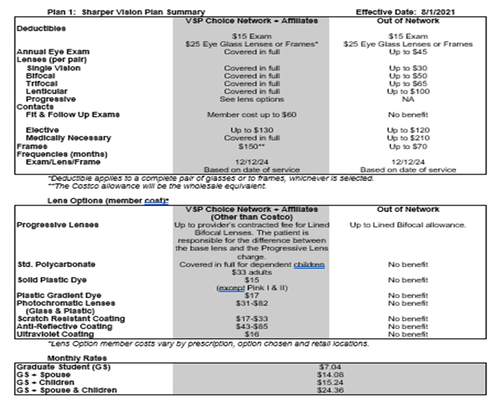
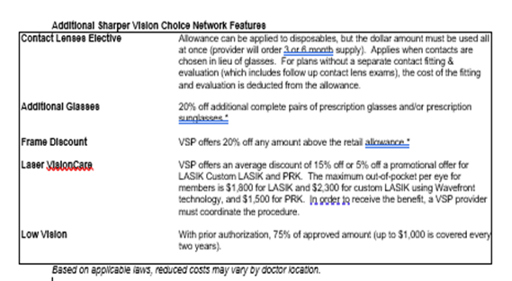
Vision Coverage for Graduates
Enrollment and the Student Experience

Slide 17
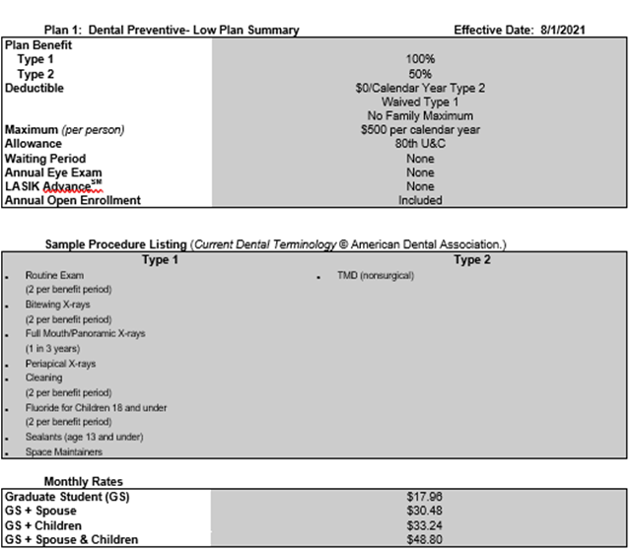
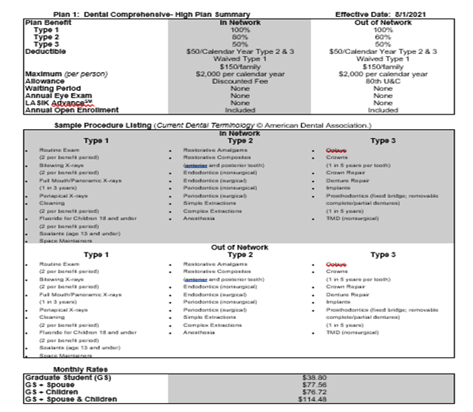
Dental Coverage for Graduates
Enrollment and the Student Experience

Slide 18
How do I enroll?
•Myslice
•Student Services
•Student Insurance
•Click: Student Insurance (Required)
On the Student Insurance Overview Page
Health Insurance- Enroll/Waive (Required), Click: Enroll/waive, then Enroll
Vision/Dental Insurance – (Optional), Click: Enroll or Decline
•Please note: your “Current Address” within MyProfile on Myslice must reflect your local address!
•Student enrollment premiums are billed to the Bursar account.
•Deadline to enroll is Monday, September 20, 2021.
•Students must pro-actively enroll to activate the insurance coverage and card!
Enrollment and the Student Experience

Slide 19
How do I enroll dependents?
•Eligible full-time matriculated students can add dependents.
•In Myslice
•Student Services
•Student Insurance
•Click: Student Insurance (Required)
On the Student Insurance Overview Page
Dependent Insurance- (Optional), click: Enroll
•Eligible students must enroll themselves first, before enrolling dependents.
•Dependents cannot enroll into coverage that student does not choose for themselves.
•Deadline to enroll dependents is Monday, Sept. 20, 2021.
•Haylor, Freyer & Coon to process enrollments and payments accordingly.
Enrollment and the Student Experience

Slide 20
I need coverage in July – HELP!
•Students who pro-actively enroll into the 2021-22 SHIP first, will be eligible to enroll into a single month of SHIP for July 2021 only.
•SHIP will be effective Sunday, July 1,2021 thru Sunday, July 31,2021 and will cost $158.10.
•Enrollment and payment is processed directly through insurance broker: Haylor, Freyer & Coon website: http://www.haylor.com/college/syracuse-university/
•July 9- is the deadline to enroll for July 2021 only coverage.
•Please note: any deductibles/out of pocket maximums met during July 2021 coverage cannot carry over into next coverage year, on August 1.
Enrollment and the Student Experience

Slide 21
Where can I get more information?
•Student Health Insurance Office
•Barnes Center at The Arch
•105 Sims Drive, Suite 305, Syracuse, NY 13244
•Phone: 315-443-9019
•Email: healthinsurance@syr.edu
•Website: https://ese.syr.edu/bewell/insurance/
Enrollment and the Student Experience

Slide 22
Transition and Homesickness
Stay Connected to Home Scheduled conversations, Skype, etc.
Build a Campus Community Student Organizations and activities, etc.
On-campus Resources Utilize support available to on- and off-campus students.
Don’t Ignore or Minimize your Experiences Communicate to someone in your support network.
Enrollment and the Student Experience
Notes:
Considerations for all of these things during a time of pandemic and racial injustice are SO important. What does this look like?
Normalizing homesickness: letting students know it is common
2017-2018 international students who completed an initial appointment, 65 of 194 (almost 1/3) endorsed some difficulty with adjusting to college/loneliness/homesickness. Anxiety is endorsed at double that rate (135). Depression is 1.5 times more likely to be reported (96). Academics was reported slightly more often (70).
For Fall 2018- Students indicated the following difficulties they were experiencing at time of initial consultation at CC.
Anxiety/Stress/Phobia 77.5%
Depression 47.6%
Academic Career 32%
Identity/Self-Concept/Self-Esteem 29.6%
Adjusting to College/Lonely/Homesick 24.4%
Attention Difficulties 24.1%

Slide 23
When and How to Ask for Help
Feeling Sick, overwhelmed, depressed, anxious, lonely, withdrawn
Experiencing Issues Sleep, food, relationships, adjustment, academics/missing classes
Reach Out and Ask for Help Make an appointment to discuss available resources.
Enrollment and the Student Experience
Notes:
Counseling
10% of students seen at OSA identify as international students.
13% of students indicate adjustment concerns as presenting concern

Slide 24
Mental Self-Care: Counseling
Individual Counseling
Group Counseling
Sexual & Relationship Violence Team
Options Program
24/7 Crisis Counseling available via Crisis line- 315-443-8000
Access services by calling 315-443-8000; All services are private and confidential.
Enrollment and Student Experience
Notes:
Mind and body are connected so to stay physically well it’s important to address stressors and other mental health concerns.
For Fall 2020 All Counseling appointment must be scheduled by calling ahead.
Individual appointments: Can be scheduled sameday or in advance. In order to maximum access to services and to maximum health and safety the majority of appointments will be offered via teletherapy (phone or Hippa Compatible Zoom). Sameday appointments offer support for more acute or urgent needs and scheduling ahead allows for students to engage in services around their schedules. Rooms in Barnes can be reserved if private space for teletherapy is needed.
Group appointments: A wide offering of groups will be available including Student of Color support/process groups, Mindfulness/Mediation groups, Understanding self & others process groups. All groups are offered via Zoom and are scheduled for wide array of time to fit students’ schedules
Sexual & Relationship Violence team: Members of Counseling staff that specialize in SRV and provide clinical services and overview of reporting options and can link to advocacy services. Are legally privileged and confidential services.
Options Program: Members of Counseling staff that specialize in Alcohol & other Drug counseling.

Slide 25
Physical Self-Care: Recreation
Aquatics
Drop-In Fitness Classes
Personal Training
Outdoor Education & Adventure Trips
Esports
Intramural Sports
Clubs Sports
Tennity Ice Skating Pavilion
Recreation at Drumlins Country Club
Enrollment and the Student Experience
Notes:
Recreation
Effective Wednesday, June 16, 2021: Reservations are no longer required for most recreation opportunities (e.g. exercise, Esports Room, Climbing Wall, indoor track, pool and more). Some experiences such as Group Fitness Classes and ’Cuse Fit Chat require reservations. Please visit the Facilities and Hours webpage for availability.
Patrons who are not vaccinated must continue to wear a mask at all times, except in the pool. Patrons who are vaccinated are not required to wear a mask.
A wide variety of locations and activity options.
Recreation facilities are open 7 days a week: Monday – Friday 6:30am – 11pm, Saturday and Sunday 10am – 11pm.
Fitness Centers located in the Barnes Center at The Arch and Ernie Davis Fitness Center.
Barnes Center has early morning hours 6:30am and late night hours open until 1am.
4 floors of weight and fitness equipment. Always basketball courts available for Open Rec play. Free day use lockers
Aquatics -6 lane pool with climbing wall, video board and 35 person spa pool in shape of an S; Swim Lessons, Dive-In Movies
7 basketball courts, MAC court for indoor soccer, roller skating and roller hockey
48 ft climbing wall and separate bouldering wall, outdoor equipment check out – free sue of tents, back packs sleeping bags
Esports room with 36 gaming PCs and 6 console gaming stations
Drop In/Same day Fitness Classes- use Wellness Portal to claim spot in any class. For the day. 55 classes per week. Aerobics, mind body
Intramural Sports- Organized leagues for team and individual sports – Basketball, Volleyball, Flag football, soccer etc.
Sport Clubs- 50 student run sports teams. Many that compete regionally and nationally – Lacrosse, rugby, Basketball, equestrian, hockey, Table tennis,
Outdoor Education & Adventure Trips- High Ropes Challenge course, trips Bobsledding, hiking, apple picking horseback ridding, hiking
Personal Training- Free equipment orientations available. Personal Training session $20 per session like help setting up exercise program
Tennity Ice Skating Pavilion- located on South Campus. Open 7 days a week. Late night Glow skate Friday & Saturdays til 1am. Free skate rental for late night.
Drumlins edge of South Campus- – Free cross country ski and snowshoe program/Free golf and Tennis programs

Slide 26
General Wellness
Fitness Equipment (four floors)
Open Monday-Sunday (Fall Hours TBD)
Strength Training → Isolation machines, compound lifting equipment, free weights
Cardio Equipment → Treadmills, bikes, ellipticals
Functional Training → Tires, sleds, plyometric boxes
Additional Areas
Indoor Walking Track
Basketball Courts
Locker Room Facilities
Multi-Activity Sport Court
Esports Gaming Room
Climbing Wall
Enrollment and the Student Experience
Notes:
Recreation
Effective Wednesday, June 16, 2021: Reservations are no longer required for most recreation opportunities (e.g. exercise, Esports Room, Climbing Wall, indoor track, pool and more). Some experiences such as Group Fitness Classes and ’Cuse Fit Chat require reservations. Please visit the Facilities and Hours webpage for availability.
Patrons who are not vaccinated must continue to wear a mask at all times, except in the pool. Patrons who are vaccinated are not required to wear a mask.
A wide variety of locations and activity options.
Recreation facilities are open 7 days a week: Monday – Friday 6:30am – 11pm, Saturday and Sunday 10am – 11pm.
Fitness Centers located in the Barnes Center at The Arch and Ernie Davis Fitness Center.
Barnes Center has early morning hours 6:30am and late night hours open until 1am.
4 floors of weight and fitness equipment. Always basketball courts available for Open Rec play. Free day use lockers
Aquatics -6 lane pool with climbing wall, video board and 35 person spa pool in shape of an S; Swim Lessons, Dive-In Movies
7 basketball courts, MAC court for indoor soccer, roller skating and roller hockey
48 ft climbing wall and separate bouldering wall, outdoor equipment check out – free sue of tents, back packs sleeping bags
Esports room with 36 gaming PCs and 6 console gaming stations
Drop In/Same day Fitness Classes- use Wellness Portal to claim spot in any class. For the day. 55 classes per week. Aerobics, mind body
Intramural Sports- Organized leagues for team and individual sports – Basketball, Volleyball, Flag football, soccer etc.
Sport Clubs- 50 student run sports teams. Many that compete regionally and nationally – Lacrosse, rugby, Basketball, equestrian, hockey, Table tennis,
Outdoor Education & Adventure Trips- High Ropes Challenge course, trips Bobsledding, hiking, apple picking horseback ridding, hiking
Personal Training- Free equipment orientations available. Personal Training session $20 per session like help setting up exercise program
Tennity Ice Skating Pavilion- located on South Campus. Open 7 days a week. Late night Glow skate Friday & Saturdays til 1am. Free skate rental for late night.
Drumlins edge of South Campus- – Free cross country ski and snowshoe program/Free golf and Tennis programs

Slide 27
Aquatics
Recreation/Lap Pool: Open Monday-Sunday (Fall Hours TBD)
Prettyman Spa Pool: Open Monday-Sunday (Fall Hours TBD)
Swim Lessons: Designed to meet different skill levels
Group Swim Lessons
Available levels: Beginner and Intermediate
SU/ESF student and non-student pricing
Private Swim Lessons
Available for all levels
SU/ESF student and non-student pricing
Enrollment and the Student Experience
Notes:
Recreation
Effective Wednesday, June 16, 2021: Reservations are no longer required for most recreation opportunities (e.g. exercise, Esports Room, Climbing Wall, indoor track, pool and more). Some experiences such as Group Fitness Classes and ’Cuse Fit Chat require reservations. Please visit the Facilities and Hours webpage for availability.
Patrons who are not vaccinated must continue to wear a mask at all times, except in the pool. Patrons who are vaccinated are not required to wear a mask.
A wide variety of locations and activity options.
Recreation facilities are open 7 days a week: Monday – Friday 6:30am – 11pm, Saturday and Sunday 10am – 11pm.
Fitness Centers located in the Barnes Center at The Arch and Ernie Davis Fitness Center.
Barnes Center has early morning hours 6:30am and late night hours open until 1am.
4 floors of weight and fitness equipment. Always basketball courts available for Open Rec play. Free day use lockers
Aquatics -6 lane pool with climbing wall, video board and 35 person spa pool in shape of an S; Swim Lessons, Dive-In Movies
7 basketball courts, MAC court for indoor soccer, roller skating and roller hockey
48 ft climbing wall and separate bouldering wall, outdoor equipment check out – free sue of tents, back packs sleeping bags
Esports room with 36 gaming PCs and 6 console gaming stations
Drop In/Same day Fitness Classes- use Wellness Portal to claim spot in any class. For the day. 55 classes per week. Aerobics, mind body
Intramural Sports- Organized leagues for team and individual sports – Basketball, Volleyball, Flag football, soccer etc.
Sport Clubs- 50 student run sports teams. Many that compete regionally and nationally – Lacrosse, rugby, Basketball, equestrian, hockey, Table tennis,
Outdoor Education & Adventure Trips- High Ropes Challenge course, trips Bobsledding, hiking, apple picking horseback ridding, hiking
Personal Training- Free equipment orientations available. Personal Training session $20 per session like help setting up exercise program
Tennity Ice Skating Pavilion- located on South Campus. Open 7 days a week. Late night Glow skate Friday & Saturdays til 1am. Free skate rental for late night.
Drumlins edge of South Campus- – Free cross country ski and snowshoe program/Free golf and Tennis programs

Slide 28
Drop-In Fitness Classes
Cycle - Low impact workout completed on an indoor stationary exercise bike
Class Options: Cycle Intervals, Cycle Cardio & Tone
Aquatics - Full body, low impact workouts held in the Barnes Center at The Arch pool
Class Options: Shallow Water, Deep Water, Aqua Zumba
Aerobics - Full body, high to low intensity workout designed to improve cardiovascular function
Class Options: Zumba
X Training - A combination workout encompassing both strength training and cardio exercises
Class Options: Strength & Tone, Full Body Sculpt, Bootcamp, Sweat in Small Spaces
Mind & Body - A workout combination of mindfulness, flexibility, balance, alignment, and control
Class Options: Barre, Cleansing Yoga Flow, Yoga Flow, Yoga’lates, Strong & Calm
Enrollment and the Student Experience
Notes:
Recreation
Effective Wednesday, June 16, 2021: Reservations are no longer required for most recreation opportunities (e.g. exercise, Esports Room, Climbing Wall, indoor track, pool and more). Some experiences such as Group Fitness Classes and ’Cuse Fit Chat require reservations. Please visit the Facilities and Hours webpage for availability.
Patrons who are not vaccinated must continue to wear a mask at all times, except in the pool. Patrons who are vaccinated are not required to wear a mask.
A wide variety of locations and activity options.
Recreation facilities are open 7 days a week: Monday – Friday 6:30am – 11pm, Saturday and Sunday 10am – 11pm.
Fitness Centers located in the Barnes Center at The Arch and Ernie Davis Fitness Center.
Barnes Center has early morning hours 6:30am and late night hours open until 1am.
4 floors of weight and fitness equipment. Always basketball courts available for Open Rec play. Free day use lockers
Aquatics -6 lane pool with climbing wall, video board and 35 person spa pool in shape of an S; Swim Lessons, Dive-In Movies
7 basketball courts, MAC court for indoor soccer, roller skating and roller hockey
48 ft climbing wall and separate bouldering wall, outdoor equipment check out – free sue of tents, back packs sleeping bags
Esports room with 36 gaming PCs and 6 console gaming stations
Drop In/Same day Fitness Classes- use Wellness Portal to claim spot in any class. For the day. 55 classes per week. Aerobics, mind body
Intramural Sports- Organized leagues for team and individual sports – Basketball, Volleyball, Flag football, soccer etc.
Sport Clubs- 50 student run sports teams. Many that compete regionally and nationally – Lacrosse, rugby, Basketball, equestrian, hockey, Table tennis,
Outdoor Education & Adventure Trips- High Ropes Challenge course, trips Bobsledding, hiking, apple picking horseback ridding, hiking
Personal Training- Free equipment orientations available. Personal Training session $20 per session like help setting up exercise program
Tennity Ice Skating Pavilion- located on South Campus. Open 7 days a week. Late night Glow skate Friday & Saturdays til 1am. Free skate rental for late night.
Drumlins edge of South Campus- – Free cross country ski and snowshoe program/Free golf and Tennis programs

Slide 29
Personal Training
One on One Training
Comprehensive fitness programs, tailored to your personal goals and schedule
Customizable, private workouts for any skill level, including in-depth education & motivation
5, 8, 12 or 18 session packages available (SU/ESF student and non-student pricing)
Cuse Fit Chat
One-on-one video meetings designed to explore your fitness goals and how to achieve them
Free to SU & ESF students, faculty, and staff
Fitness Center Orientations
Meet with a Barnes Center at The Arch personal trainer, for a one-time meeting to provide
Entry-level hands-on introduction to basic fitness equipment
Free to SU & ESF students, faculty, and staff
Enrollment and the Student Experience
Notes:
Recreation
Effective Wednesday, June 16, 2021: Reservations are no longer required for most recreation opportunities (e.g. exercise, Esports Room, Climbing Wall, indoor track, pool and more). Some experiences such as Group Fitness Classes and ’Cuse Fit Chat require reservations. Please visit the Facilities and Hours webpage for availability.
Patrons who are not vaccinated must continue to wear a mask at all times, except in the pool. Patrons who are vaccinated are not required to wear a mask.
A wide variety of locations and activity options.
Recreation facilities are open 7 days a week: Monday – Friday 6:30am – 11pm, Saturday and Sunday 10am – 11pm.
Fitness Centers located in the Barnes Center at The Arch and Ernie Davis Fitness Center.
Barnes Center has early morning hours 6:30am and late night hours open until 1am.
4 floors of weight and fitness equipment. Always basketball courts available for Open Rec play. Free day use lockers
Aquatics -6 lane pool with climbing wall, video board and 35 person spa pool in shape of an S; Swim Lessons, Dive-In Movies
7 basketball courts, MAC court for indoor soccer, roller skating and roller hockey
48 ft climbing wall and separate bouldering wall, outdoor equipment check out – free sue of tents, back packs sleeping bags
Esports room with 36 gaming PCs and 6 console gaming stations
Drop In/Same day Fitness Classes- use Wellness Portal to claim spot in any class. For the day. 55 classes per week. Aerobics, mind body
Intramural Sports- Organized leagues for team and individual sports – Basketball, Volleyball, Flag football, soccer etc.
Sport Clubs- 50 student run sports teams. Many that compete regionally and nationally – Lacrosse, rugby, Basketball, equestrian, hockey, Table tennis,
Outdoor Education & Adventure Trips- High Ropes Challenge course, trips Bobsledding, hiking, apple picking horseback ridding, hiking
Personal Training- Free equipment orientations available. Personal Training session $20 per session like help setting up exercise program
Tennity Ice Skating Pavilion- located on South Campus. Open 7 days a week. Late night Glow skate Friday & Saturdays til 1am. Free skate rental for late night.
Drumlins edge of South Campus- – Free cross country ski and snowshoe program/Free golf and Tennis programs

Slide 30
Outdoor Adventure, Climbing Wall & Esports
Off Campus Adventure Trips
Fall 2021
Outdoor Rock Climbing
Horseback Riding
Whitewater Rafting
Local Day Hiking
Zip Lining
Apple Picking
Mountain Coaster
Niagara Falls Hiking Trip
Letchworth State Park Hiking Trip
Watkins Glen Hiking Trip
Barnes Center at The Arch
Esports Room
Climbing Wall
South Campus
Outdoor Challenge Course
Zip Lines
Enrollment and the Student Experience
Notes:
Recreation
Effective Wednesday, June 16, 2021: Reservations are no longer required for most recreation opportunities (e.g. exercise, Esports Room, Climbing Wall, indoor track, pool and more). Some experiences such as Group Fitness Classes and ’Cuse Fit Chat require reservations. Please visit the Facilities and Hours webpage for availability.
Patrons who are not vaccinated must continue to wear a mask at all times, except in the pool. Patrons who are vaccinated are not required to wear a mask.
A wide variety of locations and activity options.
Recreation facilities are open 7 days a week: Monday – Friday 6:30am – 11pm, Saturday and Sunday 10am – 11pm.
Fitness Centers located in the Barnes Center at The Arch and Ernie Davis Fitness Center.
Barnes Center has early morning hours 6:30am and late night hours open until 1am.
4 floors of weight and fitness equipment. Always basketball courts available for Open Rec play. Free day use lockers
Aquatics -6 lane pool with climbing wall, video board and 35 person spa pool in shape of an S; Swim Lessons, Dive-In Movies
7 basketball courts, MAC court for indoor soccer, roller skating and roller hockey
48 ft climbing wall and separate bouldering wall, outdoor equipment check out – free sue of tents, back packs sleeping bags
Esports room with 36 gaming PCs and 6 console gaming stations
Drop In/Same day Fitness Classes- use Wellness Portal to claim spot in any class. For the day. 55 classes per week. Aerobics, mind body
Intramural Sports- Organized leagues for team and individual sports – Basketball, Volleyball, Flag football, soccer etc.
Sport Clubs- 50 student run sports teams. Many that compete regionally and nationally – Lacrosse, rugby, Basketball, equestrian, hockey, Table tennis,
Outdoor Education & Adventure Trips- High Ropes Challenge course, trips Bobsledding, hiking, apple picking horseback ridding, hiking
Personal Training- Free equipment orientations available. Personal Training session $20 per session like help setting up exercise program
Tennity Ice Skating Pavilion- located on South Campus. Open 7 days a week. Late night Glow skate Friday & Saturdays til 1am. Free skate rental for late night.
Drumlins edge of South Campus- – Free cross country ski and snowshoe program/Free golf and Tennis programs

Slide 31
Intramural Sports
Fall 2021
*Programs are subject to change
Major Sports
Flag Football
Outdoor Soccer
Indoor Volleyball
Handball
Golf League
Fantasy Football
Minor Sports
Sand Volleyball
Futsal
Madden 21
NBA 2K
Mario Kart
3v3 Basketball
Spikeball
Cornhole/Kan Jam
Enrollment and the Student Experience
Notes:
Recreation
Effective Wednesday, June 16, 2021: Reservations are no longer required for most recreation opportunities (e.g. exercise, Esports Room, Climbing Wall, indoor track, pool and more). Some experiences such as Group Fitness Classes and ’Cuse Fit Chat require reservations. Please visit the Facilities and Hours webpage for availability.
Patrons who are not vaccinated must continue to wear a mask at all times, except in the pool. Patrons who are vaccinated are not required to wear a mask.
A wide variety of locations and activity options.
Recreation facilities are open 7 days a week: Monday – Friday 6:30am – 11pm, Saturday and Sunday 10am – 11pm.
Fitness Centers located in the Barnes Center at The Arch and Ernie Davis Fitness Center.
Barnes Center has early morning hours 6:30am and late night hours open until 1am.
4 floors of weight and fitness equipment. Always basketball courts available for Open Rec play. Free day use lockers
Aquatics -6 lane pool with climbing wall, video board and 35 person spa pool in shape of an S; Swim Lessons, Dive-In Movies
7 basketball courts, MAC court for indoor soccer, roller skating and roller hockey
48 ft climbing wall and separate bouldering wall, outdoor equipment check out – free sue of tents, back packs sleeping bags
Esports room with 36 gaming PCs and 6 console gaming stations
Drop In/Same day Fitness Classes- use Wellness Portal to claim spot in any class. For the day. 55 classes per week. Aerobics, mind body
Intramural Sports- Organized leagues for team and individual sports – Basketball, Volleyball, Flag football, soccer etc.
Sport Clubs- 50 student run sports teams. Many that compete regionally and nationally – Lacrosse, rugby, Basketball, equestrian, hockey, Table tennis,
Outdoor Education & Adventure Trips- High Ropes Challenge course, trips Bobsledding, hiking, apple picking horseback ridding, hiking
Personal Training- Free equipment orientations available. Personal Training session $20 per session like help setting up exercise program
Tennity Ice Skating Pavilion- located on South Campus. Open 7 days a week. Late night Glow skate Friday & Saturdays til 1am. Free skate rental for late night.
Drumlins edge of South Campus- – Free cross country ski and snowshoe program/Free golf and Tennis programs

Slide 32
Sport Clubs
Aikido
Badminton
Ballroom and Swing
Baseball
Basketball (Men’s and Women’s)
Bowling
Boxing
Cricket
Curling
Equestrian (English and Western)
Fencing
Field Hockey
Golf
Gymnastics (Men’s and Women’s)
Ice Hockey (Men’s and Women’s)
Kendo
Lacrosse (Men’s and Women’s)
Orange Barbell
Outing
Quidditch
Enrollment and the Student Experience
Notes:
Recreation
Effective Wednesday, June 16, 2021: Reservations are no longer required for most recreation opportunities (e.g. exercise, Esports Room, Climbing Wall, indoor track, pool and more). Some experiences such as Group Fitness Classes and ’Cuse Fit Chat require reservations. Please visit the Facilities and Hours webpage for availability.
Patrons who are not vaccinated must continue to wear a mask at all times, except in the pool. Patrons who are vaccinated are not required to wear a mask.
A wide variety of locations and activity options.
Recreation facilities are open 7 days a week: Monday – Friday 6:30am – 11pm, Saturday and Sunday 10am – 11pm.
Fitness Centers located in the Barnes Center at The Arch and Ernie Davis Fitness Center.
Barnes Center has early morning hours 6:30am and late night hours open until 1am.
4 floors of weight and fitness equipment. Always basketball courts available for Open Rec play. Free day use lockers
Aquatics -6 lane pool with climbing wall, video board and 35 person spa pool in shape of an S; Swim Lessons, Dive-In Movies
7 basketball courts, MAC court for indoor soccer, roller skating and roller hockey
48 ft climbing wall and separate bouldering wall, outdoor equipment check out – free sue of tents, back packs sleeping bags
Esports room with 36 gaming PCs and 6 console gaming stations
Drop In/Same day Fitness Classes- use Wellness Portal to claim spot in any class. For the day. 55 classes per week. Aerobics, mind body
Intramural Sports- Organized leagues for team and individual sports – Basketball, Volleyball, Flag football, soccer etc.
Sport Clubs- 50 student run sports teams. Many that compete regionally and nationally – Lacrosse, rugby, Basketball, equestrian, hockey, Table tennis,
Outdoor Education & Adventure Trips- High Ropes Challenge course, trips Bobsledding, hiking, apple picking horseback ridding, hiking
Personal Training- Free equipment orientations available. Personal Training session $20 per session like help setting up exercise program
Tennity Ice Skating Pavilion- located on South Campus. Open 7 days a week. Late night Glow skate Friday & Saturdays til 1am. Free skate rental for late night.
Drumlins edge of South Campus- – Free cross country ski and snowshoe program/Free golf and Tennis programs

Slide 33
Sport Clubs
Rock Climbing
Roller Hockey
Rugby (Men’s and Women’s)
Running
Sailing
Ski Racing
Soccer (Men’s and Women’s)
Softball
Spikeball
Swimming
Synchronized Figure Skating
Table Tennis
Tennis
Ultimate (Men’s and Women’s)
Volleyball (Men’s and Women’s)
Water Polo (Men’s and Women’s)
Wrestling
Enrollment and the Student Experience
Notes:
Recreation
Effective Wednesday, June 16, 2021: Reservations are no longer required for most recreation opportunities (e.g. exercise, Esports Room, Climbing Wall, indoor track, pool and more). Some experiences such as Group Fitness Classes and ’Cuse Fit Chat require reservations. Please visit the Facilities and Hours webpage for availability.
Patrons who are not vaccinated must continue to wear a mask at all times, except in the pool. Patrons who are vaccinated are not required to wear a mask.
A wide variety of locations and activity options.
Recreation facilities are open 7 days a week: Monday – Friday 6:30am – 11pm, Saturday and Sunday 10am – 11pm.
Fitness Centers located in the Barnes Center at The Arch and Ernie Davis Fitness Center.
Barnes Center has early morning hours 6:30am and late night hours open until 1am.
4 floors of weight and fitness equipment. Always basketball courts available for Open Rec play. Free day use lockers
Aquatics -6 lane pool with climbing wall, video board and 35 person spa pool in shape of an S; Swim Lessons, Dive-In Movies
7 basketball courts, MAC court for indoor soccer, roller skating and roller hockey
48 ft climbing wall and separate bouldering wall, outdoor equipment check out – free sue of tents, back packs sleeping bags
Esports room with 36 gaming PCs and 6 console gaming stations
Drop In/Same day Fitness Classes- use Wellness Portal to claim spot in any class. For the day. 55 classes per week. Aerobics, mind body
Intramural Sports- Organized leagues for team and individual sports – Basketball, Volleyball, Flag football, soccer etc.
Sport Clubs- 50 student run sports teams. Many that compete regionally and nationally – Lacrosse, rugby, Basketball, equestrian, hockey, Table tennis,
Outdoor Education & Adventure Trips- High Ropes Challenge course, trips Bobsledding, hiking, apple picking horseback ridding, hiking
Personal Training- Free equipment orientations available. Personal Training session $20 per session like help setting up exercise program
Tennity Ice Skating Pavilion- located on South Campus. Open 7 days a week. Late night Glow skate Friday & Saturdays til 1am. Free skate rental for late night.
Drumlins edge of South Campus- – Free cross country ski and snowshoe program/Free golf and Tennis programs

Slide 34
Tennity Ice Skating Pavilion
General Offerings
Broomball League
Curling League
Open Skate
Ice Skating Instruction
Private Lessons
Hockey Offerings
Drop-In Ice Hockey
Sled and Ice Leagues
Open Sled Hockey
Skate & Shoot
Facilities
Regulation-sized rink
A smaller studio sheet
Pro Shop
Skate rentals
Skate sharpening
Enrollment and the Student Experience
Notes:
Recreation
Effective Wednesday, June 16, 2021: Reservations are no longer required for most recreation opportunities (e.g. exercise, Esports Room, Climbing Wall, indoor track, pool and more). Some experiences such as Group Fitness Classes and ’Cuse Fit Chat require reservations. Please visit the Facilities and Hours webpage for availability.
Patrons who are not vaccinated must continue to wear a mask at all times, except in the pool. Patrons who are vaccinated are not required to wear a mask.
A wide variety of locations and activity options.
Recreation facilities are open 7 days a week: Monday – Friday 6:30am – 11pm, Saturday and Sunday 10am – 11pm.
Fitness Centers located in the Barnes Center at The Arch and Ernie Davis Fitness Center.
Barnes Center has early morning hours 6:30am and late night hours open until 1am.
4 floors of weight and fitness equipment. Always basketball courts available for Open Rec play. Free day use lockers
Aquatics -6 lane pool with climbing wall, video board and 35 person spa pool in shape of an S; Swim Lessons, Dive-In Movies
7 basketball courts, MAC court for indoor soccer, roller skating and roller hockey
48 ft climbing wall and separate bouldering wall, outdoor equipment check out – free sue of tents, back packs sleeping bags
Esports room with 36 gaming PCs and 6 console gaming stations
Drop In/Same day Fitness Classes- use Wellness Portal to claim spot in any class. For the day. 55 classes per week. Aerobics, mind body
Intramural Sports- Organized leagues for team and individual sports – Basketball, Volleyball, Flag football, soccer etc.
Sport Clubs- 50 student run sports teams. Many that compete regionally and nationally – Lacrosse, rugby, Basketball, equestrian, hockey, Table tennis,
Outdoor Education & Adventure Trips- High Ropes Challenge course, trips Bobsledding, hiking, apple picking horseback ridding, hiking
Personal Training- Free equipment orientations available. Personal Training session $20 per session like help setting up exercise program
Tennity Ice Skating Pavilion- located on South Campus. Open 7 days a week. Late night Glow skate Friday & Saturdays til 1am. Free skate rental for late night.
Drumlins edge of South Campus- – Free cross country ski and snowshoe program/Free golf and Tennis programs

Slide 35
Recreation at Drumlins Country Club
Tennis
Instructional Tennis Clinics
Independent Tennis Play – Open Court & Same Day
Pricing is available on the Drumlins website
Golf
Monday-Sunday 8 a.m.-7 p.m. (West Course)
Free golf for full time SU/ESF undergraduate students
Graduate Pricing available on the Drumlins website
Cross Country Skiing and Snowshoeing
Winter Hours TBD
All experience levels welcome and FREE equipment rentals
Transportation
The Centro Bus is free for SU and SUNY ESF I.D. holders
Visit the Centro website or the SU Parking and Transit Services website
Enrollment and the Student Experience
Notes:
Recreation
Effective Wednesday, June 16, 2021: Reservations are no longer required for most recreation opportunities (e.g. exercise, Esports Room, Climbing Wall, indoor track, pool and more). Some experiences such as Group Fitness Classes and ’Cuse Fit Chat require reservations. Please visit the Facilities and Hours webpage for availability.
Patrons who are not vaccinated must continue to wear a mask at all times, except in the pool. Patrons who are vaccinated are not required to wear a mask.
A wide variety of locations and activity options.
Recreation facilities are open 7 days a week: Monday – Friday 6:30am – 11pm, Saturday and Sunday 10am – 11pm.
Fitness Centers located in the Barnes Center at The Arch and Ernie Davis Fitness Center.
Barnes Center has early morning hours 6:30am and late night hours open until 1am.
4 floors of weight and fitness equipment. Always basketball courts available for Open Rec play. Free day use lockers
Aquatics -6 lane pool with climbing wall, video board and 35 person spa pool in shape of an S; Swim Lessons, Dive-In Movies
7 basketball courts, MAC court for indoor soccer, roller skating and roller hockey
48 ft climbing wall and separate bouldering wall, outdoor equipment check out – free sue of tents, back packs sleeping bags
Esports room with 36 gaming PCs and 6 console gaming stations
Drop In/Same day Fitness Classes- use Wellness Portal to claim spot in any class. For the day. 55 classes per week. Aerobics, mind body
Intramural Sports- Organized leagues for team and individual sports – Basketball, Volleyball, Flag football, soccer etc.
Sport Clubs- 50 student run sports teams. Many that compete regionally and nationally – Lacrosse, rugby, Basketball, equestrian, hockey, Table tennis,
Outdoor Education & Adventure Trips- High Ropes Challenge course, trips Bobsledding, hiking, apple picking horseback ridding, hiking
Personal Training- Free equipment orientations available. Personal Training session $20 per session like help setting up exercise program
Tennity Ice Skating Pavilion- located on South Campus. Open 7 days a week. Late night Glow skate Friday & Saturdays til 1am. Free skate rental for late night.
Drumlins edge of South Campus- – Free cross country ski and snowshoe program/Free golf and Tennis programs

Slide 36
Health and Wellness Resources
Vaccine Clinics and Screenings
Flu shots, STI/STD, HPV
Safer Sex Express
Confidentially delivered.
Crowley Family MindSpa
Monday - Thursday10am-7pm
Friday- 10am-5pm
Enrollment and the Student Experience
Notes:
Health Promotion
Sexual health supplies can be ordered free – for all SU students
STD Testing appointments can be made through the patient portal

Slide 37
Health and Wellness Resources
Health Hub
Pet Therapy Program
Sanvello App
Soul Series:
SoulTalk
Thursdays 7-8pm, Meditation room
SoulScape
Wellness Leadership Institute
Enrollment and the Student Experience
Notes:
Health Promotion
Sanvello – phone app that is free to download for any su community member, and provides tools and strategies for stress and anxiety management
Mindspa- Free space that can be reserved on campus with tools including a biofeedback program, light therapy box, yoga mats, medication pillows, Buddha board and more; Massage chairs in mindspa waiting area.
Therapy Dog Thursday –All dogs are certified therapy dogs
SoulTalk – weekly discussion group that talks over life's big questions in a non-religious way- open to all students, staff and faculty
SoulScape open to all students
Soulful Eats – At Hendricks Chapel on Sundays before convocation – open to all students, staff, faculty regardless of religious affiliation
Health Hub – Pop-up tent that appears on campus with health information and free giveaways, visit 10x to receive a free swell water bottle (all students can receive waterbottle, staff and faculty can participate but will not earn waterbottle) - find us by following our social media

Slide 38
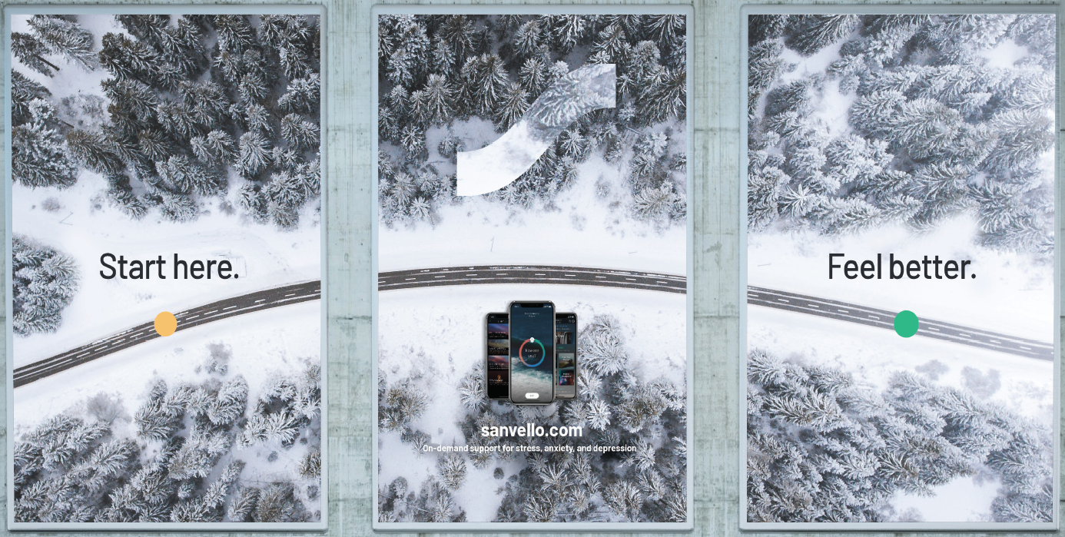
Sanvello App
Enrollment and the Student Experience
Notes:
Health Promotion
Sanvello – phone app that is free to download for any su community member, and provides tools and strategies for stress and anxiety management
Mindspa- Free space that can be reserved on campus with tools including a biofeedback program, light therapy box, yoga mats, meditation pillows, Buddha board and more
SoulTalk – weekly discussion group that talks over life's big questions in a non-religious way- open to all students, staff and faculty
SoulScape open to all students
Health Hub – Pop-up tent that appears on campus with health information and free giveaways, visit 10x to receive a free swell water bottle (all students can receive waterbottle, staff and faculty can participate but will not earn waterbottle) - find us by following our social media

Slide 39
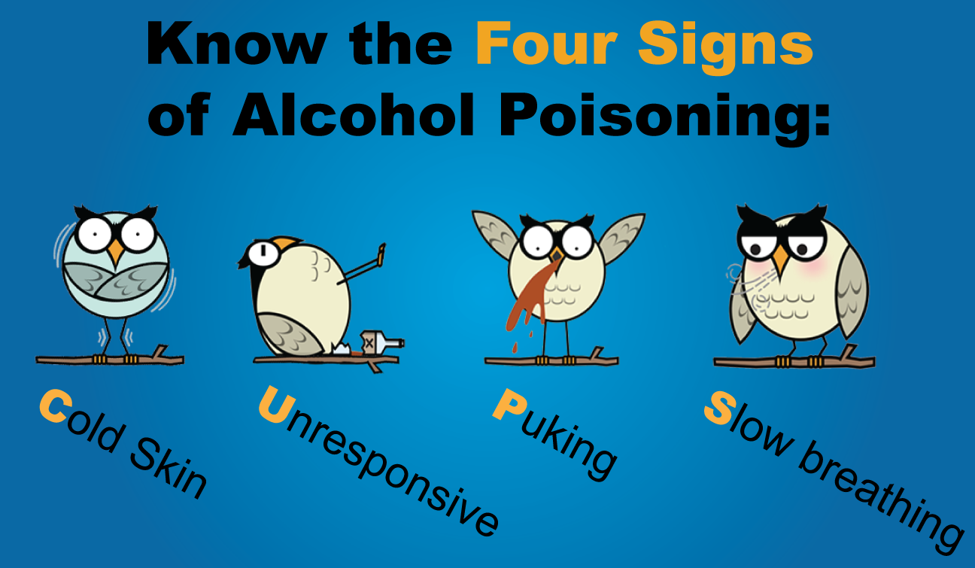
Alcohol and Other Substances
More than a third of first-year college students do not drink alcohol.
All drinks are not created equal.
Be a friend, always plan a safe way home.
It’s always OK to call for help- Dept. Public Safety 315.443.2224.
Enrollment and the Student Experience
Notes:
Health Promotion
Based on our incoming freshman survey through Alcohol.edu. Syracuse incoming freshman are pretty close to the national average trend with about 25% self reporting as abstainers is defined no alcohol in the past year and 24% self reporting as nondrinkers which is defined as not consuming alcohol in the past 2 weeks but possibly tried alcohol in the past year.
I say this to dispel the college myth that everyone is drinking. There is about a 1 in 4 chance that your friend or person that lives in a residence hall with you doesn’t drink at all and an even greater chance that if you do consume but don’t feel like you want to that night there is someone willing to hang out but not drink right along side of you.
For those who do choose to drink however, we want to let you know that all drinks are not created equal and that it is important to always know what’s in your cup. For students who haven’t completed the Alcohol.edu online module there is some great information in there on standard drink sizes and how biologically you may react differently to alcohol that some of your peers. I want to point out a few things for you to keep in mind if you choose to drink which are make your own beverages, try to follow the guidelines for standard drink sizes so you can better keep track of how alcohol may impact you. Try to avoid punch a single cup may have 5-6 standard drinks. Think would you want to drink 6 beers in 30 minutes if the answer is no void the punch. Last thing to keep in mind is lower risk drinking for women is less than 4 drinks in a single setting or occasion and less than 5 drinks for men in a single occasion. However know what works for you if your biological sex is female and your weight is 125lbs 4 drinks in 3 hours would put your BAC at .10 which is over the legal limit and may lead to some unintended outcomes.
Always plan a safe way home. If you are over the age of 21 the legal limit is a .08BAC and if you are under 21 NY is a zero tolerance state with some exceptions so your BAC should be under a .02 which really means no alcohol at all. Call a sober friend for a ride. Decide before going out whose got the UBER for the night and stick to that plan.
Cannibus major thing I want to point out to you all here is that in NY Marjunana is currently illegal. Though that may change it is still not permitted on Syracuse’s campus

Slide 40
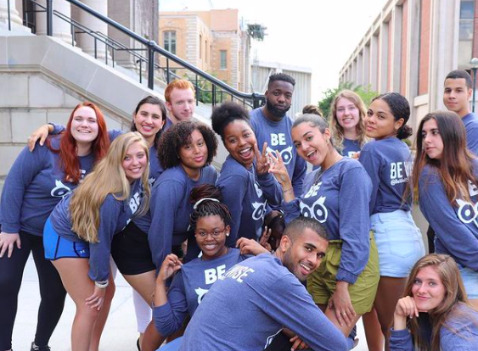
Be Involved
Apply to become a Peer Educator!
- Be Wise
- Encouraging Healthy Relationships & Sexuality
- Students Advocating for Mental Health Empowerment
Student Employment Opportunities (Handshake)
Enrollment and the Student Experience
Notes:
Health Promotion

Slide 41
Campus Resources
Health Care, Counseling and Pharmacy
Monday - Friday: 8:30 a.m. – 5 p.m.
Saturday: 10 a.m. - 2 p.m.
Sunday: 10 a.m. - 2 p.m. (Healthcare and Pharmacy only)
Disability Cultural Center
Email: sudcc@syr.edu
Phone: 315-443-0228
The Office of Multicultural Affairs
Email: oma@syr.edu
Phone: 315-443-9676
LGBTQ+ Resource Center
Email: lgbt@syr.edu
Phone: 315-443-3983
Dean of Students
Email: DOS@syr.edu
315-443-4357
Enrollment and the Student Experience
Notes:
Barnes Health and Counseling - 8:30am-5pm Monday – Friday; 10am-2pm Saturday

Slide 42
Campus Resources
Office of Equal Opportunity, Inclusion, and Resolution Services/Title IX
Email: EqualOpp@syr.edu
Phone: 315-443-4018
Email: TitleIX@syr.edu
Hendricks Chapel
Email: chapel@syr.edu
Phone: 315-443-2901
Center for International Resources
Email: international@syr.edu
Phone: 315-443-2457
STOP Bias Initiative
Enrollment and the Student Experience
Notes:
Barnes Health and Counseling - 8:30am-5pm Monday – Friday; 10am-2pm Saturday

Slide 43
Hours of Operation
Crowley Family MindSpa
Monday - Thursday: 10am-7pm;
Friday: 10am-5pm
Meditation Room- See website for programming info.
Recreation
Wellness portal- mywellness.syr.edu
Available early-morning and late night hours
Drop-in fitness classes and special programing as scheduled
Use Wellness portal to make appointments
Enrollment and the Student Experience
Notes:
Rec spaces Monday- Friday 6:30am-10pm. Saturday 10am-10pm

Slide 44
Contact Us
Barnes Center at The Arch Between the Dome and Carnegie Library. Email: BarnesCenter@syr.edu
Phone number: 315.443.8000
Website: Syracuse.edu/BeWell
Enrollment and the Student Experience

